Slide 1


Lessons Learned on the Path to Guaranteeing the Error Bound in Lossy Quantizers
Alex Fallin and Martin Burtscher
Texas State University
Department of Computer Science
San Marcos, Texas, USA

Slide 2
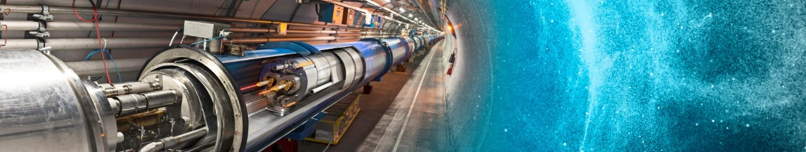
Introduction
Scientific data in HPC environments is becoming too large and being produced too fast
Lossless compression typically cannot yield high compression ratios on this type of data
Lossy compression needs to be error-bounded
Support for heterogenous systems is important

Slide 3
Introduction
Lossy compression
  Three main error-bound types: ABS, REL, and NOA
  Error bounds are often not guaranteed
Heterogenous systems
  Data compressed on one system (GPU or CPU)
  Accessed on another system (GPU or CPU)
  CPU/GPU compatibility rarely supported in SOTA

Slide 4

LC Framework
Tool for automatic compressor synthesis
Can create lossy and lossless compression codes
  Guarantees error bounds
Compatible between CPUs and GPUs
  Guarantees bit-for-bit parity
User extensible
Available in open source
  https://github.com/burtscher/LC-framework/

Slide 5
LC Framework – Components
Framework includes a set of components
Components transform the data losslessly
  Mutators: transform values (e.g., TCMS)
  Shufflers: rearrange values (e.g., BIT)
  Predictors: guess values based on previous (e.g., DIFF)
  Reducers: compress the data (e.g., RLE)
Include an inverse that reverses transformation
  Needed for decompression

Slide 6
LC Framework – Preprocessors
Framework includes a set of preprocessors
Preprocessors transform the data lossily
  ABS: quantizes data using an absolute error bound
  REL: quantizes data using a relative error bound
  NOA: quantizes data using a normalized ABS bound
Include an inverse that reverses transformation
  Guarantees error bound
  Optional auto correlation mitigation

Slide 7
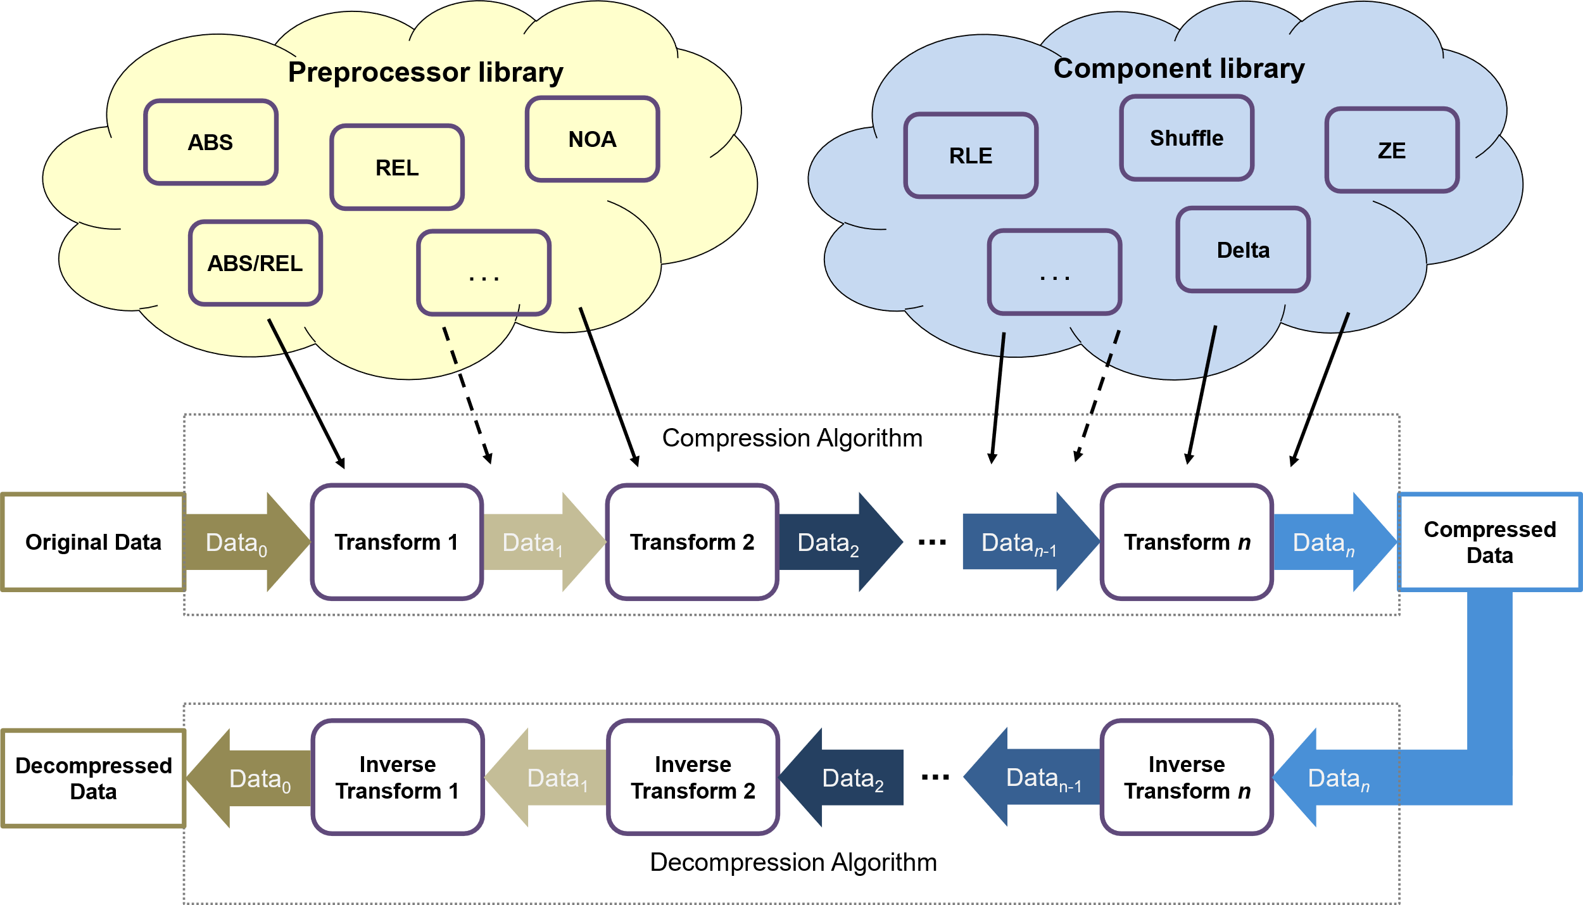
LC Framework – Operation

Slide 8
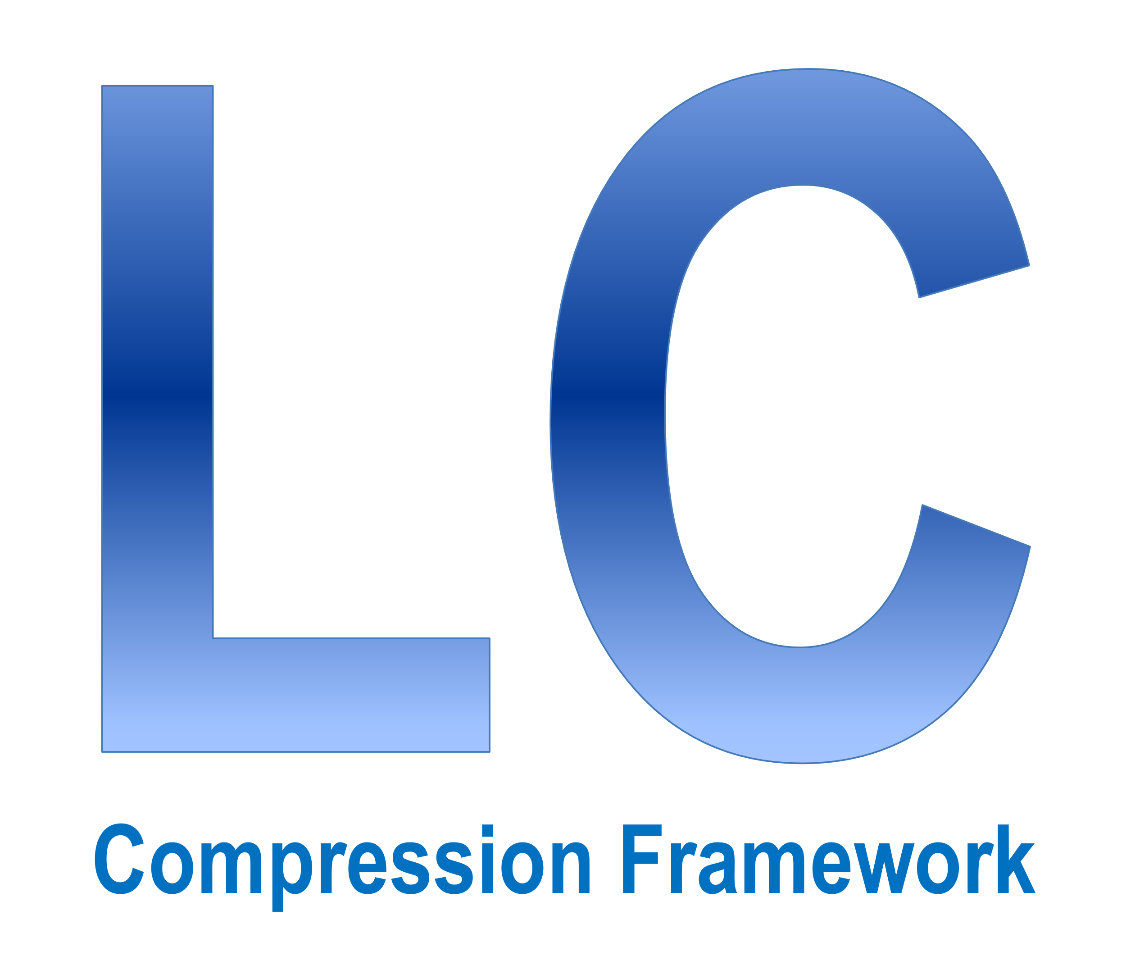
LC Framework Demo
How to generate the framework
How to evaluate a compression algorithm
How to search for a compression algorithm
  Restricting search with regular expressions
Generating standalone compressors

Slide 9
Lessons Learned

Slide 10
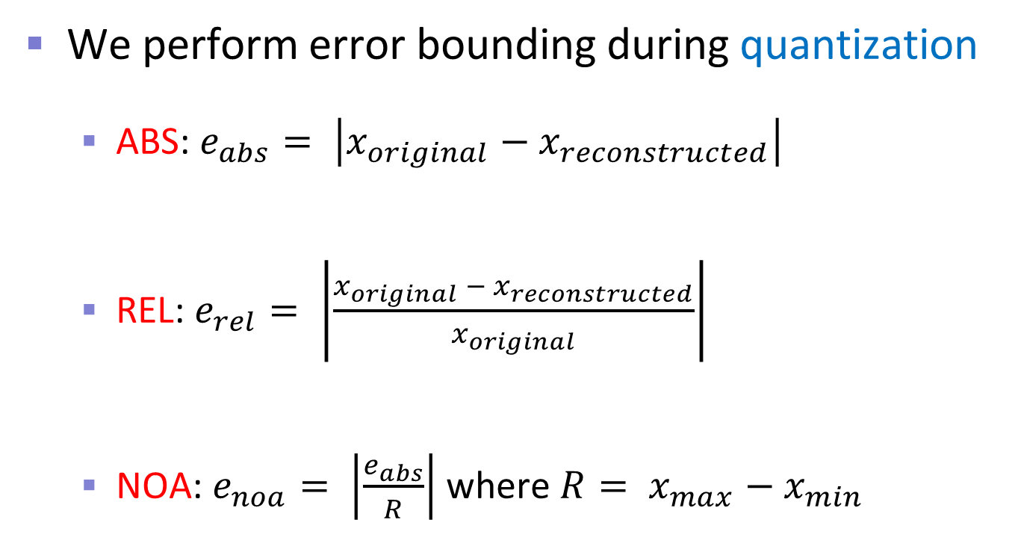
Background – Error Bounding
We perform error bounding during quantization
  ABS: $e_{abs}= \left|x_{original}−x_{reconstructed}\right|$
  REL: $e_{rel}= \left|\frac{x_{original} − x_{reconstructed}}{x_{original}}\right|$
  NOA: $e_{noa}= \left|\frac{e_{abs}}{R}\right|$ where $R= x_{max}−x_{min}$
a variant of ABS

Slide 11
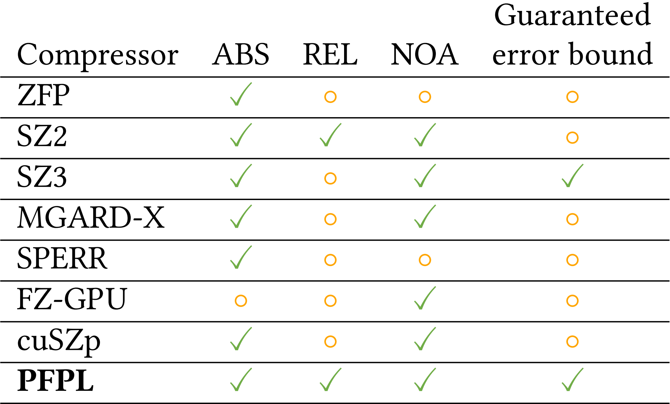
Background – Error Bounding
Only due to REL support
LC

Slide 12
Challenge 1 – Floating-Point Math
Quantization converts floats to integers
  Uses floating-point operations
Floating-point arithmetic has finite precision
  Rounding errors can cause values to be quantized outside of the error bound
Special floating-point values
  Infinity, Not a Number (NaN), denormal values
  May need to be handled separately

Slide 13
Challenge 2 – CPU/GPU Parity
Parity between CPU and GPU is increasingly important in heterogenous computing
Difficult to achieve
  Only supported by one tested compressor (MGARD)
  Compilers optimize code differently
    Emit fused multiply adds in different places
  Built-in libraries differ in implementation
    CUDA and C++ log functions produce different results

Slide 14
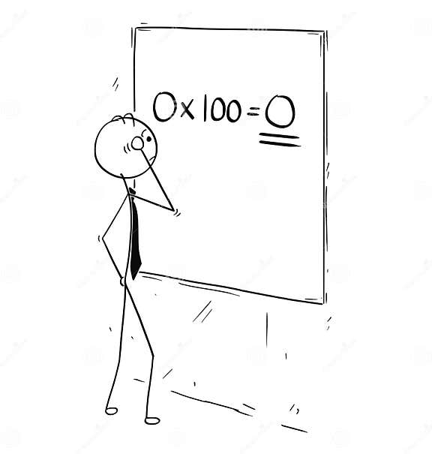
Solution 1 – Floating-Point Math
Rounding errors are handled by double checking
  Compressor checks each value by decoding it
  In case of violation, stores the value losslessly
Infinity and NaN are losslessly preserved
Denormals are handled by the double checking

Slide 15
Solution 2 – Result Parity
FMA disabled with compiler flags
  Technically degrades precision but supplies parity
Non-matching built-in functions (pow and log)
  Implemented our own fully matching versions
    Only use fully IEEE 754 compliant operations
  Degrades precision but supplies parity
Double checking catches any excessive degradation

Slide 16
Related Work – CPU Only
ZFP
  Converts floats to integers, performs a decorrelating transform, data mutation, and bit shuffling
  Lossless compression applied after the above steps
SPERR
  Uses wavelet transformations and SPECK
  Detects outliers and stores a correction factor
  Lossless compression step is ZSTD

Slide 17
Related Work – CPU Only
SZ2
  Uses Lorenzo prediction and linear regression followed by quantization
  Uses Huffman followed by GZIP after lossy stage
SZ3
  Often produces better compression ratios than SZ2 with similar throughputs
  Modular, lossless stage can be customized (e.g., ZSTD)

Slide 18
Related Work – GPU Only
FZ-GPU
  Uses Lorenzo prediction followed by GPU-friendly multi-byte Huffman coding
cuSZp
  Splits data into blocks, then quantizes and predicts values in non-zero blocks
  Compresses non-zero blocks using fixed-length encoding

Slide 19
Related Work – CPU and GPU
MGARD-X
  Only other compressor to support compatible CPU/GPU compression/decompression
  Uses multigrid hierarchical data refactoring to decompose and recompose data
  Selective loading based on the hierarchy after decomposition to determine accuracy

Slide 20
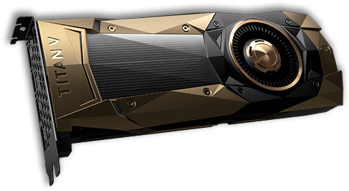
Experimental Methodology
System
  GPU: NVIDIA RTX 4090, 16384 PEs, 128 SMs, 24 GB memory, nvcc 12.0.14
  CPU: AMD Ryzen Threadripper 2950X (16 cores, 3.5GHz), gcc 12.2.1
We measure compression ratio and compression/decompression throughput
  Median of 9 runs

Slide 21
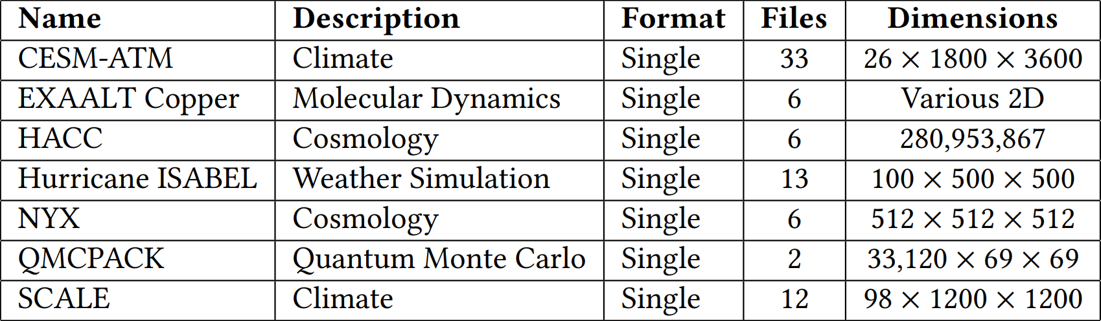
Inputs
SDRBench inputs: https://sdrbench.github.io/
Also generated single- and double-precision inputs that cover many special float values

Slide 22
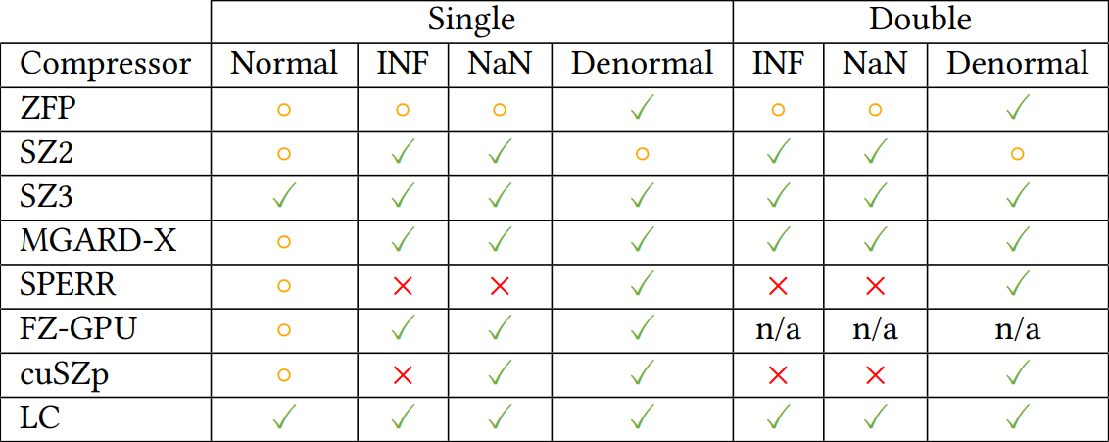
Results – Special-Value Support
Only other code that handles all values

Slide 23
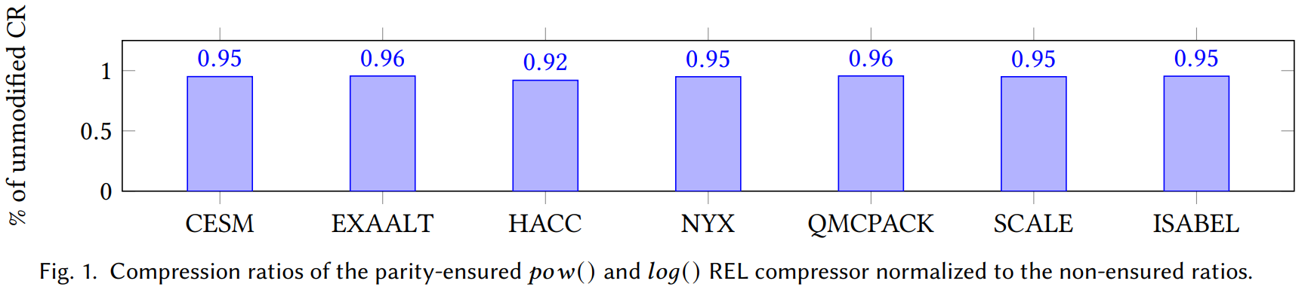
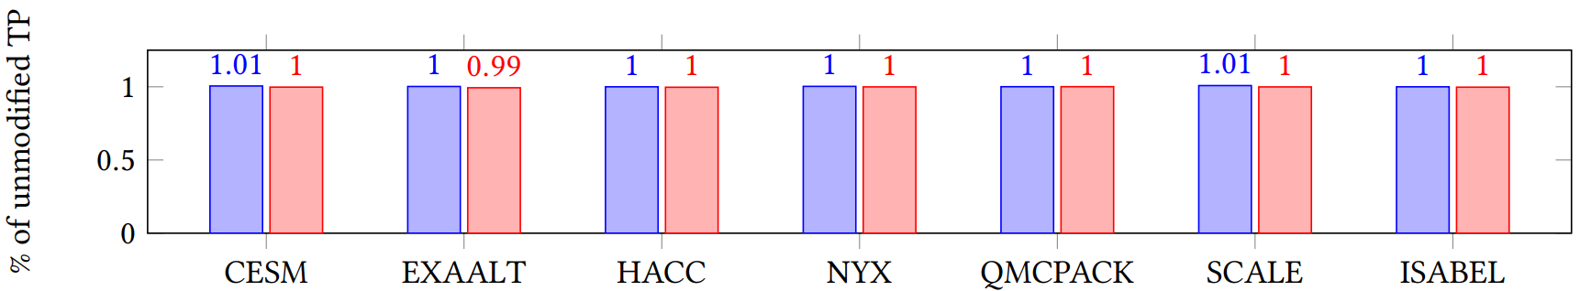
Results – Cost of Parity
Largest loss in compression ratio is only 8%
Throughput mostly unaffected: native functions also slow, and code is memory-bound

Slide 24
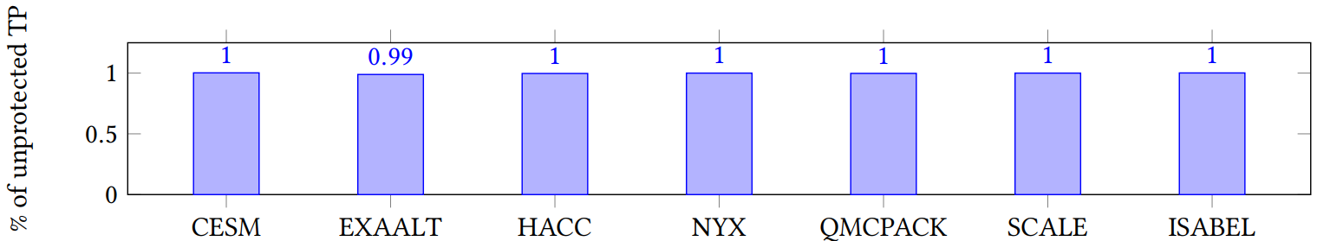
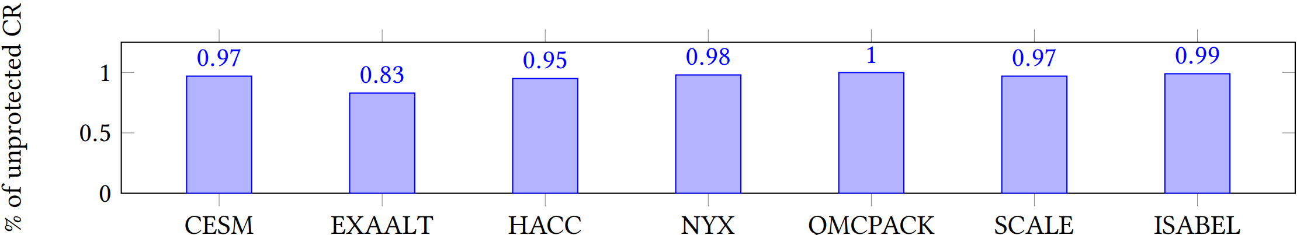
Results – Cost of Double Checking
Throughput mostly unaffected: code is memory-bound, and check is a small portion of runtime
ABS only
Compression ratio not impacted much: see next slide

Slide 25
Results – Double Checking of Rounding
REL unaffected
  Allows larger error for larger values
Affects few values in most cases for ABS
  Also an issue for other compressors
  Still allows for good compression
Matches loss of compression ratio in previous slide
Compression change from 2.9x to 3.2x
Compression change 1.372x to 1.373x

Slide 26

Summary and Conclusions
Built LC compression algorithm synthesis framework
Techniques to guarantee error bound and parity
  Double checking to guarantee error bound
  Custom pow/log & no FMA to guarantee CPU/GPU parity
Small impact on compression ratio and throughput
Acknowledgements: Sheng & Franck, DOE & NVIDIA
https://userweb.cs.txstate.edu/~burtscher/papers/codac24.pdf
Contact: waf13@txstate.edu

