Slide 1

Structural-Similarity-Preserving Lossy Data Compression for CPUs and GPUs
Alex Fallin and Martin Burtscher
Texas State University
Department of Computer Science
San Marcos, Texas, USA

Slide 2
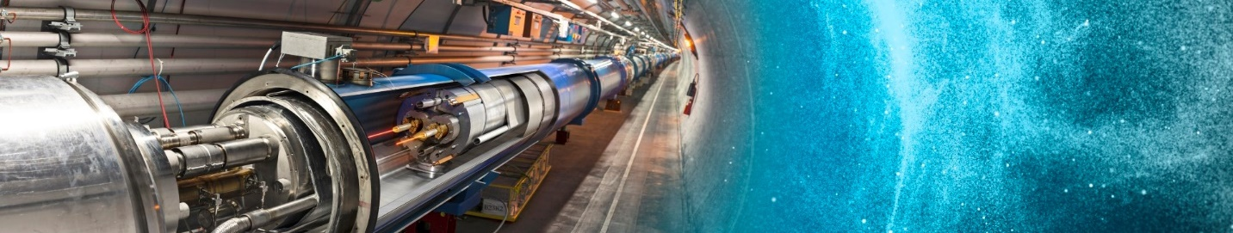
Introduction
Scientific data in HPC environments is becoming too large and being produced too fast
Lossless compression typically cannot yield high compression ratios on this type of data
Scientific data is often visualized
http://cds.cern.ch/record/1996997

Slide 3
Introduction
Lossy compression
  Three main error-bound types: ABS, REL, and NOA
  Error bounds are often not guaranteed
  Properties of interest: topology, visual quality, etc.
Heterogenous systems
  Data compressed on one system (GPU or CPU)
  Accessed on another system (GPU or CPU)
  CPU/GPU compatibility rarely supported in SOTA

Slide 4
Motivation
Scientific data is often visualized
Lossy compression reduces visual quality
Poor visual quality can change or obscure findings that may be visible to an expert
Structural Similarity Index Measure (SSIM) is an aggregate metric that doesn’t tell the whole story
Can you guarantee visual quality the same way that you can a point-wise error bound?

Slide 5

Background – SSIM
SSIM is a metric meant to evaluate human visual quality
Average of many local SSIM window calculations
We use the same window size and stride as QCAT
  Window size 7, stride 2
Values between -1 and 1
  1 indicates strong similarity, 0 is
  no similarity, and -1 indicates negative correlation

Slide 6
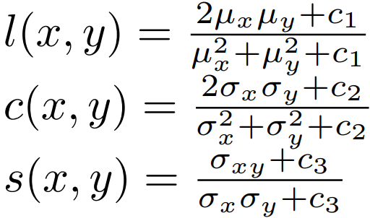
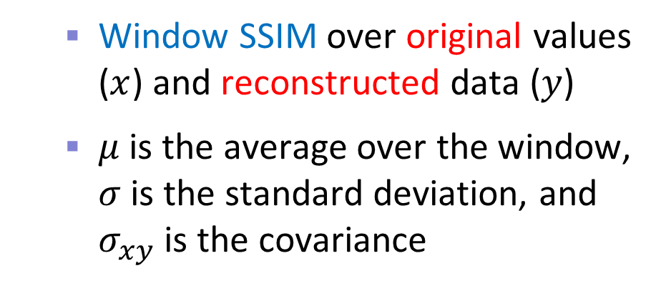
Background – SSIM
  Window SSIM over original values ($x$) and reconstructed data ($y$)
  $μ$is the average over the window, $σ$is the standard deviation, and $σ_{xy}$ is the covariance

Slide 7
minSSIM – Overview
A new metric based on SSIM
SSIM is the average over all windows, which can hide areas with poor local SSIM
minSSIM solves this problem by reporting the lowest local SSIM
  SSIM ≥ minSSIM
Bound in SBLC to guarantee SSIM

Slide 8
SBLC – Overview
SSIM-Bounded Lossy Compressor (SBLC)
Guaranteed point-wise error
Guaranteed SSIM using minSSIM
Full CPU/GPU compatibility
Fast and effective lossy base compressor
High decompression speed

Slide 9
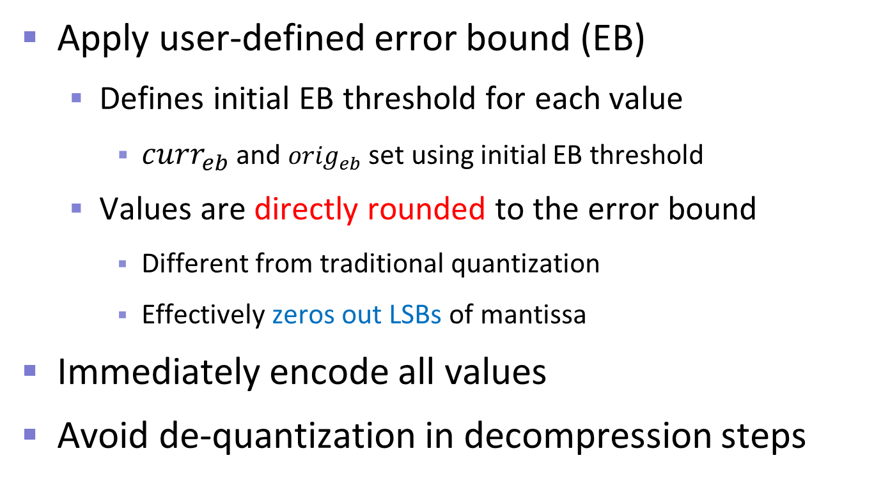
SBLC – Error Bound Guarantee
Apply user-defined error bound (EB)
  Defines initial EB threshold for each value
    ${curr}_{eb}$ and ${orig}_{eb}$ set using initial EB threshold
  Values are directly rounded to the error bound
    Different from traditional quantization
    Effectively zeros out LSBs of mantissa
Immediately encode all values
Avoid de-quantization in decompression steps

Slide 10
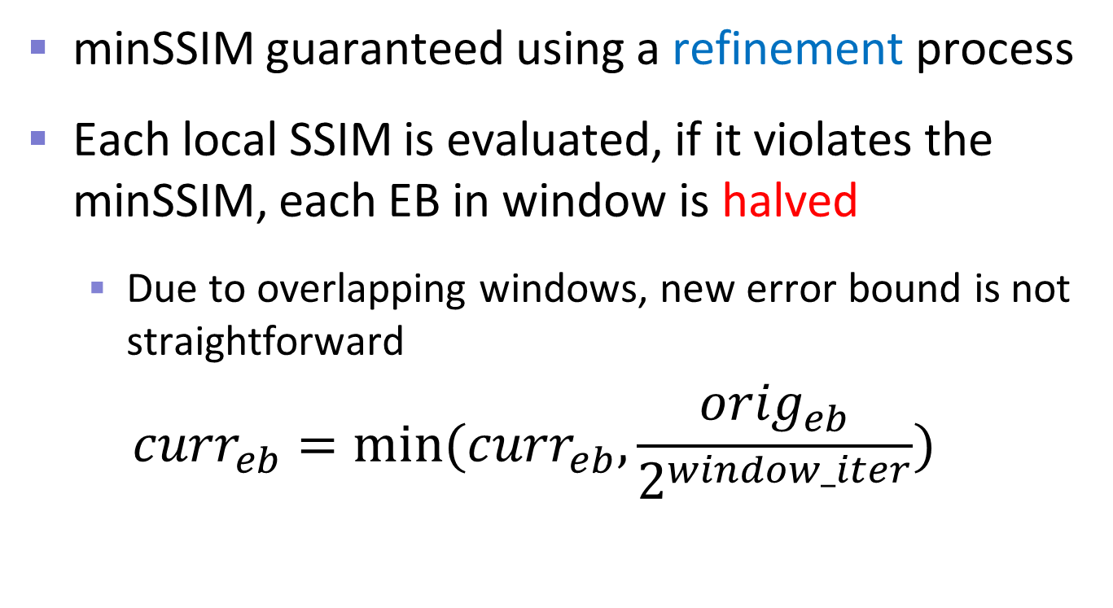
SBLC – minSSIM Guarantee
minSSIM guaranteed using a refinement process
Each local SSIM is evaluated, if it violates the minSSIM, each EB in window is halved
  Due to overlapping windows, new error bound is not straightforward
  $${curr}_{eb}=min⁡({curr}_{eb}, \frac{{orig}_{eb}}{2^{window_iter}})$$

Slide 11
SBLC – Lossless Compression
Discovered using LC
Stage 1: difference sequence with negabinary
  Exploits mostly rounded mantissa
Stage 2: chunked LOG from both sides
  Prevents outliers from excessively decreasing CR
  Removes leading and trailing 0s
Stage 3: repeated zero elimination

Slide 12
SBLC – Parallelization
Parallel processing difficult due to overlapping local windows
For CPU and GPU, windows are divided into non-overlapping sets
  CPU: run in parallel with a dynamic schedule and OpenMP collapsed inner loops
  GPU: loops are manually collapsed, thread based
However, performance is still low

Slide 13
SBLC – Optimization
Most windows do not need refinement after the first iteration
  Worklist is an obvious choice, but doesn’t supply parity
  Timestamp array is maintained
  Refined windows mark themselves and overlapping windows
  Do not calculate SSIM if a window is not recently modified

Slide 14
Related Work – ML approaches
Many SSIM-optimized machine learning approaches exist
Almost all target the much slower MS-SSIM as training is performed offline
While they use SSIM loss functions, they offer no guarantees
When throughputs are reported, they are in the tens of megabytes per second

Slide 15
Related Work – Lossy
ZFP
  Converts floats to integers, performs a decorrelating transform, data mutation, and bit shuffling
  Lossless compression applied after the above steps
SZ3
  Often produces better compression ratios than SZ2 at similar throughputs
  Modular, lossless stage can be customized (e.g., ZSTD)
  OpenMP enabled

Slide 16
Related Work – Lossy
PFPL
  Fast, CPU/GPU compatible, lossy data compressor
  Quantization followed by 3-stage compression
cuSZp v3
  Splits data into blocks, then quantizes and predicts values in non-zero blocks
  Compresses non-zero blocks using fixed-length encoding with delta
  Adds dimensionality support

Slide 17
Related Work – Lossy
MGARD-X
  Only other compressor to support compatible CPU/GPU compression/decompression
  Uses multigrid hierarchical data refactoring to decompose and recompose data
  Selective loading based on the hierarchy after decomposition to refine accuracy
  Designed for the L₂ norm, but tested with L_{inf} norm
    Supplies point-wise error bounding

Slide 18
Related Work – Lossy
SLEEK
  Ultra-high-throughput lossy compressor designed to operate near memory copy speeds
  New quantization method that guarantees error bound without outliers
Jiao et al.
  Identifies quantization boundaries and interpolates across them to directly address visual artifacts that come from quantization

Slide 19
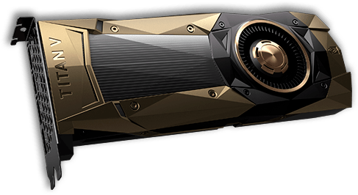
Experimental Methodology
2 GPUs
  NVIDIA RTX 4090, 16384 PEs, 128 SMs, 24 GB memory
  NVIDIA A100, 6912 PEs, 108 SMs, 40 GB memory
2 CPUs
  CPU: Intel Xeon Gold 6226R (16 cores, 3.9 GHz)
  CPU: AMD Ryzen Threadripper 3970X (32 cores, 3.7 GHz)

Slide 20
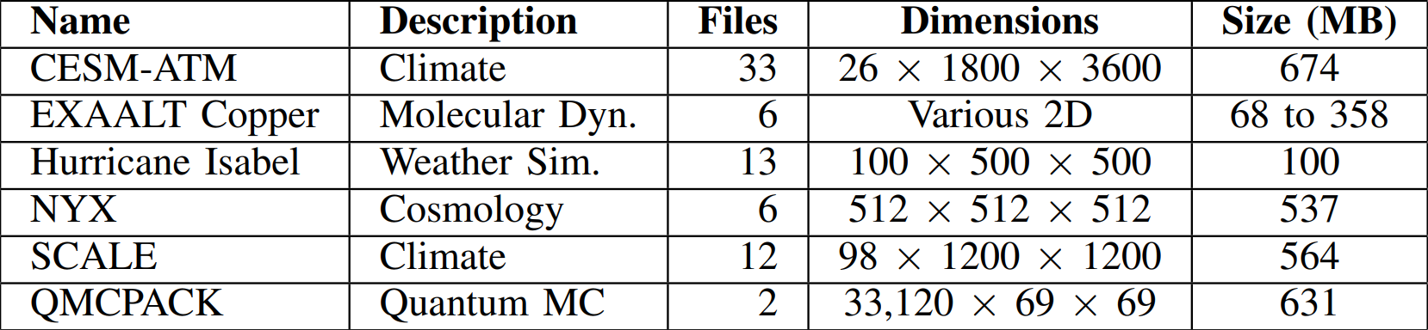
Experimental Methodology
72 single-precision inputs
Median of 9 runs

Slide 21
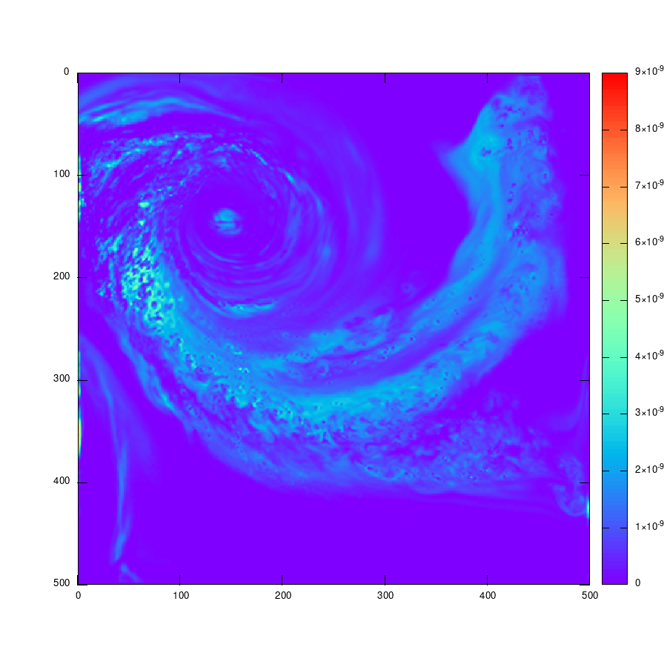
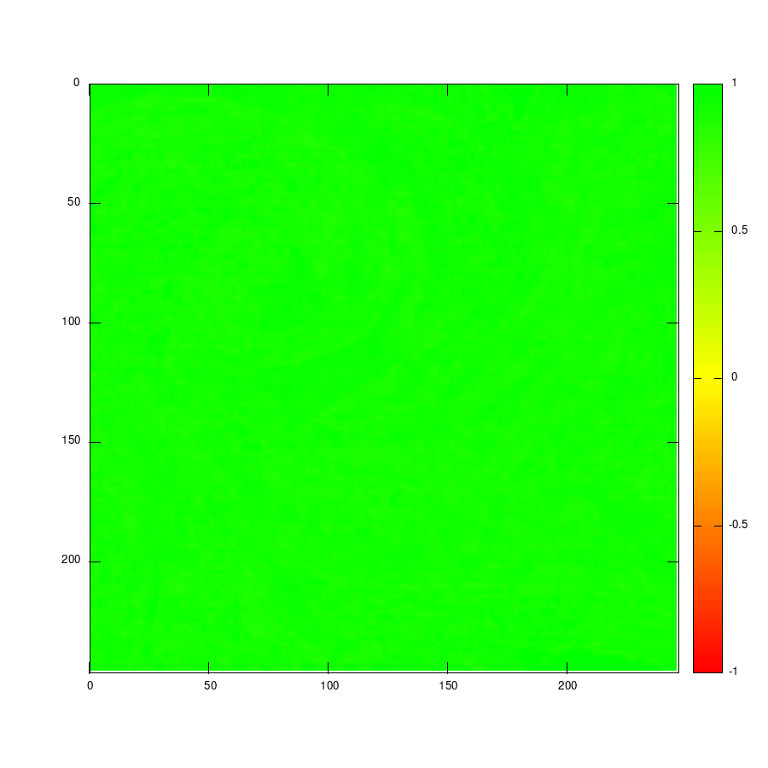
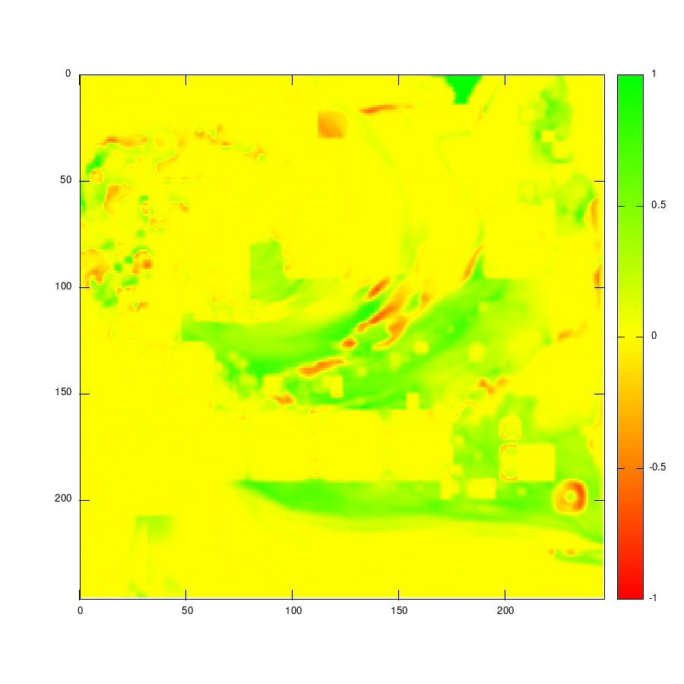
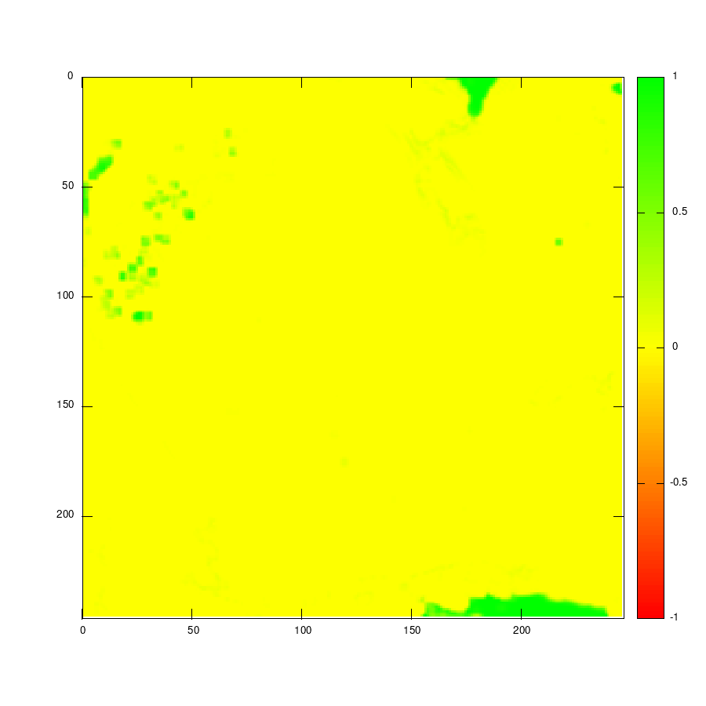
Results – Local SSIM Analysis
High SSIM in unimportant areas
High SSIM in unimportant areas
High SSIM in unimportant areas
Original
SBLC 0.85
SZ3
Base Compressor

Slide 22
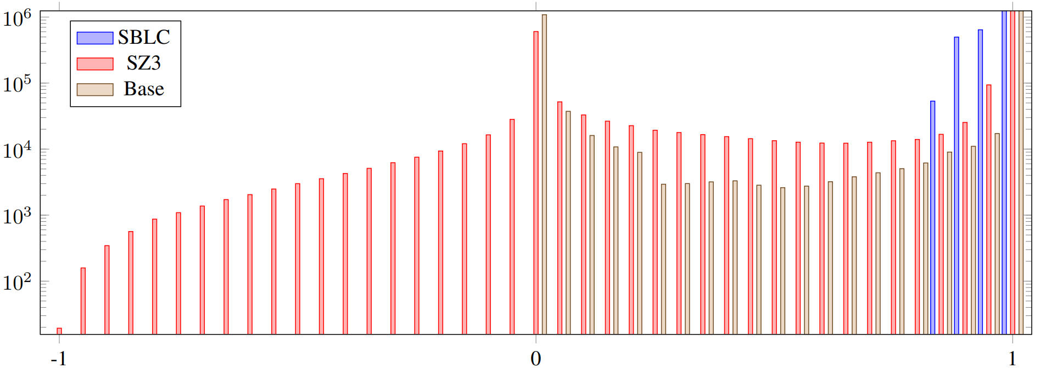
Results – Local SSIM Analysis
Peaks at 0 and 1
Peaks at 0 and 1
SBLC starts at 0.85
4%

Slide 23
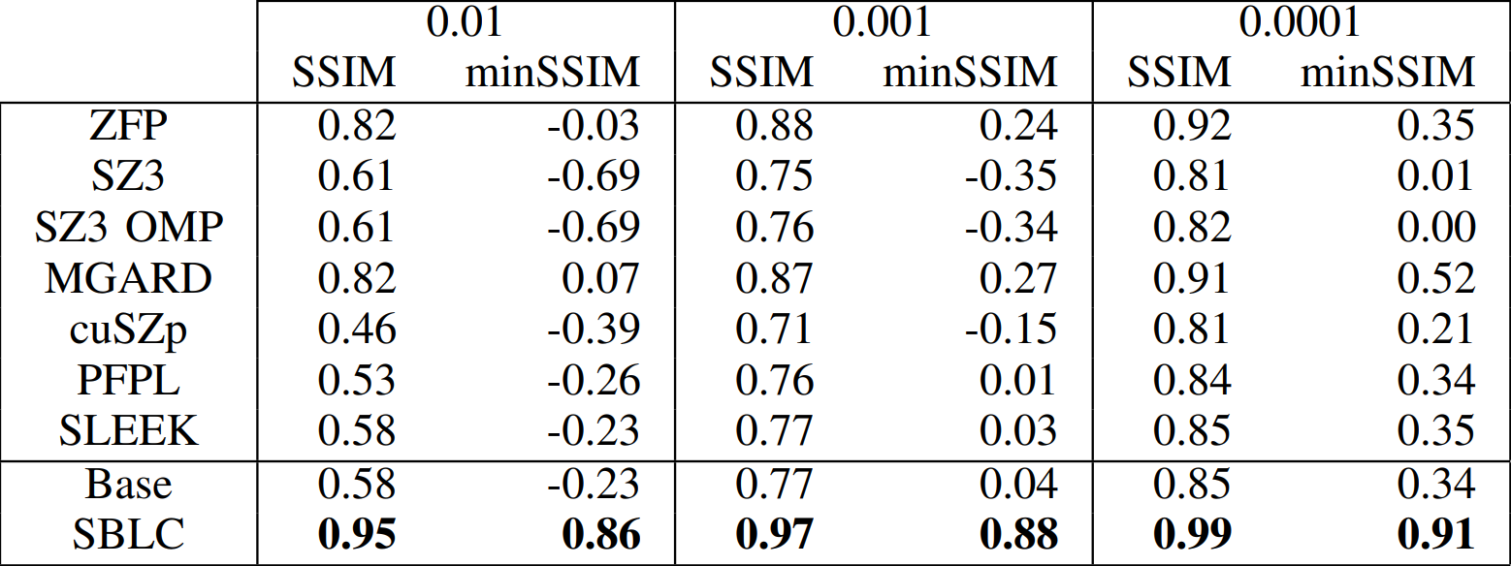
Results – SSIM over all Inputs
Many in the negative
Aggregate hides low minSSIM
Many in the negative
Always the best

Slide 24
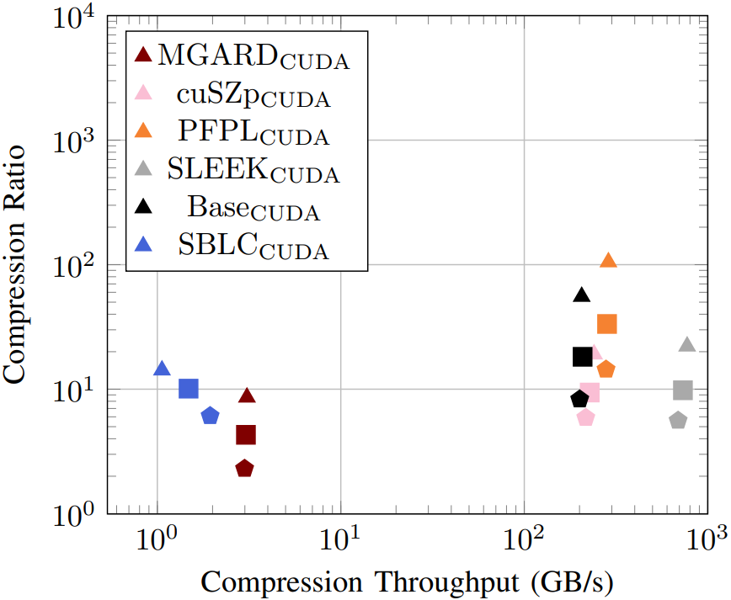
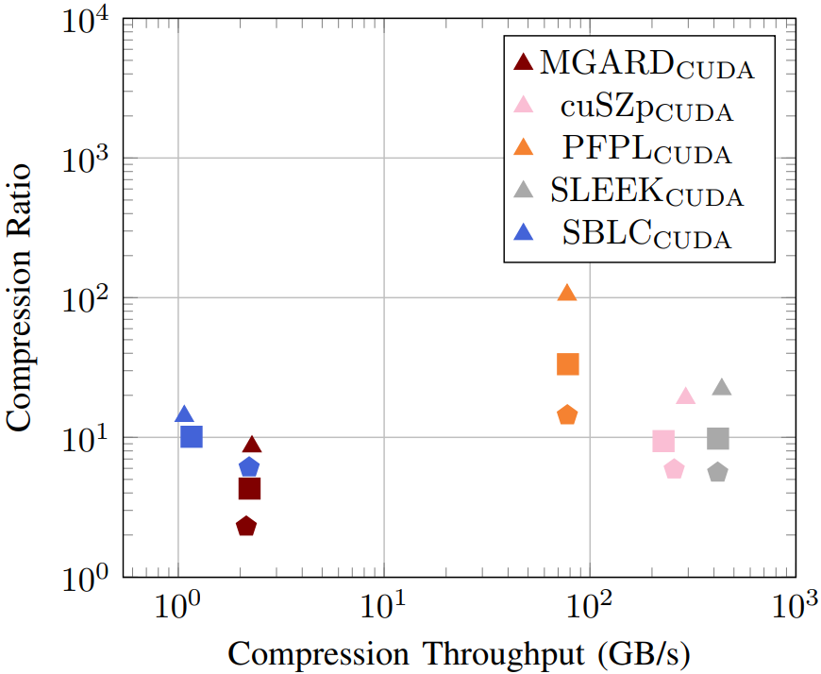
Results – Compression on GPU
Base compressor has similar throughput to other GPU codes
Fastest at lowest EB
On par CRs at lower EBs
4090
On par CRs at lower EBs
A100

Slide 25
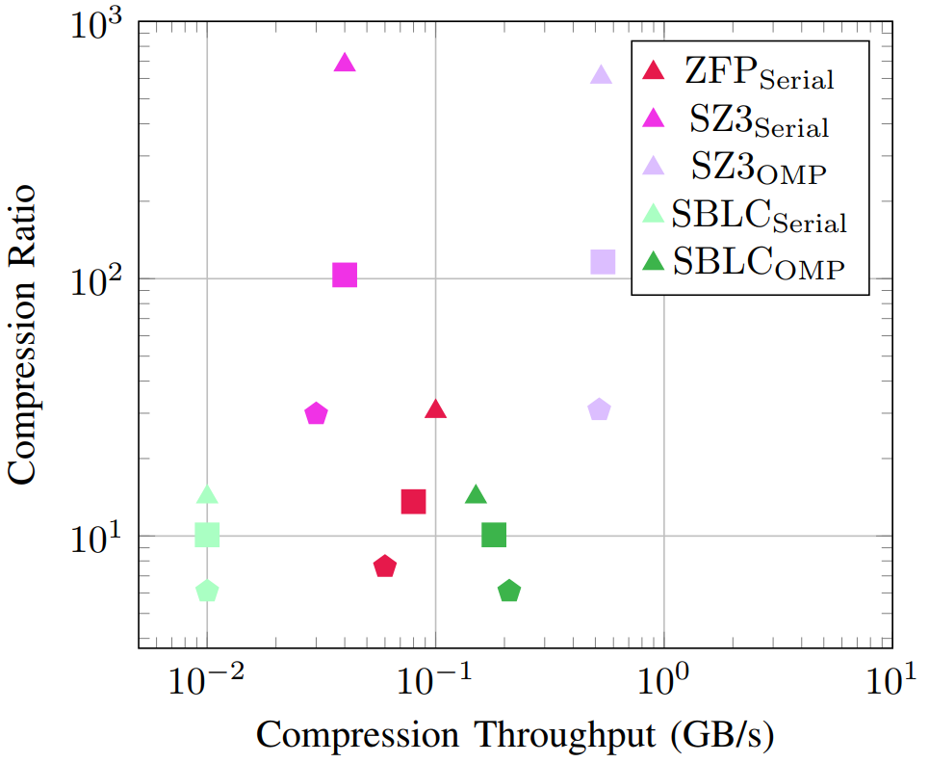
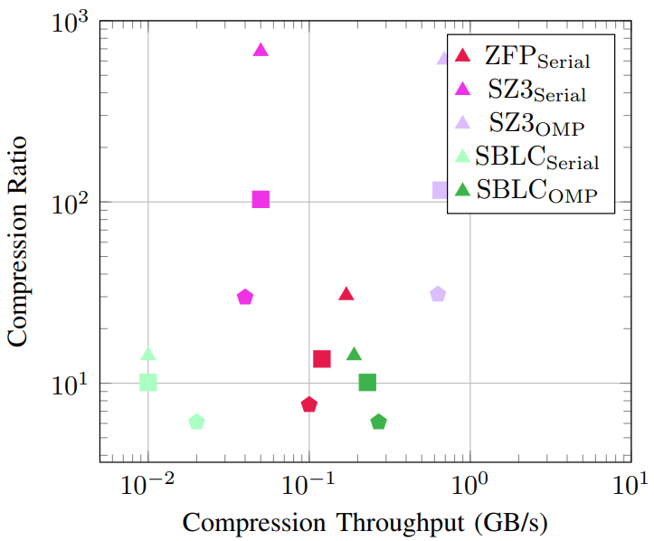
Results – Compression on CPU
SZ3 compresses well
SZ3 compresses well
Intel
Slower than only SZ3 OMP
AMD

Slide 26
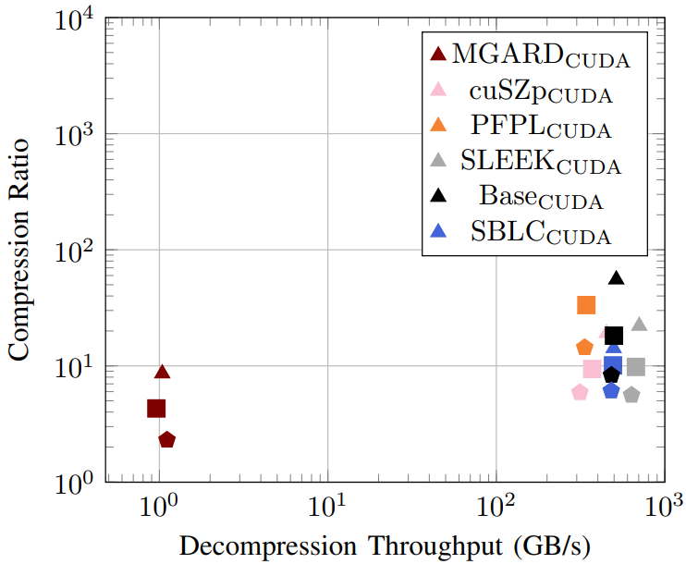
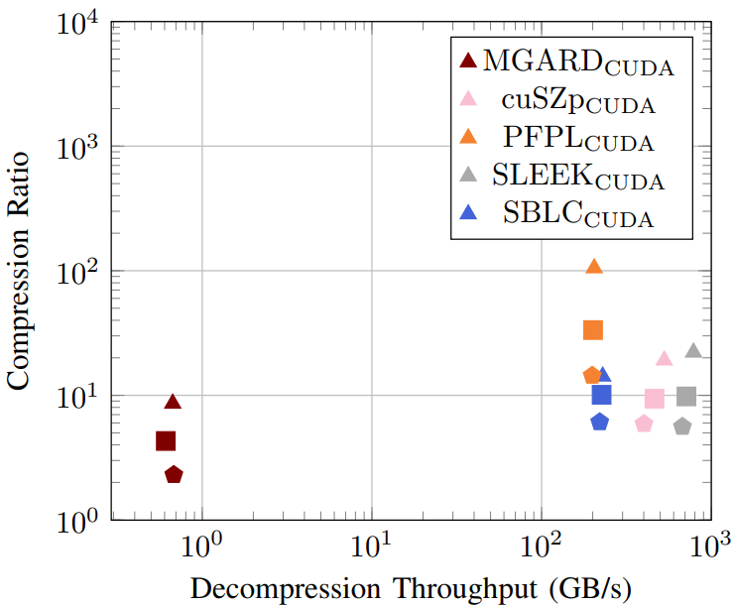
Results – Decompression on GPU
Base compressor only compresses better
No longer slow
4090
A100

Slide 27
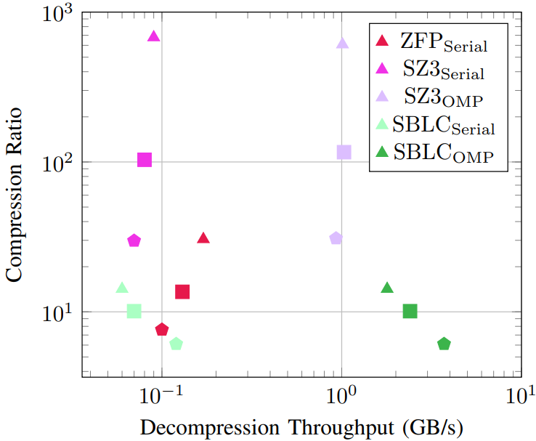
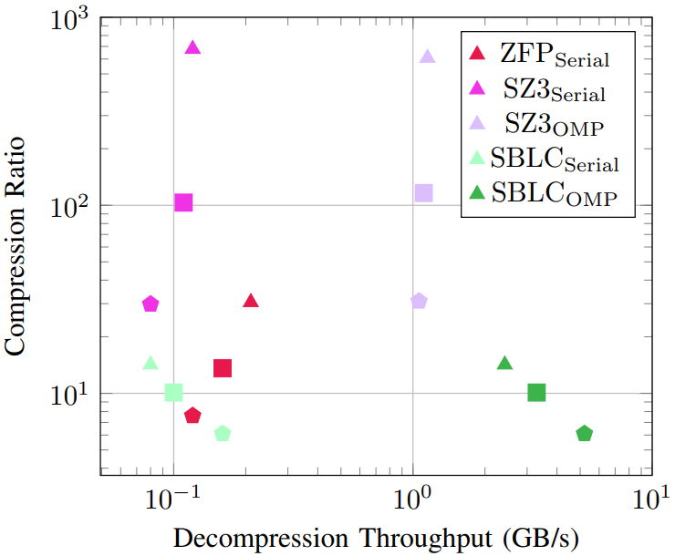
Results – Decompression on CPU
Intel
Now faster than SZ3 OMP
AMD

Slide 28
Summary
Introduced minSSIM, a metric that exposes hidden worst cases for visualized data
Created tunable SSIM-bounded lossy compressor
  First lossy compressor to guarantee SSIM
  Offers full CPU/GPU compatibility and strict error bound guarantees
Highest SSIM and minSSIM across all tested inputs
Acknowledgements: DOE, NSF, NVIDIA

Slide 29

Code
GitHub - https://github.com/burtscher/minSSIM
or

