Slide 1
Performance Impact of Removing Data Races from GPU Graph Analytics Programs
Yiqian Liu, Avery VanAusdal, and Martin Burtscher
Department of Computer Science

Slide 2
Graph Analytics Codes
Important in many domains
Social networks
Search engines
Recommender systems
GPS navigators
Have unpredictable, data-dependent behavior
Control flow: visiting neighbors in adjacency list
Memory accesses: pointer-chasing operations
Growing input sizes motivate GPU solutions
https://medium.com/analytics-vidhya/social-network-analytics-f082f4e21b16

Slide 3
Highlights
Study 5 high-performance graph analytics codes
Contain “benign” data races to boost performance
Remove data races to make codes portable
Using atomics from NVIDIA’s libcu++ library (2019)
Using type casting and masking for unsupported types
Evaluate new codes on 4 GPUs and several inputs
Analyze the performance impact
Removing races can hurt or help performance

Slide 4
“Benign” Data Races
Complex & irregular parallel codes
Typically require non-trivial synchronization
Some data races do not affect correctness
But limited to certain systems
Programmers use “benign” data races
Commonly believed to yield faster and simpler code
Until recently, CUDA relied on volatile semantics
Disables optimizations of accesses to shared data

Slide 5
Problem
Codes with “benign” data races are non-portable
Data races are undefined behavior as of Dec. 2020
CUDA compilers are free to miscompile code
Without atomic accesses, word tearing can occur
Ex: 0xFFFFFFFFFFFFFFFF; write 0 and print at same time
Can print 0xFFFFFFFFFFFFFFFF, 0x0000000000000000, 0xFFFFFFFF00000000, or 0x00000000FFFFFFFF
Must be fixed, but what is performance impact?

Slide 6
Background

Slide 7
Terminology
Word tearing: a single-element access performed using multiple loads or stores
Atomic access: a load or store memory operation that cannot be interrupted
Volatile variable: a memory location that can be modified by another thread
Memory ordering: restrictions on which memory accesses can be reordered relative to each other

Slide 8
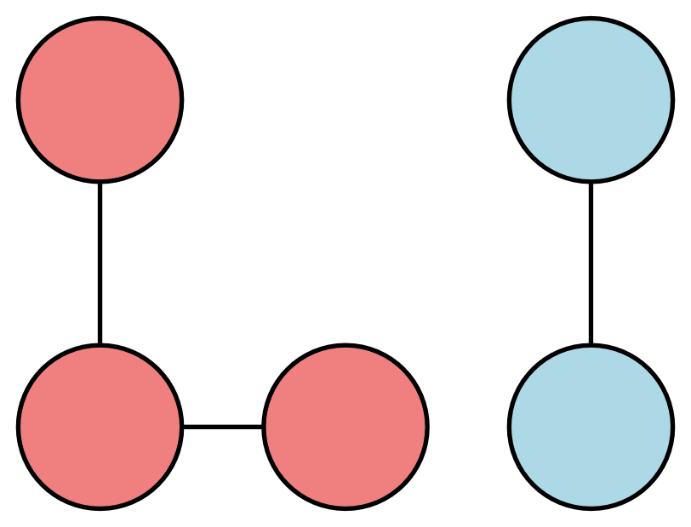
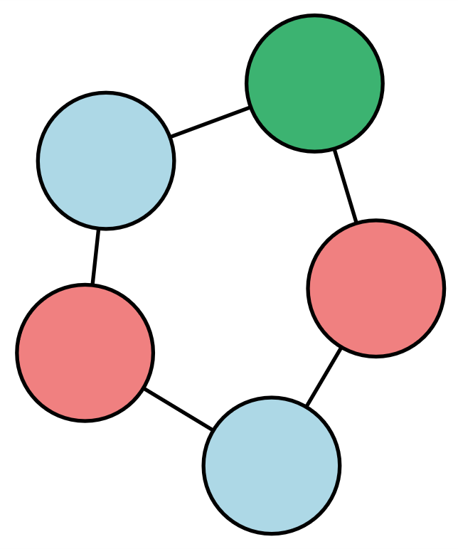
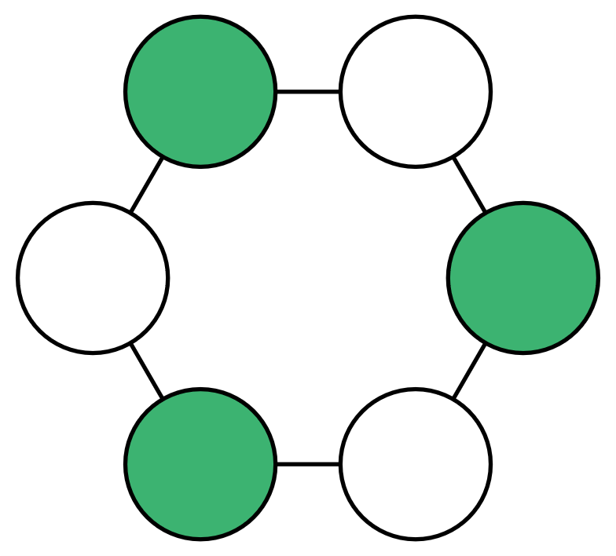
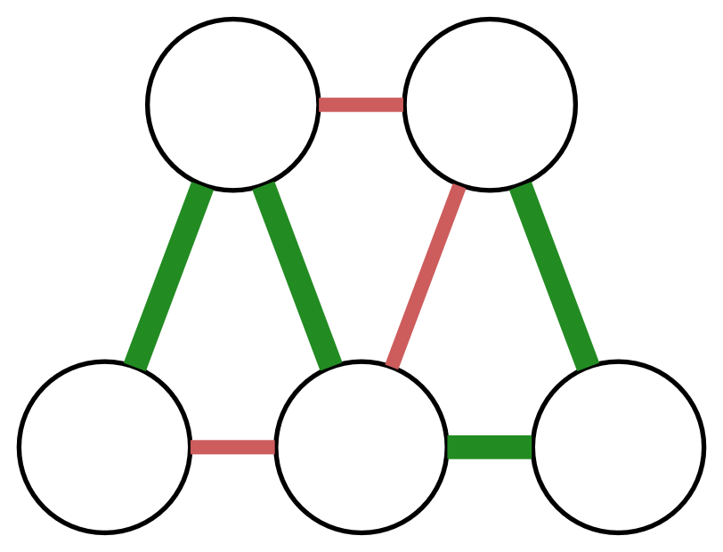
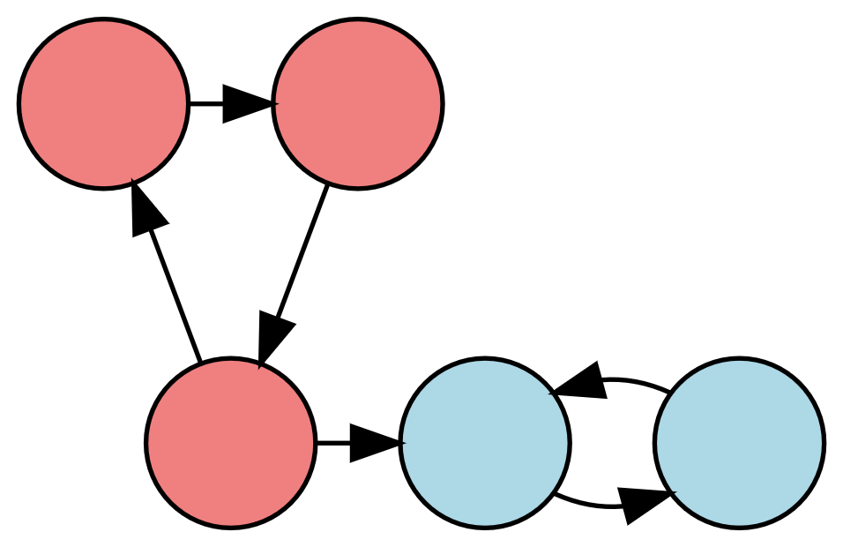
Selected Codes
CC - Connected Components
GC - Graph Coloring
MIS - Maximal Independent Set
MST - Minimum Spanning Tree
SCC - Strongly Connected Components

Slide 9
Related Work
Splash-3 corrects performance bugs and “benign” data races from Splash-2 and analyzes the overall performance impact
Covers CPU codes and primarily focuses on locks
Verification suites such as Indigo, Indigo3, DataRaceBench, and RMARaceBench include races but do not discuss performance
Several data-race detection tools categorize data races as harmful or “harmless”
Boehm explains why data races cannot be benign in source code (only in machine code), motivating our work

Slide 10
Approach

Slide 11
Races Found
CC - vertex labels for subset representatives
GC - vertex labels for possible & chosen colors
MIS - vertex labels for status & priority
MST - vertex labels for best neighbor to merge
SCC - vertex labels for incoming & outgoing paths

Slide 12
Atomic Reads and Writes
Replaced all memory accesses to shared data with atomic loads and stores using libcu++
const auto relaxed = cuda::memory_order_relaxed;
template <typename T>
__device__ inline T atomicRead(T* const addr) {
return ((cuda::atomic<T>*)addr)->load(relaxed);
}
template <typename T>
__device__ inline void atomicWrite(T* const addr, const T val) {
((cuda::atomic<T>*)addr)->store(val, relaxed);
}

Slide 13
Typecasting and Masking
Some data types not supported by CUDA atomics
E.g., char, bool, pair, int2
To read a char, we cast to int, atomically read the int, and bit-shift & mask to extract value
0x12345678 → 0x00001234 → 0x34
To write a char, we cast to int and use atomic AND & OR operations to write to the desired byte
We replace int2 with unsigned long long

Slide 14
Experimental Methodology

Slide 15
Undirected Inputs - CC, GC, MIS, MST
Graph Name | Edges | Vertices | Type | d-avg | d-max | Graph Name | Edges | Vertices | Type | d-avg | d-max
2d-2e20.sym | 4.2 M | 1 M | grid | 4.0 | 4 | internet | 387.2 K | 124.7 K | Internet topology | 3.1 | 151
amazon0601 | 4.9 M | 403 K | co-purchases | 12.1 | 2,752 | kron_g500-logn21 | 182.1 M | 2.1 M | Kronecker | 86.8 | 213.9 K
as-skitter | 22.2 M | 1.7 M | Internet topology | 13.1 | 35.5 K | r4-2e23.sym | 67.1 M | 8.4 M | random | 8.0 | 26
citationCiteseer | 2.3 M | 268.4 K | publication citations | 8.6 | 1,318 | rmat16.sym | 967.9 K | 65.5 K | RMAT | 14.8 | 569
cit-Patents | 33 M | 3.8 M | patent citations | 8.8 | 793 | rmat22.sym | 65.7 M | 4.2 M | RMAT | 15.7 | 3,687
coPapersDBLP | 30 M | 540 K | publication citations | 56.4 | 3,299 | soc-LiveJournal1 | 85.7 K | 4.8 M | commu-nity | 17.7 | 20.3 K
delaunay_n24 | 100.1 M | 16.8 M | triangulation | 6.0 | 26 | USA-road-d.NY | 730.1 K | 264.3 K | roadmap | 2.8 | 8
europe_osm | 108 M | 50.1 M | roadmap | 2.1 | 13 | USA-road-d.USA | 57.7 M | 23.9 M | roadmap | 2.4 | 9
in-2004 | 27 M | 1.4 M | weblinks | 19.7 | 21.9 K

Slide 16
Directed Inputs - SCC
Graph Name | Edges | Vertices | Type | d-avg | d-max
cage14 | 27,130,349 | 1,505,785 | power-law | 18.02 | 41
circuit5M | 59,524,291 | 5,558,326 | power-law | 10.71 | 1,290,501
cold-flow | 6,295,941 | 2,112,512 | mesh | 2.98 | 5
flickr | 9,837,214 | 820,878 | power-law | 11.98 | 10,272
klein-bottle | 18,793,715 | 8,388,608 | mesh | 2.24 | 4
star | 654,080 | 327,680 | mesh | 2.00 | 2
toroid-hex | 4,684,142 | 1,572,864 | mesh | 2.98 | 4
toroid-wedge | 487,798 | 196,608 | mesh | 2.48 | 4
web-Google | 5,105,039 | 916,428 | power-law | 5.57 | 456
wikipedia | 39,383,235 | 3,148,440 | power-law | 12.51 | 6,576

Slide 17
Hardware and Software
GPU Name | Architecture | Cores | SMs | Memory | NVCC
Titan V | Volta | 5120 | 80 | 12 GB | 10.1
2070 Super | Turing | 2560 | 40 | 8 GB | 12.0
A100 | Ampere | 6912 | 108 | 40 GB | 12.0
RTX 4090 | Ada Lovelace | 16,384 | 128 | 24 GB | 12.0

Slide 18
Results

Slide 19
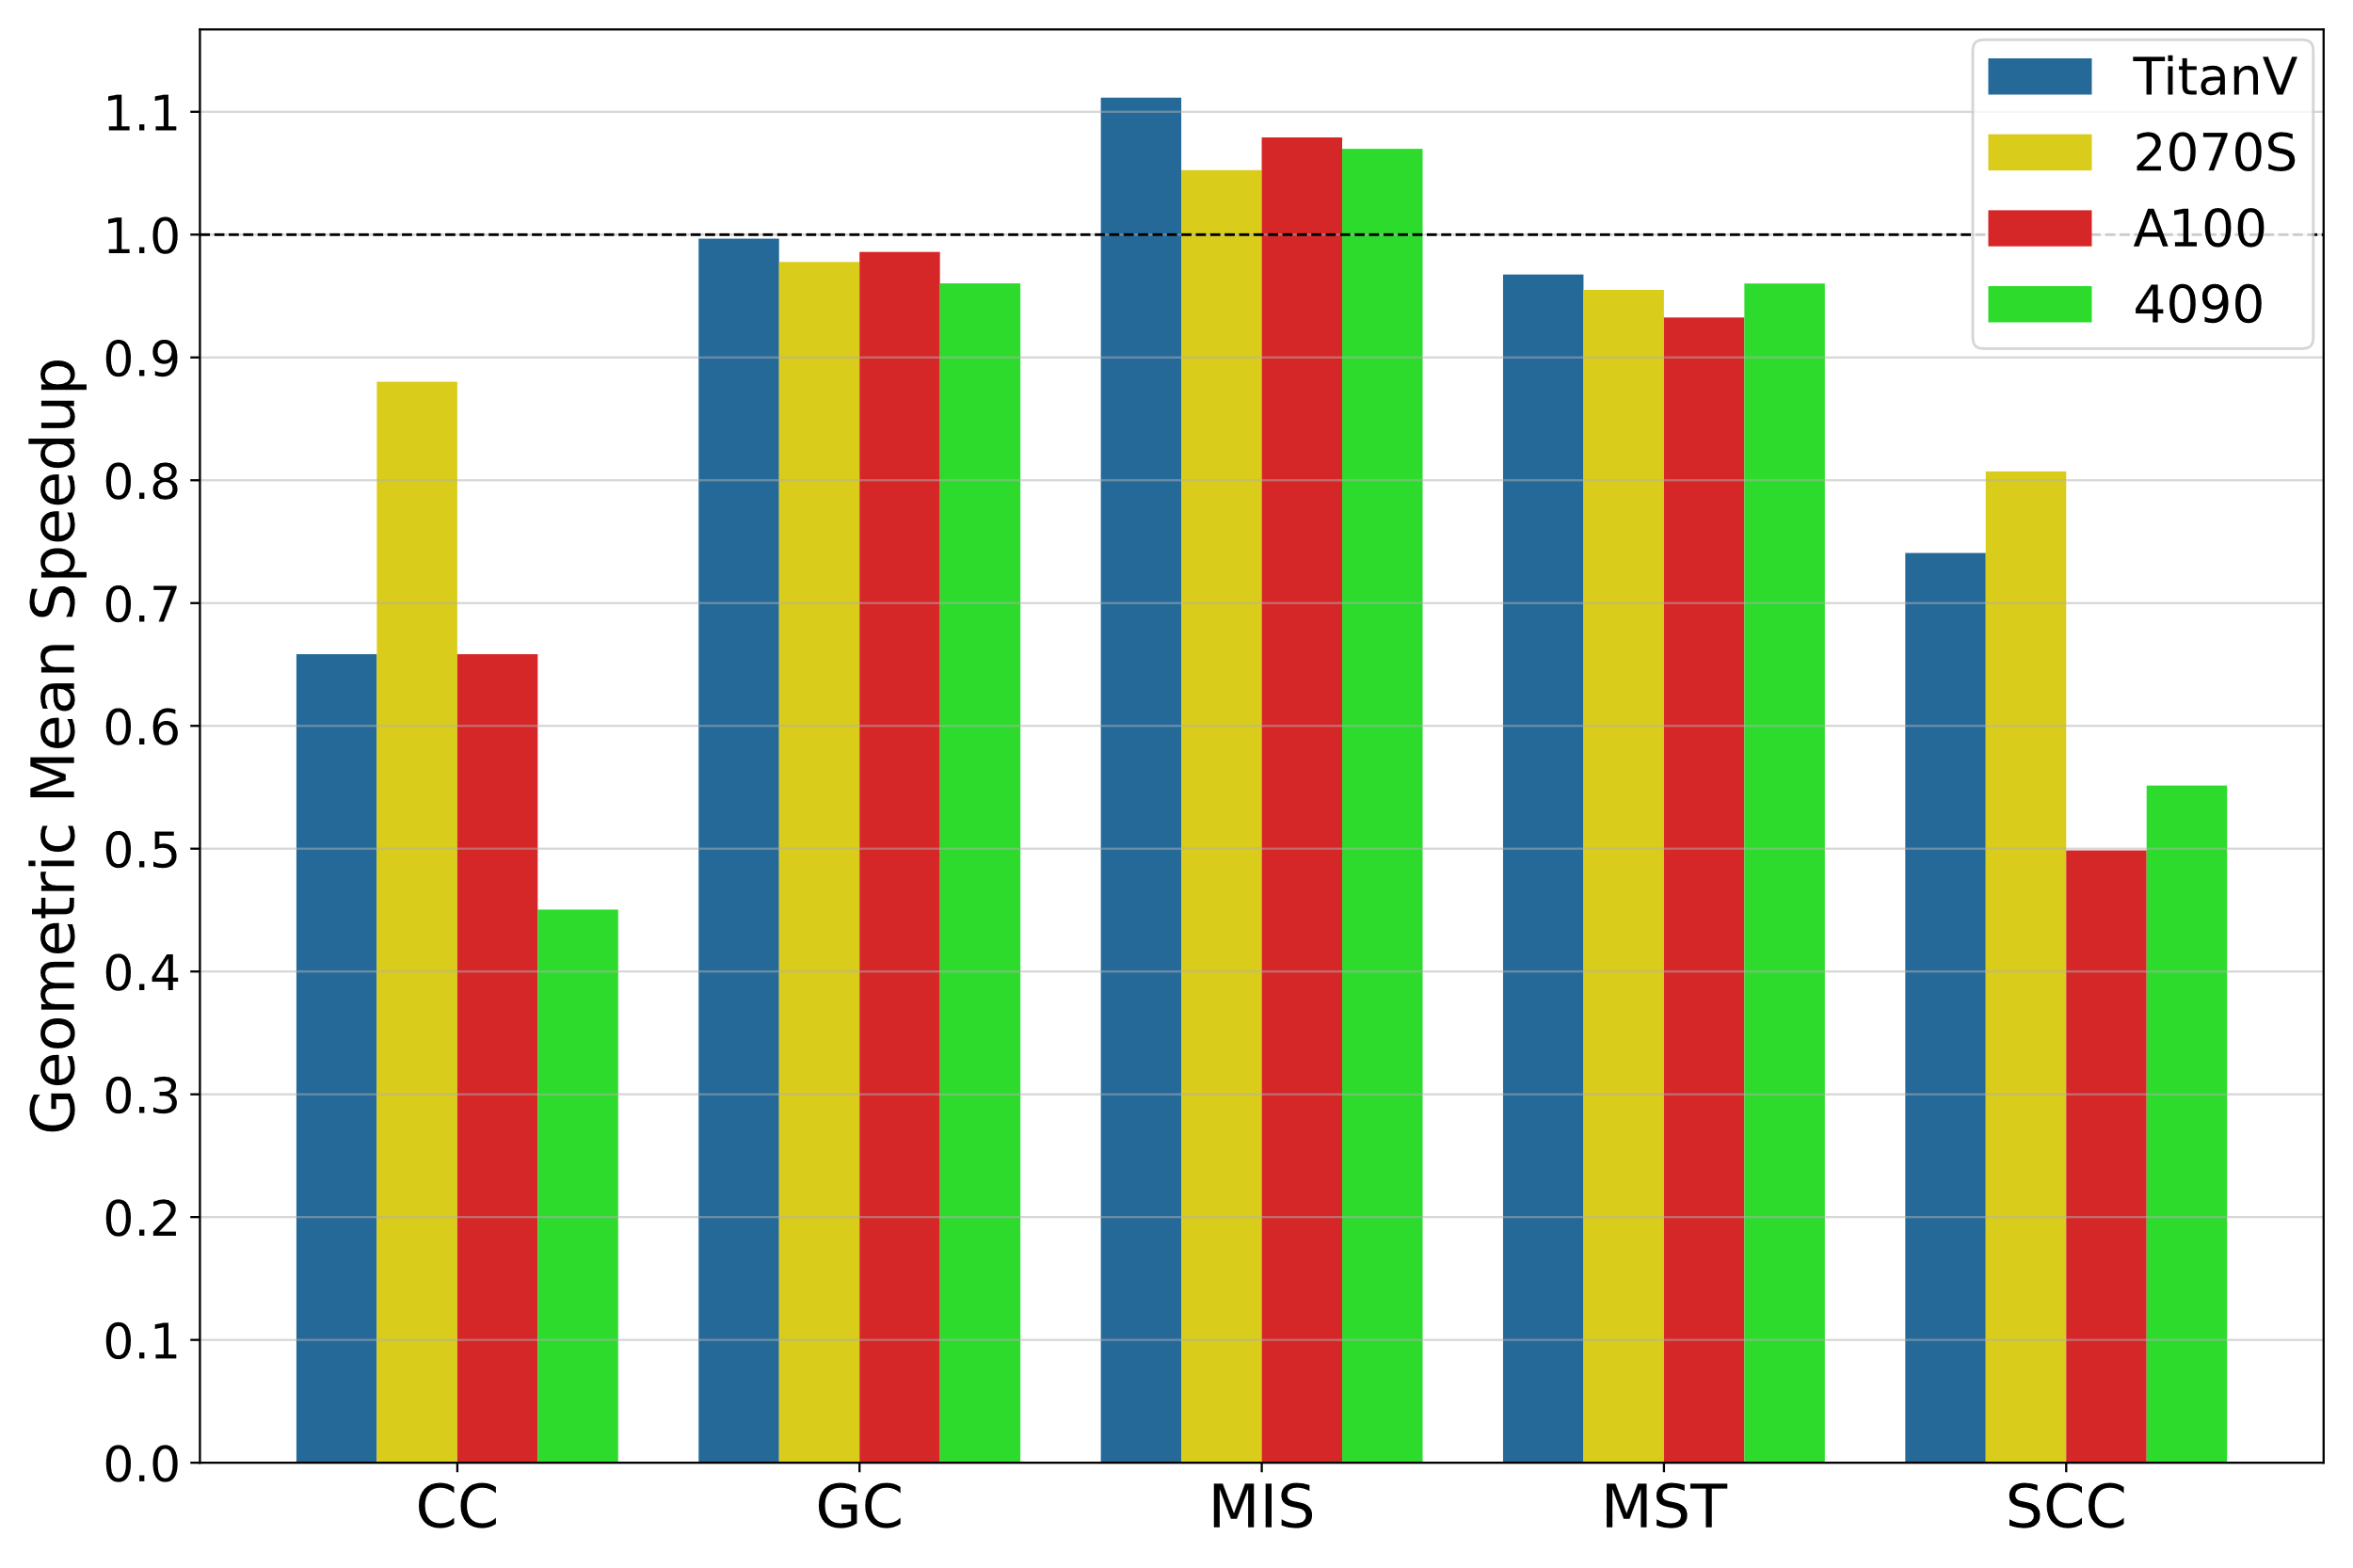
Performance of Race-Free Programs
MIS is faster!
CC slower
SCC slower
Geometric-mean speedup over the baseline across all inputs

Slide 20
Correlation with Graph Properties
Correlated with: | CC | GC | MIS | MST | SCC
 | Titan V
Edge Count | 0.71 | -0.07 | -0.21 | -0.35 | -0.27
Vertex Count | 0.72 | 0.09 | -0.20 | 0.32 | -0.30
Average Degree | -0.03 | 0.03 | -0.04 | -0.57 | -0.62
 | 2070 Super
Edge Count | 0.57 | 0.41 | -0.23 | 0.54 | -0.34
Vertex Count | 0.43 | 0.32 | -0.21 | 0.47 | 0.01
Average Degree | -0.02 | 0.03 | -0.04 | 0.11 | -0.68
 | A100
Edge Count | -0.60 | -0.16 | -0.10 | 0.04 | 0.09
Vertex Count | -0.42 | 0.26 | -0.37 | 0.47 | -0.07
Average Degree | -0.17 | -0.67 | 0.25 | -0.28 | -0.37
 | 4090
Edge Count | -0.30 | -0.06 | -0.07 | -0.38 | -0.21
Vertex Count | -0.35 | 0.14 | -0.25 | 0.14 | -0.23
Average Degree | 0.10 | -0.48 | 0.19 | -0.52 | -0.47

Slide 21
Correlation with Graph Properties
Correlated with: | CC | GC | MIS | MST | SCC
 | Titan V
Edge Count | 0.71 | -0.07 | -0.21 | -0.35 | -0.27
Vertex Count | 0.72 | 0.09 | -0.20 | 0.32 | -0.30
Average Degree | -0.03 | 0.03 | -0.04 | -0.57 | -0.62
 | 2070 Super
Edge Count | 0.57 | 0.41 | -0.23 | 0.54 | -0.34
Vertex Count | 0.43 | 0.32 | -0.21 | 0.47 | 0.01
Average Degree | -0.02 | 0.03 | -0.04 | 0.11 | -0.68
 | A100
Edge Count | -0.60 | -0.16 | -0.10 | 0.04 | 0.09
Vertex Count | -0.42 | 0.26 | -0.37 | 0.47 | -0.07
Average Degree | -0.17 | -0.67 | 0.25 | -0.28 | -0.37
 | 4090
Edge Count | -0.30 | -0.06 | -0.07 | -0.38 | -0.21
Vertex Count | -0.35 | 0.14 | -0.25 | 0.14 | -0.23
Average Degree | 0.10 | -0.48 | 0.19 | -0.52 | -0.47
Mild to moderate negative correlation with average degree

Slide 22
Correlation with Graph Properties
Correlated with: | CC | GC | MIS | MST | SCC
 | Titan V
Edge Count | 0.71 | -0.07 | -0.21 | -0.35 | -0.27
Vertex Count | 0.72 | 0.09 | -0.20 | 0.32 | -0.30
Average Degree | -0.03 | 0.03 | -0.04 | -0.57 | -0.62
 | 2070 Super
Edge Count | 0.57 | 0.41 | -0.23 | 0.54 | -0.34
Vertex Count | 0.43 | 0.32 | -0.21 | 0.47 | 0.01
Average Degree | -0.02 | 0.03 | -0.04 | 0.11 | -0.68
 | A100
Edge Count | -0.60 | -0.16 | -0.10 | 0.04 | 0.09
Vertex Count | -0.42 | 0.26 | -0.37 | 0.47 | -0.07
Average Degree | -0.17 | -0.67 | 0.25 | -0.28 | -0.37
 | 4090
Edge Count | -0.30 | -0.06 | -0.07 | -0.38 | -0.21
Vertex Count | -0.35 | 0.14 | -0.25 | 0.14 | -0.23
Average Degree | 0.10 | -0.48 | 0.19 | -0.52 | -0.47
Mild but consistent negative correlation with vertex count

Slide 23
Correlation with Graph Properties
Correlated with: | CC | GC | MIS | MST | SCC
 | Titan V
Edge Count | 0.71 | -0.07 | -0.21 | -0.35 | -0.27
Vertex Count | 0.72 | 0.09 | -0.20 | 0.32 | -0.30
Average Degree | -0.03 | 0.03 | -0.04 | -0.57 | -0.62
 | 2070 Super
Edge Count | 0.57 | 0.41 | -0.23 | 0.54 | -0.34
Vertex Count | 0.43 | 0.32 | -0.21 | 0.47 | 0.01
Average Degree | -0.02 | 0.03 | -0.04 | 0.11 | -0.68
 | A100
Edge Count | -0.60 | -0.16 | -0.10 | 0.04 | 0.09
Vertex Count | -0.42 | 0.26 | -0.37 | 0.47 | -0.07
Average Degree | -0.17 | -0.67 | 0.25 | -0.28 | -0.37
 | 4090
Edge Count | -0.30 | -0.06 | -0.07 | -0.38 | -0.21
Vertex Count | -0.35 | 0.14 | -0.25 | 0.14 | -0.23
Average Degree | 0.10 | -0.48 | 0.19 | -0.52 | -0.47
Moderate to strong positive correlation with graph size
Mild to moderate negative correlation with graph size

Slide 24
Summary and Conclusions
Identified “benign” data races in 5 high-performance GPU graph analytics codes
Modified the codes to remove the data races
Makes codes portable & correct (no undefined behavior)
Quantified the performance impact on 4 GPUs
Removing races may slow down the code
Removing races can also speed up the code

Slide 25
Thank you!
Acknowledgements
NSF and NVIDIA
Contact information
arv107@txstate.edu
ECL Suite available in open source
https://github.com/burtscher/ECL-Suite

