Slide 1


An Efficient Push-Relabel Implementation for Max-Flow Computations on GPUs
Avery VanAusdal* and Martin Burtscher
Department of Computer Science

Slide 2
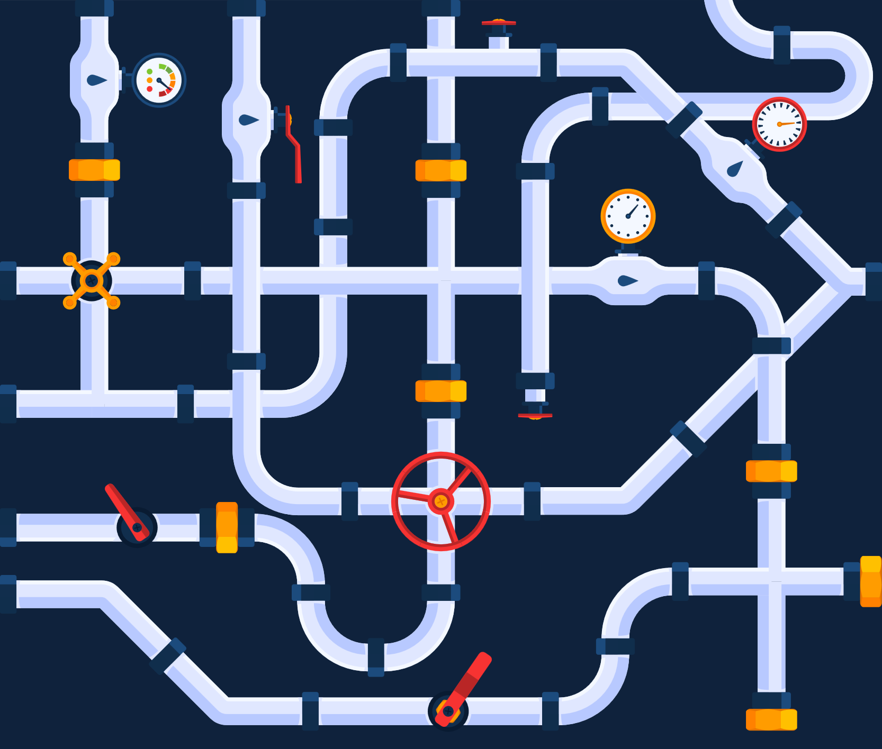
Flow Networks
A directed graph with edge capacities G(V, E, cap)
Edges carry flow, vertices act as junctions
Can model many real-world systems
Fluid pipes and junctions
Ethernet cables and routers
Roads and intersections
Capacities constrain flow
Ɐe ∈ E, flow(e) ≤ capacity(e)
Vectorstock

Slide 3
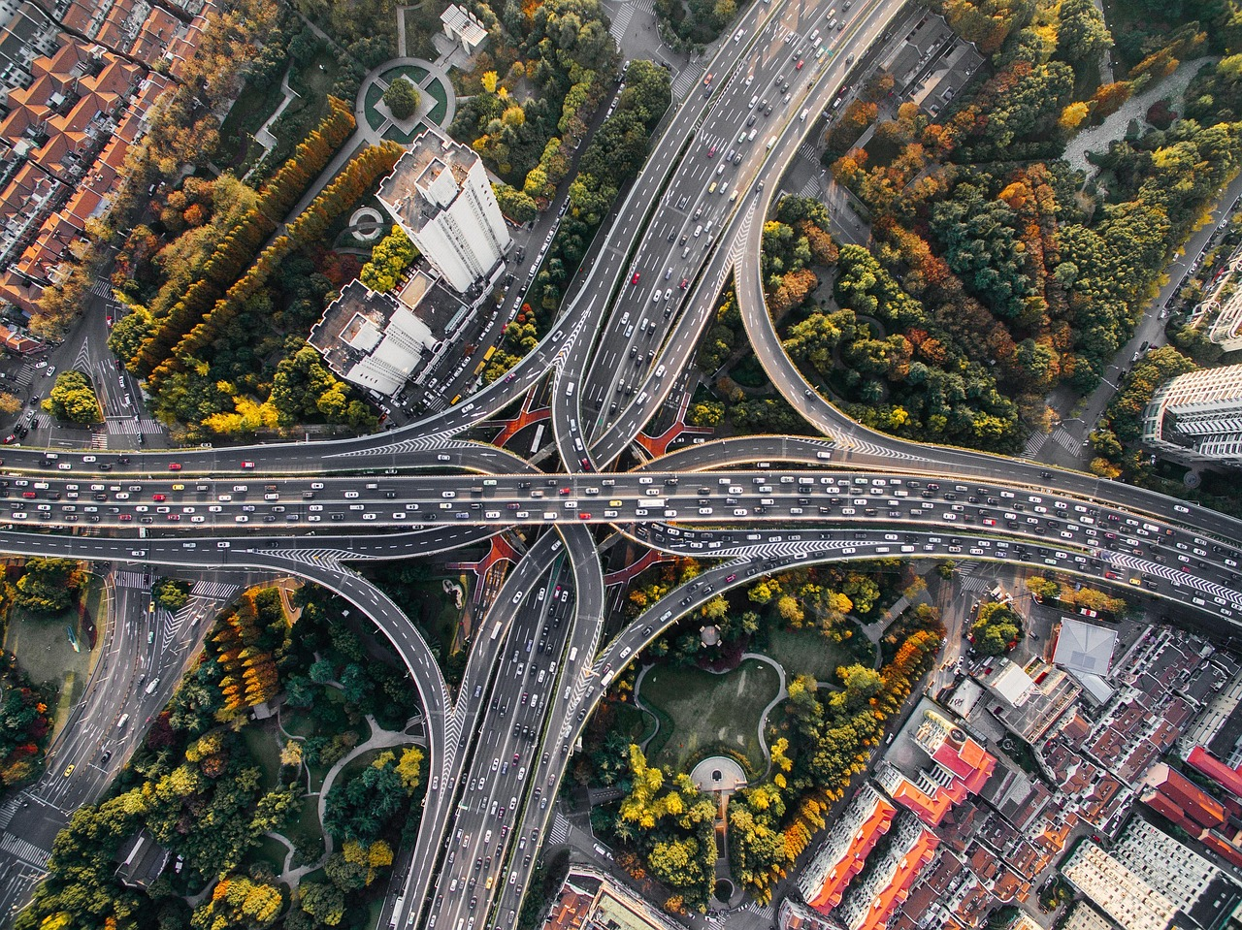
Maximum Flow (Max-Flow)
Maximum possible flow from source s to sink t
E.g., available bandwidth between two routers
Useful in many applications
Optimization
Transportation planning
Minimum cut
Image segmentation
Maximum matching
Pexels/Pixabay

Slide 4
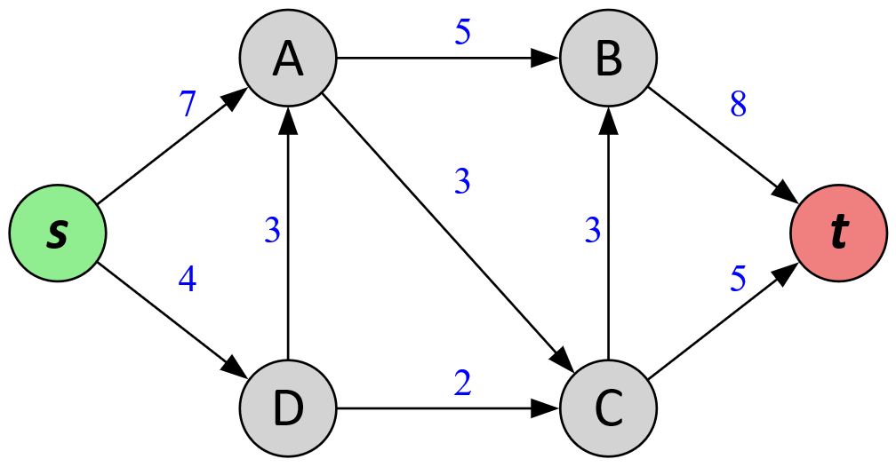
Max-Flow Example
flow/capacity

Slide 5
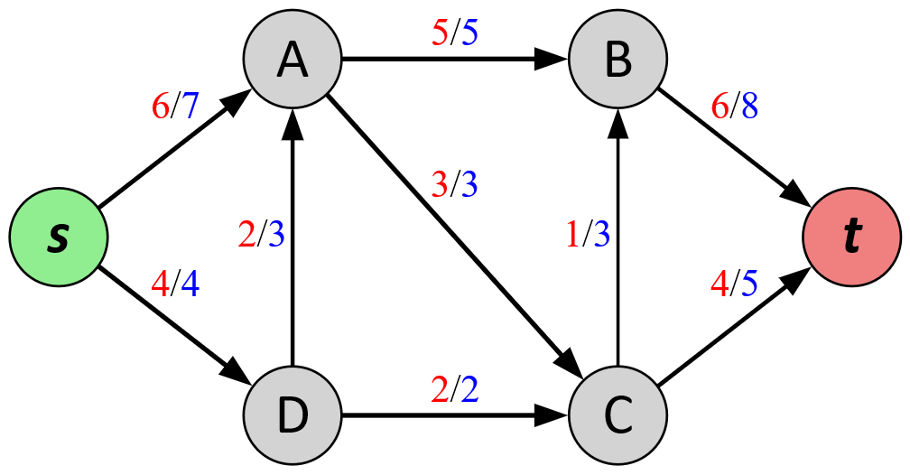
Max-Flow Example
flow/capacity
Max-Flow is 10

Slide 6
Max-Flow Example (Min-Cut)
flow/capacity
Min-Cut is also 10

Slide 7
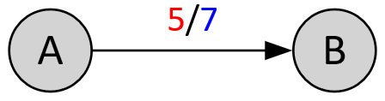
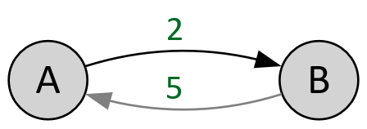
Preflow & Residual Graph
Allow flow to pool at vertices during computation
excess(v) = flow_{in}(v) − flow_{out}(v)
Overflowing vertices have excess > 0
The residual graph G_{f} (V, E_{f} , c_{f} ) shows where excess flow can be moved
For each edge (v, n) ∈ E:
c_{f} (v, n) = capacity(v, n) − flow(v, n) remaining capacity
c_{f} (n, v) = flow(v, n) reversible flow
E_{f} includes all edges with c_{f} > 0
G(V, E): flow/capacity
G_{f} (V, E_{f} ): c_{f} (residual)

Slide 8
Push-Relabel (PR) Algorithm
Main idea
Push as much flow as possible from source vertex s
Iteratively push excess flow across G_{f} until convergence
Use “heights” to guide flow, only push to lower vertices
Phase I: push flow to sink t
Initial heights: distance to sink t via backwards BFS
Phase II: return remaining excess to source s
Initial heights: distance to source s via backwards BFS
Breadth-First Search

Slide 9
Push and Lift Operations
Repeatedly Push or Lift vertices with excess > 0
For a vertex v with excess(v) > 0:
n = v’s minimum-height neighbor in G_{f}
If height(n) < height(v): Push excess to n
Δ = min[excess(v), c_{f} (v, n)]
Else: Lift by relabeling height(v) to height(n) + 1
Looks for an alternative path
Phase II exclusively reduces incoming flow
n = v’s minimum-height neighbor in G_{f} s.t. (n, v) ∈ E

Slide 10
Global Relabeling Heuristic
Height values become outdated as G_{f} changes
Periodically recompute the height labels via BFS
Common frequency: every |V| lift operations
Tradeoff between BFS overhead and work saved
Highly effective, essentially required for fast PR

Slide 11
Related Work
hi_pr¹: serial CPU code, extremely well-optimized
>20 years old, GPU codes still struggle to beat hi_pr
He and Hong² proposed first generic PR for GPU
Gunrock³, Khatri et al.⁴, WBPR⁵, and our code are all based on this lock-free algorithm
WBPR is hybrid, uses CPU when parallelism is low
[1] Cherkassky and Goldberg, "On Implementing Push-Relabel Method for the Maximum Flow Problem," IPCO-4, 1995
[2] He and Hong, “Dynamically tuned push-relabel algorithm for the maximum flow problem on CPU-GPU-hybrid platforms,” IPDPS, 2010
[3] “Gunrock: GPU graph analytics,” URL: https://github.com/gunrock/gunrock/tree/dev/gunrock/app/mf
[4] Khatri et al., “Scaling the maximum flow computation on GPUs,” IJPP, 2022
[5] Hsieh et al., “Accelerating Push-Relabel Algorithm on GPU via Two-Level Parallelism Paradigm and Efficient CSR Designs,” HPEC, 2025

Slide 12
ECL-MAXFLOW Approach

Slide 13
GPU-based BFS
Most prior GPU PR works offload BFS to the CPU
Memory transfer overhead limits scalability
Khatri et al. mark unvisited neighbors, count children, prefix sum, fill next queue in parallel
ECL-MaxFlow fills next queue as it discovers new neighbors by atomically incrementing size
WL_{next}[atomicAdd(WLsize, 1)] = neighbor

Slide 14
Worklists
All prior GPU PR works repeatedly check all vertices
Many extra threads & wasted memory accesses
ECL-MaxFlow’s kernels for PR and BFS use worklists
Only process vertices that likely need computing

Slide 15
Efficiently Avoiding Duplicates
In PR, we check if v was already added to WL_{next}
if (PR_iter != atomicMax(time[v], PR_iter)), add to WL
In BFS, we check if v was already visited this BFS
if (−BFS_ID != atomicMin(time[v], −BFS_ID)), add to WL
Monotonic in opposite directions (+/-)
The shared time array never needs to be reset

Slide 16
Two-level Parallelization
Variation in vertex degree causes load imbalance
32 CUDA threads form a warp
Process vertices in parallel: one warp each
Process neighbors in parallel within each warp
Use warp-level primitives for a parallel reduction to find the minimum-height neighbor
Only WBPR uses a similar two-level scheme for PR
They use shared memory for reduction

Slide 17
Global Relabeling Frequency
Common strategy: global relabel every |V| cycles
A cycle is one attempted push or lift on each vertex
Hardcoded thresholds
He and Hong (4096 cycles)
Stefanes and Alvino, Khatri et al. (100 cycles)
hi_pr accounts for graph density including |E| and weighting the lifts by the vertices’ degrees
We globally relabel every |V|² / (1000*|E|) cycles
Combines |V|, average degree, and a scaling factor

Slide 18
Handling Residual Capacity c_{f}
Prior works store c_{f} for all E_{f}
Pushes must update c_{f} for e and inverse(e)
ECL-MaxFlow stores flow and capacity for E only
Derive c_{f} as-needed based on if edge is in E or not
Pushes only update flow; capacity is constant
Saves an atomic operation for every Push

Slide 19
Experimental Methodology

Slide 20

Codes
1 serial CPU code
hi_pr (extremely fast)
4 GPU codes
Gunrock
Khatri et al.
WBPR-RCSR (hybrid)
ECL-MaxFlow (ours)
Set a 1-hour timeout for each run
Average speedups do not include timeouts

Slide 21
Hardware
System 1
GPU: NVIDIA RTX 4090, 16384 PEs, 24 GB of memory
CPU: Ryzen Threadripper 2950X, 48 GB of memory
System 2 [results in paper]
GPU: NVIDIA A100, 6912 PEs, 40 GB of memory
CPU: Xeon Gold 6226R, 64 GB of memory
System 3 (hi_pr only)
CPU: Ryzen Threadripper 3970X, 256 GB of memory
Notes:
The paper also runs the code on an A100, but we’ll be focusing on the 4090 for this presentation.

Slide 22
Input Set 1: DIMACS
Graph Name | Vertices | Edges | d-avg | d-max
ac_n2000 | 2,000 | 1,999,000 | 999.50 | 1999
3 hidden... | ... | ... | ... | ...
ac_n10000 | 10,000 | 49,995,000 | 4999.50 | 9999
genrmf-long_a32_b256 | 262,144 | 1,276,928 | 4.87 | 5
3 hidden... | ... | ... | ... | ...
genrmf-long_a96_b768 | 7,077,888 | 35,085,312 | 4.96 | 5
genrmf-wide_a64_b64 | 262,144 | 1,290,240 | 4.92 | 5
3 hidden... | ... | ... | ... | ...
genrmf-wide_a192_b192 | 7,077,888 | 35,205,120 | 4.97 | 5
wash...-long_r512_c1024 | 524,290 | 1,572,352 | 3.00 | 512
3 hidden... | ... | ... | ... | ...
wash...-long_r2048_c4096 | 8,388,610 | 25,163,776 | 3.00 | 2048
wash...-wide_r1024_c1024 | 1,048,578 | 3,144,704 | 3.00 | 1024
3 hidden... | ... | ... | ... | ...
wash...-wide_r3072_c3072 | 9,437,186 | 28,308,480 | 3.00 | 3072
25 synthetic directed graphs from 3 DIMACS generators
Acyclic-Dense
Genrmf
Washington-RLG
Used in related work

Slide 23
Input Set 2: Undirected
15 undirected graphs from various sources
DIMACS, Galois, SNAP, SSMC
Use 5 pairs of highest-degree vertices for separate source/sink runs for each graph
Graph Name | Vertices | Edges | d-avg | d-max
2d-2e20.sym | 1,048,576 | 4,190,208 | 4.00 | 4
amazon0312 | 400,727 | 4,699,738 | 11.73 | 2747
as-skitter | 1,694,616 | 22,188,418 | 13.09 | 35455
cit-Patents | 3,764,117 | 33,023,480 | 8.77 | 793
coPapersDBLP | 540,486 | 30,491,458 | 56.41 | 3299
delaunay_n24 | 16,777,216 | 100,663,202 | 6.00 | 26
in-2004 | 1,353,703 | 26,252,344 | 19.39 | 21869
kron_g500-logn21 | 1,543,901 | 182,081,678 | 117.94 | 213904
rgg_n_2_22_s0 | 4,194,299 | 60,718,394 | 14.48 | 36
rmat22.sym | 3,744,385 | 65,618,254 | 17.52 | 3687
soc-LiveJournal1 | 4,843,953 | 85,691,368 | 17.69 | 20333
uk-2002 | 18,459,128 | 523,113,442 | 28.34 | 194955
USA-road-d.E | 3,598,623 | 8,708,058 | 2.42 | 9
USA-road-d.NY | 264,346 | 730,100 | 2.76 | 8
USA-road-d.W | 6,262,104 | 15,119,284 | 2.41 | 9

Slide 24
Results

Slide 25
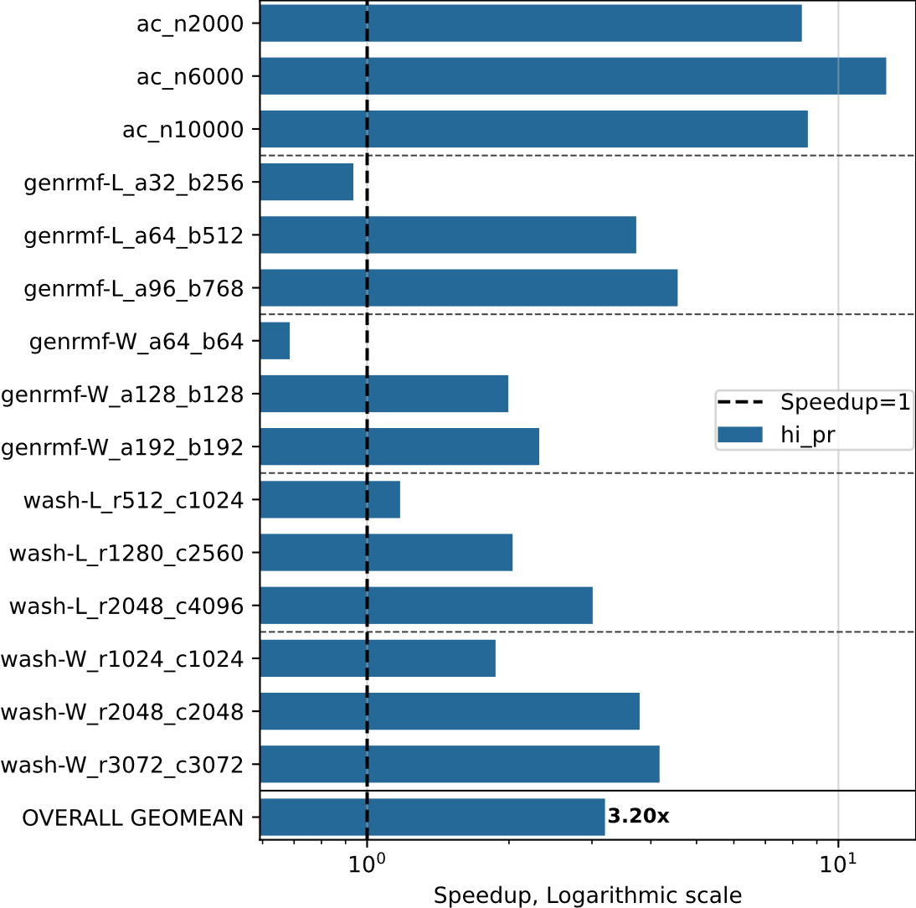
Speedup: ECL-MF vs. hi_pr (CPU)
DIMACS inputs
RTX 4090 vs. Threadripper 3970X
Faster on all but smallest inputs
Speedup increases with size
Scaling w/ input size

Slide 26
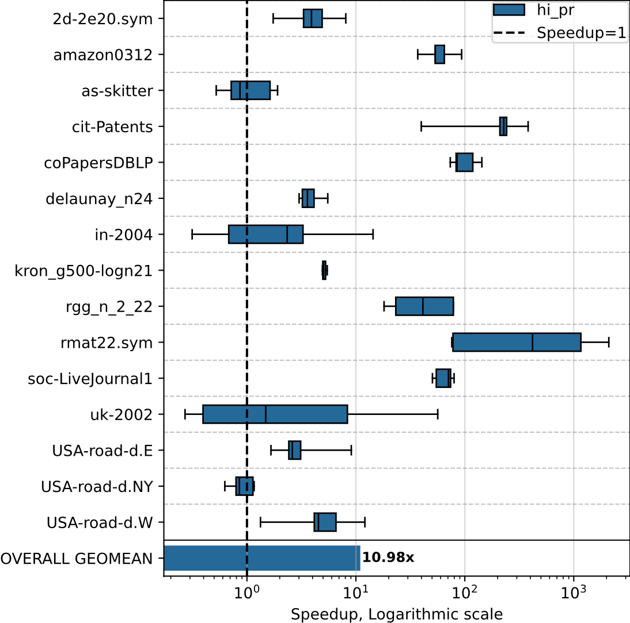
Speedup: ECL-MF vs. hi_pr (CPU)
Undirected inputs
RTX 4090 vs. Threadripper 3970X
Faster on most undirected inputs

Slide 27
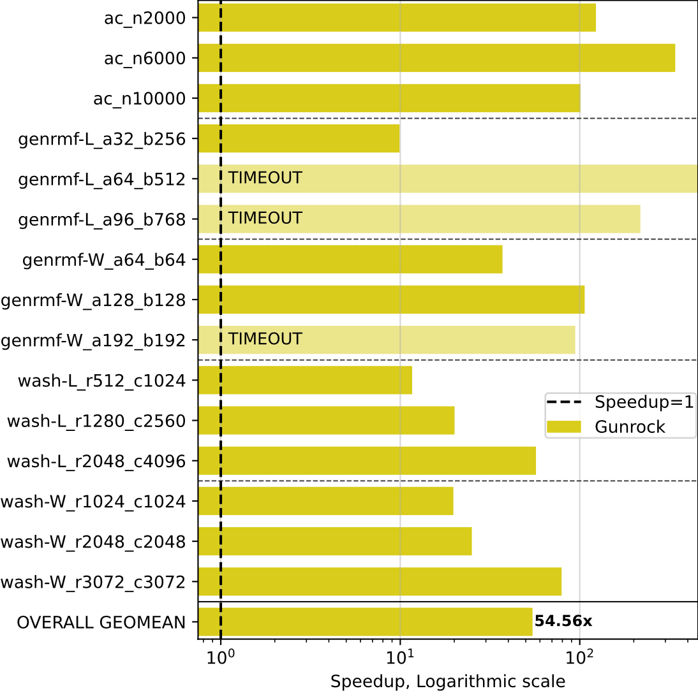
Speedup: ECL-MF vs. Gunrock (GPU)
DIMACS inputs
RTX 4090
Note: Deprecated and contains bug
Faster on all inputs
Gunrock times out on 3 genrmf graphs

Slide 28
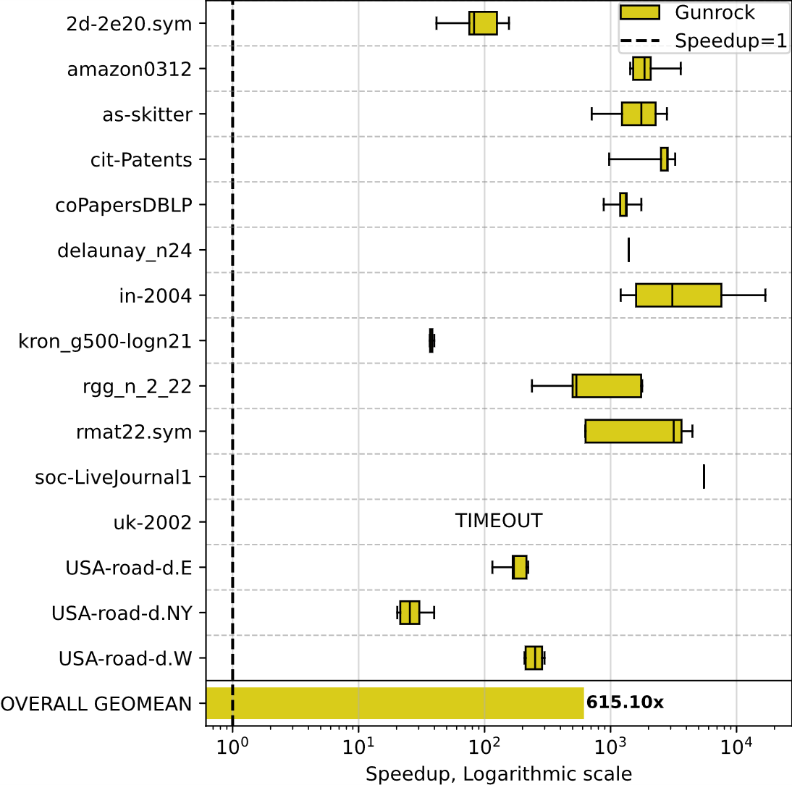
Speedup: ECL-MF vs. Gunrock (GPU)
Undirected inputs
RTX 4090
Note: Deprecated and contains bug
Faster on all inputs
Gunrock times out on largest graph

Slide 29
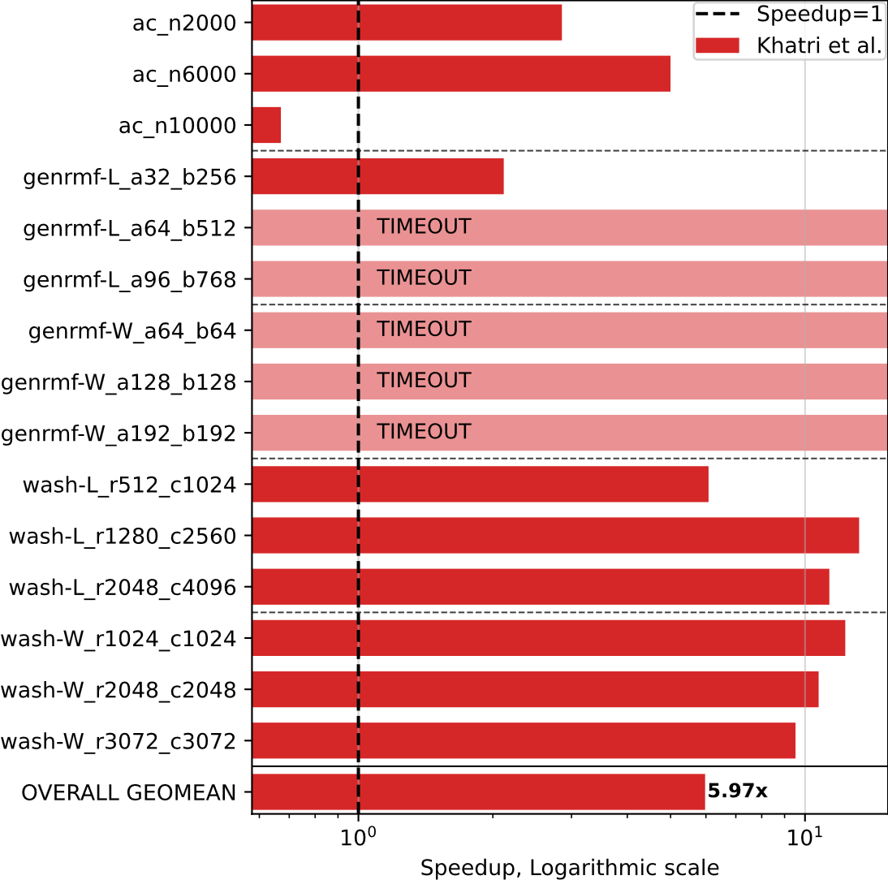
Speedup: ECL-MF vs. Khatri (GPU)
DIMACS inputs
RTX 4090
Faster on all inputs except ac_n10000
Other code times out on most genrmf graphs
Takes us <1 sec
Slowest takes us <39 sec

Slide 30
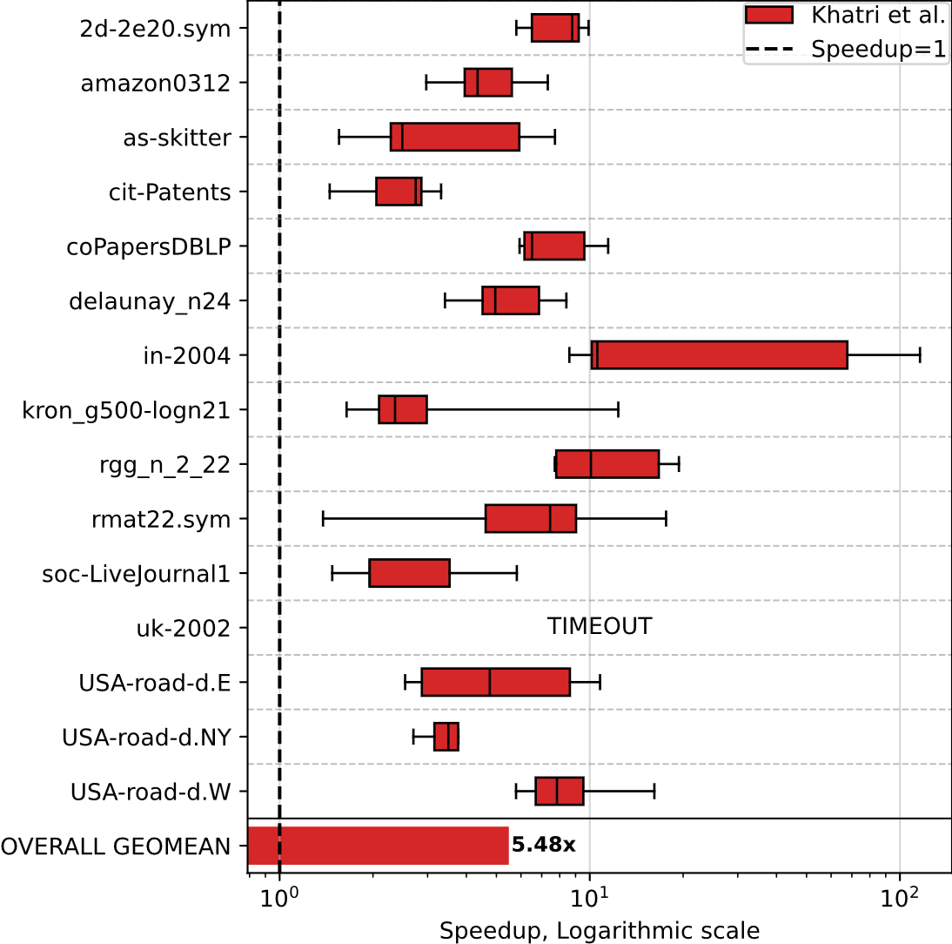
Speedup: ECL-MF vs. Khatri (GPU)
Undirected inputs
RTX 4090
Faster on all inputs
Other code times out on largest graph

Slide 31
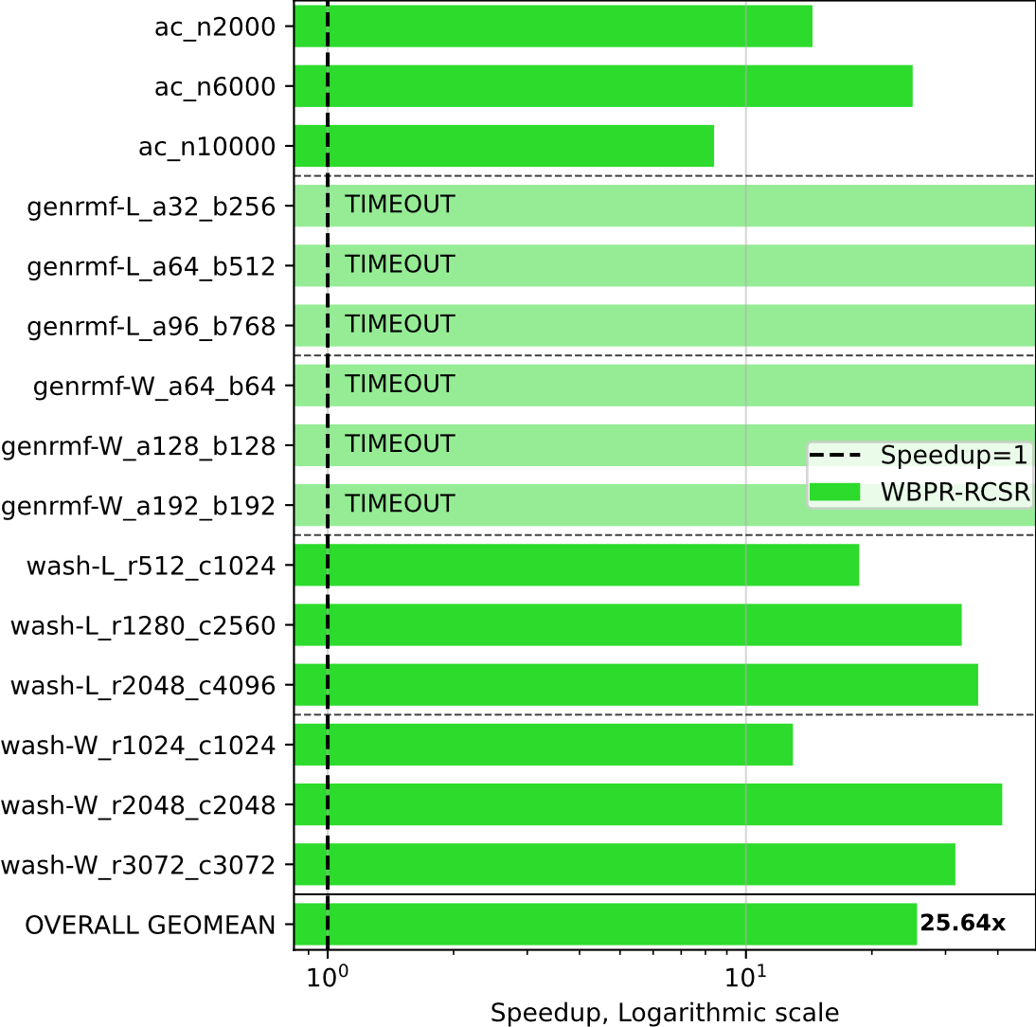
Speedup: ECL-MF vs. WBPR (Hybrid)
DIMACS inputs
RTX 4090
Note: contains unknown bug
Faster on all inputs
WBPR-RCSR times out on all genrmf graphs

Slide 32
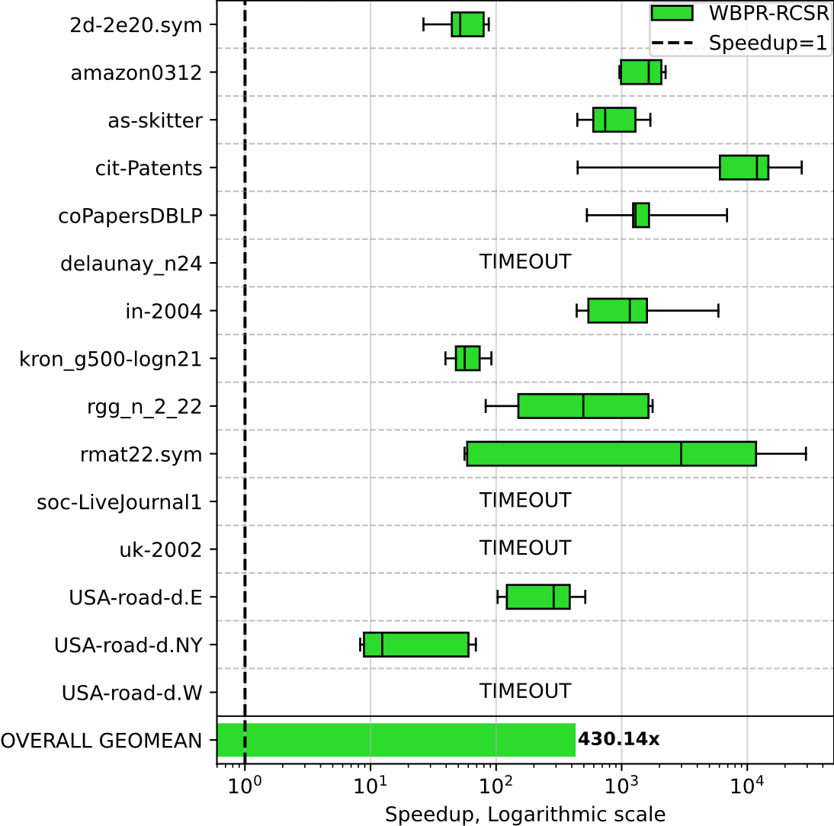
Speedup: ECL-MF vs. WBPR (Hybrid)
Undirected inputs
RTX 4090
Note: contains unknown bug
Faster on all inputs
WBPR-RCSR times out on 4 largest graphs

Slide 33
Summary
ECL-MaxFlow: fastest available PR GPU code
5.1x and 5.8x faster than fastest CPU and GPU codes
Runs Global Relabeling with new frequency
Minimizes wasted work using worklists
Exploits GPU hardware with 2-level parallelization
Acknowledgements: NSF Award #1955367 and NVIDIA
Contact: arv107@txstate.edu
Code + Paper: github.com/burtscher/ECL-MaxFlow

