Slide 1


Omni-Homomorphic Compression for Large Scientific Datasets
Alex Fallin* and Martin Burtscher
Texas State University
San Marcos, Texas, USA

Slide 2
Introduction
Scientific data in HPC environments is becoming too large and being produced too fast
  HACC emits multiple petabytes per simulation
  LHC generates close to a petabyte per second
Lossless compression typically cannot yield high compression ratios on this type of data
Even aggressive lossy compression is insufficient to enable local analysis of petabyte datasets

Slide 3
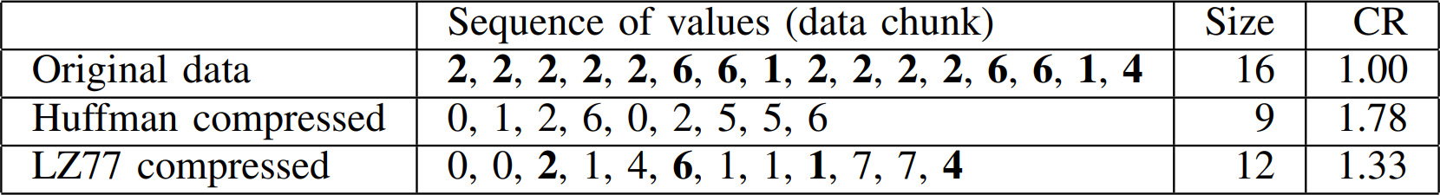
Homomorphic Data Compression
Homomorphic compression can help
  Facilitates direct computation on compressed data
  Either w/o decompression (full homomorphism),
  or w/o full decompression (partial homomorphism)
Higher compression ratio but non-homomorphic
Unique values can be recovered without decompression

Slide 4

Problems with Existing Approaches
Drawbacks of prior homomorphic compressors
  Tied to specific compression algorithms that are slow or do not compress well
  Do not support floating-point data or cannot guarantee the error bound
  Only support a few homomorphic operations
    May not be the ones the user needs
http://cds.cern.ch/record/1996997

Slide 5
Our Solution
Omni-homomorphic compression (oHC)
  1st solution to enable local processing of petabyte data
oHC approach
  Employs an existing fast and effective compression algorithm to maintain speed and compression ratio
  Uses a second separate algorithm to enable almost any user-requested homomorphic operation
  Generates very small indices to enable retrieval of only the important parts of large datasets

Slide 6


oHC Users
Data Providers
  Use compressor to compress main data in chunks
  Generate small index for tracking attributes of interest
  Host the compressed data and indices
Data Consumers
  Download appropriate index from data provider
  Use index to determine chunks of interest from main data
  Download and decompress just those chunks
  Perform local analysis on decompressed data

Slide 7
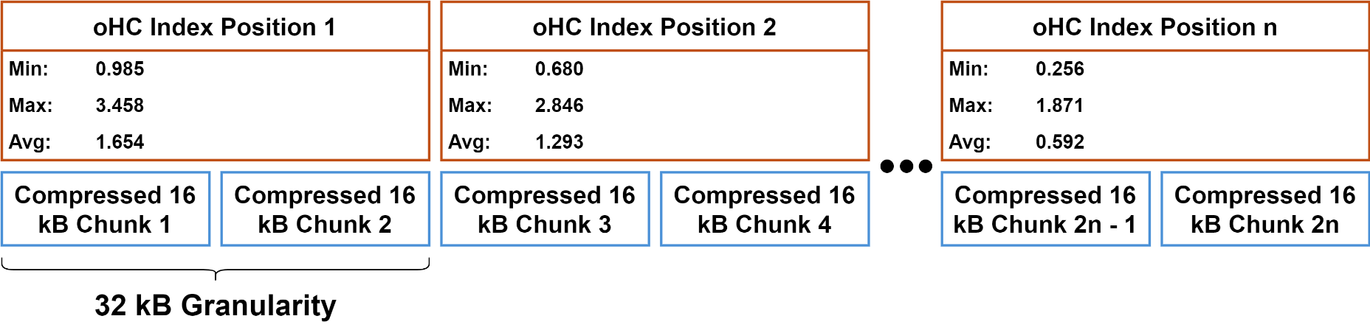
oHC Index Example
Generated by data provider
Contain attributes of interest
  E.g., minimum, maximum, and average of an oHC chunk
Data consumer uses index to find chunks of interest
  E.g., all chunks with values of at least 3.0

Slide 8
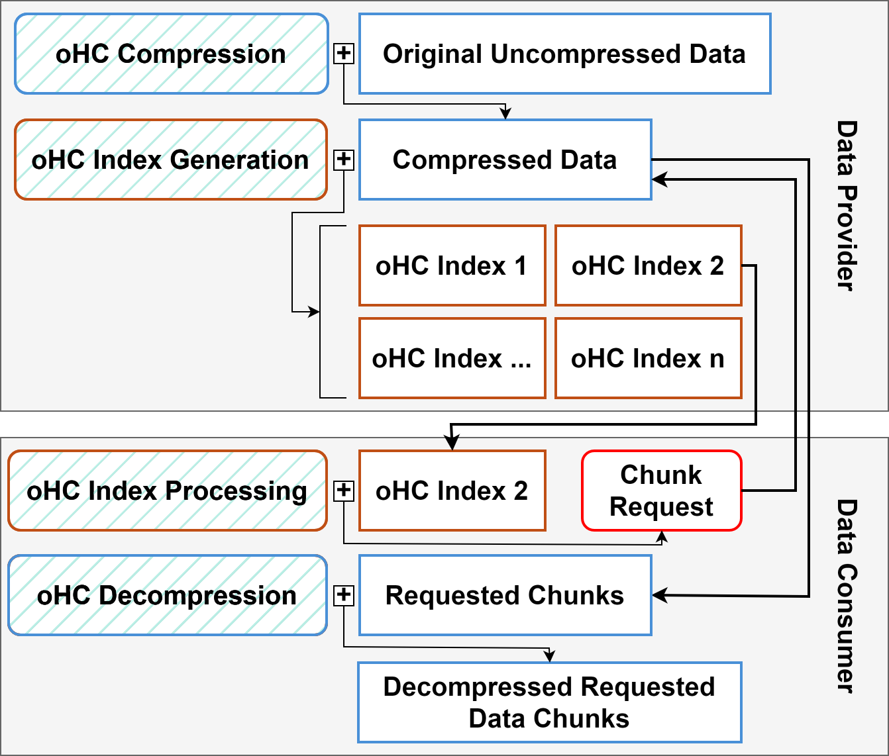
oHC Operation
Large scientific dataset
Compress data and track desired attributes
Multiple indices for different attributes
Download index of interest
Determine and download only desired chunks
Decompress chunks for local analysis

Slide 9


Related Work – PFPL
The lossy compressor used in our oHC code
Guarantees error bound
CPU/GPU compatible
Uses a base chunk size of 16 kB
Quantization plus 3 lossless data transformations
Alex Fallin, Noushin Azami, Sheng Di, Franck Cappello, and Martin Burtscher. Fast and Effective Lossy Compression on GPUs and CPUs with Guaranteed Error Bounds. Proceedings of the 39th IEEE International Parallel and Distributed Processing Symposium. June 2025.

Slide 10
Related Work – Homomorphic
HOCO
  Homomorphic text compression
    Run-length encoding (RLE)
    Lempel Ziv-Welch (LZW)
    Text analytics directly on compression (TADOC)
PyBlaz
  Homomorphic compression for arrays
    Splits arrays then uses discrete cosine transform (DCT)
    DCT coefficients can be homomorphically modified
Jiawei Guan, Feng Zhang, Siqi Ma, Kuangyu Chen, Yihua Hu, Yuxing Chen, Anqun Pan, and Xiaoyong Du. Homomorphic Compression: Making Text Processing on Compression Unlimited. Proc. Manag. Data, 1(4), 2023.
Tripti Agarwal, Harvey Dam, Ponnuswamy Sadayappan, Ganesh Gopalakrishnan, Dorra Ben Khalifa, and Matthieu Martel. What Operations can be Performed Directly on Compressed Arrays, and with What Error? In Proceedings of the SC ’23 Workshops of The International Conference on High Performance Computing, Network, Storage, and Analysis, SC-W ’23

Slide 11
Related Work – Homomorphic
HoSZp
  Augmented PyBlaz to add error bounding
  Supports several homomorphic operations
    Derivative
    Divergence
    Laplacian
    Mean
    Variance
  Only the scalar operations are fully homomorphic
Tripti Agarwal, Sheng Di, Jiajun Huang, Yafan Huang, Ganesh Gopalakrishnan, Robert Underwood, Kai Zhao, Xin Liang, Guanpeng Li, and Franck Cappello. HoSZp: An Efficient Homomorphic Error-bounded Lossy Compressor for Scientific Data, 2024

Slide 12
Related Work – Lossy
SZ2
  Uses Lorenzo prediction and linear regression followed by quantization
  Uses Huffman followed by GZIP after lossy stage
SZ3
  Often produces better compression ratios than SZ2 at similar throughputs
  Modular, lossless stage can be customized (e.g., ZSTD)
  OpenMP enabled
Xin Liang, Sheng Di, Dingwen Tao, Sihuan Li, Shaomeng Li, Hanqi Guo, Zizhong Chen, and Franck Cappello. Error-Controlled Lossy Compression Optimized for High Compression Ratios of Scientific Datasets. In 2018 IEEE International Conference on Big Data (Big Data), pages 438–447, 2018.
Xin Liang, Kai Zhao, Sheng Di, Sihuan Li, Robert Underwood, Ali M. Gok, Jiannan Tian, Junjing Deng, Jon C. Calhoun, Dingwen Tao, Zizhong Chen, and Franck Cappello. SZ3: A Modular Framework for Composing Prediction-Based Error-Bounded Lossy Compressors. IEEE Transactions on Big Data, 9(2):485–498, 2023.

Slide 13
Related Work – Lossy
Boyuan Zhang, Jiannan Tian, Sheng Di, Xiaodong Yu, Yunhe Feng, Xin Liang, Dingwen Tao, and Franck Cappello. FZ-GPU: A Fast and High-Ratio Lossy Compressor for Scientific Computing Applications on GPUs. In Proceedings of the 32nd International Symposium on High-Performance Parallel and Distributed Computing, HPDC ’23, New York, NY, USA, 2023. Association for Computing Machinery.
FZ-GPU
  Uses Lorenzo prediction followed by GPU-friendly multi-byte Huffman coding
cuSZp
  Splits data into blocks, then quantizes and predicts values in non-zero blocks
  Compresses non-zero blocks using fixed-length encoding
Yafan Huang, Sheng Di, Xiaodong Yu, Guanpeng Li, and Franck Cappello. cuSZp: An Ultra-Fast GPU Error-Bounded Lossy Compression Framework with Optimized End-to-End Performance. In Proceedings of the Inter-national Conference for High Performance Computing, Networking, Storage and Analysis, SC’23, Denver, CO,USA, 2023. Association for Computing Machinery.

Slide 14
Related Work – Lossy
Xin Liang, Ben Whitney, Jieyang Chen, Lipeng Wan, Qing Liu, Dingwen Tao, James Kress, David Pugmire, Matthew Wolf, Norbert Podhorszki, and Scott Klasky. MGARD+: Optimizing Multilevel Methods for Error-Bounded Scientific Data Reduction. IEEE Transactions on Computers, 71(7):1522–1536, 2022.
MGARD-X
  Only other compressor to support compatible CPU/GPU compression/decompression
  Uses multigrid hierarchical data refactoring to decompose and recompose data
  Selective loading based on the hierarchy after decomposition to refine accuracy
  Designed for the L₂ norm, but tested with L_{inf} norm
    Supplies point-wise error bounding

Slide 15
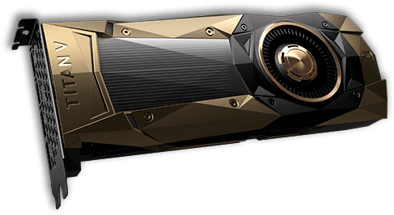
Experimental Methodology
System
  GPU: NVIDIA RTX 4090, 16384 PEs, 128 SMs, 24 GB memory, nvcc 12.0.14
  CPU: AMD Ryzen Threadripper 2950X (16 cores,
  3.5 GHz), gcc 12.2.1
We measure compression ratio and compression/decompression throughput
  Median of 9 runs

Slide 16
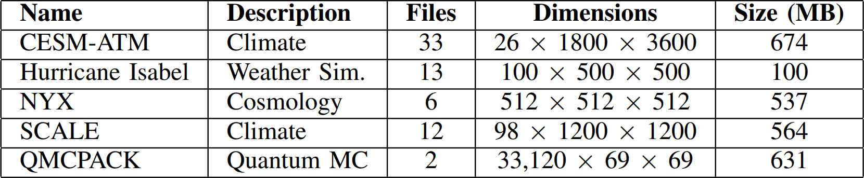
Evaluation Methodology
Use 66 SDRbench floating-point inputs
  From 5 scientific domains
Pointwise normalized absolute error bound
  Absolute error normalized to the data range

Slide 17
Results

Slide 18
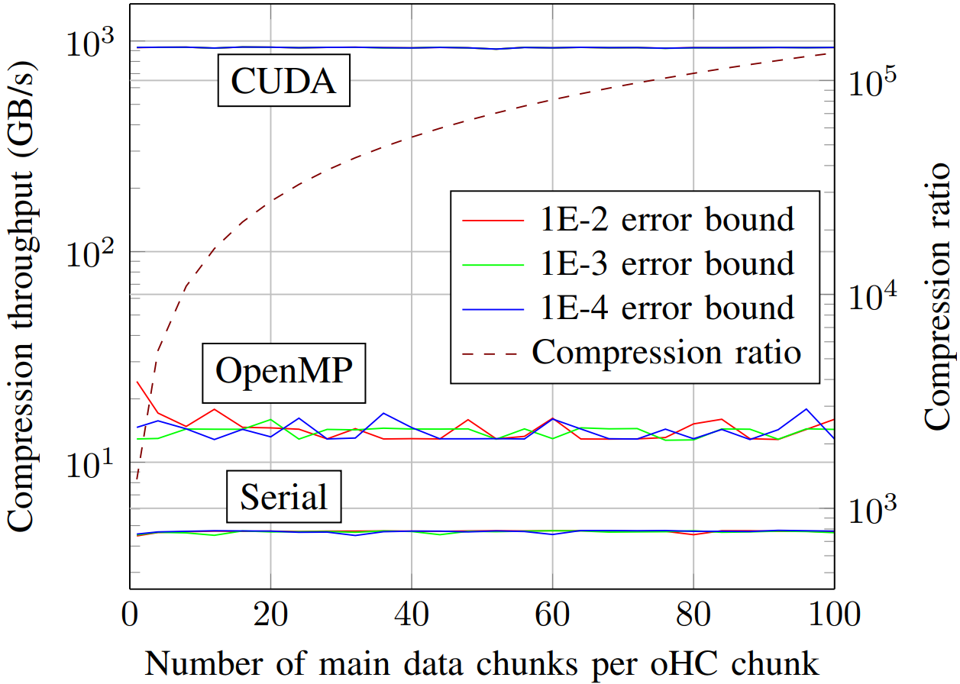
oHC Index Generation
Throughput unaffected by error bound and granularity
Throughput unaffected by EB and granularity
Compression ratio solely determined by granularity
Throughput unaffected by EB and granularity
Separate Y axes

Slide 19
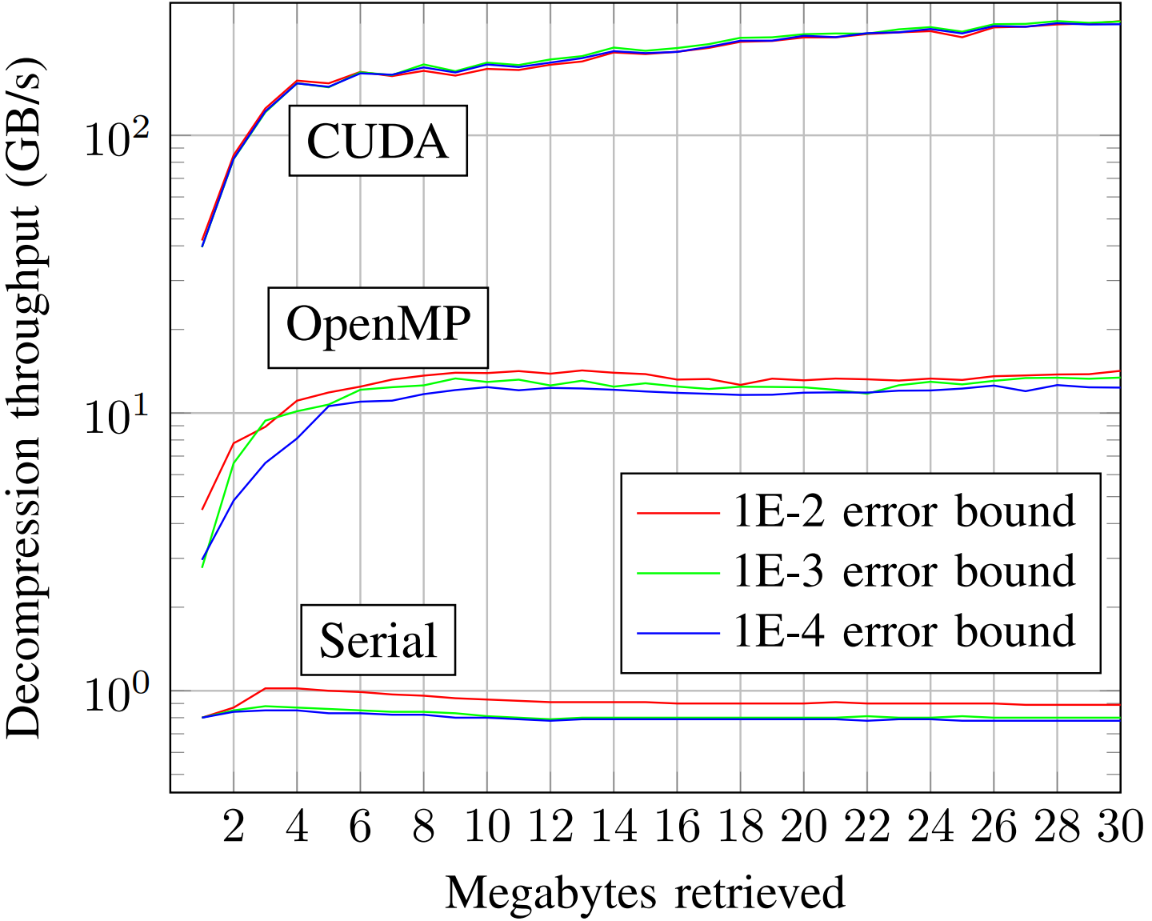
Chunk Decompression
Still increasing, 255 GB/s at 30 MB
Steady throughput of 13 GB/s
Steady at 800 MB/s

Slide 20
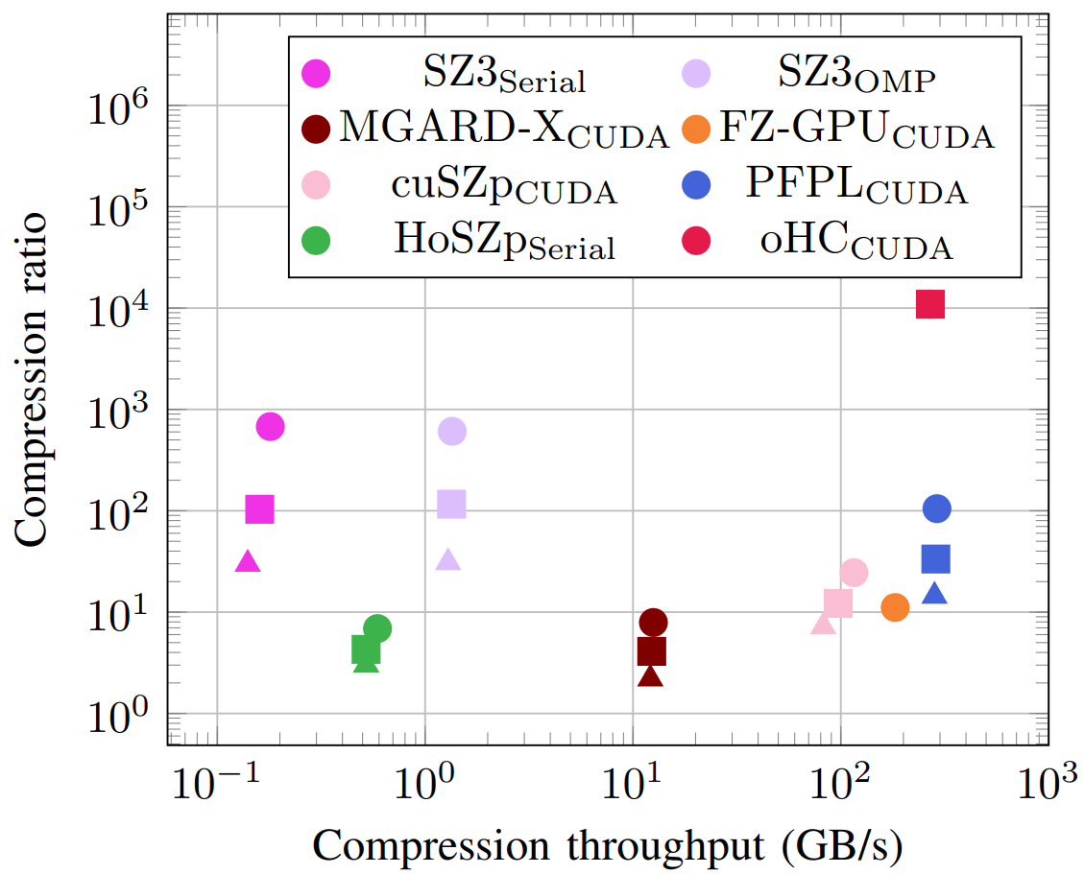
Compression
Only the index file
Error Bounds
1E-2
1E-3
1E-4
Dots stacked: independent of error bound
PFPL is a little faster than oHC
HoSZp compresses 1586x less than oHC
oHC compresses the most by over an order of magnitude

Slide 21
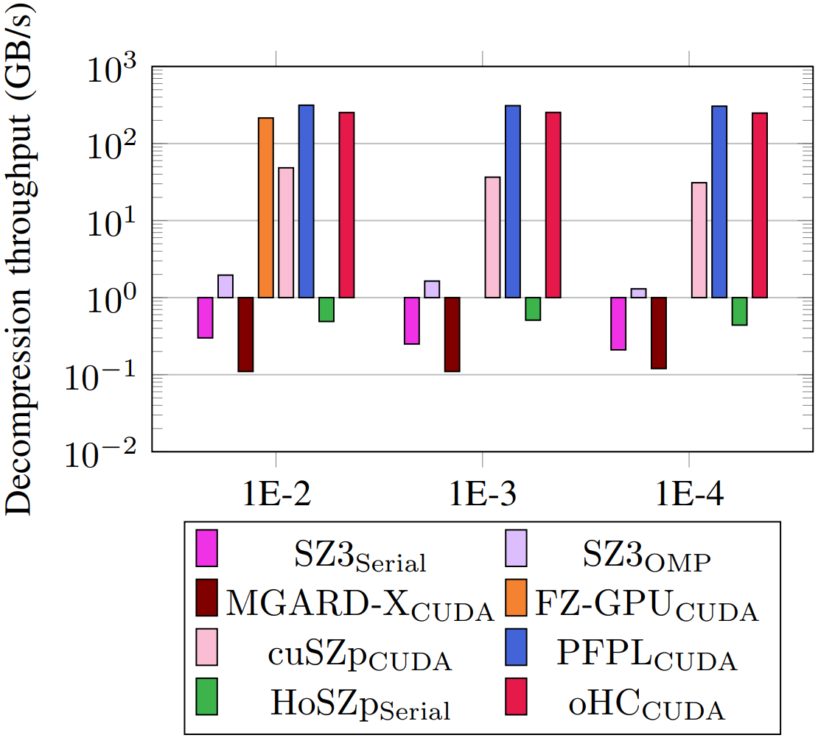
Decompression
oHC is 2nd fastest decompressor
HoSZp is orders of magnitude slower than oHC
Using only 30 MB chunk of input

Slide 22
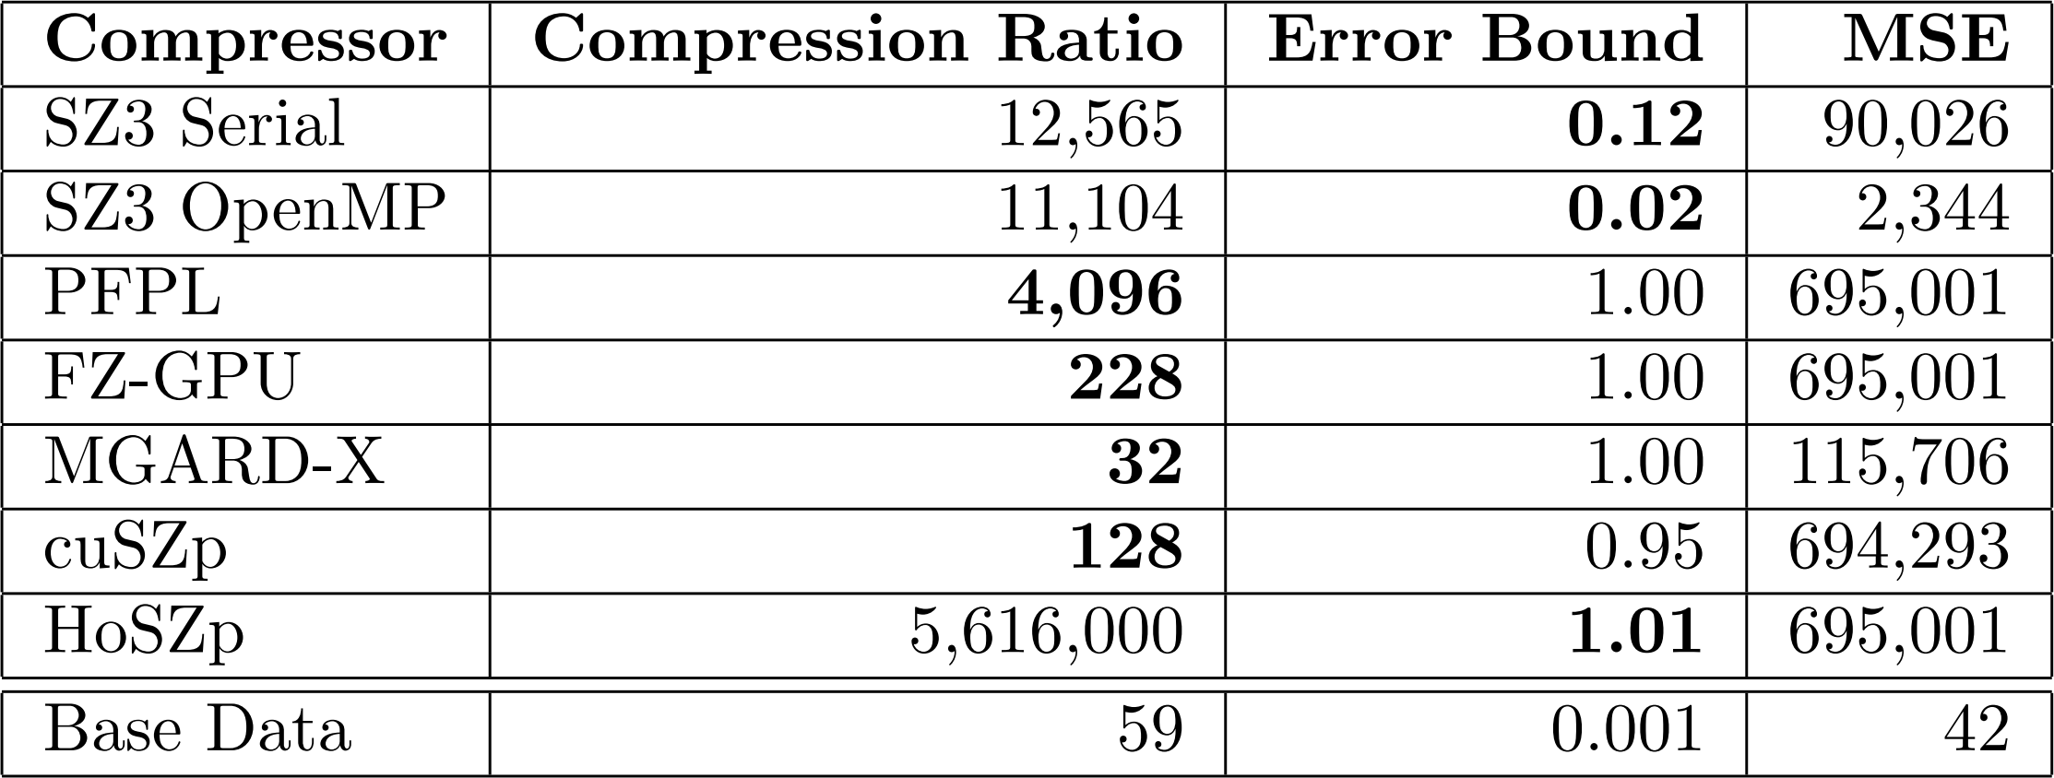
Trying to Match Compression Ratios
Adjusting other compressors to achieve compression ratio of 10,000 to match oHC
Can’t achieve CR of 10,000 due to overhead
Effectively no information left
Much lower error on base data

Slide 23
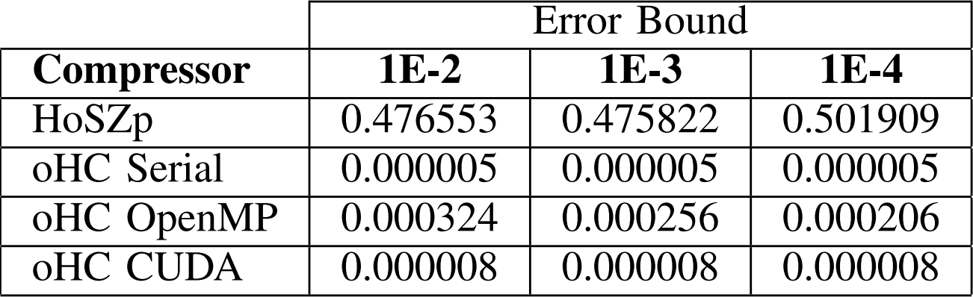
Homomorphic Average Computation
Time required for oHC and HoSZp to homomorphically compute average of dataset
Can’t achieve due to overhead
Error bound makes only small difference
Not much variance with EB
So little work that serial is the fastest
oHC is 95,000x faster

Slide 24
Summary
Pioneered omni-homomorphic compression
  Fast and effective homomorphic compressor
  First approach that enables processing of a petabyte dataset on a local workstation
Highest CR & 2nd highest throughput
Acknowledgements
  DOE
Code available on GitHub
  https://github.com/burtscher/oHC
Contact: waf13@txstate.edu

