Slide 1
A Bidirectional GPU Algorithm for Computing Maximum Matchings
Anju Mongandampulath Akathoott and Martin Burtscher
Department of Computer Science
Texas State University

Slide 2
Problem Setting
Bipartite graph: two disjoint sets of vertices; edges only across sets
Matching: set of vertex-disjoint edges
Maximum matching
Contains maximum possible # of edges
Applications of maximum matching
Job assignment, biological studies, chemical structural analysis, …
Jobs
Applicants
a₁
b₁
a₂
b₂
a₃
b₃
A matching
a₁
b₁
a₂
b₂
a₃
b₃
Maximum matching

Slide 3
Computing Maximum Matchings
Augmenting paths
Start and end in unmatched vertices of opposite sets
Edges must alternate in their matching status
# unmatched edges = # matched edges + 1
Flip the matching status of edges on augmenting path (augmentation step)
|New matching| = |Previous matching| + 1
Repeat until no more augm. paths exist
Always yields a maximum matching
Jobs
Applicants
a₁
b₁
a₂
b₂
a₃
b₃

Slide 4
Augmenting Path Search
The costliest step (uses modified BFS / DFS)
Parallel algorithms (multi-source)
Find vertex-disjoint augmenting paths in parallel
Augment along all of them in parallel
Large graphs with many augmenting paths motivate use of GPUs
a₁
b₁
a₂
b₂
a₃
Not vertex-disjoint
b₃

Slide 5
Augmenting-path GPU Algorithms
Key challenges
Exposing enough parallelism
Path overlaps limit the number of threads that can proceed in parallel
Synchronization can become the bottleneck
Long paths make the path searches slow
Issues amplified if only single-directional searches are used (as in the literature)

Slide 6
ECL-MM – Efficient GPU Algorithm
Employs bidirectional level-synchronous BFS for augmenting path searches
About twice the amount of parallelism
Path of length L identified in around L/2 steps
Smaller search spaces for all threads ⇒ reduced overlap, reduced synchronization
Reuse of bidirectional search trees
Reduces re-computations

Slide 7
Bidirectional Augmenting Path Search
Vertex-disjoint search trees grown via level-synchronous BFS from all unmatched vertices
Check for neighbors belonging to a search tree rooted in the other set
Recording of half-path-ends attempted via 2 atomicCAS operations
Success ⇒ a full augmenting path is found
4 steps in bidirectional search vs 7 steps in single-directional search
a₁
b₁
a₂
b₂
a₃
b₃
a₄
b₄
end[a₁] = b₂
end[b₄] = a₃

Slide 8
Reduced Path Overlaps in Search
Single-directional search
Trees rooted at a₃ and a₆ stop growing due to overlap
Only one useful path
Bidirectional search
b₄ and b₈ are not in the search space of a₂
3 vertex-disjoint paths identified in 4 steps
a₃
b₃
a₄
b₄
a₅
b₅
a₁
b₁
a₂
b₂
a₆
b₆
a₇
b₇
a₈
b₈
a₉
b₉

Slide 9
Reusing Search Trees
Search trees at the end of each iteration
Dead and Active
Clearing all trees
Unnecessary re-computations
ECL-MM retains active trees
Grow them further in next iteration
Tree-Grafting¹
Grafts dead vertices to active trees, but in a different way
Active tree
Ta₂
Tb₂
a₁
b₁
a₂
b₂
a₃
b₃
Ta₄
Tb₅
Dead tree
b₄
a₄
b₅
a₅
b₆
Dead tree
Ta₇
a₆
b₇
a₇
[1] A. Azad, A. Buluc ̧, and A. Pothen, “A parallel tree grafting algorithm for maximum cardinality matching in bipartite graphs,” IPDPS 2015

Slide 10
Evaluation Methodology
Compare with the SOTA GPU & CPU codes
GPU: RTX 4090
16384 CUDA cores, 24 GB global memory
CPU: Ryzen Threadripper 3970X
1 socket, 32 cores per socket, 64 hyperthreads
256 GB main memory
22 input graphs of various sizes, types, degrees
Performance metric: throughput
Edges processed per second

Slide 11
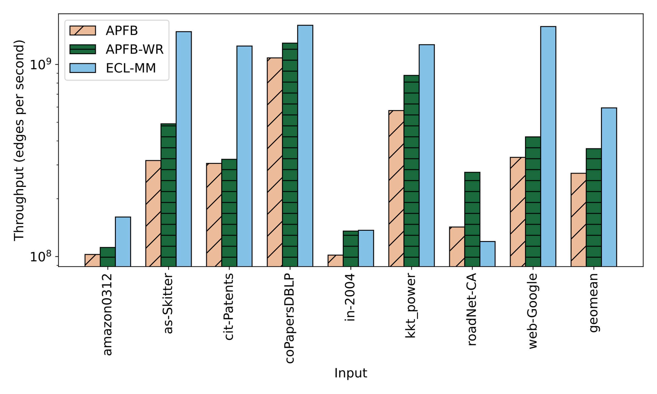
Comparison with SOTA GPU Codes²
Geomean - ECL-MM is 1.63x and 2.18x faster than APFB-WR & APFB
RoadNet-CA: Small graph with small average and maximum degrees
[2] M. Deveci, K. Kaya, B. Uçar, and Ü. V. Çatalyürek, “GPU-accelerated maximum cardinality matching algorithms for bipartite graphs,” in Euro-Par 2013

Slide 12
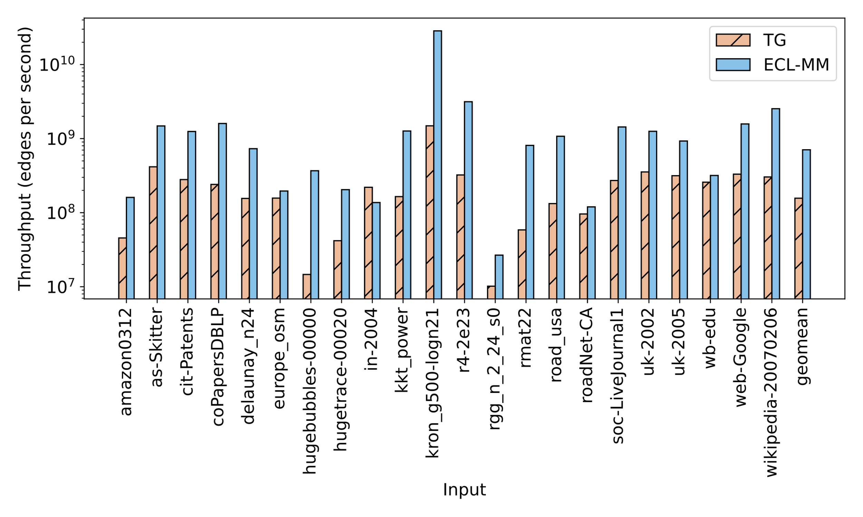
CPU Comparison (Tree Grafting Code)
Geomean
ECL-MM is 4.5x faster than TG
TG run with 31 threads
ECL-MM is faster on almost all inputs

Slide 13
Summary
ECL-MM: fastest maximum matching GPU code
Exposes additional parallelism
Bidirectional search leads to larger frontiers
Avoids re-computations
Reusing trees makes later iterations faster
Reduces thread conflicts
Growing trees only half-way minimizes path overlaps
Acknowledgements: NSF Award No. 1955367
Contact: anju.m.a@txstate.edu
Code available at github.com/burtscher/ECL-MM

