Slide 1


Choosing the Best Parallelization and Implementation Styles for Graph Analytics Codes: Lessons learned from 1106 Programs
Yiqian Liu*, Noushin Azami, Avery VanAusdal,
and Martin Burtscher

Slide 2
Highlights
Describe 13 styles for CPU and GPU graph codes
Combine the styles in 100s of ways and apply them to 6 important graph analytics problems
Evaluate the 1106 resulting codes on 2 GPUs, 2 CPUs, and 5 input graphs from different domains
Analyze the performance and extract guidelines for selecting the best combination of styles

Slide 3

Graph Analytics Codes
Important in many domains
  Social networks
  Search engines
  Recommender systems
  GPS navigators
Have unpredictable data-dependent behavior
  Control flow: while loops (e.g., traversing adjacency list)
  Memory accesses: pointer-chasing operations
https://medium.com/analytics-vidhya/social-network-analytics-f082f4e21b16

Slide 4
Parallelization/Implementation Styles
 | CC | MIS | PR | TC | BFS | SSSP
Number of codes | 240 | 184 | 90 | 96 | 256 | 240
Vertex-based, edge-based | + + | + + | + - | + + | + + | + +
Topology-driven, data-driven | + + | + + | + - | + - | + + | + +
Duplicates on WL, no duplicates on WL | + + | - + | - - | - - | + + | + +
Push, pull | + + | + + | + + | + - | + + | + +
Read-write, read-modify-write | + + | - + | - + | - + | + + | + +
Deterministic, non-deterministic | + + | + + | + + | + - | + + | + +
Persistent, non-persistent | + + | + + | + + | + + | + + | + +
Thread, warp, block | + + + | + + + | + + + | + + + | + + + | + + +
Atomic, cudaAtomic | + + | + + | + + | + + | + + | + +
Global-add, block-add, reduction-add | - - - | - - - | + + + | + + + | - - - | - - -
Atomic-red., critical-red., clause-red. | - - - | - - - | + + + | + + + | - - - | - - -
Default schedule, dynamic schedule | + + | + + | + + | + + | + + | + +
Blocked scheduling, cyclic scheduling | + + | + + | + + | + + | + + | + +

Slide 5
Parallelization Styles
Granularity at which computations are parallelized
Example
  GPUs expose multiple levels of hardware parallelism
Granularity | Benefits | Drawbacks
Thread | Easy to implement | May suffer from load imbalance
Warp | Warp-level primitives | May require complex synchronization
Block | Shared memory | May require complex synchronization

Slide 6
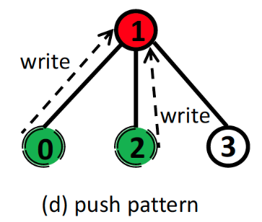
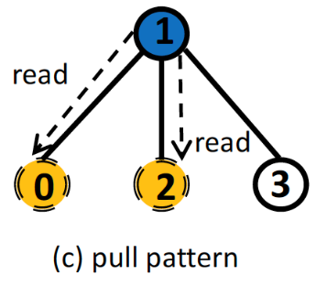
Implementation Styles
Style in which computations are implemented
Example
  Push: updates a neighbor’s data based on private data
  Pull: updates a vertex’s private data based on neighbors’ data
Red: shared write
Green: non-shared read
: active vertex
: data flow
Blue: shared read
Yellow: non-shared write
: active vertex
: data flow

Slide 7
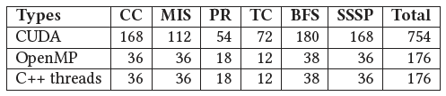
Combinations
Parallelization/implementation styles
  13 sets of alternatives
  Mostly orthogonal and can be combined
    Example
      2 sets: {push, pull} and {thread, warp, block}
      6 combinations: push-thread, push-warp, push-block, pull-thread, pull-warp, and pull-block
  Most styles apply to CPU and GPU codes

Slide 8
13 Parallelization and Implementation Styles in Detail

Slide 9
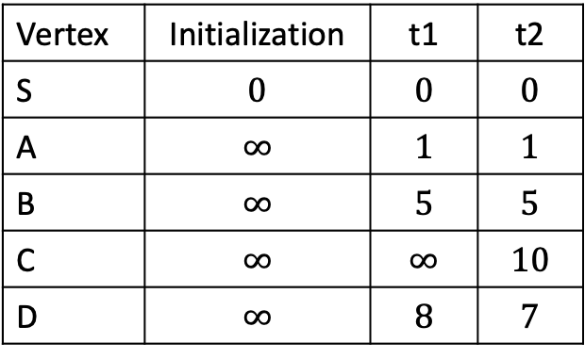
Example: Single-Source Shortest Path
Bellman-Ford SSSP algorithm
  Computes the shortest distance from the source to every vertex for a weighted graph
  Edge (u, v)
    distance[v] = min(distance[u] + weight(u, v), distance[v])
S
Vertex | Initialization | t1 | t2
S | $$0$$ | $$0$$ | $$0$$
A | $$∞$$ | $$1$$ | $$1$$
B | $$∞$$ | $$5$$ | $$5$$
C | $$∞$$ | $$∞$$ | $$10$$
D | $$∞$$ | $$8$$ | $$7$$
1
5
A
8
B
9
2
C
D

Slide 10
Vertex-based vs. Edge-based
Vertex-based
  Process each vertex by iterating over the neighbors to compute a new distance
v = threadIdx.x + blockIdx.x * blockDim.x;
if (v < num_nodes) {
beg = nbr_idx[v];
end = nbr_idx[v + 1];
for (i = beg; i < end; i++) {
u = nbr_list[i];
...
}
}
Edge-based
  Process each edge to compute a new distance for one of its endpoints
e = threadIdx.x + blockIdx.x * blockDim.x;
if (e < num_edges) {
v = src_list[e];
u = dst_list[e];
...
}

Slide 11
Topology-driven vs. Data-driven
Topology-driven
  Process all elements
  More parallelism, easier to implement
v = threadIdx.x + blockIdx.x * blockDim.x;
if (v < num_nodes) {
...
}
Data-driven
  Only process the elements that likely need to be updated (worklist)
  More work efficient
idx = threadIdx.x + blockIdx.x * blockDim.x;
if (idx < worklist_size) {
v = worklist[idx]
...
}

Slide 12
Duplicates vs. No Duplicates
Duplicates on WL
  Put vertex on WL regardless of whether the WL already contains it
idx = atomicAdd(&worklist_size, 1);
worklist[idx] = v;
No duplicates on WL
  Put vertex on WL only if it is not already on the WL
  Eliminates redundant work
  Caps the WL size
  More synchronization overhead
if (atomicMax(&status[v], iteration) != iteration) {
idx = atomicAdd(&worklist_size, 1);
worklist[idx] = v;
}

Slide 13
Push vs. Pull
Push
  Push data to neighbors
  Different threads may update the same neighboring vertex
  Preferred in combination with data-driven style
for (i = beg; i < end; i++) {
u = nbr_list[i];
new_dist = dist[v] + e_weight[i];
atomicMin(&dist[u], new_dist);
}
Pull
  Pull data from neighbors
  One writer per vertex
for (i = beg; i < end; i++) {
u = nbr_list[i];
new_dist = dist[u] + e_weight[i];
atomicMin(&dist[v], new_dist);
}

Slide 14
Read-write vs. Read-modify-write
Read-write
  Independently read and write
  Update must be monotonic
old_dist = atomicRead(&dist[v]);
if (new_dist < old_dist)
atomicWrite(&dist[v], new_dist);
Read-modify-write
  Atomic operation
  Slower and reduces parallelism
atomicMin(&dist[v], new_dist);

Slide 15
Non-deterministic vs. Deterministic
Internally non-deterministic
  Ultimate result is deterministic
  Unpredictable number of iterations to converge
new_dist = dist[v] + edge_weight;
atomicMin(&dist[u], new_dist);
Deterministic
  Fixed number of iterations
  Simplifies debugging
  May slow down the program
new_dist = dist1[v] + edge_weight;
atomicMin(&dist2[u], new_dist);

Slide 16
Persistent vs. Non-persistent
Persistent
  As many threads as the GPU can concurrently schedule
  Precompute or preload data may improve performance
num_threads = blockDim.x * gridDim.x;
idx = threadIdx.x + blockIdx.x * gridDim.x;
for (v = idx; v < num_nodes; v += num_threads) {
...
}
Non-persistent
  Assign no more than one vertex to each thread
  Easier to implement
v = threadIdx.x + blockIdx.x * blockDim.x;
if (v < num_nodes) {
...
}

Slide 17
Thread vs. Warp vs. Block
Thread
  Each thread processes an
  entire neighbor list
beg = nbr_idx[v];
end = nbr_idx[v + 1];
for (i = beg; i < end; i++) {
...
}
Warp
  32 threads in a warp simultaneously operate on neighbors of a vertex
lane = threadIdx.x % warpSize;
beg = nbr_idx[v];
end = nbr_idx[v + 1];
for (i = beg + lane; i < end; i += warpSize) {
...
}
Block
  Entire block processes one
  neighbor list
beg = nbr_idx[v];
end = nbr_idx[v + 1];
for (i = beg + threadIdx.x; i < end; i += blockDim.x) {
...
}

Slide 18
Atomic vs. CudaAtomic
Atomic
  Atomic functions
  Only for GPU codes
__global__ type dist[...];
...
atomicMin(&dist[u], new_dist);
CudaAtomic
  Recent libcu++ library
  For both CPU & GPU code
  Data type, memory-ordering, and scope
__global__ cuda::atomic<type> dist[...];
...
dist[u].fetch_min(new_dist);

Slide 19
GPU Reduction Styles
Global-add
  Update a global variable
atomicAdd(&counter, value);
Block-add
  Block solution → global solution
  Shared memory, fewer global atomics
atomicAdd_block(&block_counter, value);
__syncthreads(); // block barrier
if (threadIdx.x == 0) {
atomicAdd(&counter, block_counter);
}
warp_counter = warp_reduction(value);
__syncthreads(); // block barrier
block_counter = block_reduction(warp_counter);
__syncthreads(); // block barrier
if (threadIdx.x == 0) {
atomicAdd(&counter, block_counter);
}
Reduction-add
  Warp solution → block solution → global solution

Slide 20
CPU Reduction Styles
Atomic-reduction
  Atomic operations
#pragma omp atomic
sum += val;
Critical-reduction
  Critical section
#pragma omp critical
sum += val;
Clause-reduction
  OpenMP reduction clause
#pragma omp parallel for reduction(+: sum)
for (i = beg; i < end; i++) {
...
sum += val;
}

Slide 21
Default vs. Dynamic Schedule
Default scheduling
  OpenMP statically assigns each thread a chunk of iterations
#pragma omp parallel for
for (v = 0; v < num_nodes; v++) {
...
}
Dynamic scheduling
  Assigns iterations at runtime
  Maintains a worklist, incurs overhead
  Improves load balance
#pragma omp parallel for schedule(dynamic)
for (v = 0; v < num_nodes; v++) {
...
}

Slide 22
Blocked vs. Cyclic Scheduling
Blocked scheduling
  Assigns a contiguous block of iterations
  Load imbalance, better data locality in CPUs
beg = threadID * num_nodes / num_threads;
end = (threadID + 1) * num_nodes / num_threads;
for (v = beg; v < end; v++) {
...
}
Cyclic scheduling
  Assigns iterations in a round-robin fashion
  Better coalescing on GPUs
for (v = threadID; v < num_nodes; v += num_threads) {
...
}

Slide 23
Experimental Methodology

Slide 24
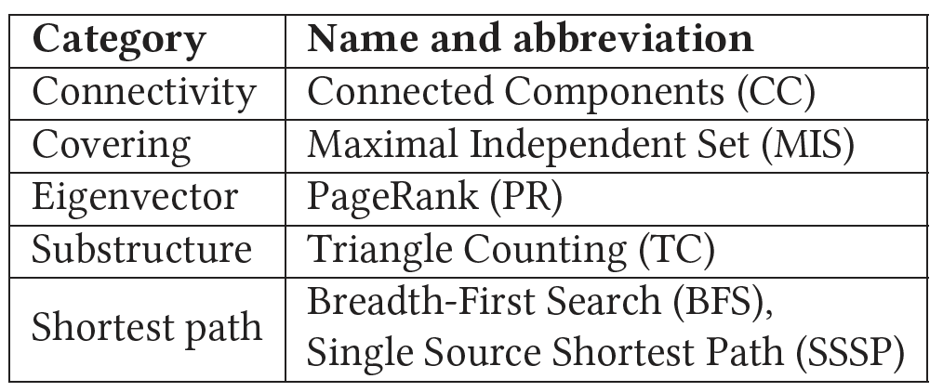
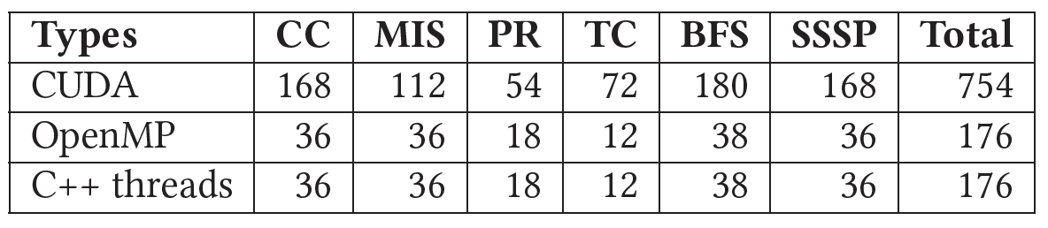
Graph Analytics Codes
6 graph problems
1106 codes

Slide 25
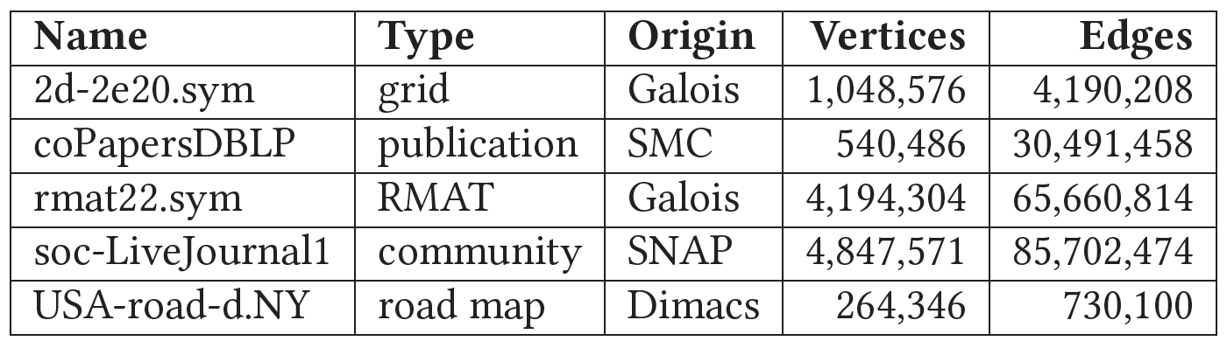
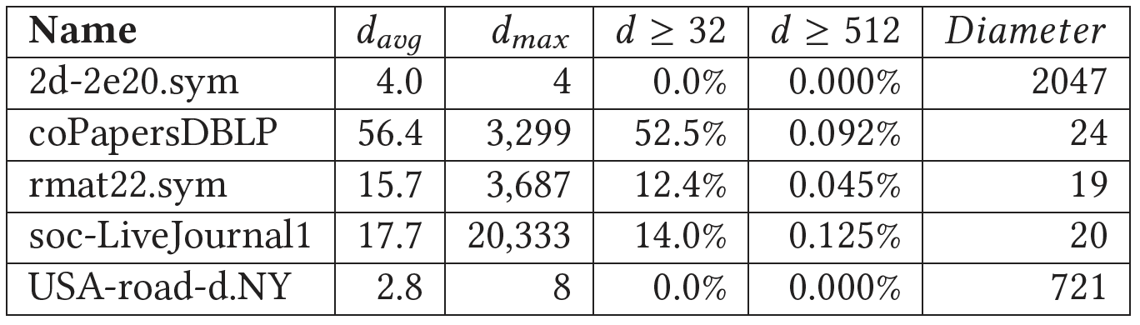
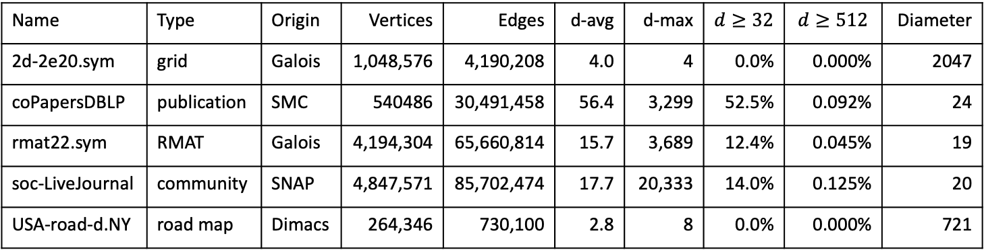
Inputs
5 graphs of various types, origins, sizes, and degree distributions
Name | Type | Origin | Vertices | Edges | d-avg | d-max | $$d≥32$$ | $$d≥512$$ | Diameter
2d-2e20.sym | grid | Galois | 1,048,576 | 4,190,208 | 4.0 | 4 | 0.0% | 0.000% | 2047
coPapersDBLP | publication | SMC | 540486 | 30,491,458 | 56.4 | 3,299 | 52.5% | 0.092% | 24
rmat22.sym | RMAT | Galois | 4,194,304 | 65,660,814 | 15.7 | 3,689 | 12.4% | 0.045% | 19
soc-LiveJournal | community | SNAP | 4,847,571 | 85,702,474 | 17.7 | 20,333 | 14.0% | 0.125% | 20
USA-road-d.NY | road map | Dimacs | 264,346 | 730,100 | 2.8 | 8 | 0.0% | 0.000% | 721

Slide 26
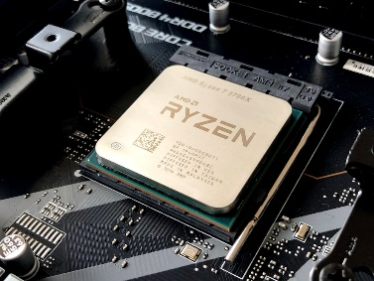
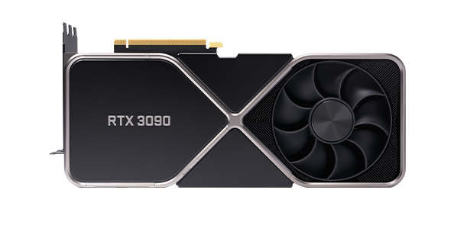
Hardware
System 1
  3.5 GHz Ryzen Threadripper 2950X CPU
    16 hyperthreaded cores
  1.2 GHz TITAN V GPU
    5120 PEs distributed over 80 SMs
System 2
  Dual 2.9 GHz Xeon Gold 6226R CPUs
    32 hyperthreaded cores
  1.74 GHz RTX 3090 GPU
    10,496 PEs distributed over 82 SMs

Slide 27



Software
CPU codes
  GCC 11.3.1
  “-O3 -fopenmp” flags for OpenMP
  “-O3 -pthread” flags for C++ codes
CUDA codes
  NVCC 11.7 with the “-arch=sm_70” for system 1
  NVCC 11.6 with the “-arch=sm_86” for system 2

Slide 28
Metrics
Throughput
  Giga-edges per second (number of edges in the graph divided by the runtime and then divided by a billion)
Throughput ratio
  To compare the throughputs of 2 alternatives
    Push-thread / pull-thread
    Push-warp / pull-warp
    Push-block / pull-block

Slide 29
Results

Slide 30
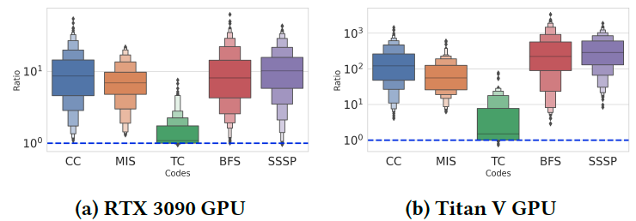
Atomic and CudaAtomic
Atomic versions are generally much faster

Slide 31
Atomic and CudaAtomic
Atomic versions are generally much faster
Atomic versions are generally much faster
Median: 10× on RTX 3090, 100× on Titan V
CudaAtomic default settings slow down the programs, especially on Titan V

Slide 32
Atomic and CudaAtomic
Atomic versions are generally much faster
Median: 10× on RTX 3090, 100× on Titan V
CudaAtomic default settings slow down the programs, especially on Titan V
TC only contains atomic add operation, other programs frequently use load() and store()

Slide 33
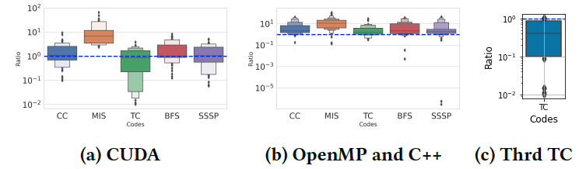
Vertex-based and Edge-based
Some codes (e.g., MIS) generally fare better with a vertex-based style
Many codes prefer vertex-based style on the CPU but not on the GPU
Edge-based simplifies load balancing

Slide 34
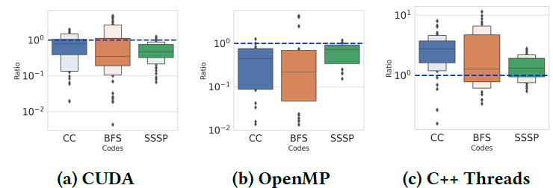
Topology-driven and Data-driven (with duplicates on WL)
CUDA and OpenMP prefer duplicates on the WL
C++ Threads prefers topology-driven
Slower critical min and max operations for OpenMP

Slide 35
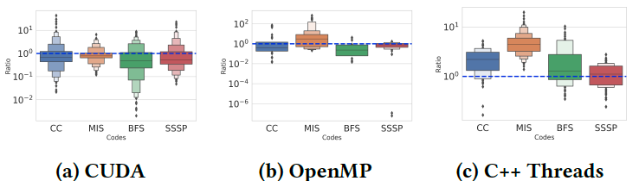
Topology-driven and Data-driven (without Duplicates on WL)
GPU and OpenMP prefer no duplicates on the WL (except MIS OpenMP)
Data-driven tends to be better on GPUs, but topology-driven can yield high speedups in some cases (e.g., low-diameter graphs)

Slide 36
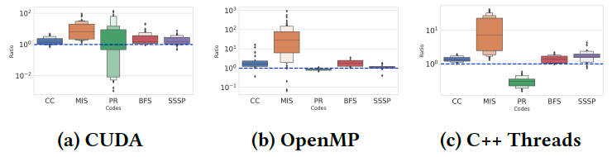
Push and Pull
Push performs better (except PR C++ Threads)
Push style combines better with data-driven style
PR does not have data-driven implementations
PR only includes deterministic push styles

Slide 37
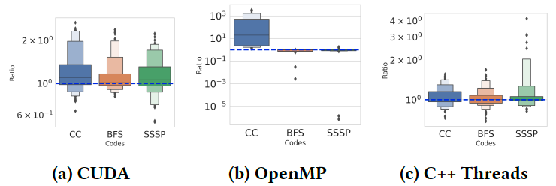
Read-write and Read-modify-write
Read-write is slightly faster (speedup is greater on CPU)
Recommend read-modify-write because it is more general (applicable to more codes)

Slide 38
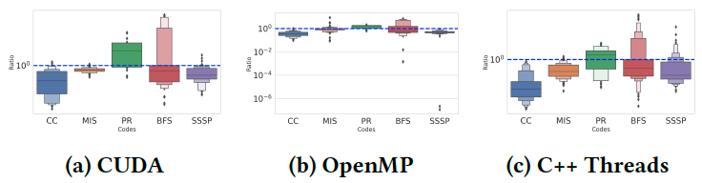
Deterministic and Non-deterministic
Non-deterministic performs better (except PR)
Deterministic is easier for debugging
Half of the PR codes do not include non-deterministic styles

Slide 39
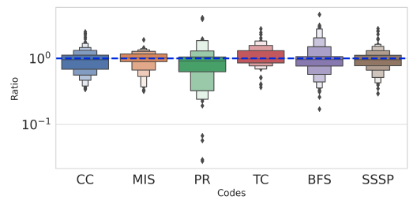
Persistent and Non-persistent
Most ratios are close to 1.0
Recommend persistent style only when there is significant work that can be performed once and reused for multiple vertices or edges
Advantage of the persistent style cannot be exploited in our graph codes

Slide 40
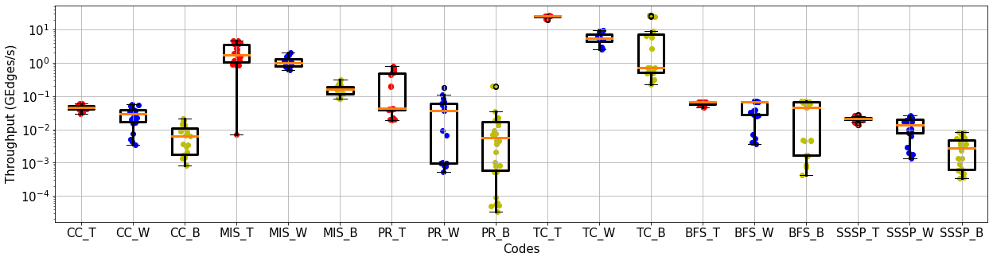
Thread, Warp, and Block
Performance is highly correlated with the degree distribution of the input graph
Thread-based provides highest performance for low-degree and relatively uniform-degree distributions

Slide 41
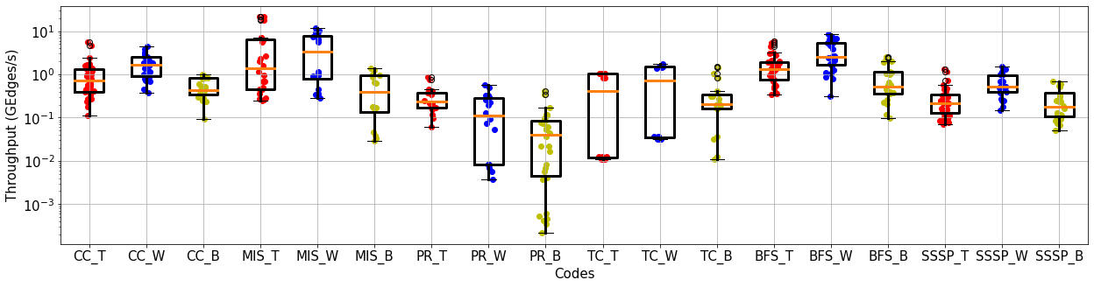
Thread, Warp, and Block
Performance is highly correlated with the degree distribution of the input graph
Block is the slowest because none of our inputs have a significant number of vertices with a degree of over 512 (i.e., the number of threads per block)
Warp-based yields best performance for scale-free graphs (high average degree or a few vertices have high degree)

Slide 42
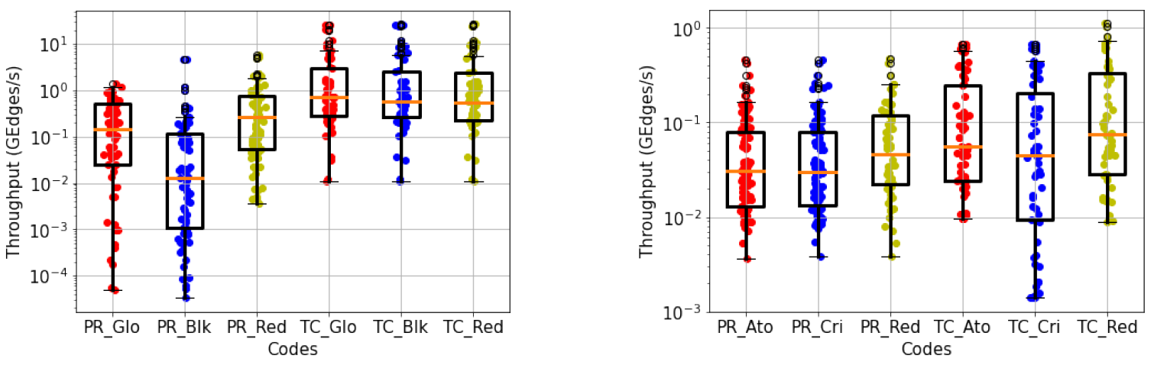
Reduction Styles
GPU reduction styles
  Block-add tends to be the slowest and reduction-add is the fastest for PR
CPU reduction styles
  Clause-reduction achieves the highest throughput

Slide 43
Reduction Styles
GPU reduction styles
  Block-add tends to be the slowest and reduction-add is the fastest for PR
CPU reduction styles
  Clause-reduction achieves the highest throughput

Slide 44
Reduction Styles
GPU reduction styles
  Block-add tends to be the slowest and reduction-add is the fastest for PR
CPU reduction styles
  Clause-reduction achieves the highest throughput

Slide 45
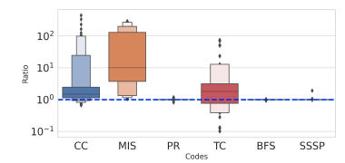
Default and Dynamic Scheduling
No difference for PR, BFS, and SSSP
MIS always faster with the default scheduling
Dynamic scheduling: load balancing, more overhead

Slide 46
Default and Dynamic Scheduling
No difference for PR, BFS, and SSSP
MIS always faster with the default scheduling
Dynamic scheduling: load balancing, more overhead
Load balancing is unnecessary, and the overhead makes the dynamic schedule slower

Slide 47
Blocked and Cyclic Scheduling
Does not affect CC, MIS, BFS, and SSSP
PR prefers a blocked schedule, TC prefers cyclic
Scheduling: important, depending on loop characteristics

Slide 48
Blocked and Cyclic Scheduling
Does not affect CC, MIS, BFS, and SSSP
PR prefers a blocked schedule, TC prefers cyclic
Scheduling: important, depending on loop characteristics

Slide 49
Blocked and Cyclic Scheduling
Does not affect CC, MIS, BFS, and SSSP
PR prefers a blocked schedule, TC prefers cyclic
Scheduling: important, depending on loop characteristics

Slide 50
Best Performing Styles
What percentage of the best-performing codes use the style of the given column
Vertex-based, push, and non-deterministic dominate the best-performing styles
C++ prefers topo-driven, others prefer data-driven

Slide 51
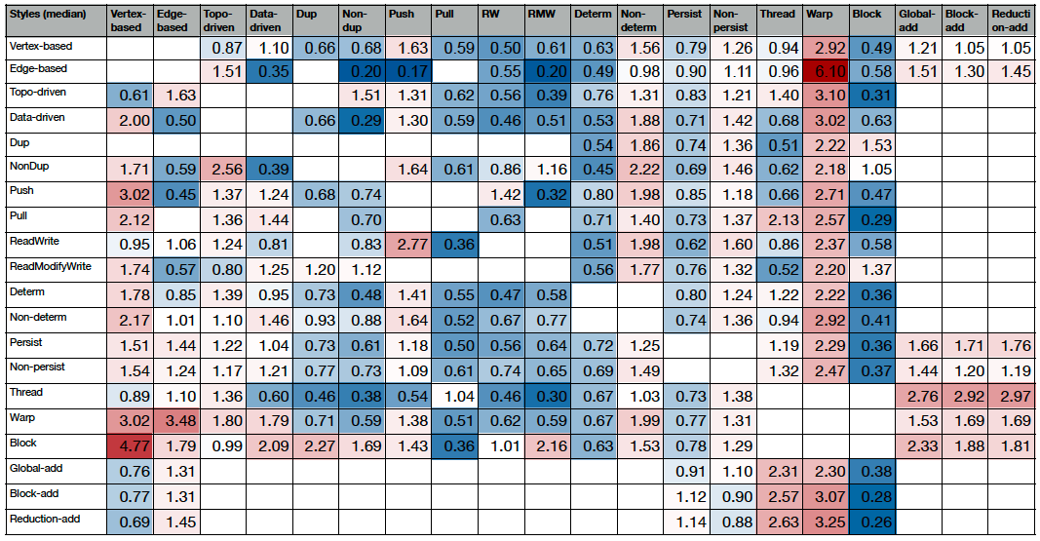
Style Combinations
“Warmer” shading indicates a higher performance improvement

Slide 52
Style Combinations
Combining push, non-deterministic, and non-persistent

Slide 53
Style Combinations
No general preference for the vertex/edge, topo/data, dup/non-dup, RW/RMW pairs

Slide 54
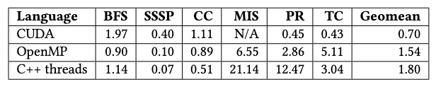
Comparison with Baseline
Baseline codes: Lonestar CPU and Gardenia
The optimized baseline codes do not outperform our codes in many cases
Speedup over baseline codes:

Slide 55
Summary
Graph analytics codes exhibit irregular behavior
  Makes efficient implementation challenging
Can be implemented in many different styles
In contrast to specific code optimizations, this work focuses on general parallelization and implementation styles that are broadly applicable

Slide 56
Summary and Conclusions
Extracted 13 sets of styles from various irregular codes and applied them to 6 graph problems
  Created benchmark suite with 2212 codes
Evaluated 1106 codes (32-bit data-type) on
2 GPUs and 2 CPUs using 5 input graphs
Selecting the wrong style can easily yield a 10× slowdown on average, especially on GPUs

Slide 57
Programming Guidelines
Help programmers write efficient parallel codes
  Outline what styles work well under what conditions
We recommend using non-deterministic and push styles
Some styles should be avoided, if possible, e.g., critical sections and default cudaAtomics

Slide 58
Programming Guidelines (cont.)
Edge-based tends to yield better performance when combined with topo-driven in CUDA
We recommend non-persistent for CUDA since persistent does not always improve performance
We suggest using default/blocked during development and then testing other schedules

Slide 59




Thank you!
Acknowledgments
  NSF, NVIDIA, Ganesh Gopalakrishnan, and John Jacobson
Contact information
  y_l120@txstate.edu
Web page (link to paper and benchmark suite)
  https://github.com/burtscher/Indigo2Suite.git

