Slide 1
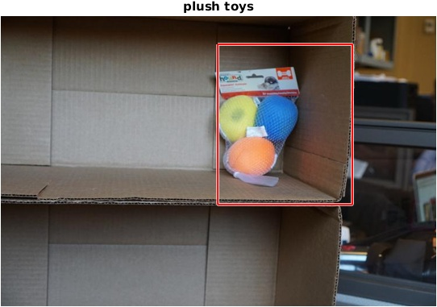
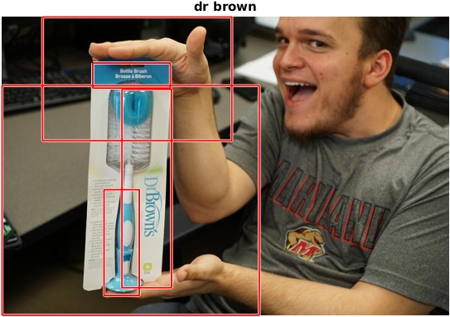
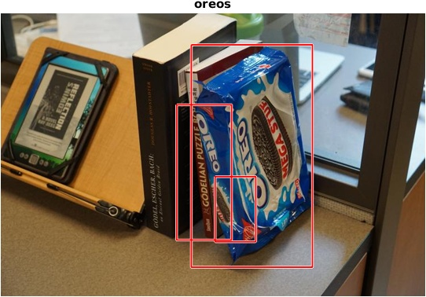
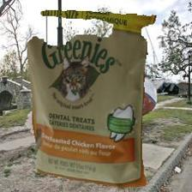
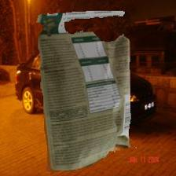
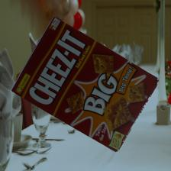
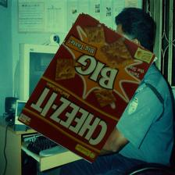
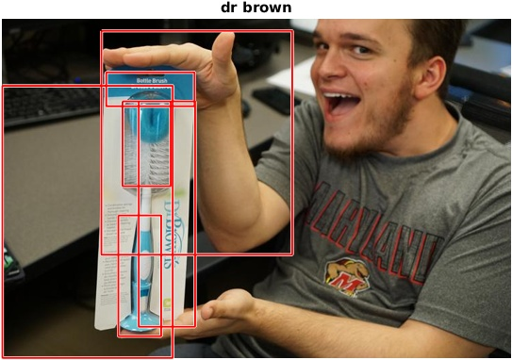
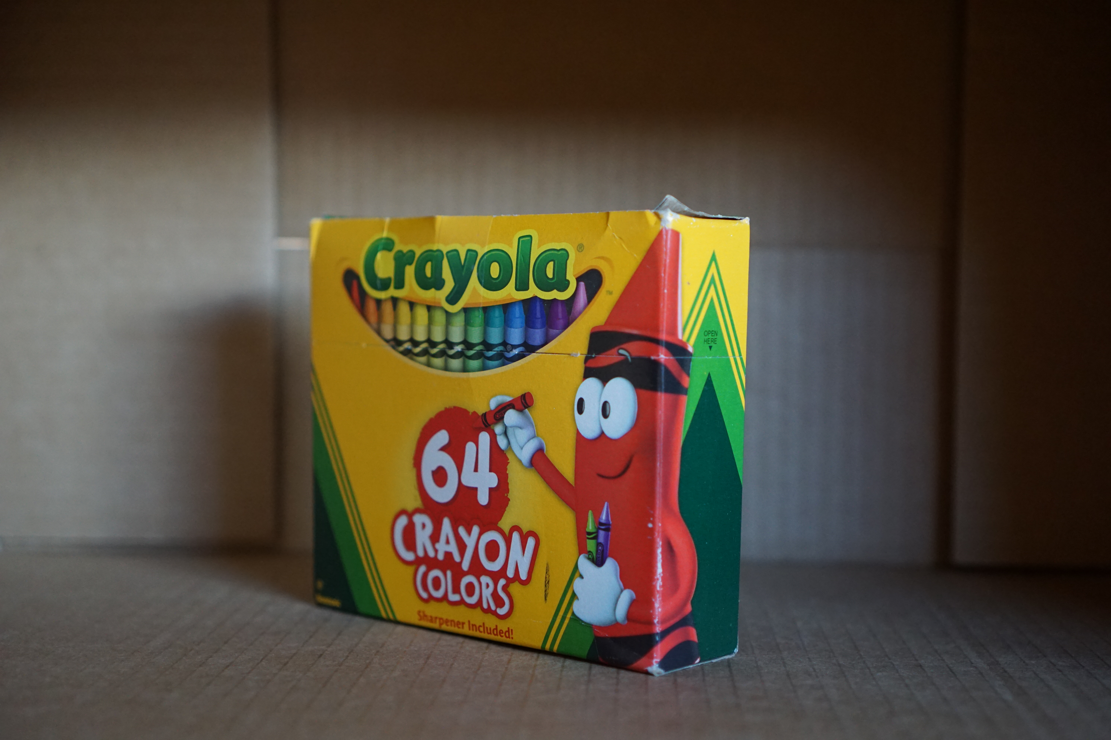
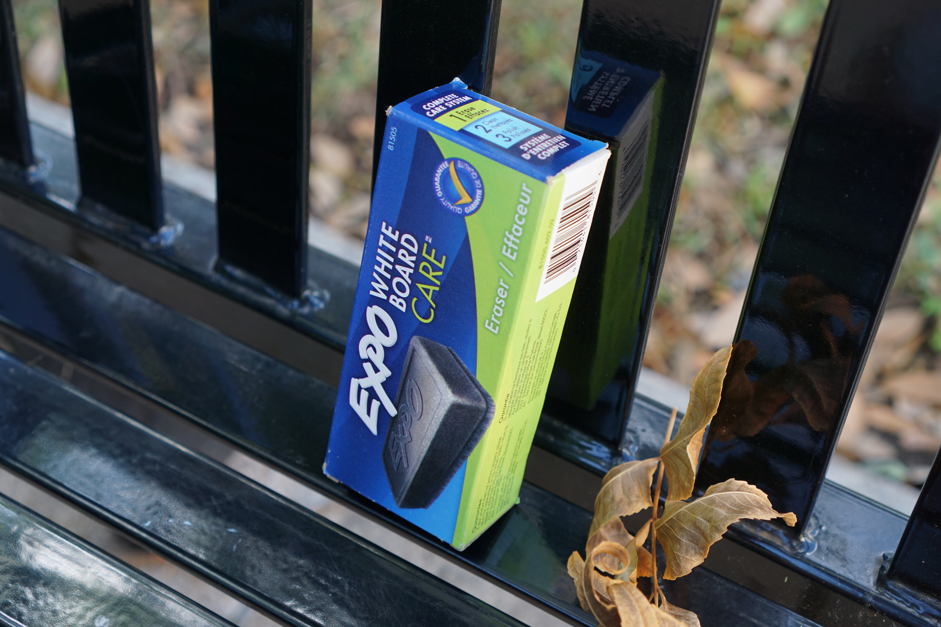
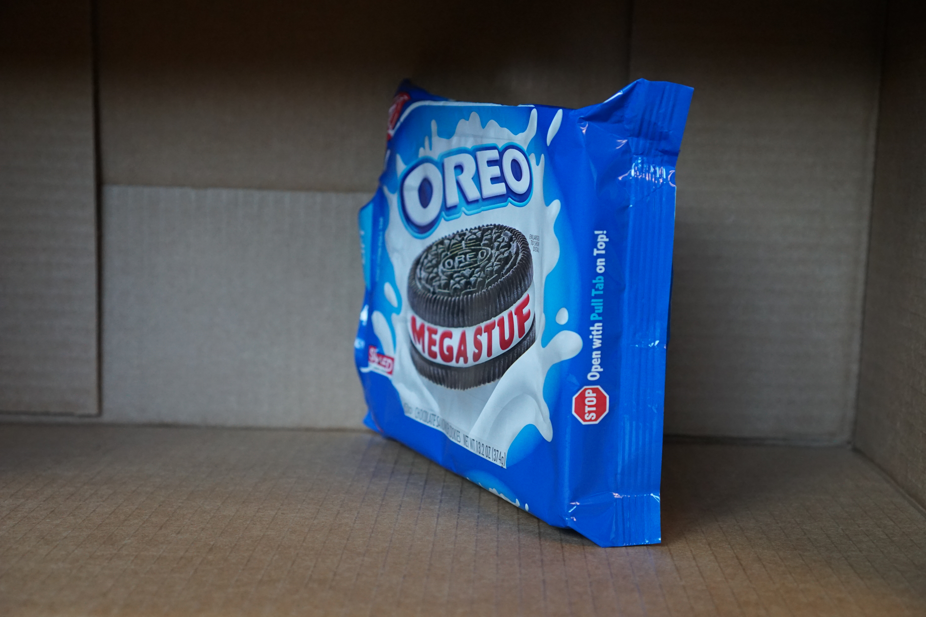
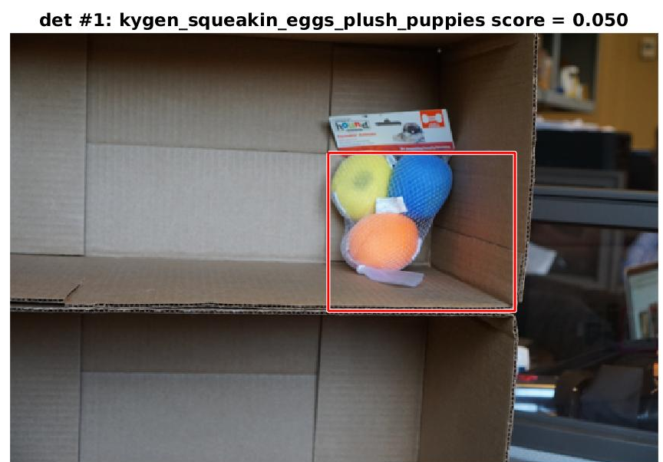
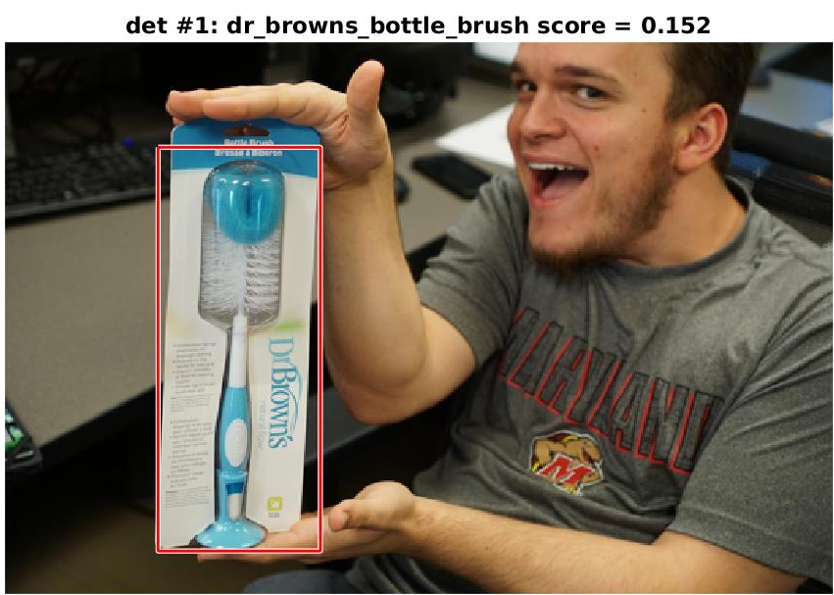
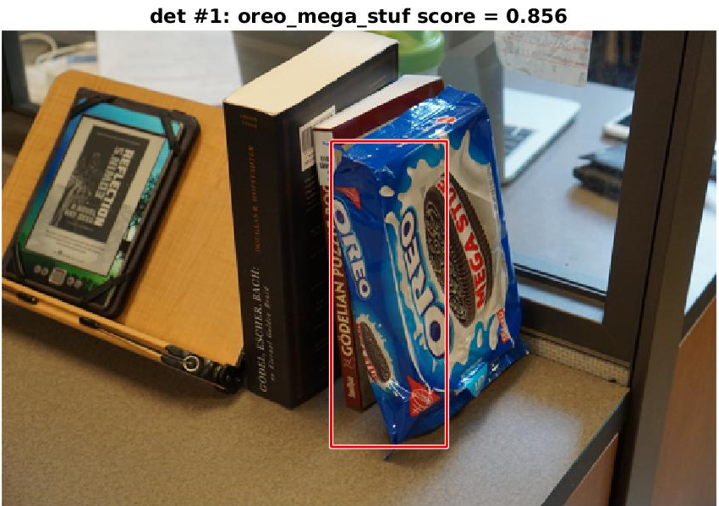
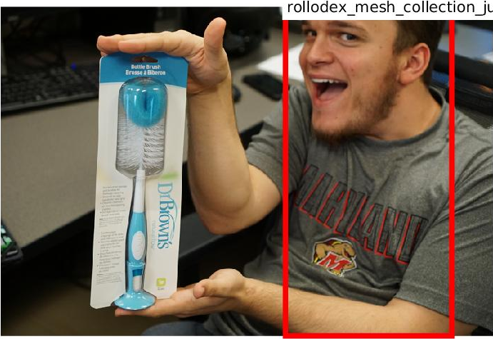
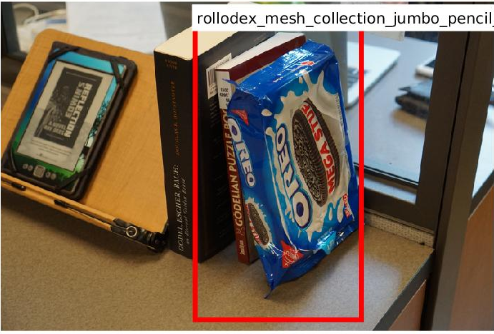
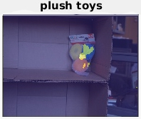
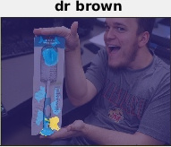
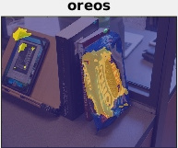
Amazon Picking Challenge: Object Detection with Deep Learning
Karinia Rard, Colorado State University
Calvin He, Syracuse University
Dr. Yijuan Lu, Texas State University
Introduction
Results
Discussion
Problem
Automated picking is a difficult challenge, so Amazon has created a challenge to inspire solutions from within academia and industry [1]. Motivation & Goals
Our goal is to compete in the 2017 Amazon Picking Challenge (APC). Deep learning has proven to be a useful tool for object classification and detection. We produced initial object detection results using deep learning methods.
 | Proposal Extraction Time | Classification Time | Total Error Rate | Best Objects and Error Rate | Worst Objects and Error Rate
Fast SS + VGG-S | 1 sec | 45 sec | 59.0% | 0%: Eraser 10%: Tools, Dr. Brown Brush | 100%: Stir Sticks, Cups, Joke Book, Bath Toy, Pencil Cup, Highlighters
SS + VGG-S | 3 sec | 90 sec | 50.4% | 10%: Eraser, Frog Toy, Index Cards, Sea Soap, Oreos, Safety Glasses | 100%: Stir Sticks, Joke Book, Twain Book, Pencil Cup, Highlighters
R-CNN | ~1.2 sec | 7-9 sec | 70.4% | 0%: Stir Sticks; 10%: Eraser 40%: Oreos, Frog Toy, Plush Toy | 100%: Spark Plug, Sticky Notes, Outlet Plugs, Papermate Pencils
Faster R-CNN | ~0.13 sec |  | 95.9% | 30%: Pencil Cup | 90-100%: Everything Else
FCN | N/A | 1 sec | 43.0% | 0%: Stir Sticks, Oreos, Tools | 100%: Cups, Stick Notes, Bath Toy, Sea Soap
Conclusion:
FCN gave the best result at 1 second to classify an image and an error rate of 43.0%.
This network, along with the R-CNNs, was trained before data augmentation unlike the VGG-S networks.
Classified every pixel as background vs object
VGG-S Classification Analysis:
Suffered from overfitting to highlighters and pencil cup
Cropping the test images improved accuracy
10 objects improved by at least 50%
R-CNN Model Analysis:
Simplified and precise bounding boxes
Only detected objects in 119 out of the 280 testing data
Trained with only 16,200 images (27 objects x 600 images)
Accuracy can improve with augmented dataset
Faster R-CNN Model Analysis:
Mostly classified every objects as pencil cup
Bounding boxes not as precise as R-CNN
Average total detection time is ~0.13 seconds
Ideal for real-time object recognition
Procedure
 | Plush Toys | Dr. Brown | Oreo
Fast SS + VGG-S
SS + VGG-S
R-CNN
Faster R-CNN | No detection
FCN
Prepared training data by adding noise to UC Berkeley’s 2015 APC dataset [2] with the VOC 2012 [3] dataset. Augmented the dataset: 27 objects x 1,200 images x 12 rotations x 2 grayscales = 777,600 total training data
Testing data preparation: 27 objects x (5 shelf images + 5 various backgrounds) + 10 multiple object images = 280 total testing data
Fine-tuned AlexNet [3] and VGG-S [4] CNNs (reserved 20% of dataset for testing)
Trained R-CNN [5] model with images, bounding boxes, and selective search data.
Tested all trained networks/models with the simulated testing data. VGG-S classification with augmented dataset gave 81.5% error rate.
Future Work
Prepare more accurate images for improved training and to address overfitting problem
Train R-CNN, Faster R-CNN, and FCN with augmented dataset
Fine-tune Faster R-CNN from VGG-16 network to improve precision [7]
 | Learning Rate | Error Rate | Best Objects | Worst Objects
Alex Net | 0.0005 | 20.50% | Spark Plug, Frog Toy | Outlet Plugs, Twain Book
VGG-S | 0.001 | 9.20% | Spark Plug, Eraser | Joke Book, Outlet Plugs
VGG-S with augmented dataset | 0.0005 | 0.23% | Dove, Greenies, Oreos | Joke Book, Safety Glasses
Acknowledgements
We thank the National Science Foundation for funding this research under the Research Experiences for Undergraduates Program, CNS-1358939, and NSF-CRI 1305302
Dr. Hao Jiang at Boston College for fine-tuning the FCN with our dataset
References
[1] “Picking Challenge,” Amazon. [Online]. Available: http://amazonpickingchallenge.org/. [Accessed: 04-Jun-2016].
[2] “Amazon Picking Challenge Object Scans,” Amazon Picking Challenge Object Scans. [Online]. Available: http://rll.berkeley.edu/amazon_picking_challenge/. [Accessed: 15-Jun-2016].
[3] “Visual Object Classes Challenge 2012 (VOC2012),” The PASCAL Visual Object Classes Challenge 2012 (VOC2012). [Online]. Available: http://host.robots.ox.ac.uk/pascal/voc/voc2012/. [Accessed: 15-Jun-2016].
[4] Chatfield, Ken, et al. "Return of the devil in the details: Delving deep into convolutional nets." arXiv preprint arXiv, vol. 1405.3531, 2014.
[5] Girshick, Ross, et al. "Rich feature hierarchies for accurate object detection and semantic segmentation." Proceedings of the IEEE conference on computer vision and pattern recognition. 2014.
[6] Uijlings, Jasper RR, et al. "Selective search for object recognition." International journal of computer vision, vol. 104.2, pp. 154-171, 2013.
[7] Ren, Shaoqing, et al, "Faster R-CNN: Towards real-time object detection with region proposal networks." Advances in neural information processing systems, 2015.

