Slide 1

Cortado:
Progressive Retrieval of Lossily Compressed Data with Guaranteed Error Bounds
Brandon Alexander Burtchell and Martin Burtscher
Department of Computer Science

Slide 2
Introduction
Floating-point data is often compressed to save space
Error-bounded lossy compression yields better compression with controlled information loss
  But provider must choose an error bound
One solution: progressive compression/retrieval
  User downloads initial copy and can optionally refine it
Cortado strictly guarantees error bounds with its unique requantization method
  Attains fastest speeds w/o sacrificing compression or quality

Slide 3
Error-Bounded Lossy Compression
To improve float compression, data is quantized
  Quantize: approximate floats into integer “bins”
  Dequantize: translate bin to the approximated float
  Based on user-defined error bound (EB)
Rounding is an intuitive example of a quantizer
3.248
2.411
0.048
…
32
24
0
…
3.2
2.4
0.0
…
Quantize
EB = 0.1
Dequantize
EB = 0.1
Original data
Quantized bins
Decoded data

Slide 4
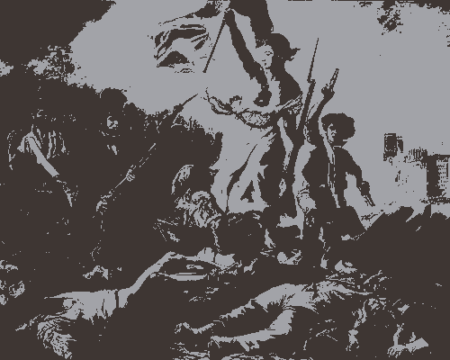
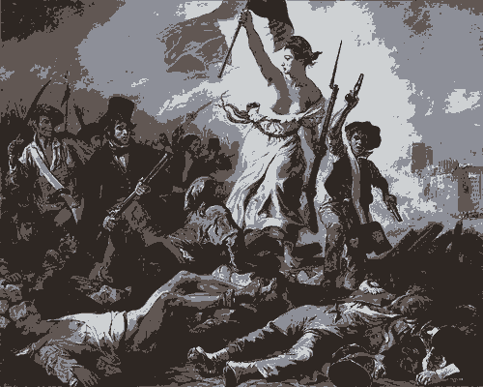

Progressive Compression
Initial download
Refinement 1
Refinement n
refine
…
Data is encoded as a hierarchical series
  Existing works typically vary resolution or precision
Users initially download data as normal
If user wants to refine, they can request more data
Refinement requests only download residual data
  Little to no redundant information → faster downloads

Slide 5
Issues with Previous Approaches
Only offer predetermined EBs
  Limited user flexibility
Multiple decompression passes per request
  Leads to long download times
Multiple quantization passes propagate floating-point error
  Could unpredictably violate EB guarantees

Slide 6

Cortado
GPU progressive compressor with guaranteed EBs
Offers near-arbitrary EBs for user flexibility
One decompression pass per request
  Via new requantization technique
No error propagation
  Requantization is implemented with int operations
Supports lossless retrieval (optional)
  Typically unsupported in previous work
burtscher/Cortado

Slide 7


Highlights
Demonstrate highest end-to-end throughputs
Exhibit on-par compression ratio and reconstruction quality
Show that Cortado is the only tested compressor that strictly guarantees all tested EBs
Investigate how sending residual data improves overall transfer times

Slide 8
Cortado Overview
Legend
compressed file
uncompressed file

Slide 9

Compression
burtscher/LC-framework
BIT
RLE
RLE
RLE
I
DIFFMS
BIT
RZE
O
Cortado compresses with DIFFMS_4 BIT_4 RZE_1
Used LC to generate a compression pipeline from a library of data transformations (components)
  Some components reduce the data size (reducers)
  Others modify data to expose redundancies

Slide 10
Requantization
Definition: dequantize then quantize to new EB
  Typical quantizers introduce error via float operations
  Error propagates through multiple requantizations
Cortado modifies SLEEK¹ to enable requantization
  Round EB to nearest power of two
  Use integer operations (no error propagation)
Requantized value == directly-quantized value
More details in full Cortado paper
¹ A. M. Akathoott, A. Rodriguez, and M. Burtscher. "SLEEK: Compressing Memory Copies for Floating-Point Data on GPUs." IPDPS 2026. May 2026. doi.org/10.1109/IPDPS65963.2026.00022

Slide 11
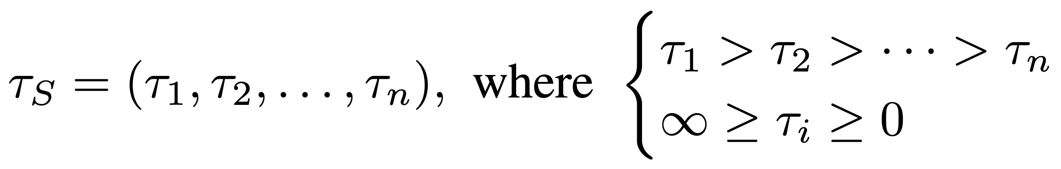
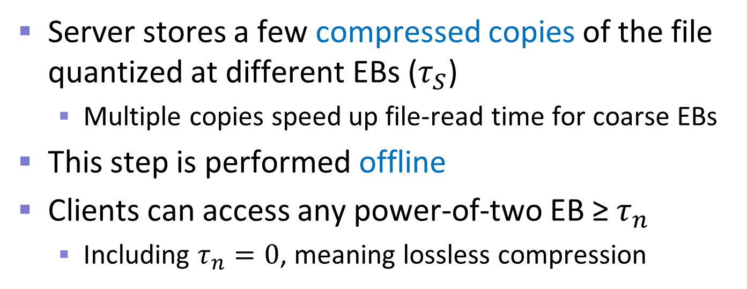
Server Encode and Store
Server stores a few compressed copies of the file quantized at different EBs ($τ_{S}$)
  Multiple copies speed up file-read time for coarse EBs
This step is performed offline
Clients can access any power-of-two EB ≥$τ_{n}$
  Including $τ_{n}=0$, meaning lossless compression

Slide 12
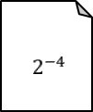




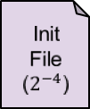

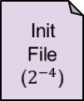
Initial Send/Receive
Client requests $2^{−4}$: server sends initial file
Storage
Initial Send
Server File ($2^{−8}$)
Init File ($2^{−4}$)
Decompress
$$2^{−8}$$
Requantize to $2^{−4}$
$$2^{−4}$$
Compress and send to client
To client…
$$2^{−16}$$
Client receives initial file
Legend
compressed file
uncompressed file
on-the-fly memory
Initial Receive
Init File ($2^{−4}$)
Decompress and dequantize
$$2^{−4}$$
From server…

Slide 13


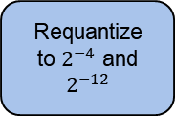










Residual Send/Receive
Client has $2^{−4}$, requests $2^{−12}$: server sends residual
Storage
Residual Send
$$2^{−8}$$
Requantize to $2^{−4}$ and $2^{−12}$
$$2^{−4}$$
Compute residual, compress, and send
Decompress
$$2^{−16}$$
Resi File ($2^{−4}$→ $2^{−12}$)
Server File
($2^{−16}$)
$$2^{−12}$$
To client…
Legend
compressed file
uncompressed file
on-the-fly memory
Client receives and applies residual
Residual Receive
$$2^{−4}$$
Requantize in terms of $2^{−12}$ bins
$$2^{−4}\text{ via }2^{−12}$$
Apply residual (and dequantize)
(From previous initial send)
$$2^{−12}$$
Resi File ($2^{−4}$→ $2^{−12}$)
Decompress
$$2^{−4}\text{→ }2^{−12}$$
From server…

Slide 14
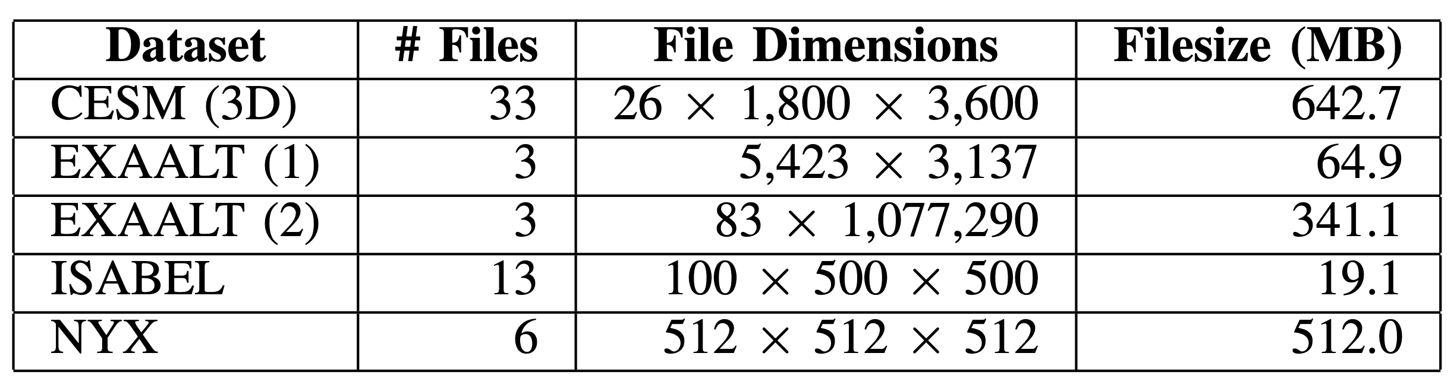
Experimental Methodology
Inputs from SDRbench (https://sdrbench.github.io/)
  Data from climate, weather, cosmology, and more
GPUs: A100 (40 GB), RTX 4090
CPU: Ryzen Threadripper 2950X
Results show geometric means

Slide 15
Third-Party Progressive Compressors
PRISM (GPU)
  Employs interpolation and bitplaning
HP-MDR (i.e., GPU Progressive MGARD)
  Coefficient levels and per-level bitplaning
M-SZ3 (CPU)
  Progressively tighter error bounds, SZ3-compressed
IPComp (CPU)
  SZ3-based, employs interpolation and bitplaning

Slide 16
Results: Comparisons

Slide 17
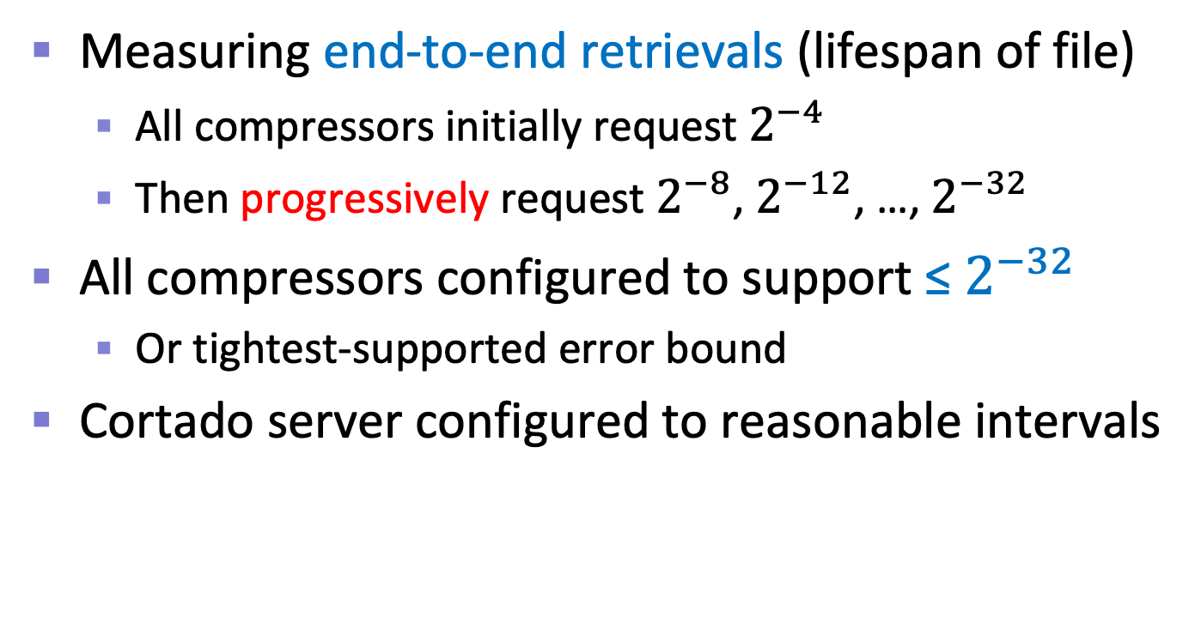



Comparison Setup
Measuring end-to-end retrievals (lifespan of file)
  All compressors initially request $2^{−4}$
  Then progressively request $2^{−8}$, $2^{−12}$, …, $2^{−32}$
All compressors configured to support ≤ $2^{−32}$
  Or tightest-supported error bound
Cortado server configured to reasonable intervals
Cortado Storage
$$2^{−10}$$
$$2^{−20}$$
$$2^{−32}$$

Slide 18
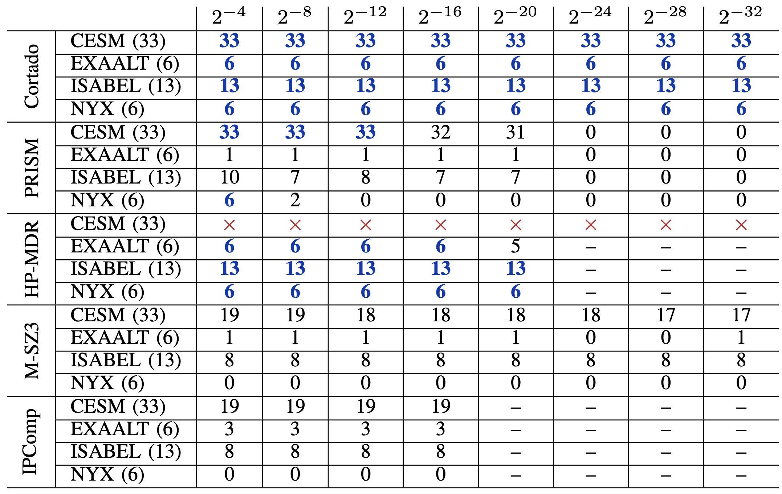
Strictly-Guaranteed Error Bounds
HP-MDR fails on all CESM inputs
Only Cortado guarantees all EBs on all files
Most other compressors struggle on NYX
HP-MDR and IPComp don’t support tighter EBs

Slide 19
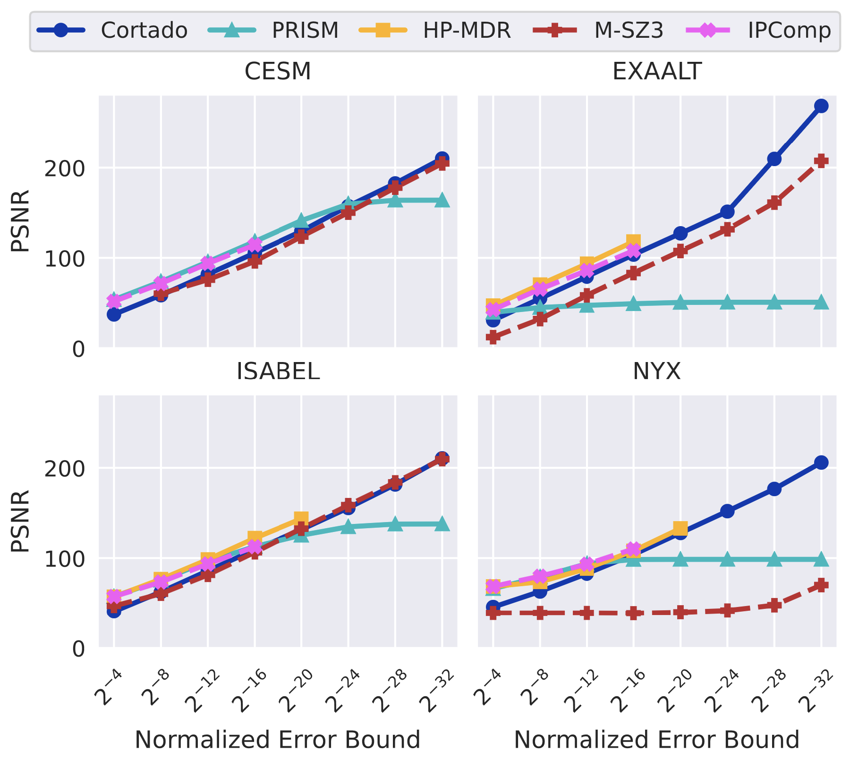
Peak Signal-to-Noise Ratio
Cortado is always on-par or better
PRISM falls off at tighter EBs on all datasets
Recall: all other compressors struggle on NYX

Slide 20
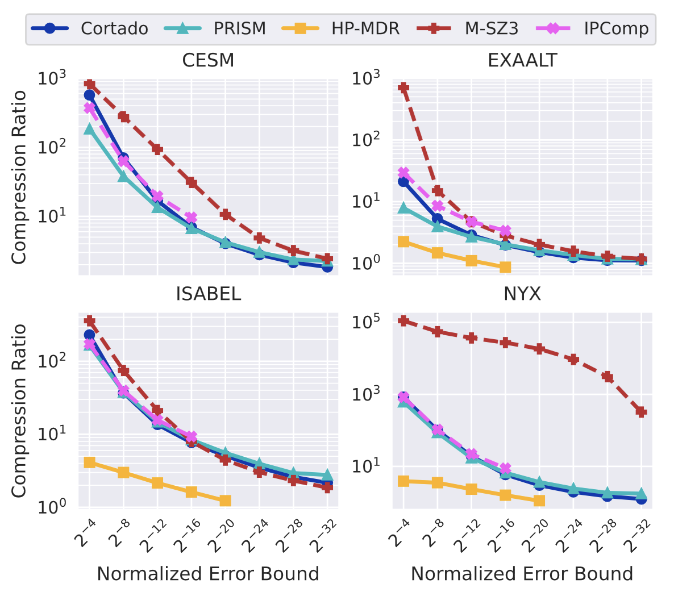
End-to-End Retrieval Compression
M-SZ3 tends to compress “best” in part because it doesn’t retain data quality/EB
Cortado is competitive with other GPU compressors and even IPComp

Slide 21
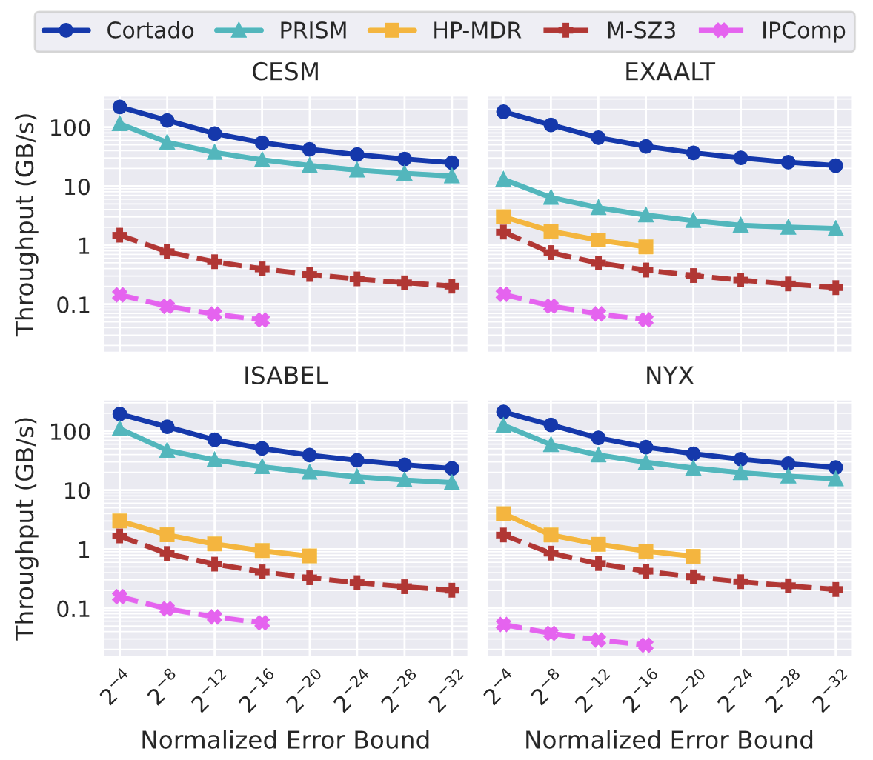
End-to-End Retrieval Throughput
Cortado is always fastest due to overlapping of server/client operations
PRISM is close behind on some datasets, but doesn’t guarantee all EBs and has worse PSNR
On RTX 4090

Slide 22
Results: Cortado Residual

Slide 23
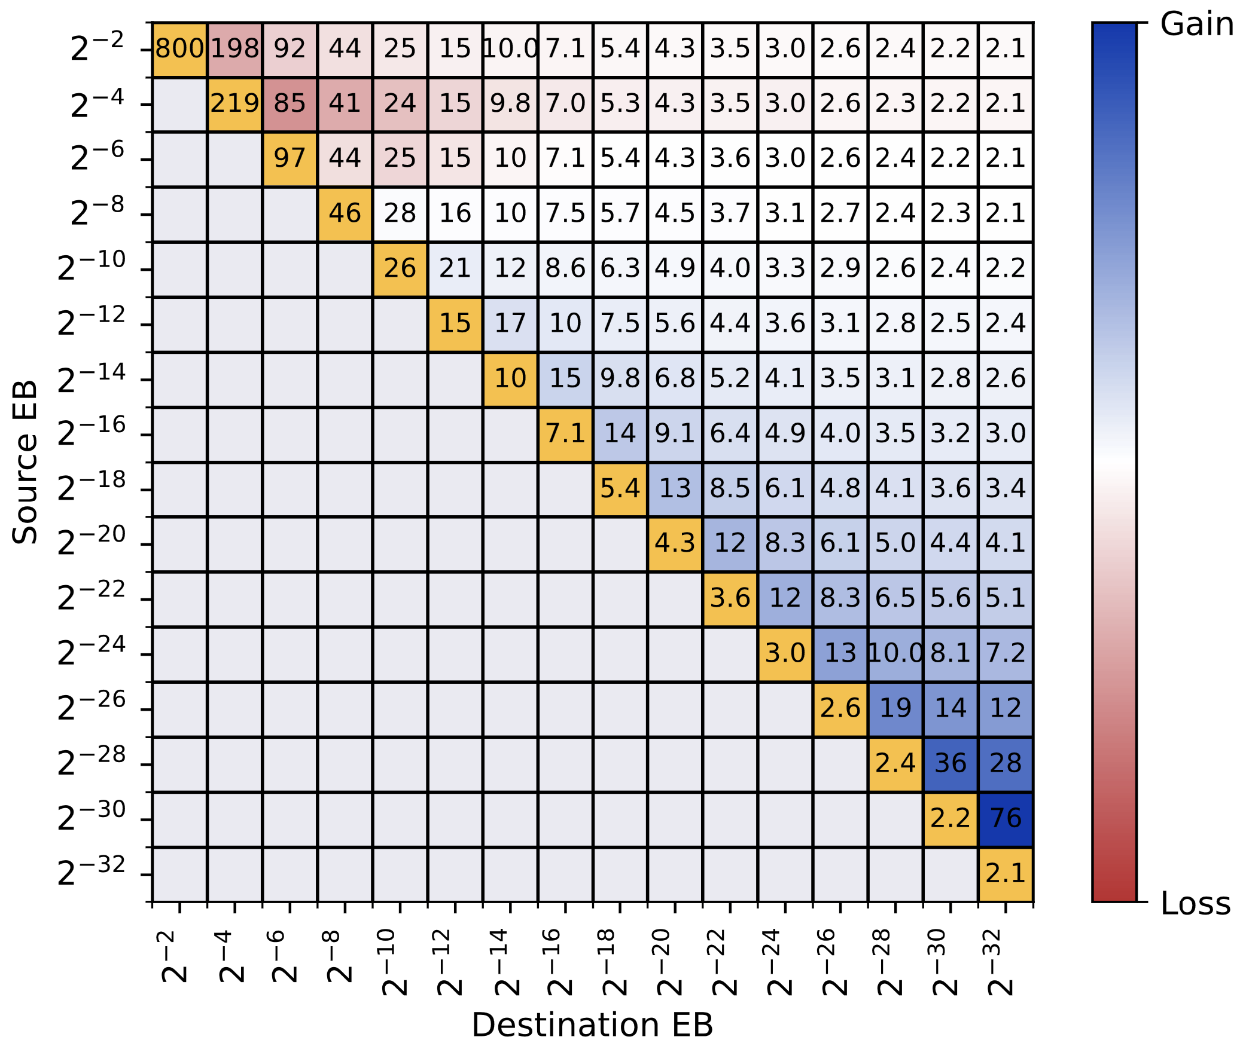
Residual File Compression Ratio
Initial file CR in yellow for reference
CR gains from sending residual file increase at tighter EBs

Slide 24
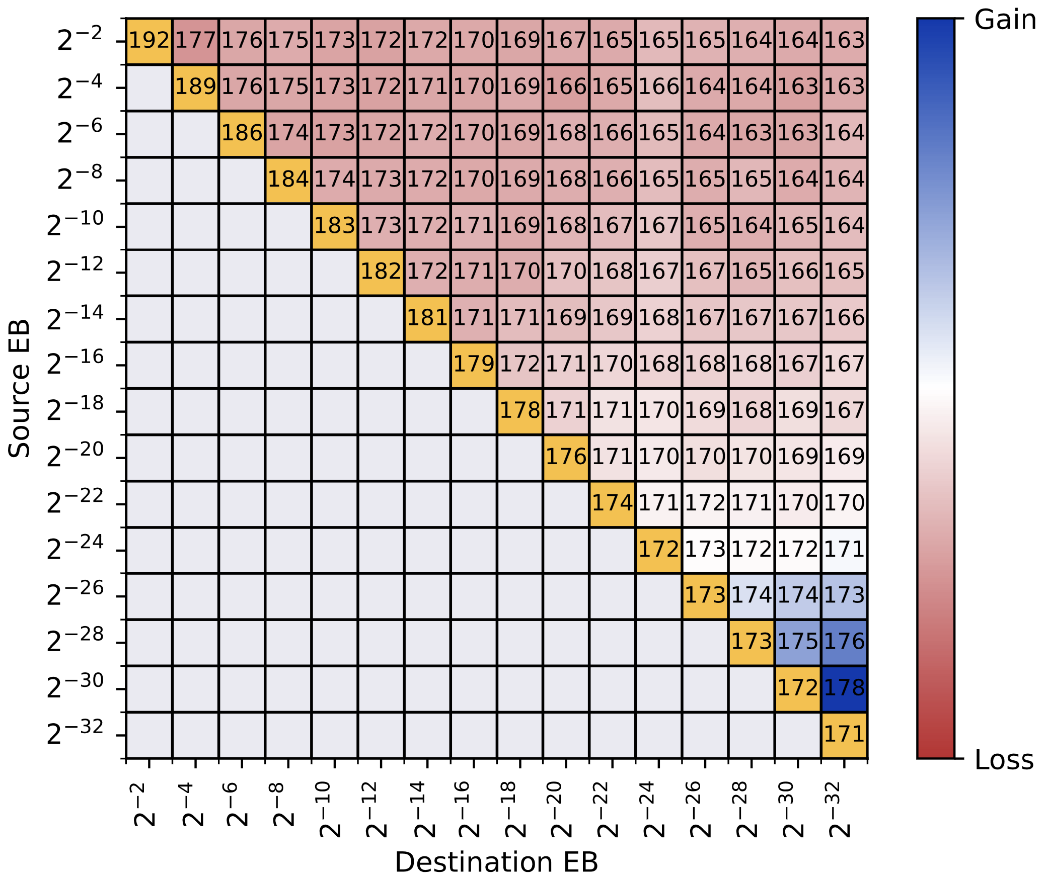
Residual Send Throughput (GB/s)
Initial send throughput in yellow for reference
Small overhead from preparing residual file instead of sending a non-progressive copy
In practice, this is overcome by overlapping the computation of the residual with data transmission
Residual files compress better, so download times are shorter overall
On RTX 4090

Slide 25
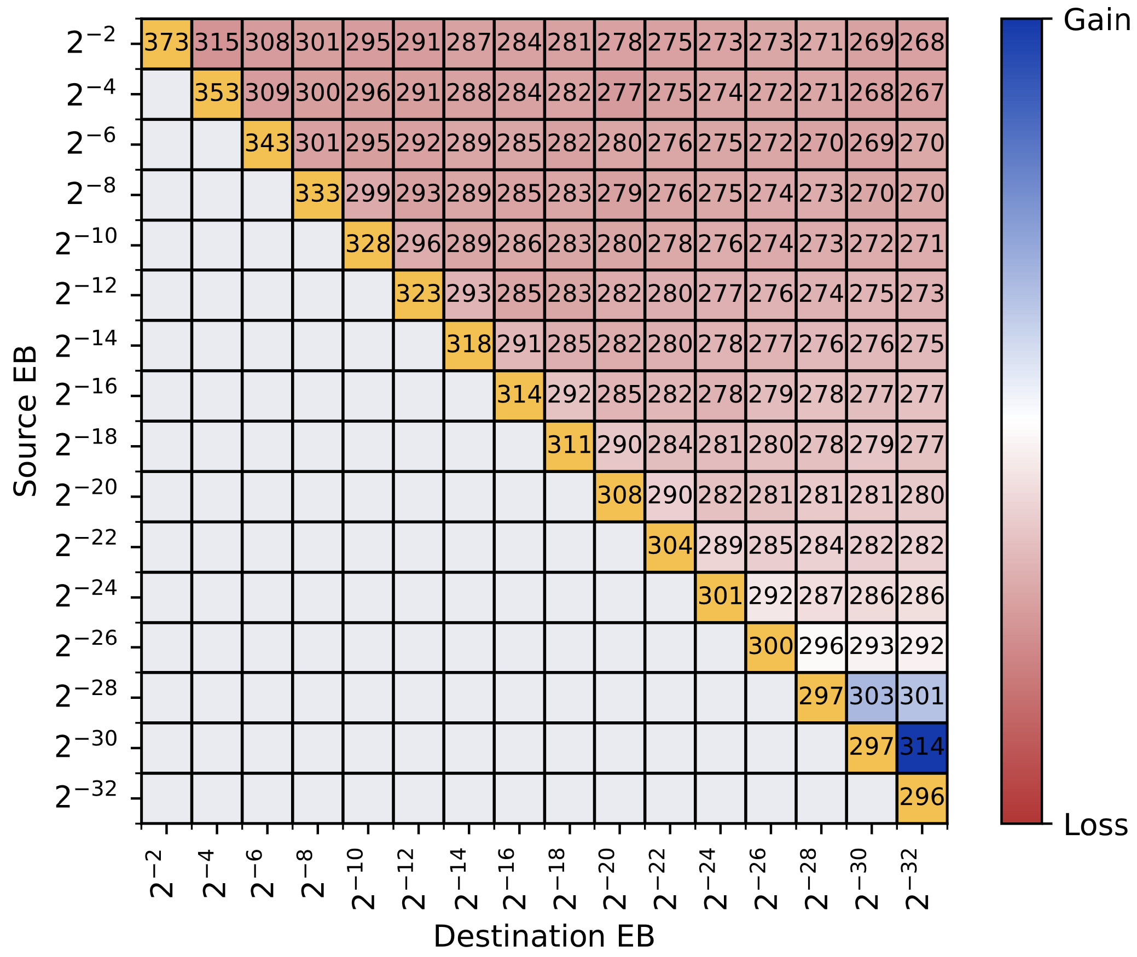
Residual Receive Throughput (GB/s)
Initial receive throughput in yellow for reference
Same overhead from handling residual file
Again, this is overcome by overlapping computation and higher CRs
On RTX 4090

Slide 26
Conclusions
Cortado progresses in terms of guaranteed EBs
  Supports lossless compression as a contingency
New requantization technique strictly-guarantees EBs with no propagated floating-point error
Cortado achieves highest end-to-end throughput
  While maintaining on-par compression ratio and PSNR
Acknowledgements
National Science Foundation (CCF-2403380)
U.S. DOE, Office of Science, Office of ASCR (DE-SC0022223)
burtscher/Cortado

