Slide 1


HP-MC: Quickly Computing Maximum Clique Sizes of Large Sparse Graphs
Cameron Bradley and Martin Burtscher

Slide 2
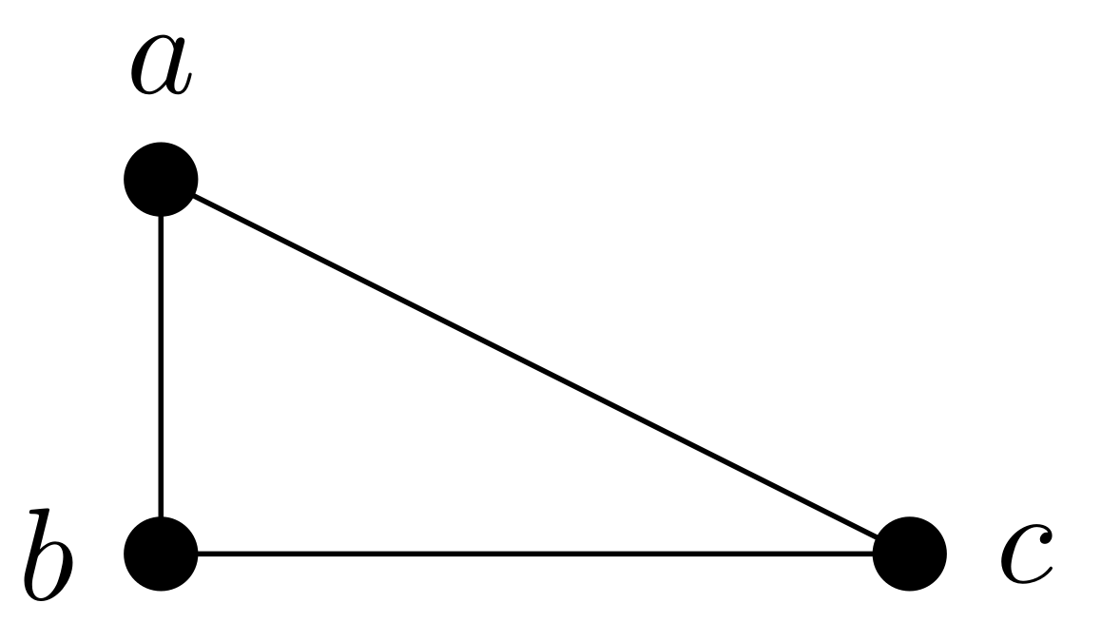
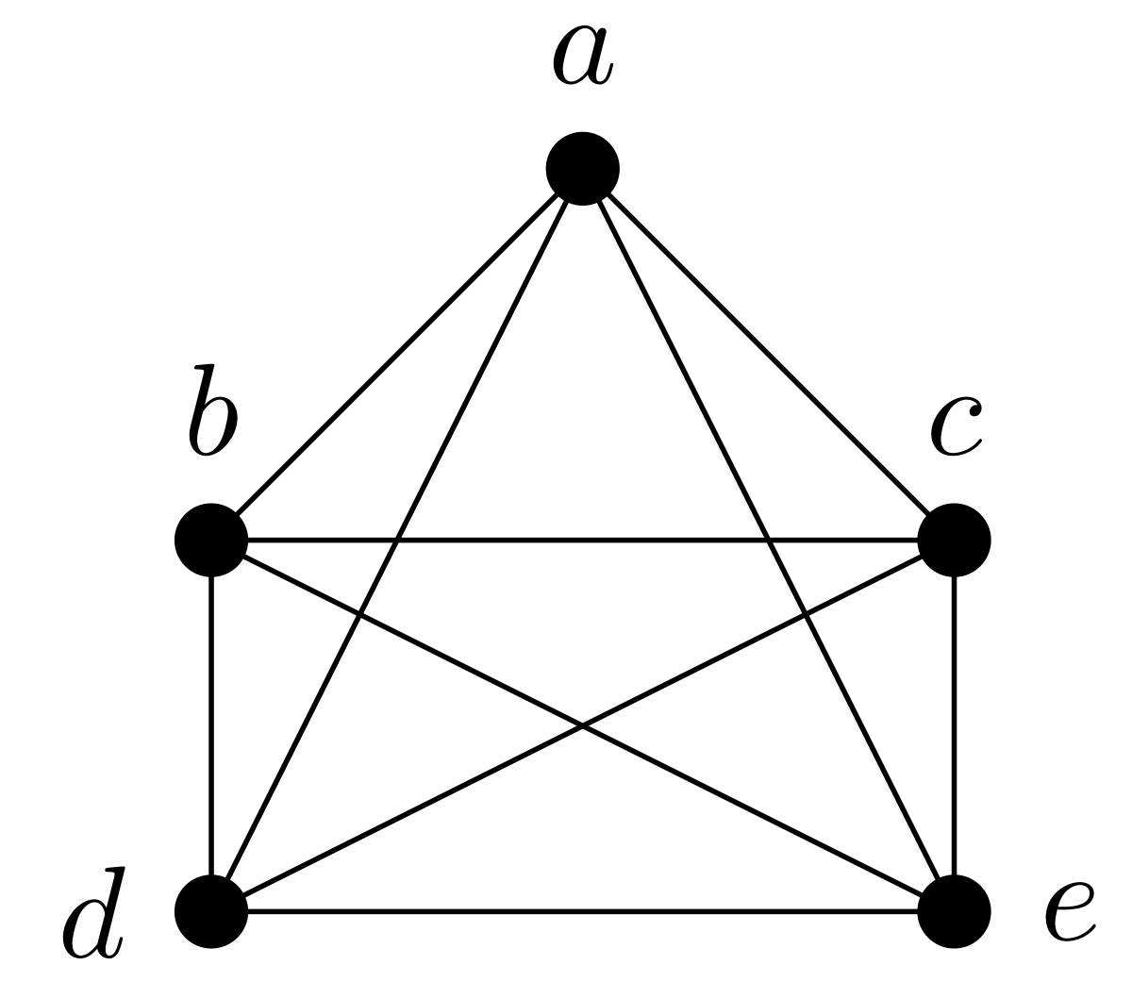
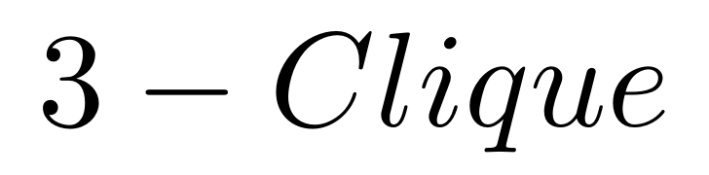
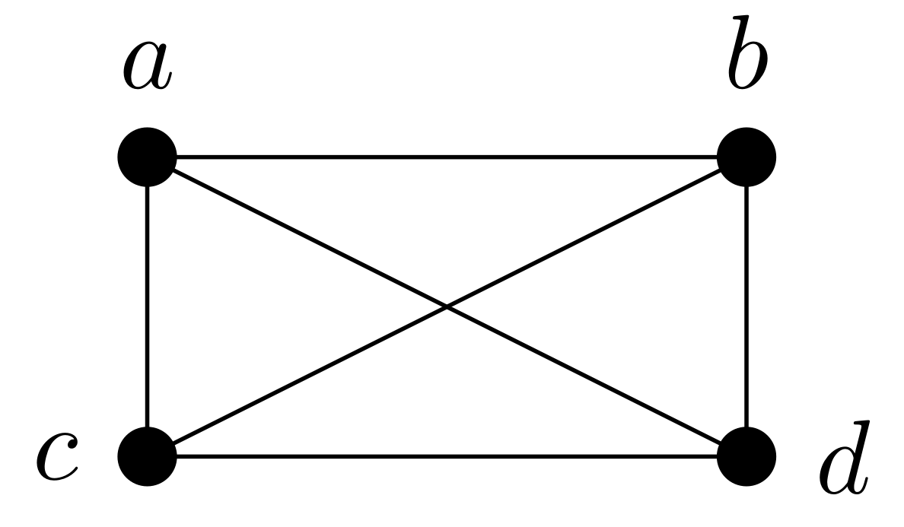
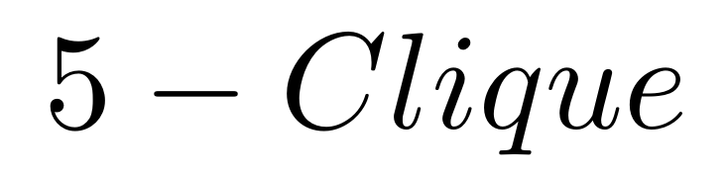
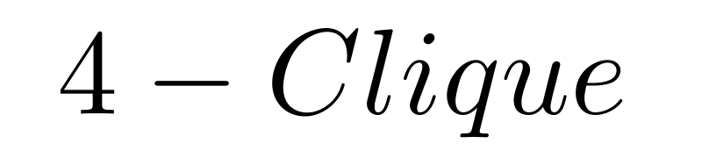
Maximum Clique Problem (MCP)
Find the largest complete subgraph in a graph
  All vertices are adjacent to all others
Applications of MCP
  Signals for terrorist recruitment
  Molecular docking
  Compatibility in phylogeny
Exact approach is NP-hard
  Exponential runtimes based on graph size and density

Slide 3
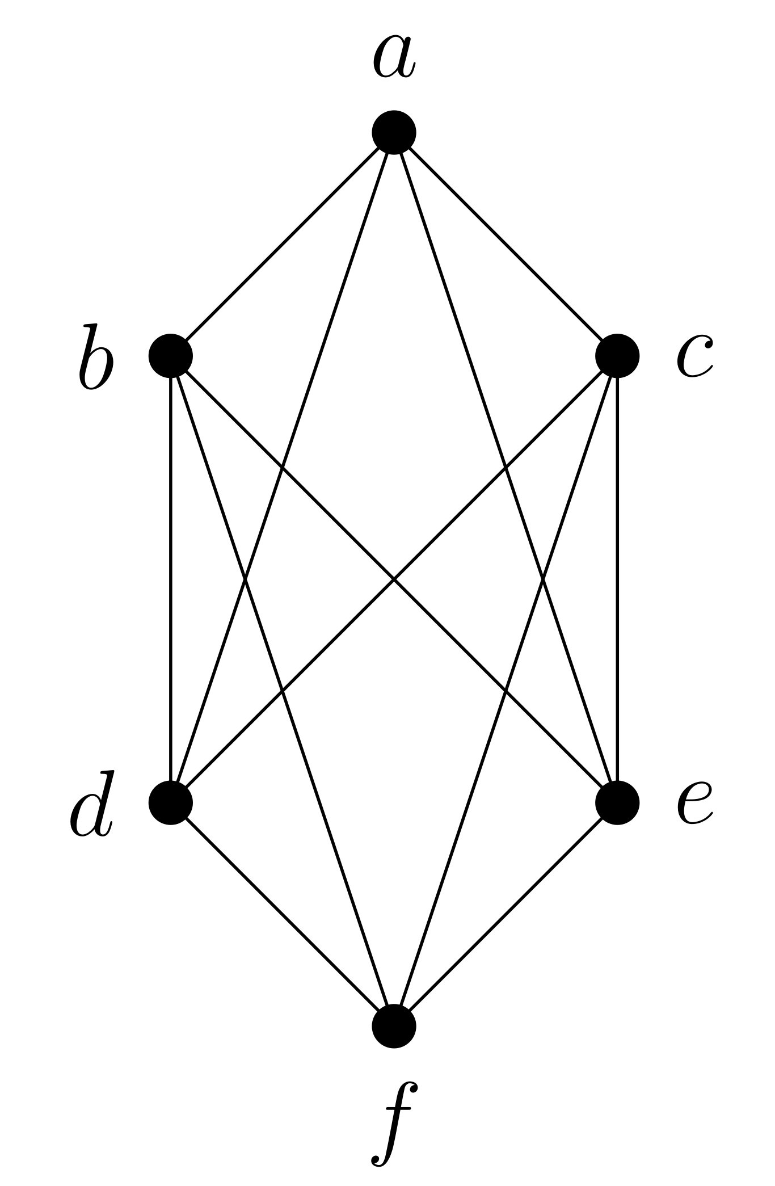
Maximal vs. Maximum
Clique
  Set of vertices where every pair is connected
Maximal Clique
  Cannot be extended by adding a vertex
Maximum Clique
  Largest maximal clique in the graph by size

Slide 4
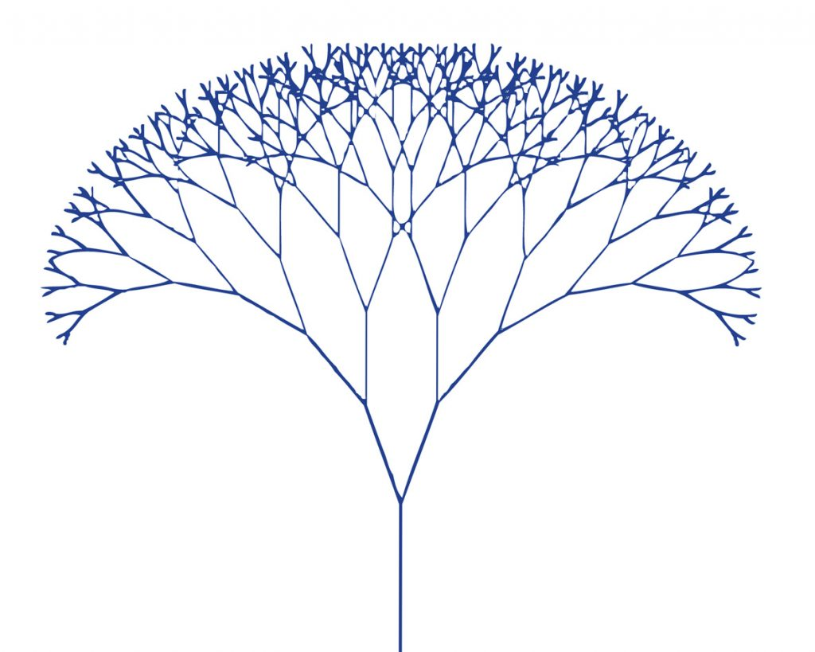
Traditional Approaches
To find the maximum clique in a graph G
Bound tightening
  Start with an initial upper and lower bound of the maximum clique
  Squeeze bounds until they are equal
Branch-and-Bound
  Recursively extend a partial clique with candidate vertices
  Use bounds to prune search branches
    Size of current clique + bound of remaining candidates

Slide 5
Upper Bounds
Degree upper bound
  A clique of size k must only contain vertices with degrees greater or equal to k – 1
K-core upper bound
  A clique of size k must lie entirely within a (k – 1)-core
Graph coloring upper bound
  Number of distinct colors is an upper bound

Slide 6
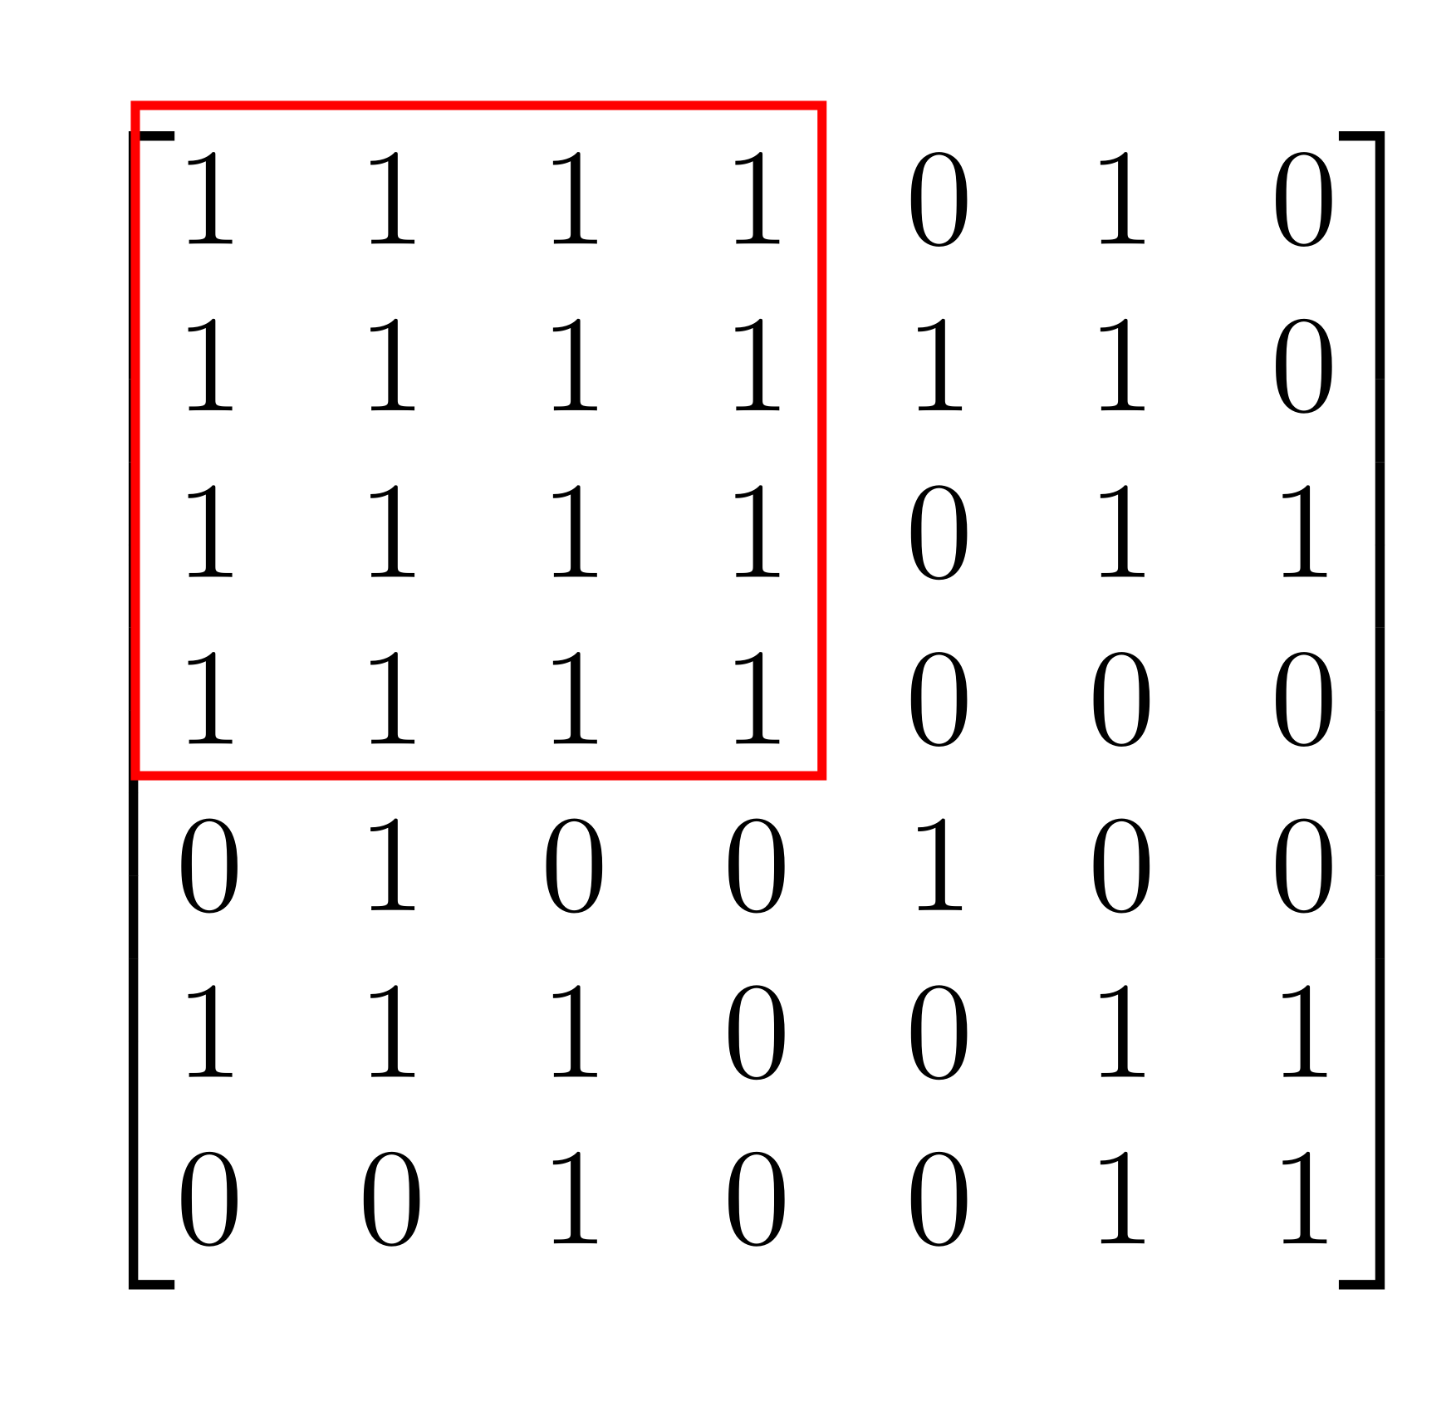
Lower Bounds
Greedy construction is often degree-based
Iteratively add a vertex compatible
with the current clique
Lower bound is updated when a larger clique is found
Quality is highly sensitive to graph structure

Slide 7
Density and Limitations in MCP
Sparse graphs color cheaply with few colors
  Generally tight bounds
Dense graphs are expensive
  Wider clique-core gap
  Weaker pruning
Most graphs have a large sparse periphery and dense clustered neighborhoods

Slide 8
HP-MC Parallel Implementation

Slide 9
Branch and Bound
Color remaining candidate vertices for an upper bound of an entire branch
Use bounds to prune search branches
Recursively add a vertex to constructed clique
Vertices adjacent to the chosen vertex build the next candidate set of vertices

Slide 10
Hybrid Ordering Strategy
Large Sparse Periphery
  Order vertices by ascending degree
Dense Core
  Degeneracy ordering
  Matrix representation
Degeneracy ordering is not justified across the whole sparse graph

Slide 11
Hybrid-Pivot Vertex
Large Sparse Periphery
  Select a pivot vertex u with the highest degree in the candidate set
  Only branch on u and vertices not adjacent to u
Dense Core
  Pivoting benefit shrinks
  Switch to standard color-bounded branch-and-bound
Pivoting performs best when it proves large portions of the candidate set as redundant

Slide 12
Connected Components (CC)
The selection of a pivot vertex creates a set of non-neighbors
The resulting set is often sparse and makes multiple connected components
Each connected component has its own upper bound
  Prune every connected component that has too low an upper bound

Slide 13
Connected Component Branching
Exhausting all branches in a connected component is not required
  At least two vertices are required from each connected component to beat a clique the pivot is a member of
For each CC, a vertex is skipped
Results in less branching in addition to the pivot vertex heuristic

Slide 14
Iterative Coloring Bound
For a candidate set C, greedily color
  Each vertex’s upper bound is computed
Prune each vertex whose upper bound cannot beat the current best size
If vertices are pruned, repeat coloring with the residual candidate set
Results in tighter bounds in sparse regions

Slide 15
Parallelization
HP-MC uses dynamic work-stealing to distribute work across threads
Each recursive expansion is expressed as an independent OpenMP task
New tasks are spawned based on the size of the candidate set
  Limits task creation overhead
Synchronization to preserve state across threads

Slide 16

Evaluation Methodology
Compare to state of the art
  PMC, MC-BRB, and Lazy-MC
System
  CPU: Intel Xeon Gold 6226R
  Cores: 32-core processor
Performance metric: throughput
  Number of vertices divided by runtime
  Median of 9 runs
  Missing values denote timeouts (> 1 hour per input)

Slide 17
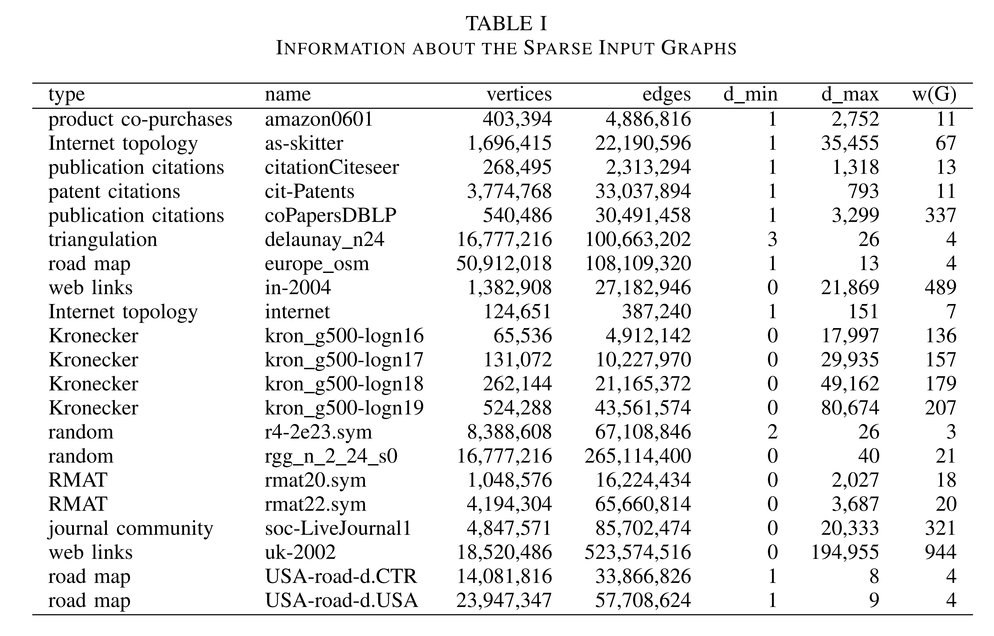
Input Graphs
All codes find the same maximum clique size
Note: Inputs represent a range in type, size and clique-core gap

Slide 18
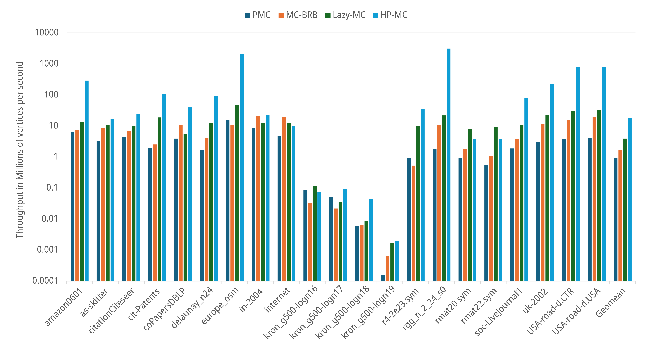
Throughput
Largest Speedup of 143.39x
Largest slowdown of 0.43x
Geomean speedup of 4.56x

Slide 19
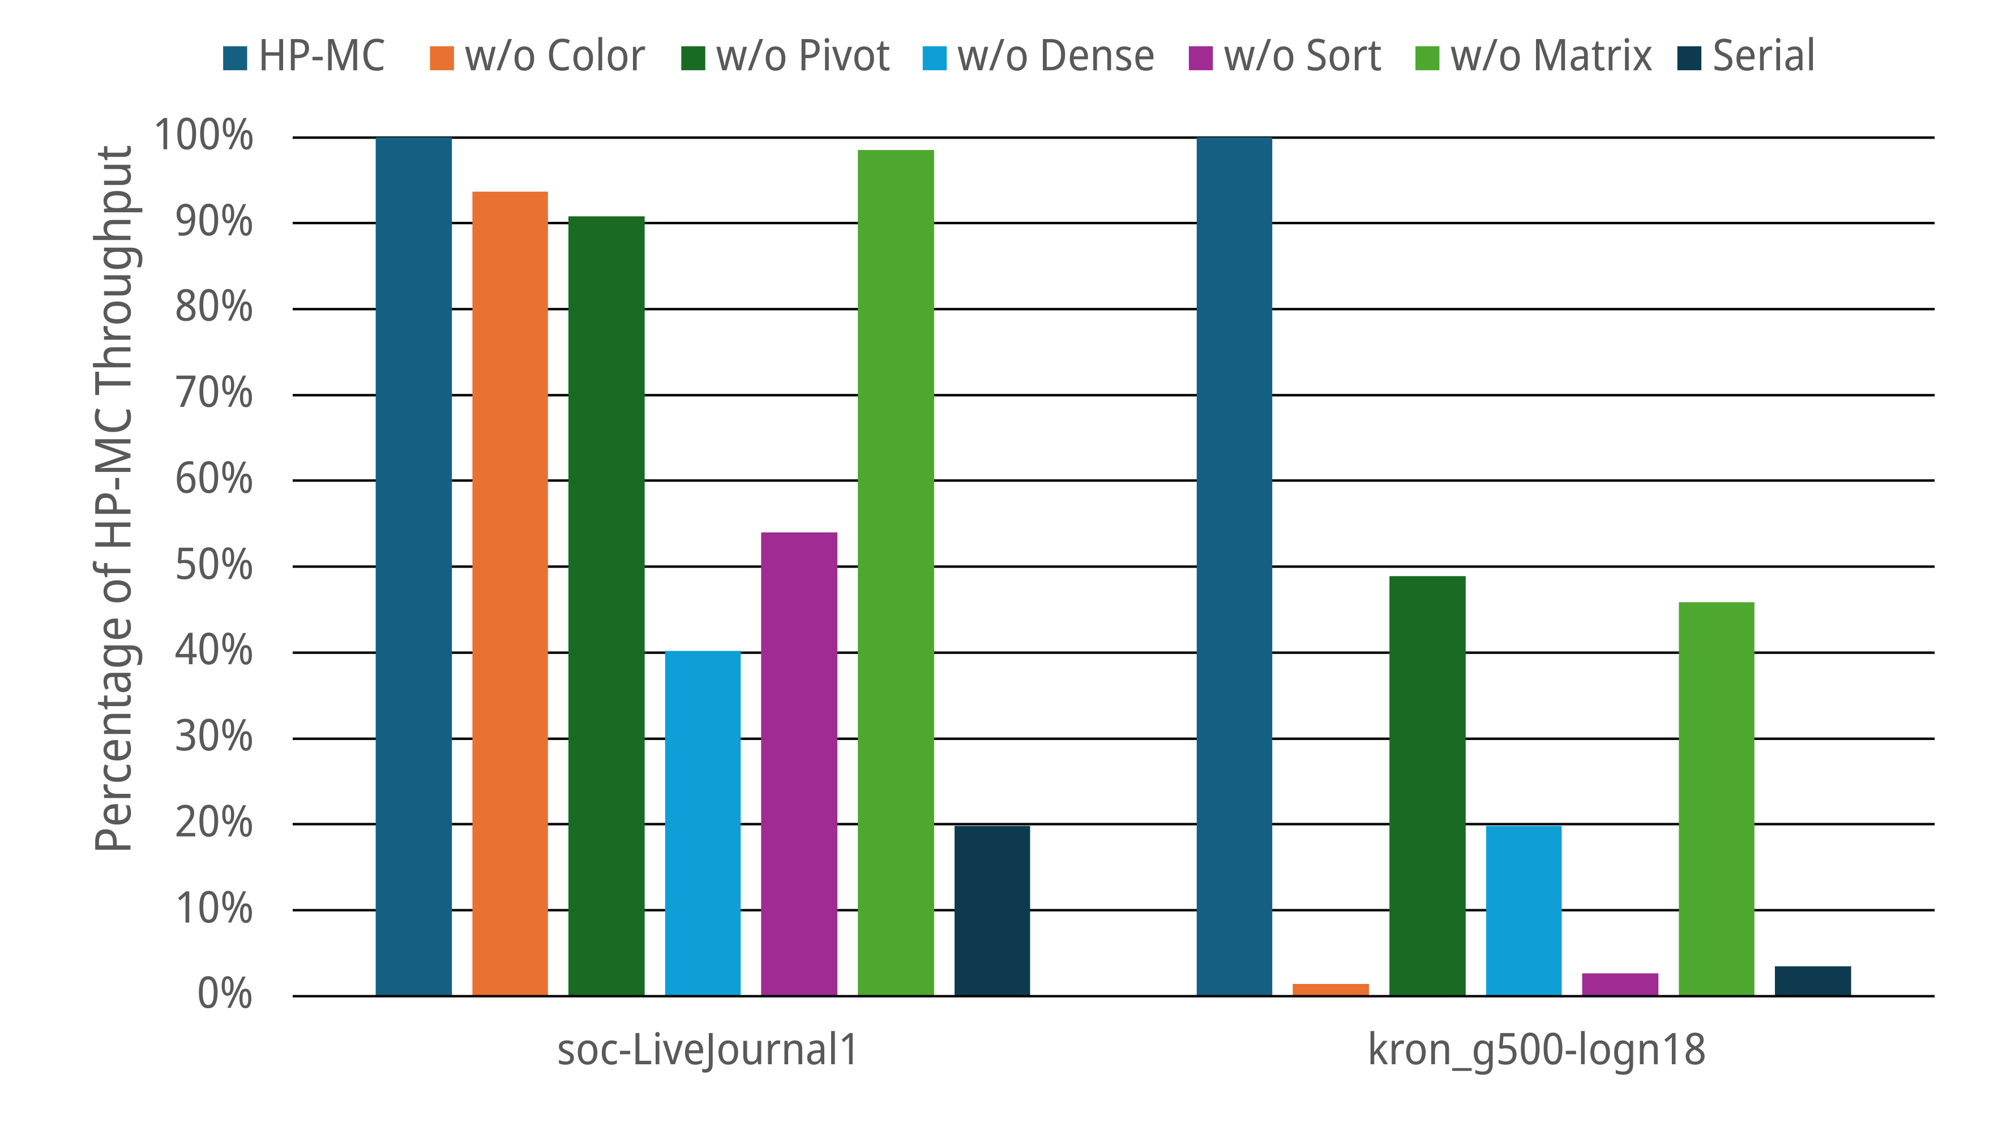
Effectiveness of HP-MC Stages
Disabling pivot is 2x slower
Disabling coloring results in 12.5x longer runtimes!
Smaller clique-core gap makes optimizations less impactful

Slide 20
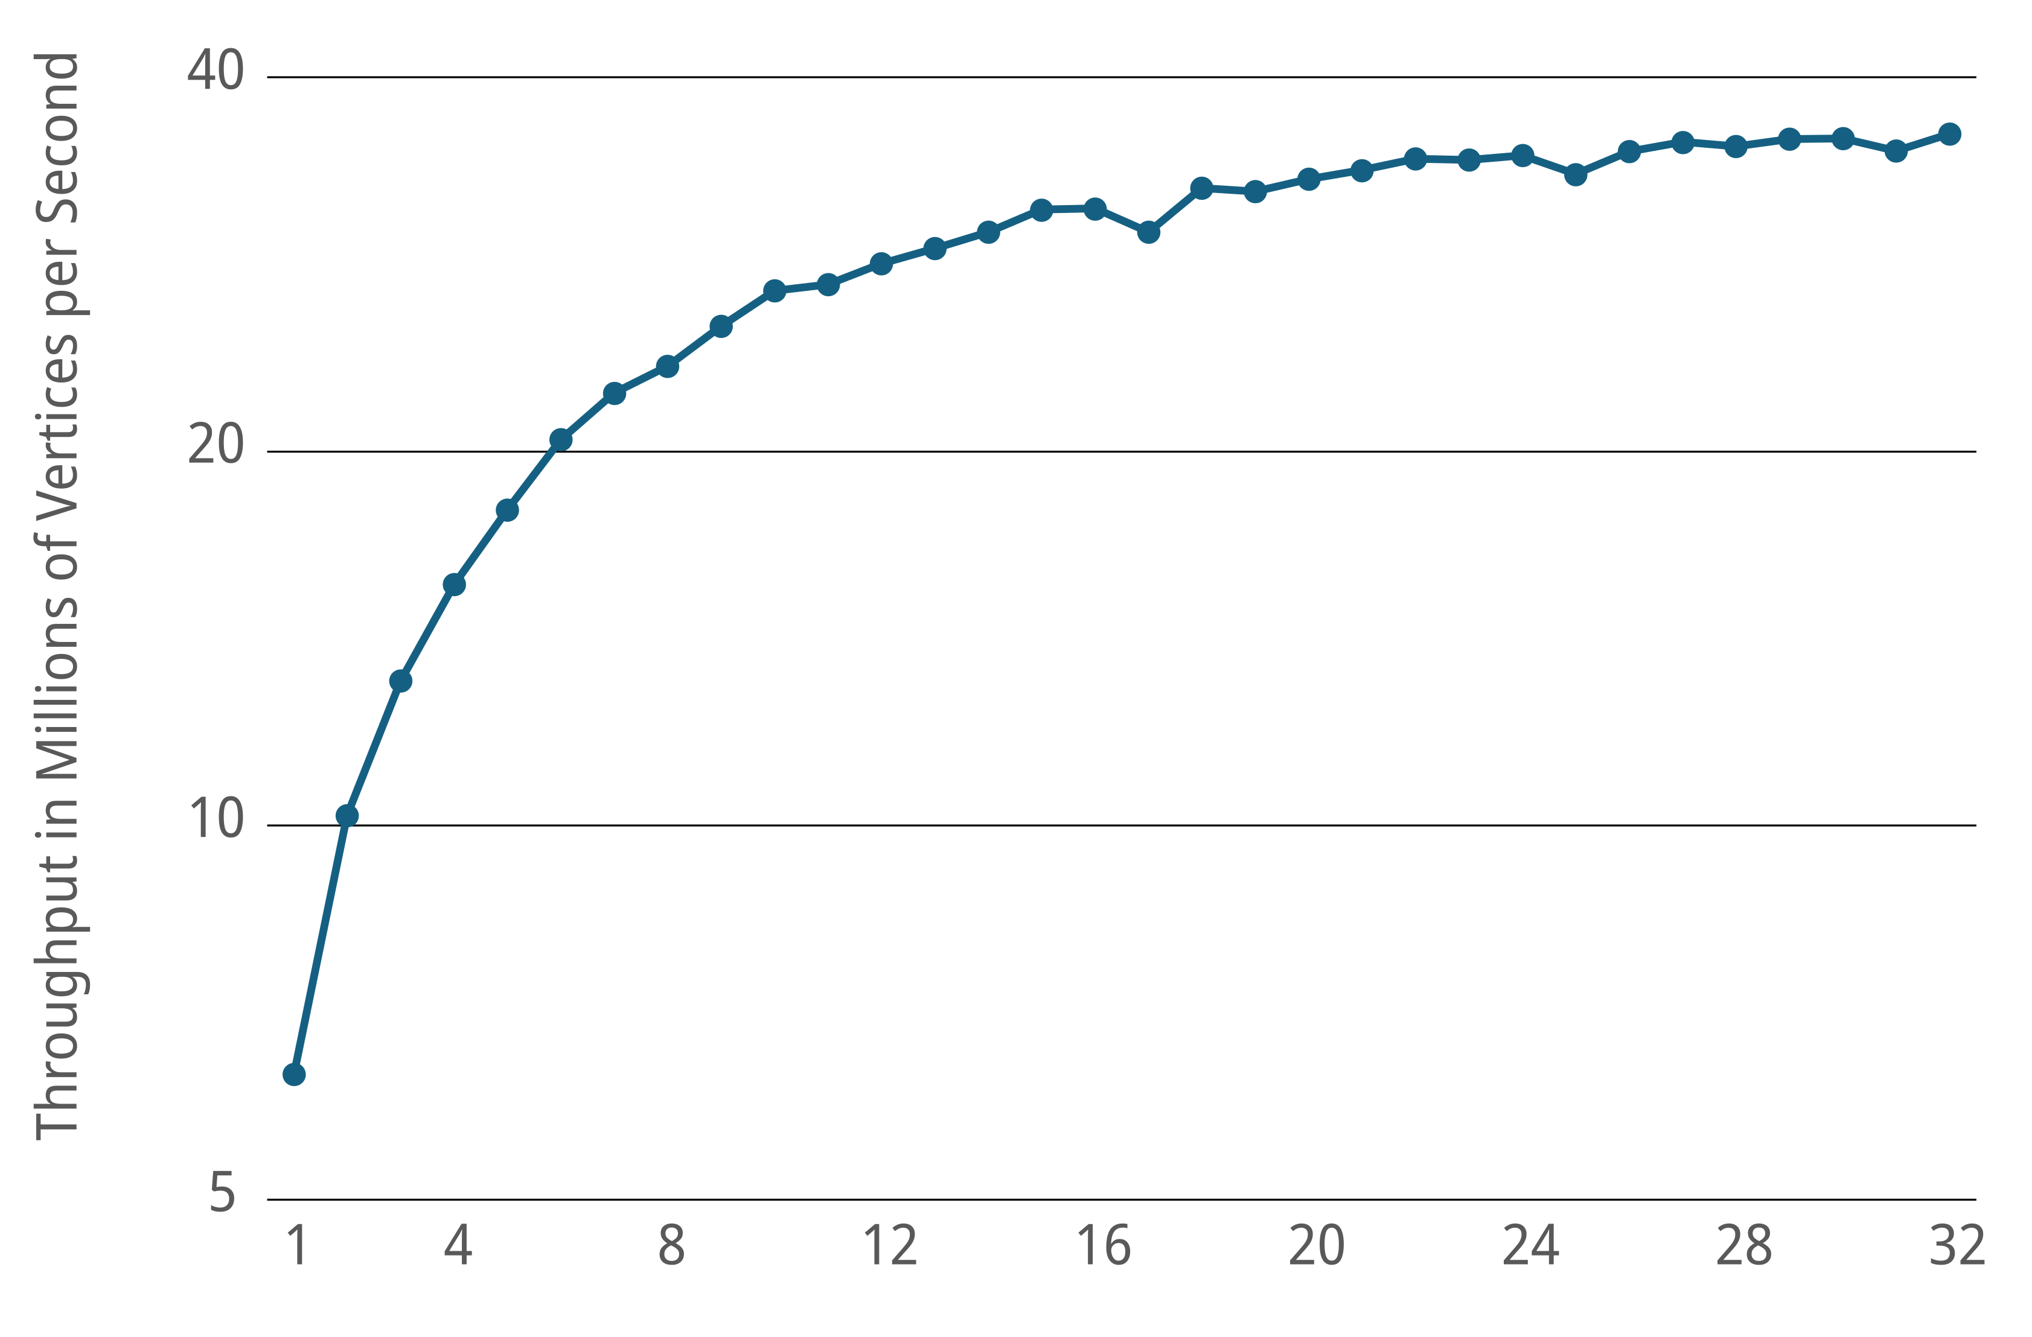
Scalability
Throughput is impacted by difficulty of the graph
Deeper search trees improve work-stealing

Slide 21
Summary
HP-MC outperforms the leading implementations due to a hybrid strategy
  Pivot vertex branching
  Iterative coloring
  Connected component pruning
Code available at github.com/burtscher/HP-MC
Contact: clb420@txstate.edu

