Slide 1


On the Compressibility of Floating-Point Data in Posit and IEEE-754 Representation
Andrew Rodriguez* and Martin Burtscher
Department of Computer Science

Slide 2
Floating-Point Arithmetic
IEEE-754: primary real number representation
Used extensively in scientific computing
Floating-point operations have problems
Finite precision and accuracy
Inconsistent results based on implementation
Less precise types (float16, float8, etc.)
Can speed up computation at the cost of accuracy

Slide 3
Posit Representation
Introduced as a direct drop-in replacement
Alleviates some issues with the IEEE-754 standard
Variable-length fraction and exponent
Larger dynamic range
Higher accuracy than IEEE floats of the same size
Many prior comparisons of posits to floats
Convert float data to posit data in experiments
Hardware units have been tested in simulators
Posits are more accurate and in some cases faster

Slide 4
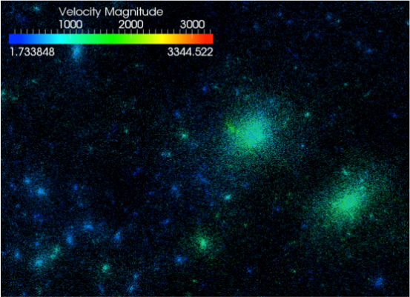
Scientific Applications
Applications emit huge amounts of float data
HACC generates petabytes of data in one simulation
Certain applications need higher accuracy
Use posits instead of floats
However, no prior work on compressibility of posits
HACC Visualization (ornl.gov)

Slide 5
This Work
Studies compressibility of posits and floats
Takes existing float data and converts to posit data
Compares the compression ratios of both encodings
Investigates 5 existing lossless compressors
Along with several newly synthesized compressors
Uses 14 single-precision inputs from SDRBench
From 7 different scientific domains

Slide 6
Float and Posit
Representations
6

Slide 7
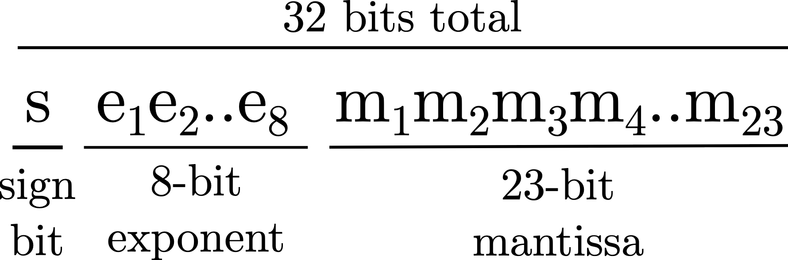
IEEE-754 Floats
A float has 3 fields: sign, exponent and mantissa
A 32-bit float has
Sign bit, 8-bit biased exponent, 23-bit mantissa
Can represent normal values and special values
Subnormals, Not-a-Number (NaNs), +/- infinity

Slide 8

Posits
A posit has 4 fields
Sign, regime, exponent and fraction
The regime acts as additional scaling of the exponent
All fields but the sign have variable-length
Posits are most accurate for values close to 1.0

Slide 9
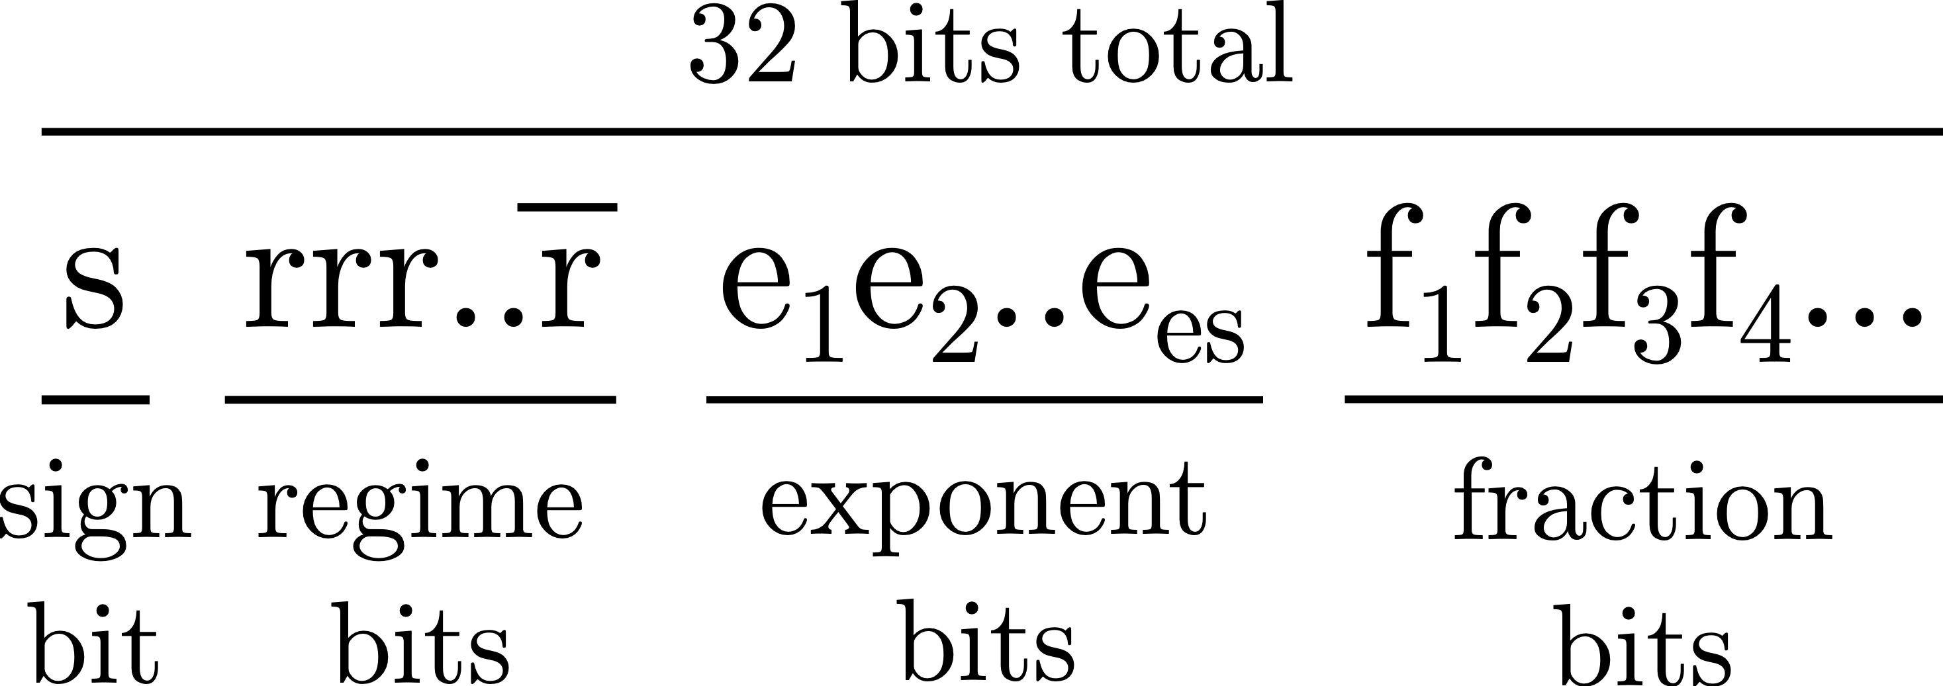
Posit<n, es>
A posit is parameterized by n and es
n is the total number of bits
es is the maximum number of exponent bits
Together create a posit<n, es> number

Slide 10
Posit<32, es> Regime
Regime r is computed by counting identical bits
k identical bits terminated by an opposite bit
If regime starts with a 0, r = -k
If regime starts with a 1, r = k - 1

Slide 11
Posit<32, es> Exponent & Fraction
The exponent begins after the regime
Is stored as an unsigned integer with no bias
The rest of the bits make up the fraction
There is an implicit 1 bit just like with IEEE floats
Negative posits are encoded in 2’s complement

Slide 12
Posit<32, es> Special Values
There are only 2 special values
Zero: all bits are 0
Not-a-Real (NaR): sign bit is set, followed by all 0s
Posits have no subnormals

Slide 13
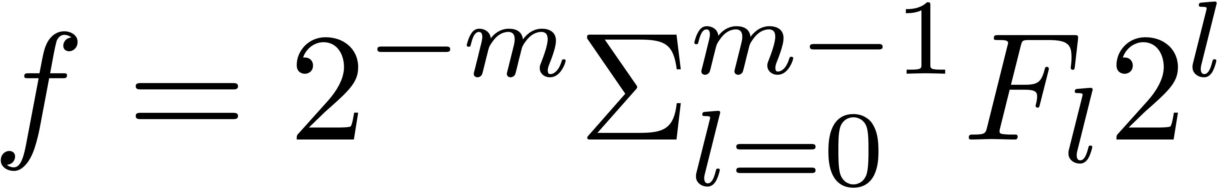
Numeric Value of a Posit
Compute fraction f with the following formula
m is the number of fraction bits
F is the fraction bitstring
The posit value v is computed with

Slide 14
Experimental
Methodology
14

Slide 15
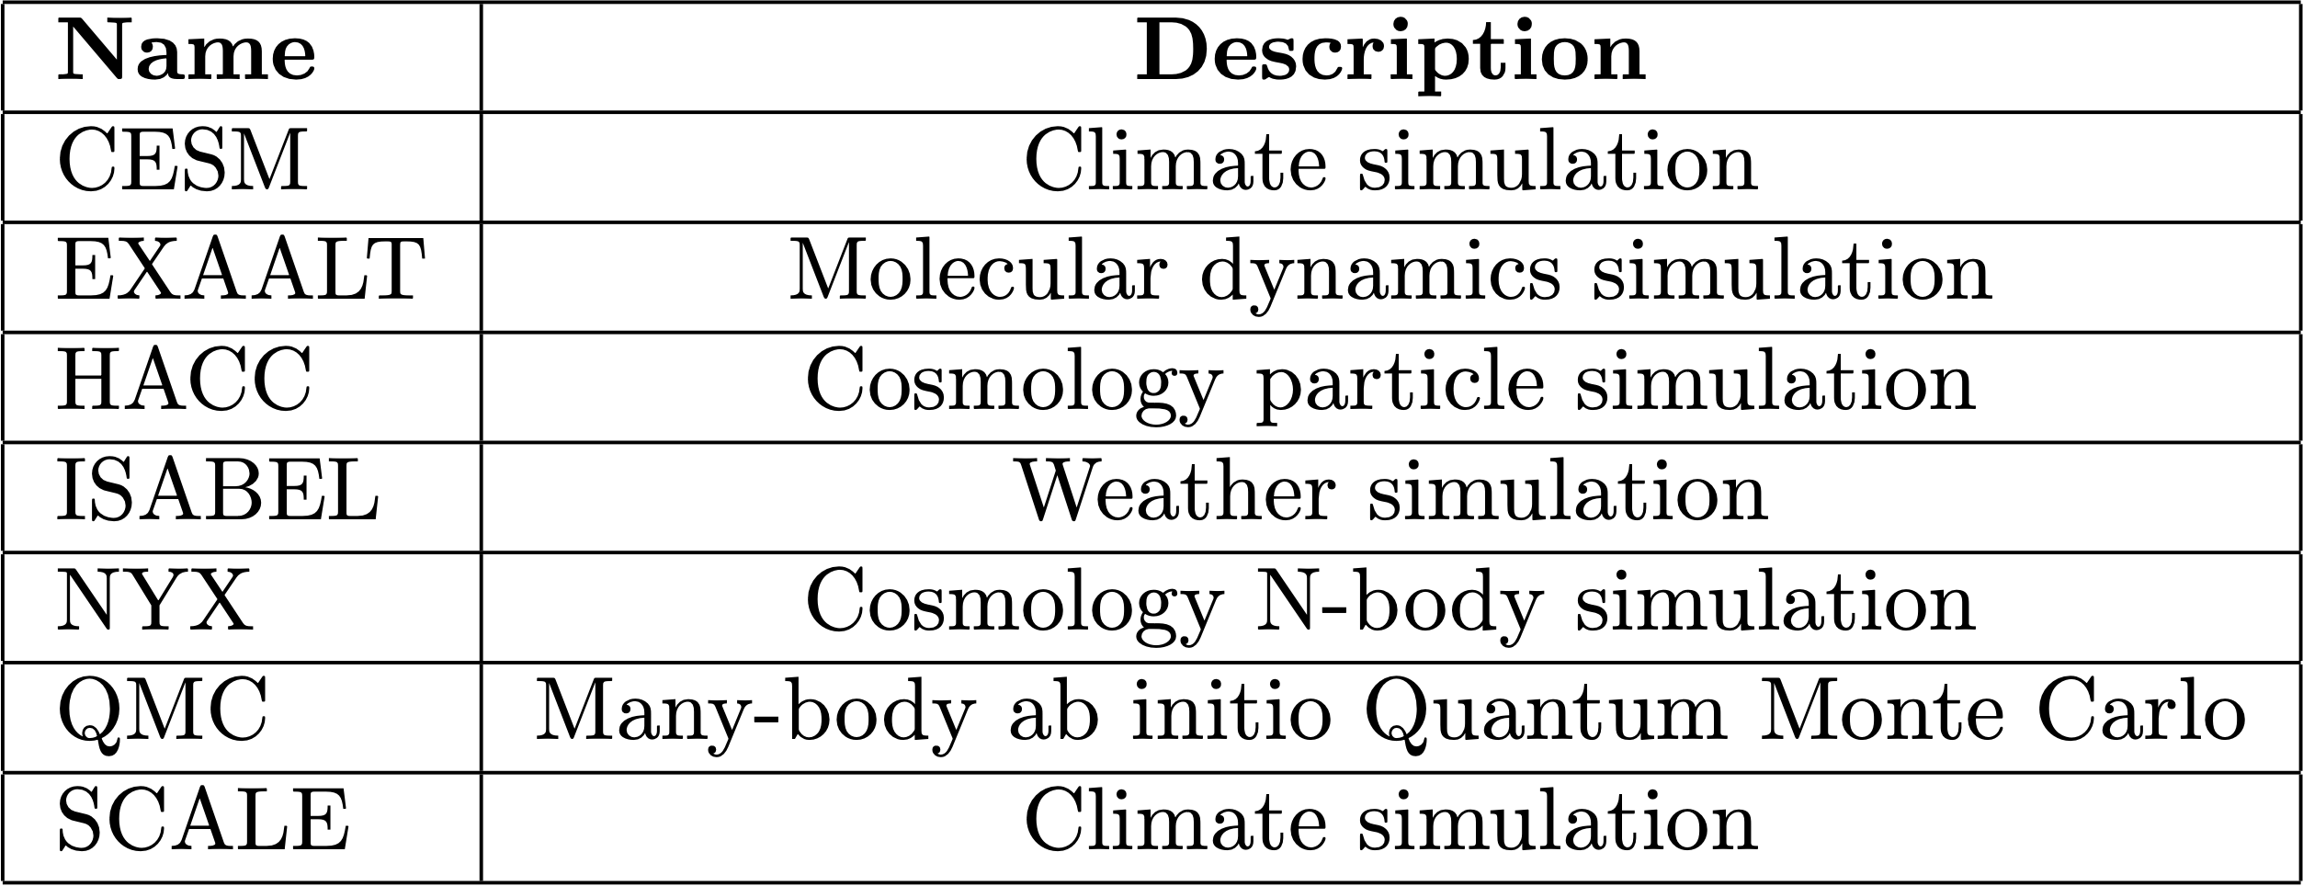
Datasets
7 SDRBench datasets from different domains

Slide 16
Inputs
14 single-precision inputs, 2 from each dataset

Slide 17

Float to Posit
Use the cppposit library for conversion
For each float input, copy and encode as posit
Use 32-bit posits with es=3 for our experiments
Standard 32-bit posit use es=2
We found that es=3 preserves more floats losslessly
es=3 yields 97.1% precise values
es=2 yields 85.6% precise values

Slide 18


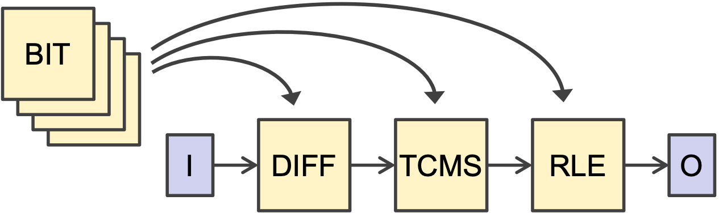
LC Framework
LC generates compression algorithms
Can be lossless and lossy
Based on a library of data transformations
LC chains transformations together
Yields many possible compression algorithms
Generated 512,000 3-stage pipelines (80 components)

Slide 19

Compressors
5 lossless general-purpose compressors
bzip2, gzip, lz4, XZ, Zstd
Generate several new compressors with LC
1 compressor for all float inputs
1 compressor for all posit inputs
Customized compressor approach
1 LC compressor per input, 28 in total
We report the geometric-mean compression ratio

Slide 20
Results

Slide 21
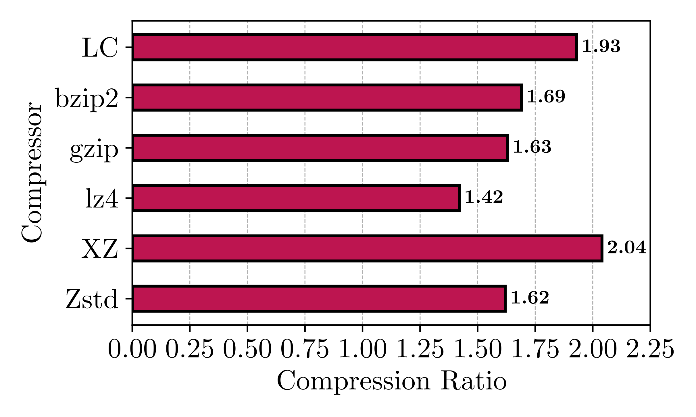
Float Compression Ratios
Highest: XZ
Best dictionary approach
Followed by LC
Lowest: lz4
lz4 designed for speed
Zstd, bzip2, gzip
Roughly the same CR

Slide 22
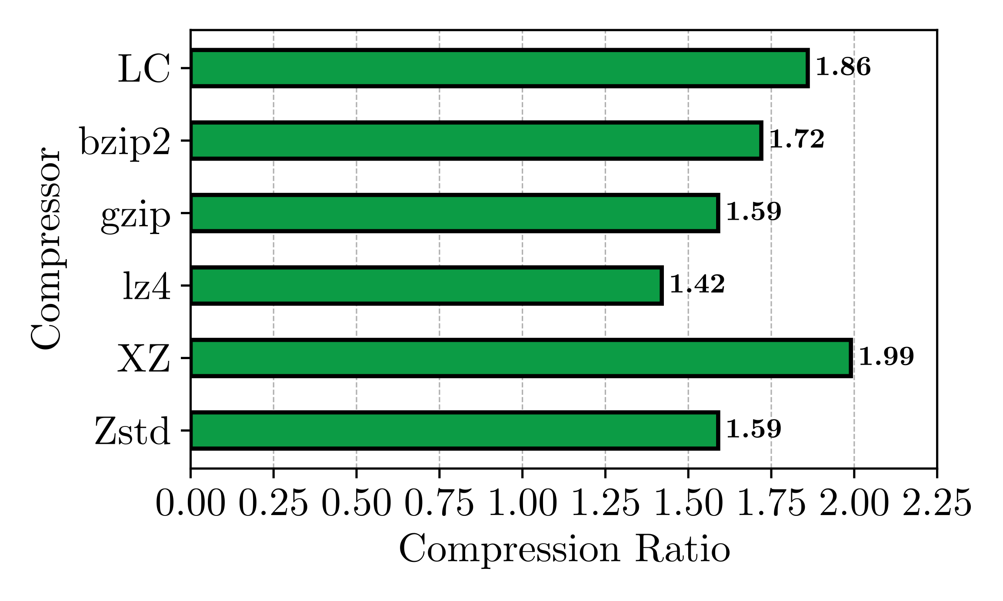
Posit Compression Ratios
Highest: XZ
Again, followed by LC
Lowest: lz4
Lower than float data
1.85-3.62% reduction in CR
bzip2 compresses better
lz4 remains the same

Slide 23
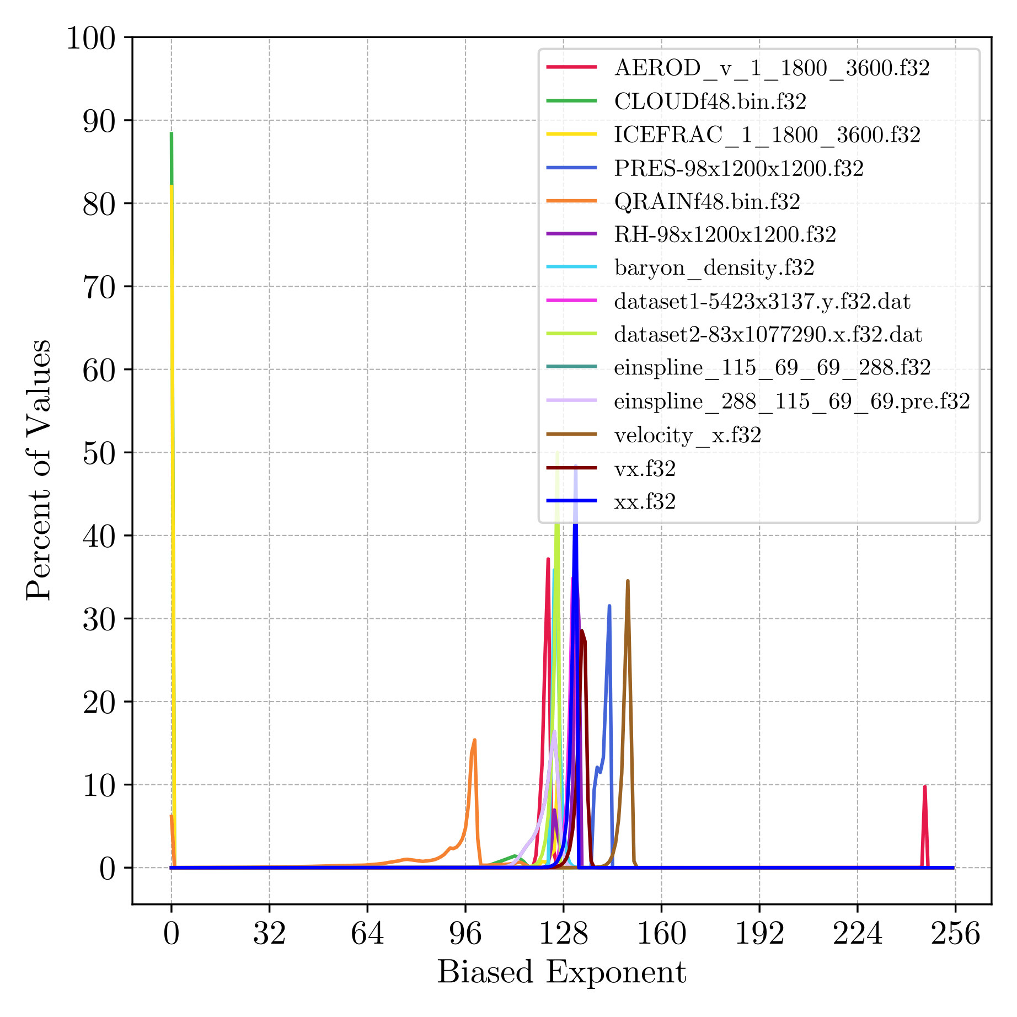
Histogram of Float Exponent Values
Most expo. around 128
Most values close to 1.0
QRAIN, CLOUD, ICEFRAC
Contain many zeros and subnormal values
Posits are more accurate for values close to 1.0
QRAIN compresses better in posit format
Due to loss in accuracy

Slide 24
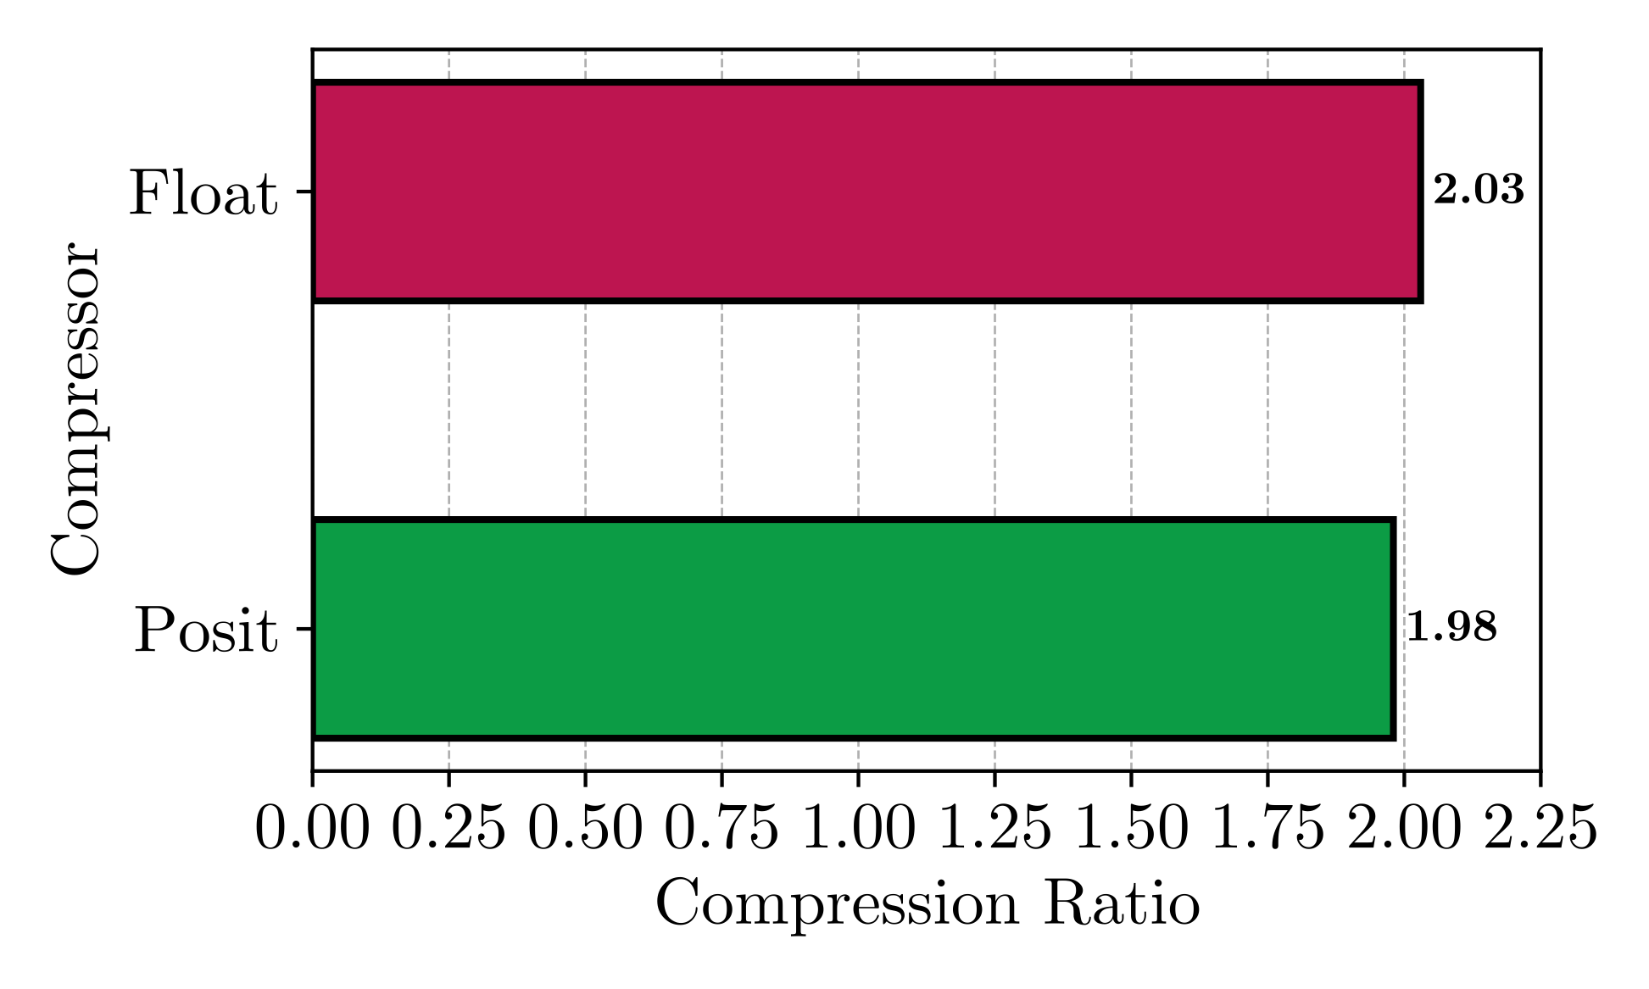


Customized Pipeline CR
Floats compress better
But not by much
Custom LC pipelines
On par with XZ

Slide 25
Conclusion
First study on posit compressibility
XZ provides highest compression on both formats
Customized LC pipelines on par with XZ
But faster and CPU/GPU compatible
Posit compressibility slightly lower than floats
Storing scientific data in posit format is a viable option
Converting float to posit may incur some loss
Aim to natively use posits to avoid this loss

Slide 26

Future Work
Study other metrics
Compression/decompression throughput
Memory overhead
Other values for es
Create special-purpose posit compressors
Compare against special-purpose float compressors

Slide 27
Thank you!
Acknowledgments
Department of Energy, reviewers
Contact information
andrew.rodriguez@txstate.edu

