Slide 1


Signed Graph Balancing in Linear Time
Avery VanAusdal*, Lucas Rusnak, Martin Burtscher

Slide 2
Social Networks
Large amounts of human interaction is now occurring online
People express opinions via social networks and online surveys
Signed graphs can represent
these sentiments
  Vertices are people, products, etc.
  Edges are agreeable (+1) or antagonistic (-1)

Slide 3
Signed Graph Balancing
Graphs are balanced if every cycle is positive
  Cycles contain an even number of negative edges
  Represents a consistent network-wide consensus
  Numerous possible balanced states
Positive
Positive
Negative

Slide 4
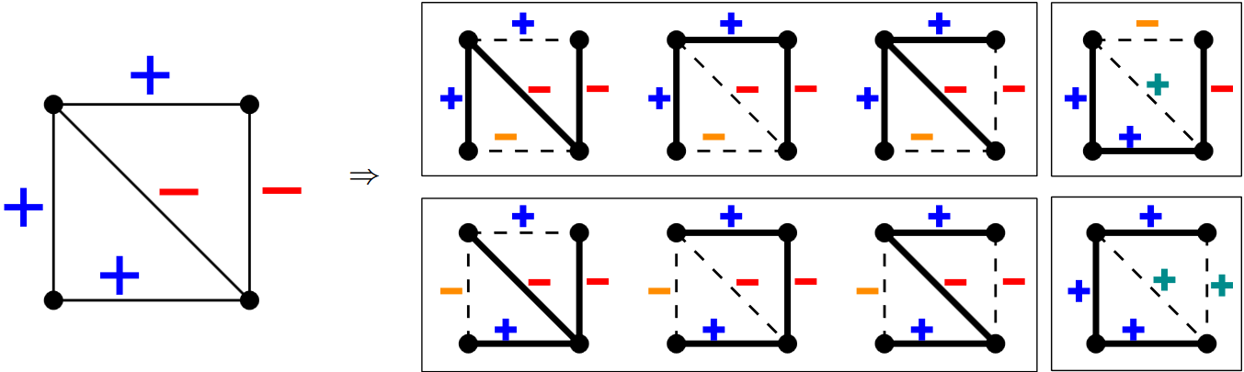
Signed Graph Balancing with Trees
graphB and graphB+ sample balanced states using spanning trees
Re-introducing edges forms fundamental cycles
  If the cycle is negative, invert the added edge
  Balance all cycles to balance the graph

Slide 5
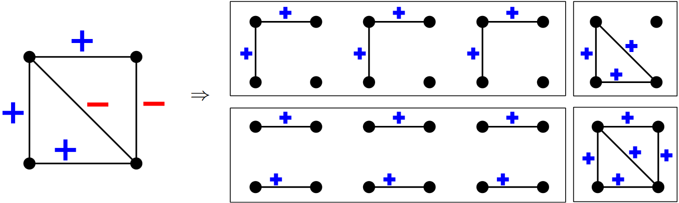
Harary Bipartitioning
Harary-bipartition identifies who is in the majority
Split balanced states along the negative edges
  The larger set is the “majority”
Sample many balanced states and track statistics
  e.g., how often vertices & edges are in the majority

Slide 6
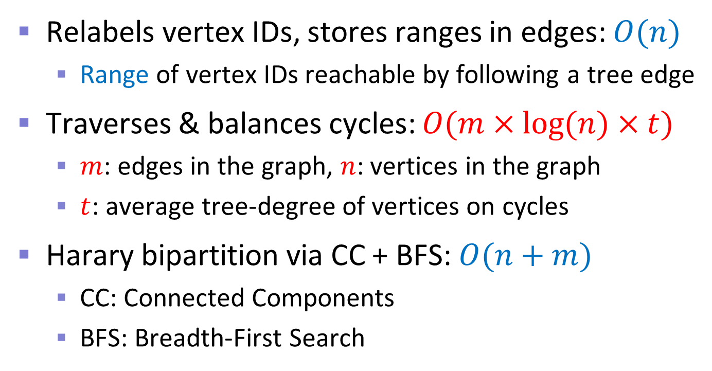
Prior Work: graphB+
Relabels vertex IDs, stores ranges in edges: $O(n)$
  Range of vertex IDs reachable by following a tree edge
Traverses & balances cycles: $O(m×log⁡(n)×t)$
  $m$: edges in the graph, $n$: vertices in the graph
  $t$: average tree-degree of vertices on cycles
Harary bipartition via CC + BFS: $O(n+m)$
  CC: Connected Components
  BFS: Breadth-First Search

Slide 7
Our ECL-SGB Algorithm

Slide 8
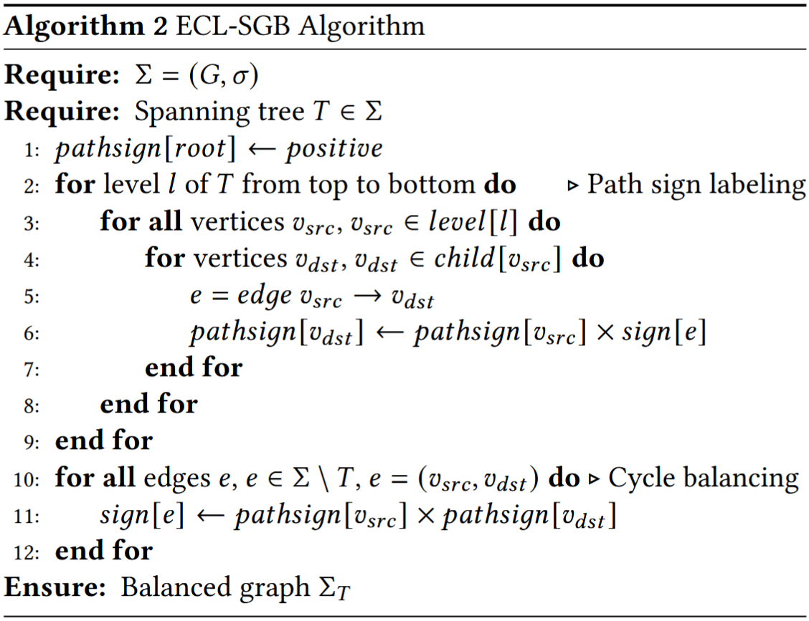
ECL-SGB Balancing
Traverse tree from root
1) Label vertices with sign of path from root
2) Balance edges by multiplying endpoint labels

Slide 9
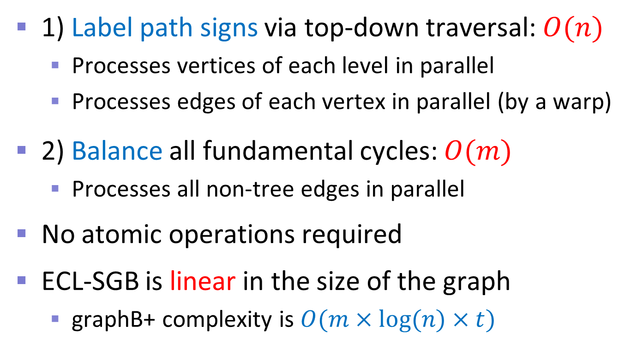
ECL-SGB Complexity & Parallelization
1) Label path signs via top-down traversal: $O(n)$
  Processes vertices of each level in parallel
  Processes edges of each vertex in parallel (by a warp)
2) Balance all fundamental cycles: $O(m)$
  Processes all non-tree edges in parallel
No atomic operations required
ECL-SGB is linear in the size of the graph
  graphB+ complexity is $O(m×log⁡(n)×t)$

Slide 10
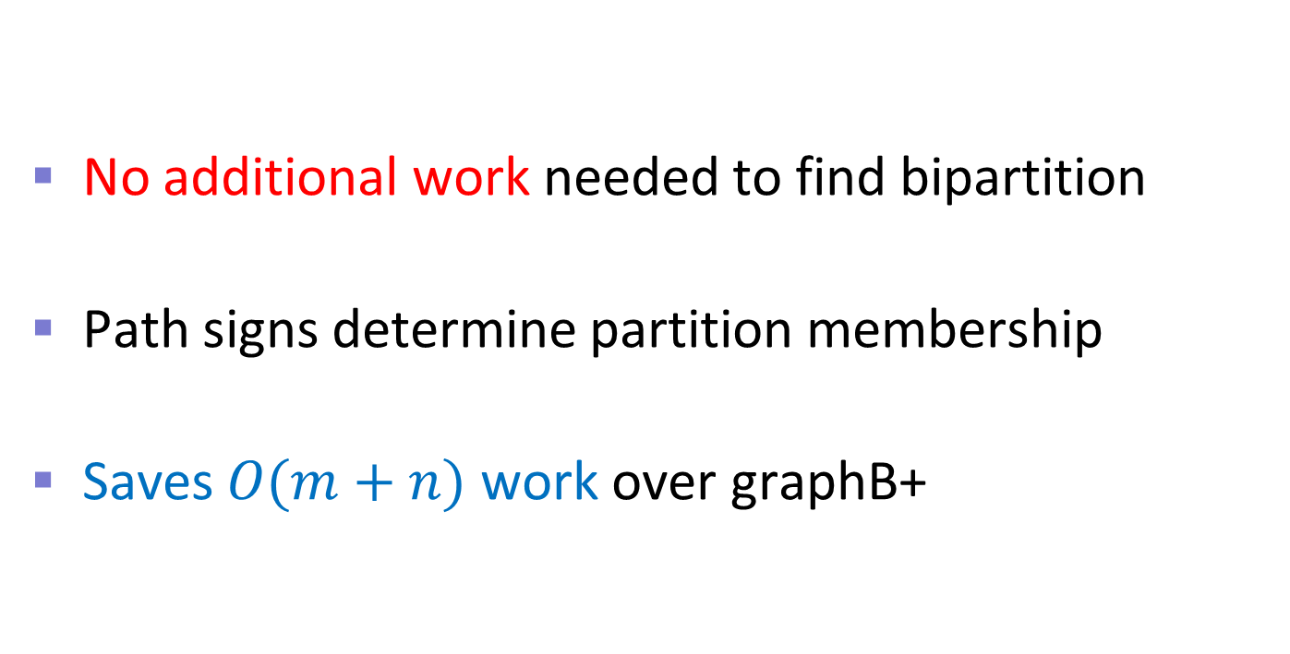
ECL-SGB Harary Bipartitioning
No additional work needed to find bipartition
Path signs determine partition membership
Saves $O(m+n)$ work over graphB+

Slide 11
GPU Implementation Details
Store signs (+1/-1) as Boolean values
Maintain a single copy of graph in CSR format
Represent trees with 1-bit edge flags in adj. lists
Tree generator produces an array of vertices partitioned by level, re-use to traverse the tree

Slide 12
Experimental Methodology

Slide 13
Performance Evaluation vs. graphB+
Timed: tree generation, balancing, bipartitioning
Not timed: reading input, allocating data structures, building internal representations
graphB+ and ECL-SGB
  Use the same parallel BFS tree generation code
  Generate the same 1000 random trees
  Compute the same results

Slide 14
Hardware & Software
RTX 4090, 24 GB of memory, 16384 PEs @ 2.24 GHz
  nvcc v12.6 with “-O3 -arch=sm_89” flags
A100, 40 GB of memory, 6912 PEs @ 765 MHz
  nvcc v12.0 with “-O3 -arch=sm_80” flags
  Results in full paper

Slide 15
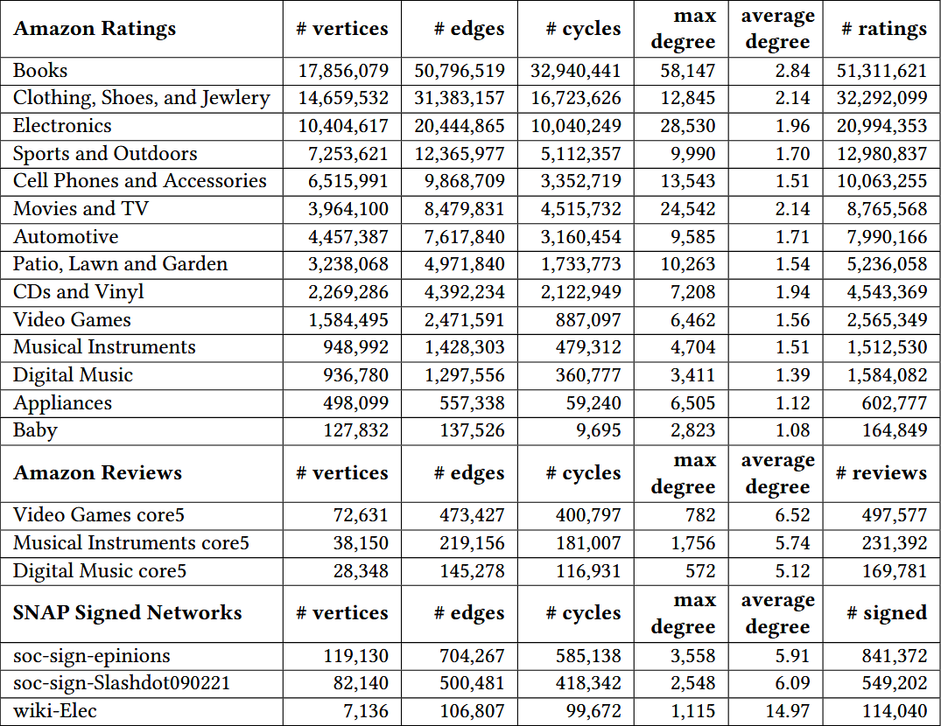
Inputs
20 signed graphs from Amazon and SNAP
Same type of inputs as in graphB+ work
  We chose
  larger versions
Graph stats are from largest CC

Slide 16
Results

Slide 17
Throughput Results on RTX 4090
logarithmic
Balances 524 million cycles per second
11.9x faster than graphB+
13.6x faster on A100, see full paper

Slide 18
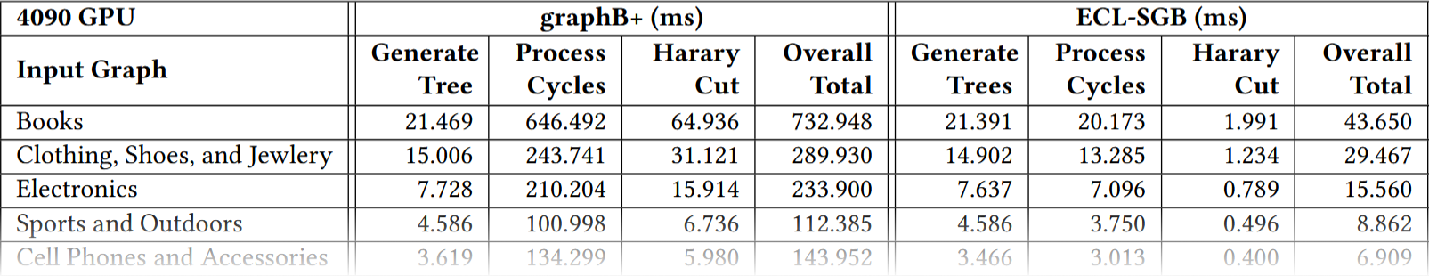
Tree Generation Overhead
We use the same code as graphB+ to generate trees
Ignoring tree gen, ECL-SGB is 24.3x and 29.3x faster than graphB+ on 4090 and A100, respectively

Slide 19
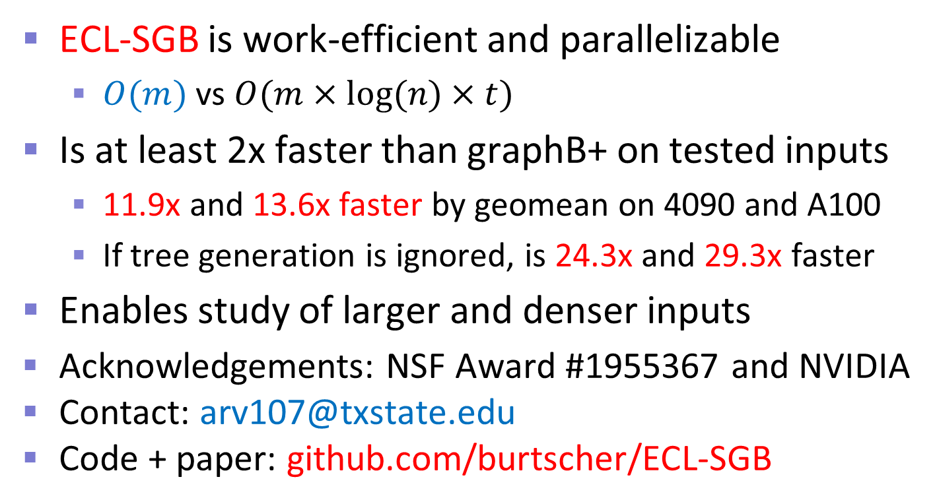
Summary
ECL-SGB is work-efficient and parallelizable
  $O(m)$ vs $O(m×log⁡(n)×t)$
Is at least 2x faster than graphB+ on tested inputs
  11.9x and 13.6x faster by geomean on 4090 and A100
  If tree generation is ignored, is 24.3x and 29.3x faster
Enables study of larger and denser inputs
Acknowledgements: NSF Award #1955367 and NVIDIA
Contact: arv107@txstate.edu
Code + paper: github.com/burtscher/ECL-SGB

Slide 20
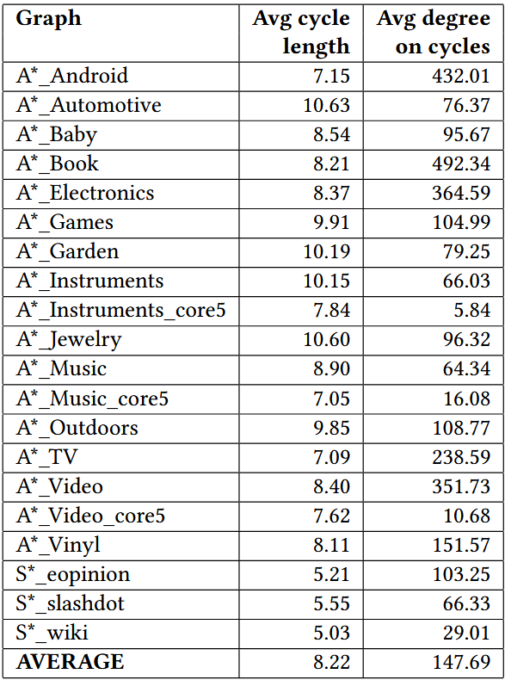
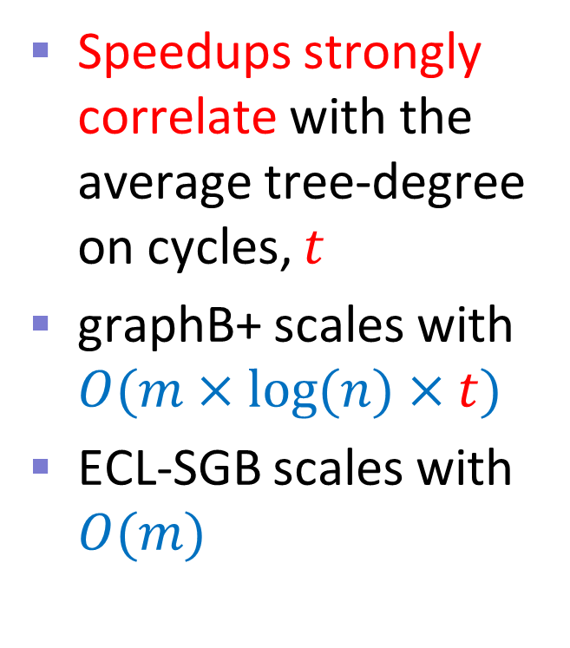
Correlations
Speedups strongly
correlate with the
average tree-degree
on cycles, $t$
graphB+ scales with
$O(m×log⁡(n)×t)$
ECL-SGB scales with $O(m)$

