Slide 1


Profiling Application-Specific Properties of Irregular Graph Algorithms on GPUs
Bishal Sharma* and Martin Burtscher
Department of Computer Science

Slide 2
Irregular Codes
Programs that have unpredictable control flow and memory-access patterns
Program execution is input dependent
  Program behavior may differ for different inputs and change during execution
Graph analytics codes are typically irregular
  E.g., each vertex can have a different degree

Slide 3
Profiling Irregular Programs
Standard profiling tools provide generic info
  E.g., function and kernel runtimes, memory allocations, stall times, and data transfer rates
They do not provide application-specific info
  E.g., number of conflicts between threads
Application-specific events must therefore be manually profiled

Slide 4
Importance of Manual Profiling
Study program-specific behavior
  To detect potential bottlenecks
  To validate key assumptions
  To understand observed behaviors
Develop application-specific optimizations
Augment output from standard profilers

Slide 5
Our Work
We study 5 high-performance graph codes
  Connected Components (CC)
  Graph Coloring (GC)
  Maximal Independent Set (MIS)
  Minimum Spanning Tree (MST)
  Strongly Connected Components (SCC)
Manually insert counters into CUDA code
Analyze data, investigate behavior, and devise optimizations based on profiled counts

Slide 6
Experimental Methodology
GPU: NVIDIA GeForce RTX 4090
  16,384 CUDA cores organized into 128 SMs
  Compiler flags: -O3 -arch=sm_89
Host System
  CPU: AMD Ryzen Threadripper 2950X
    32 hardware threads
  128 GB DDR4 main memory
  Fedora Linux, kernel version 6.12.8

Slide 7
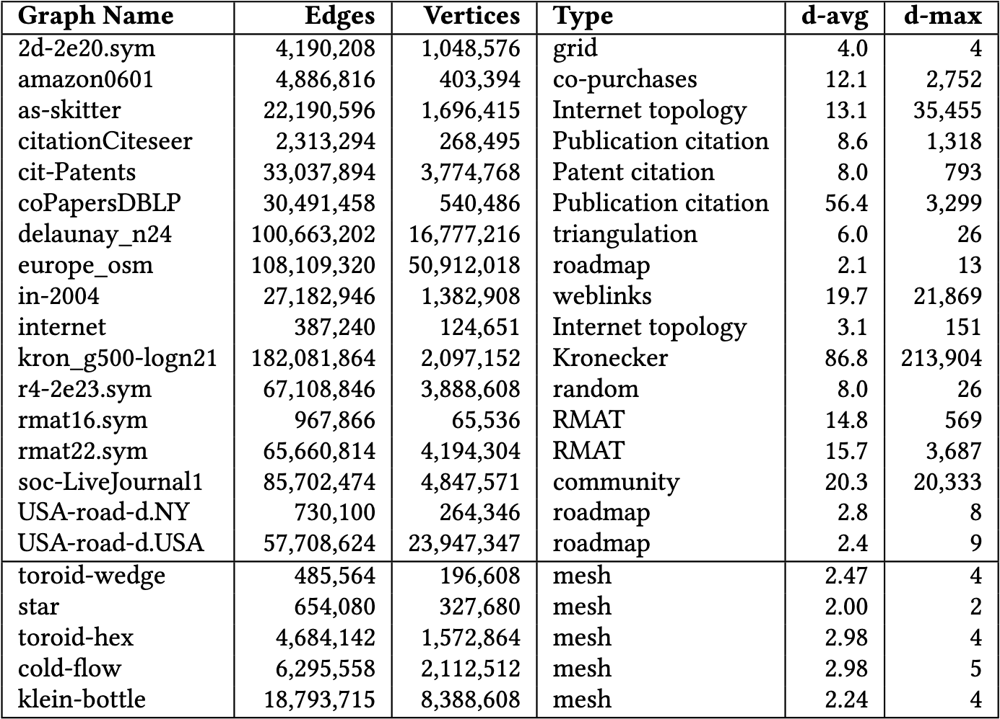
Input Graphs
17 undirected graphs for CC, GC, MIS, and MST code
5 directed mesh graphs for SCC code

Slide 8
Connected Components (CC)
J. Jaiganesh and M. Burtscher. "A High-Performance Connected Components Implementation for GPUs." In Proceedings of the 2018 ACM International Symposium on High-Performance Parallel and Distributed Computing. 2018.

Slide 9
ECL-CC Implementation (3 Phases)
Initialization
  Assign initial label values to vertex ID of first seen smaller neighbor
  Label value is vertex ID if no smaller neighbors exist
Computation
  Find (pointer jumping) and merge (hooking) with lower label (i.e., union-find with path compression)
Finalization
  Shortens path lengths to 1 (compute final labels)

Slide 10
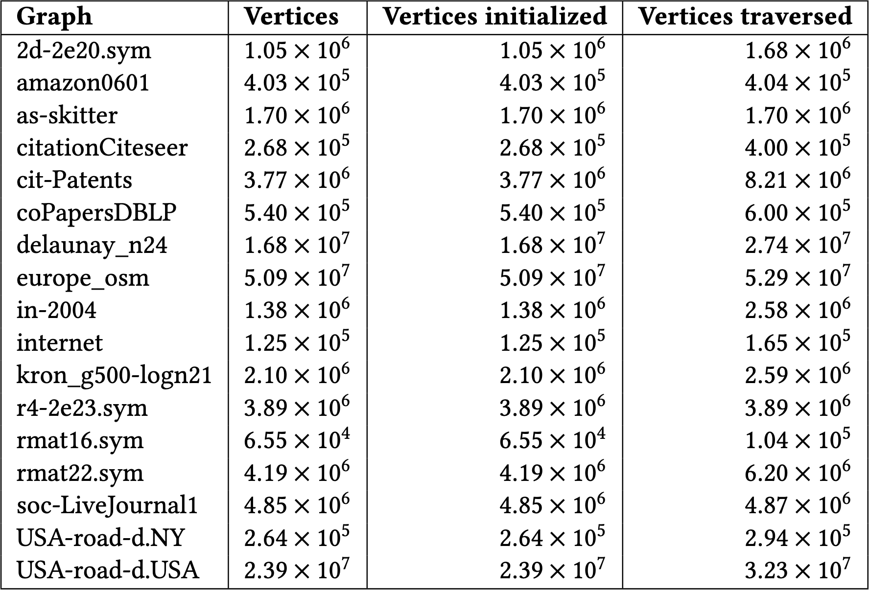
Profiling Results
Vertices traversed close to the number of vertices initialized
Indicates single neighbor scanned for every vertex initialized
Vertices initialized vs. vertices traversed in the init kernel
Lot more traversals observed for some inputs
The number of vertices initialized must be equal to the total number of vertices

Slide 11
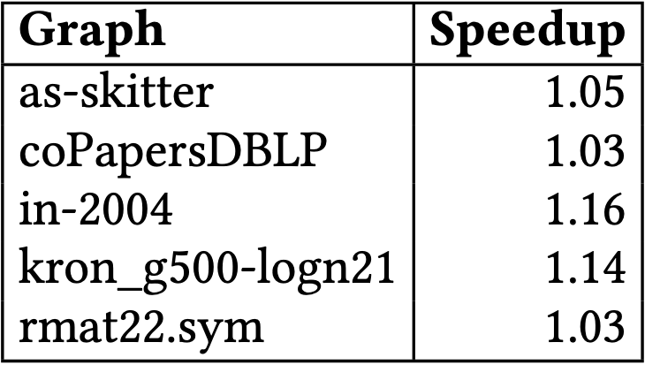
CC Code Optimization
Vertex labels initialized as follows
  Assign vertex’s label to ID of first neighbor
  If vertex ID < label, update label to vertex ID
Noticeable speedup on some graphs
  Init kernel is already fast for other inputs
Inputs with notable speedups after optimization

Slide 12
Maximal Independent Set (MIS)
M. Burtscher, S. Devale, S. Azimi, J. Jaiganesh, and E. Powers. "A High-Quality and Fast Maximal Independent Set Implementation for GPUs." ACM Transactions on Parallel Computing, Vol. 5, No. 2, Article 8. 2018.
Profiling Application-Specific Properties of Irregular Graph Algorithms on GPUs

Slide 13
ECL-MIS Permutation-Selection Algorithm
Initialization
  Assign priorities based on degree
    Nodes with the same degree use tie breaker
Selection
  Add vertices with highest local priority to set
  Remove their neighbors from consideration

Slide 14
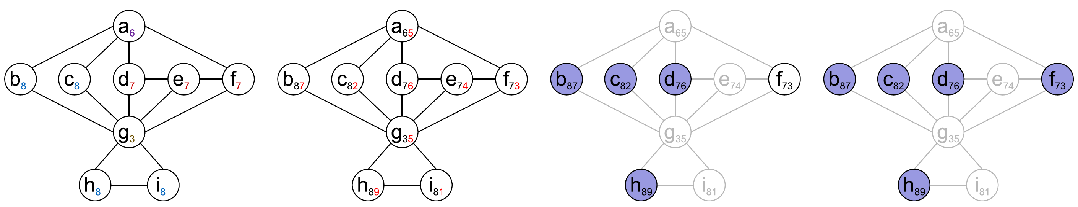
ECL-MIS Permutation-Selection Algorithm
Compute priorities based on degree
Randomize within degree (i.e., apply tie breaker)
Select vertices with locally maximal priority
Remove their neighbors (grayed out)
Repeat using same priorities until no more vertices remain

Slide 15
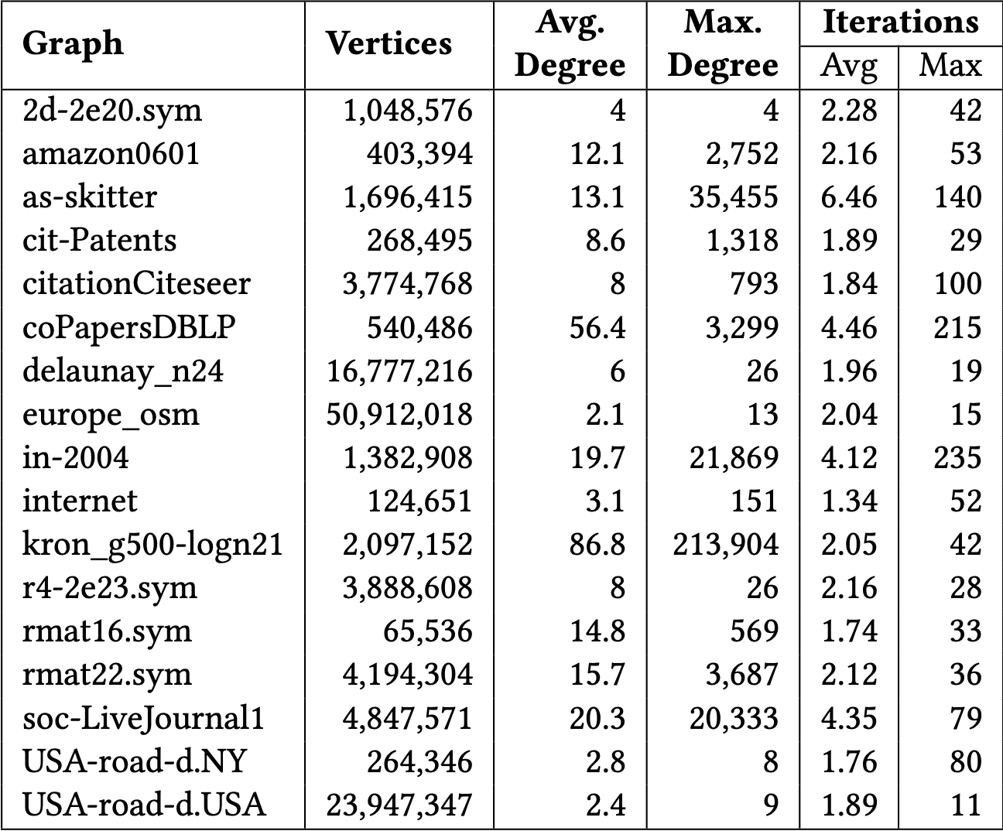
ECL-MIS Profiling Results
Per thread statistics of counters of the main computation kernel
196,608 threads launched
Small: most decisions are locally made based on neighboring vertices
Max. is larger in smaller graphs
Amount of work per thread is small
Thread loops many times before any progress made by neighbors

Slide 16
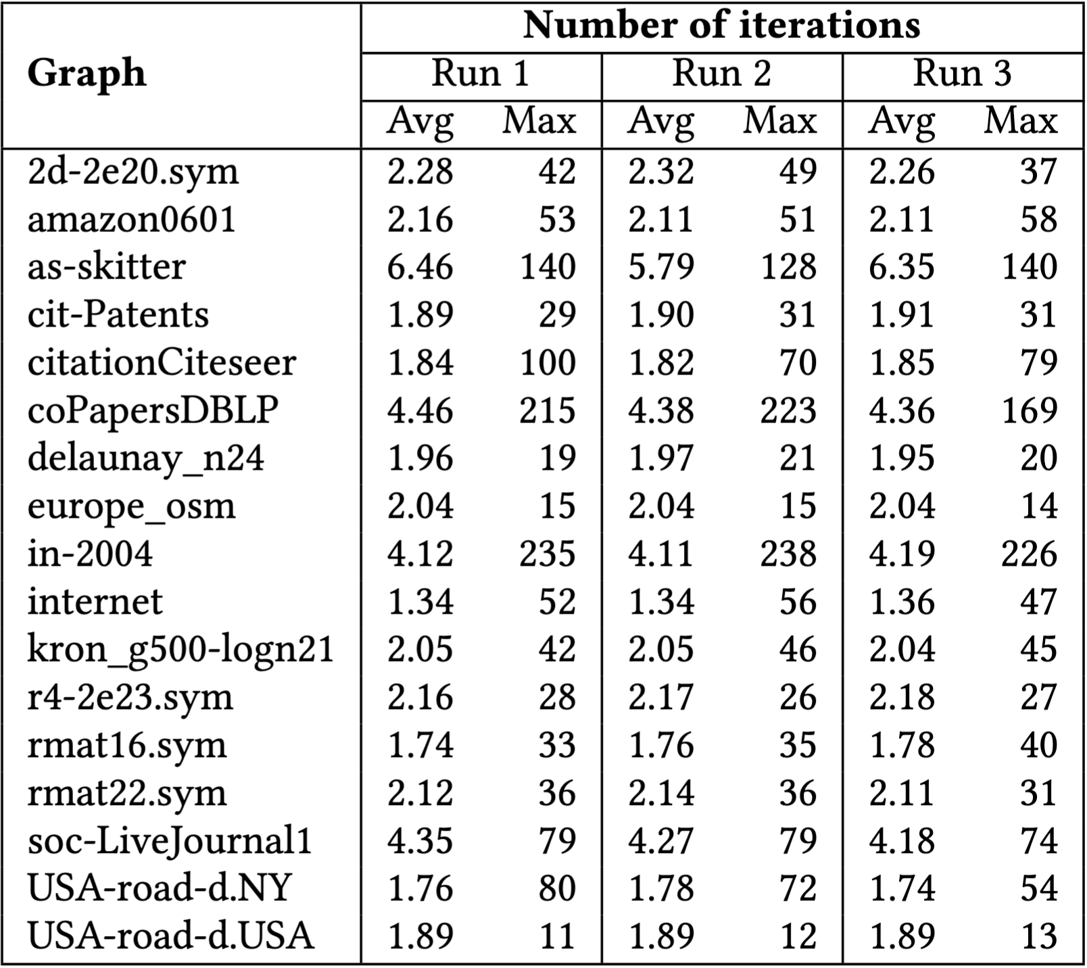
Profiling Results – Multiple Runs
ECL-MIS is asynchronous
  Exhibits thread-timing dependent behavior
  Internally non-deterministic
  Final result is deterministic
  Thread statistics can vary between runs
Manual profiling data can vary for thread-timing-sensitive events

Slide 17
Minimum Spanning Tree (MST)
Fallin, Alex, Andres Gonzalez, Jarim Seo, and Martin Burtscher. "A High-Performance MST Implementation for GPUs." In Proceedings of the International Conference for High Performance Computing, Networking, Storage and Analysis. 2023.

Slide 18
ECL-MST Implementation
Based on Kruskal’s algorithm
  Partition edges into ‘light’ and ‘heavy’ lists (weight)
    MST might get built using only the ‘light’ edges
  Use a weight threshold to partition edges
    Randomly sample 20 edge weights and sort them
    Threshold = weight at index (4|V|/|E|)*20
  Filter → edges checked for cycles before processing
    Filter or partition only when average degree > 4

Slide 19
Profiling Results
ECL-MST main computation kernel (K1) event counts
Iterations before filtering
Figure: ECL-MST main computation kernel (K1) event counts
Input graph: amazon0601
Input graph: amazon0601
Per iteration statistics of 3 events
  Fraction of threads assigned some task (blue bars)
  Percentage of conflicting threads (orange bars)
  Fraction of ineffective (failed) atomics (green bars)

Slide 20
Profiling Results
ECL-MST main computation kernel (K1) event counts
Iterations before filtering
Input graph: amazon0601
Thread conflicts decrease as iterations progress
  Atomic-operation guards mostly pass initially
  Atomic-operation guards mostly fail later on

Slide 21
Profiling Results
ECL-MST main computation kernel (K1) event counts
Iterations before filtering
Input graph: amazon0601
Failure rate of atomics tends to increase
  Atomics target fewer locations in later iterations
Most threads idle in later iterations

Slide 22
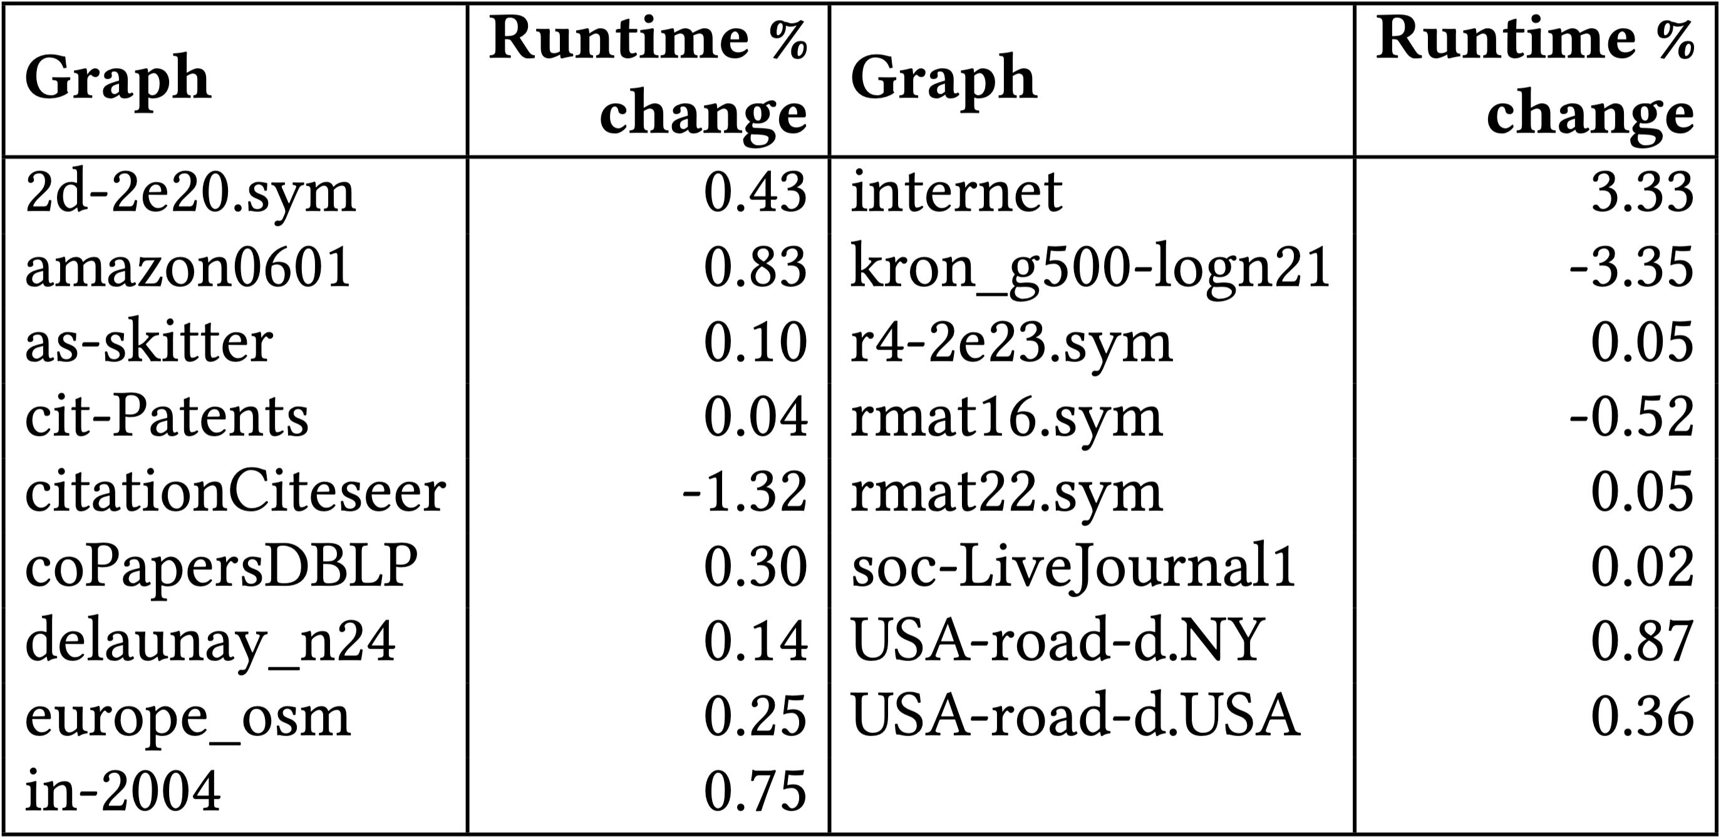
MST Code Optimization
Analysis: incorrect kernel launch configuration
  More thread blocks launched than necessary
Degraded performance on some inputs
Launch config computations more expensive than launching excess threads

Slide 23
Strongly Connected Components (SCC)
G. Alabandi, W. Sands, G. Biros, and M. Burtscher. "A GPU Algorithm for Detecting Strongly Connected Components." In Proceedings of the 2023 ACM/IEEE International Conference for High Performance Computing, Networking, Storage, and Analysis. Article 17. 2023.

Slide 24
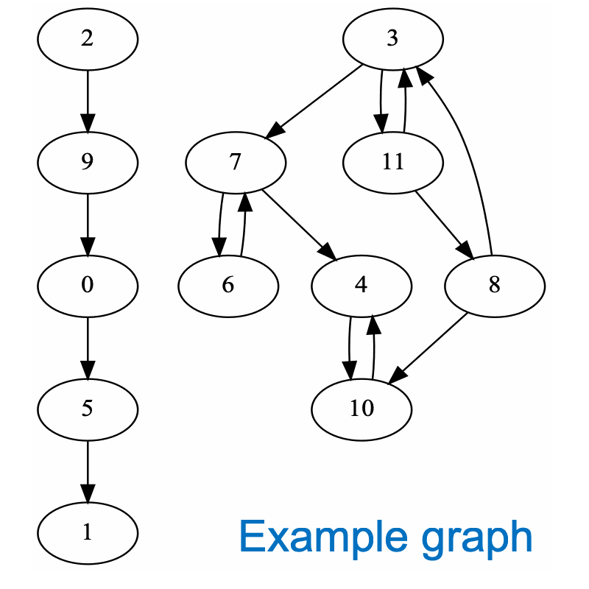
ECL-SCC Algorithm
Computes two signature values v_{in} and v_{out} for each vertex
  𝑣_{𝑖𝑛}: max reachable vertex ID on incoming paths
  𝑣_{𝑜𝑢𝑡}: max reachable vertex ID on outgoing paths
Step 1: signature initialization
  Initializes signature values to vertex ID
Step 2: maximum-value propagation
  Updates signatures until fixed-point reached
    𝑣_{𝑖𝑛} = max of itself and 𝑣_{𝑖𝑛} of in-neighbors
    𝑣_{𝑜𝑢𝑡} = max of itself and 𝑣_{𝑜𝑢𝑡} of out-neighbors
Step 3: edge removal
  Delete edges between differing signatures
Repeat above steps until every vertex satisfies 𝑣_{𝑖𝑛} = 𝑣_{out}

Slide 25
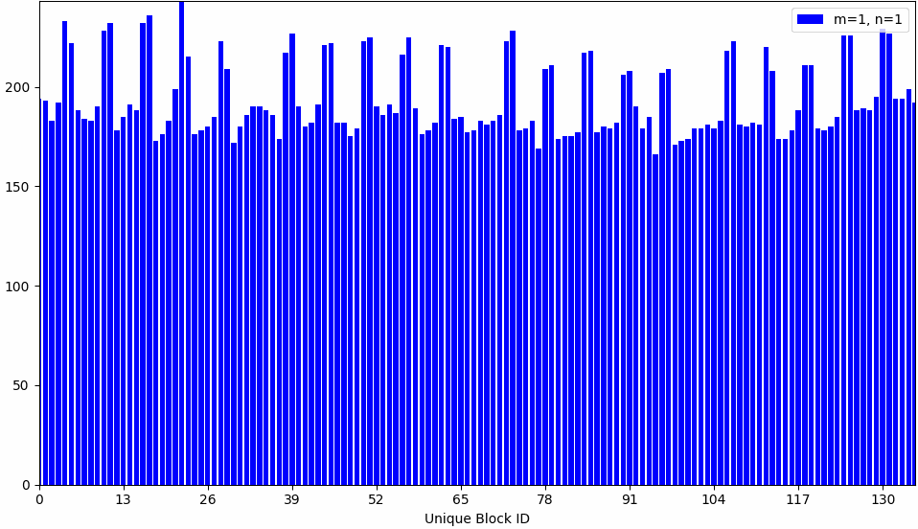

Profiling Results
Block-aggregate signature propagation counts vs. block Id
m = outer loop counter (Step 1)
Signatures reset to vertex Id
n = inner loop counter (Steps 2 and 3)
Current signature propagation iteration
Max-reachable vertex-ID updates
Thread-block level
Graph: cold-flow
Nodes: 2,112,512
Edges: 6,295,941
Block-local signature propagations
+1 block iteration (n) when one or more of its threads update signature
Updates decrease drastically
Most activity at first update round (n=1) for each new m

Slide 26
SCC Code Behavior Analysis
Signature update by single thread triggers extra iteration in corresponding thread block
  Triggers additional outer loop iteration
Smaller block sizes localize these updates
  But spread activity to more blocks → more outer loop iterations
→ Performance depends on threads per block

Slide 27
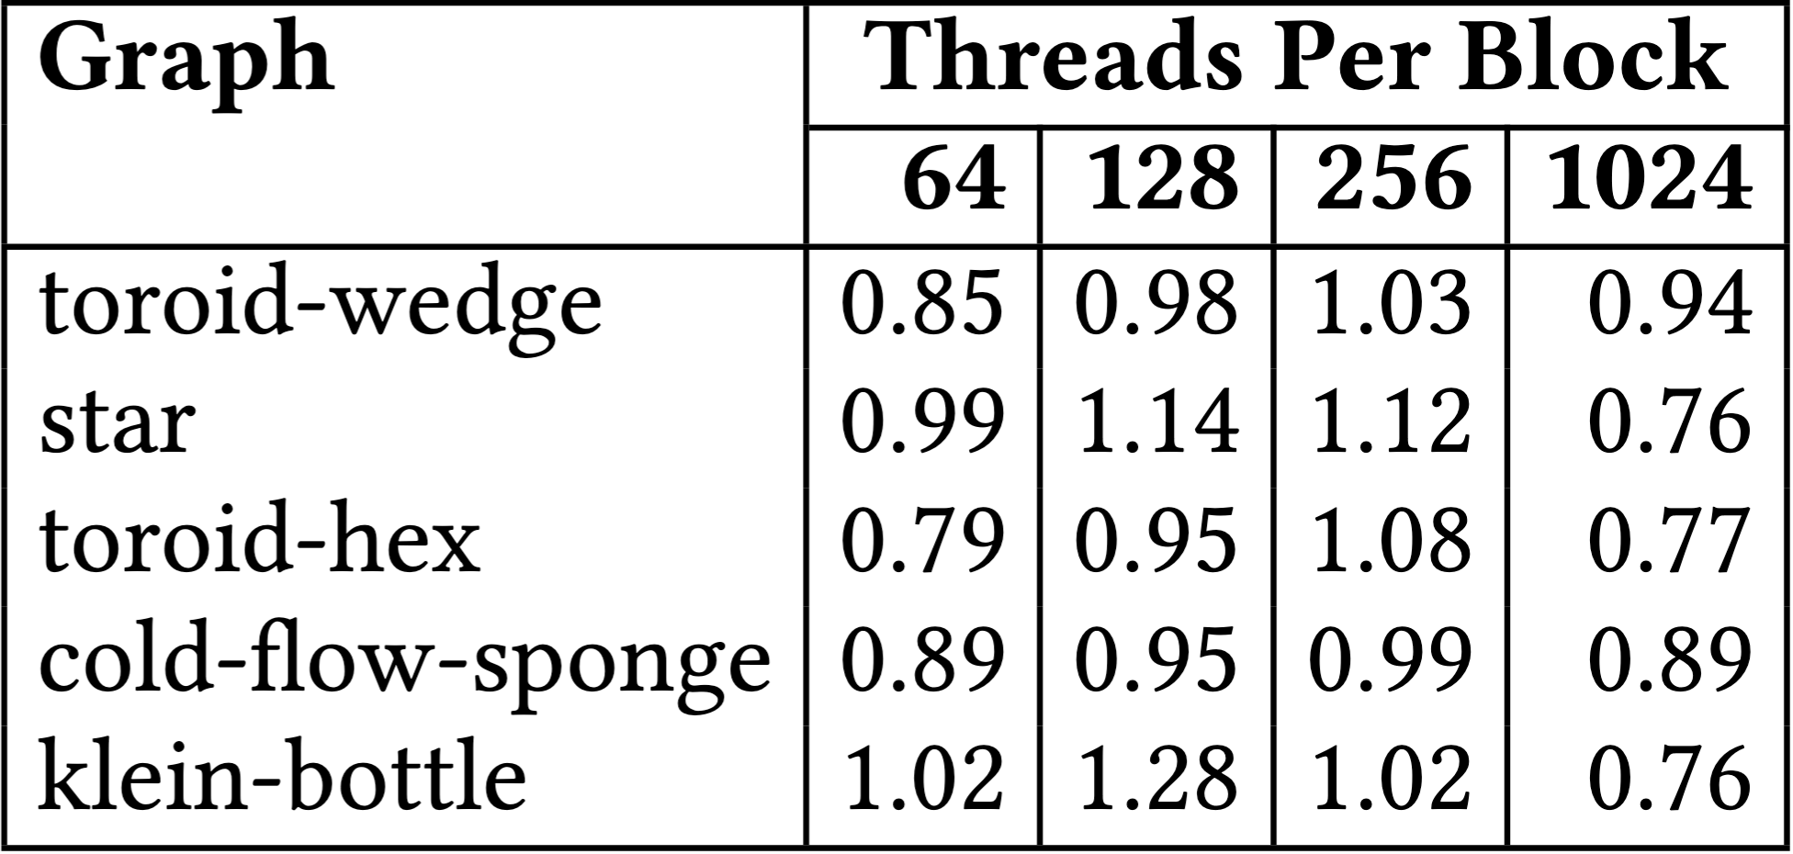
SCC Code Optimization
Speedups with various block sizes
Original block size = 512
Too small or too large a block size negatively affects performance
Too small → more outer-loop iterations (m)
Too large → more signature-propagation iterations (n)
ECL-SCC generally performs better with 256 threads-per-block configuration
More balanced inner and outer iterations

Slide 28

Conclusion
Embedding counters into source code is a simple but often forgotten approach
  Complements standard profilers
  Enables application-specific profiling
    Especially important for irregular algorithms
Up to 16% performance improvement form small changes in SOTA irregular GPU codes
Acknowledgments
  NSF award #1955367

