Slide 1


Comparing Graph Algorithm Styles on NVIDIA and AMD GPUs
Avery VanAusdal* and Martin Burtscher
Department of Computer Science

Slide 2
Highlights
Evaluate 330 HIP codes ported from CUDA on
1 AMD and 2 NVIDIA GPUs using 5 input graphs
Show that HIP conversion does not affect code performance on NVIDIA GPUs
Demonstrate that code style trends are similar between AMD and NVIDIA GPUs

Slide 3
Indigo3 Benchmark Suite
Describes 13 implementation and parallelization styles for irregular graph analytics codes
  Styles are decisions about how the code is written
Combines the styles in hundreds of ways and applies them to 7 important graph problems
We used 330 CUDA codes from 6 problems
BFS: Breadth-First-Search
MIS: Maximal Independent Set
MST: Minimum Spanning Tree
PR: PageRank
SSSP: Single Source Shortest Path
TC: Triangle Counting

Slide 4
Parallelization Styles
Granularity at which computations are parallelized
Example
  GPUs expose multiple levels of hardware parallelism
Granularity | Benefits | Drawbacks
Thread | Easy to implement | May suffer from load imbalance
Warp | Warp-level primitives | May require complex synchronization
Block | Shared memory | May require complex synchronization

Slide 5
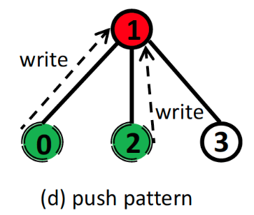
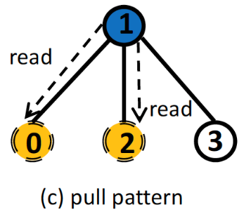
Implementation Styles
Style in which computations are implemented
Example
  Push: updates a neighbor’s data based on private data
  Pull: updates a vertex’s private data based on neighbors’ data
Red: shared write
Green: non-shared read
: active vertex
: data flow
Blue: shared read
Yellow: non-shared write
: active vertex
: data flow

Slide 6
Combinations
Parallelization/implementation styles
  9 sets of alternatives
  Mostly orthogonal and can be combined
Example
  2 sets: {push, pull} and {thread, warp, block}
  6 combinations: push-thread, push-warp, push-block, pull-thread, pull-warp, and pull-block

Slide 7
Investigated Styles
 | BFS | MIS | MST | PR | SSSP | TC
Vertex-based, Edge-based | + + | + + | + + | + - | + + | + +
Topology-driven, Data-driven | + + | + + | + + | + - | + + | + -
Duplicates on WL, No duplicates on WL | + + | - + | - - | - - | + + | - -
Push, Pull | + + | + + | - - | + + | + + | + -
Read-write, Read-modify-write | + + | - + | - - | - + | + + | - +
Deterministic, Non-deterministic | + + | + + | - - | + + | + + | + -
Persistent, Non-persistent | + + | + + | + + | + + | + + | + +
Thread, Warp, Block | + + + | + + + | + + + | + + + | + + + | + + +
Global-add, Block-add, Reduction-add | - - - | - - - | - - - | + + + | - - - | + + +

Slide 8

Porting to HIP
HIP code can run on both NVIDIA and AMD GPUs
  Similar syntax to CUDA
  HIPify tools translate CUDA to HIP
Differences in architecture can necessitate changes
  Multiple warp sizes
  Missing functions
  Lower maximum thread count (2³²)

Slide 9
Porting – Multiple Warp Sizes
CUDA codes often hardcode 32 threads per warp
AMD GPUs can have 32 or 64 threads per warp
const int WarpSize = 32;
count += __shfl_down_sync(~0, count, 16);
count += __shfl_down_sync(~0, count, 8);
count += __shfl_down_sync(~0, count, 4);
count += __shfl_down_sync(~0, count, 2);
count += __shfl_down_sync(~0, count, 1);
for (int off = warpSize / 2; off > 0; off /= 2)
count += __shfl_down_sync(~0, count, off);

Slide 10
Porting – Missing Functions
AMD warps execute in lockstep and do not need some CUDA intrinsic functions
  __syncwarp()
  *_sync variants of __shfl*, __any, __all
Use macros to disable or replace missing functions
  #if defined(__HIP_PLATFORM_AMD__)
    static inline __device__ void __syncwarp() {}
    #define __shfl_sync(mask, val, src) __shfl(val, src)
    #define __any_sync(mask, predicate) __any(predicate)
  #endif
Replacing *_sync works since (mask == ~0)

Slide 11
EXPERIMENTAL METHODOLOGY

Slide 12
Graph Analytics Codes
Name and abbreviation | # codes
Maximal Independent Set (MIS) | 56
Minimum Spanning Tree (MST) | 16
PageRank (PR) | 54
Triangle Counting (TC) | 36
Breadth-First-Search (BFS) | 84
Single Source Shortest Path (SSSP) | 84
Total | 330

Slide 13
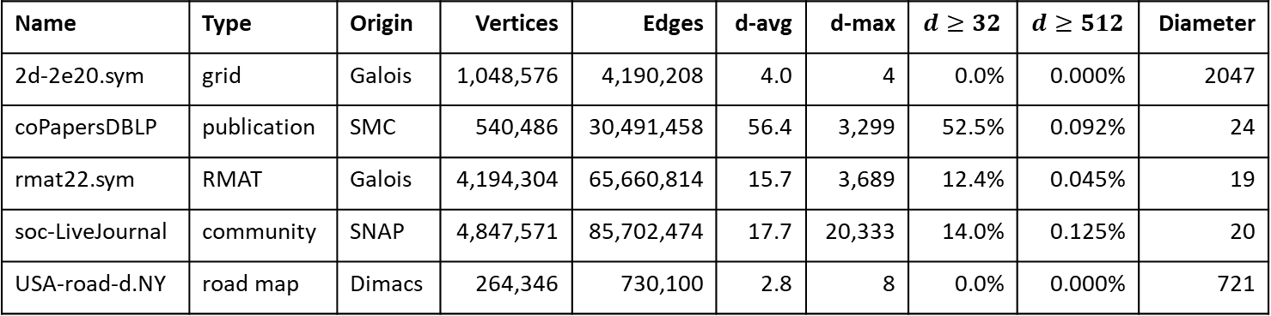
Inputs
5 graphs of various types, origins, sizes, and degree distributions
Name | Type | Origin | Vertices | Edges | d-avg | d-max | $$d≥32$$ | $$d≥512$$ | Diameter
2d-2e20.sym | grid | Galois | 1,048,576 | 4,190,208 | 4.0 | 4 | 0.0% | 0.000% | 2047
coPapersDBLP | publication | SMC | 540,486 | 30,491,458 | 56.4 | 3,299 | 52.5% | 0.092% | 24
rmat22.sym | RMAT | Galois | 4,194,304 | 65,660,814 | 15.7 | 3,689 | 12.4% | 0.045% | 19
soc-LiveJournal | community | SNAP | 4,847,571 | 85,702,474 | 17.7 | 20,333 | 14.0% | 0.125% | 20
USA-road-d.NY | road map | Dimacs | 264,346 | 730,100 | 2.8 | 8 | 0.0% | 0.000% | 721

Slide 14
Hardware
AMD GPU – HIP codes
  RX 7900 XTX 24 GB
    6,144 PEs over 96 compute units
NVIDIA GPUs – HIP and CUDA codes
  RTX 4090 24 GB
    16,384 PEs over 128 SMs
  A100 40 GB
    6,912 PEs over 108 SMs

Slide 15

Software
RX 7900 XTX
  HIP 6.2.41134
  ROCm 6.2.3
RTX 4090
  HIP 6.3.42134
  nvcc 12.6
A100
  HIP 6.3.42134
  nvcc 12.0

Slide 16
Metrics
Throughput
  Giga-edges per second: |Edges| / runtime / 1 billion
Throughput ratio
  E.g., compare the throughputs of 2 alternatives
    Push-thread vs. pull-thread
    Push-warp vs. pull-warp
    Push-block vs. pull-block

Slide 17
RESULTS

Slide 18
HIP versus CUDA on NVIDIA GPUs
Geometric mean of throughput ratios for each code
1.0x is equal performance
Port does not significantly affect performance on NVIDIA GPUs
 | 4090 | A100
BFS | 1.006x | 0.999x
MIS | 0.998x | 1.000x
MST | 1.000x | 1.001x
PR | 0.998x | 1.000x
SSSP | 1.003x | 1.000x
TC | 1.012x | 1.000x

Slide 19
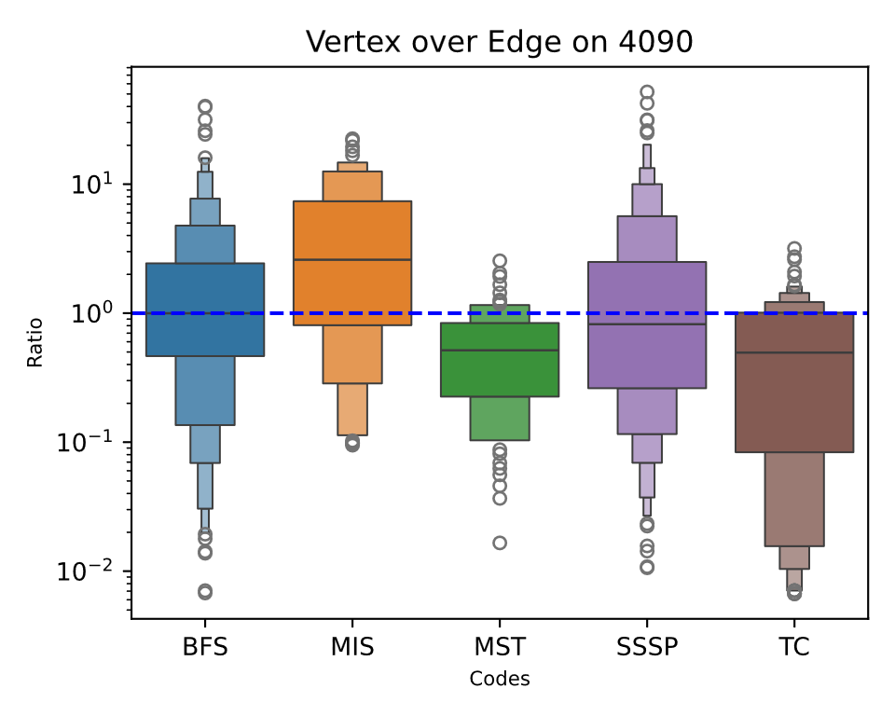
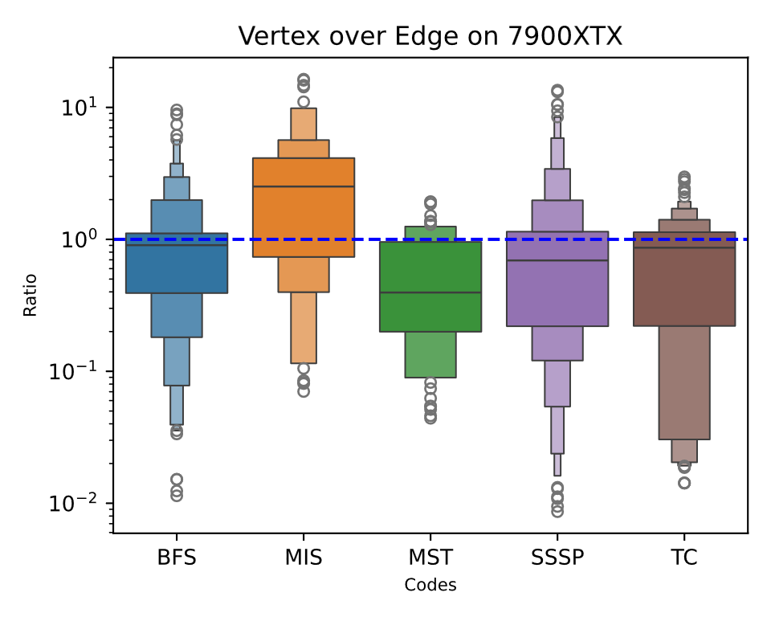
Style Trends – Vertex/Edge
Similar trends between NVIDIA and AMD

Slide 20
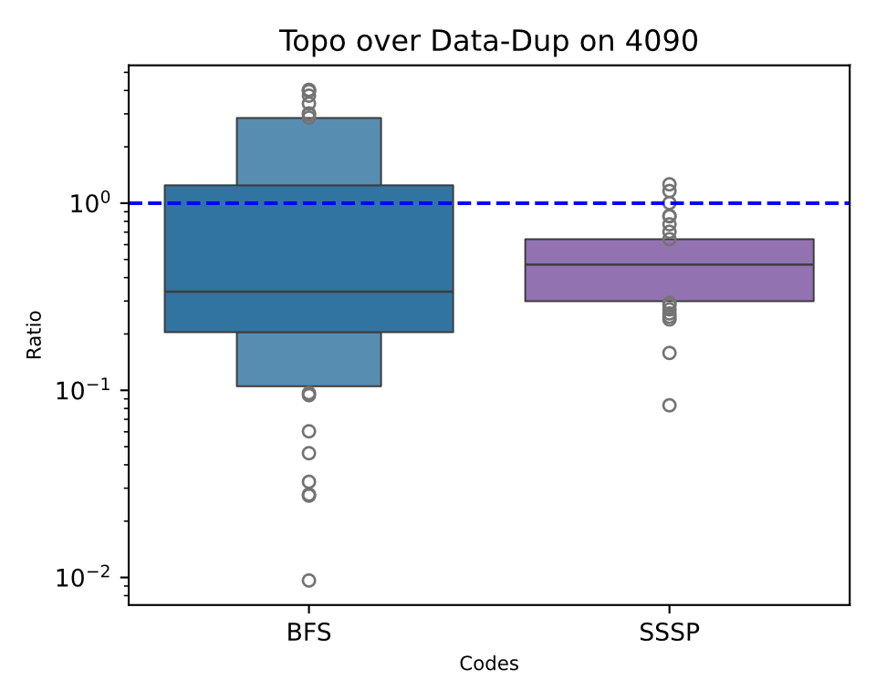
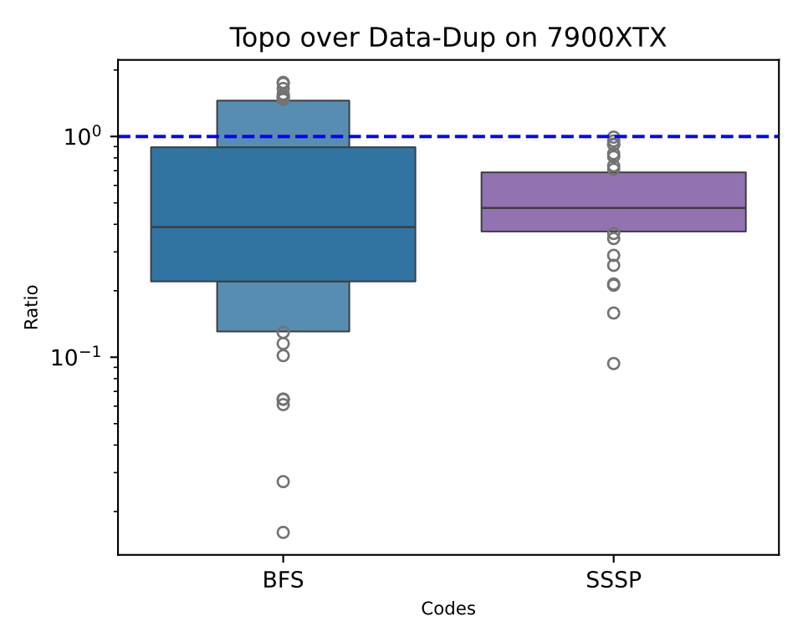
Style Trends – Topo/Data with Dups
Similar trends between NVIDIA and AMD

Slide 21
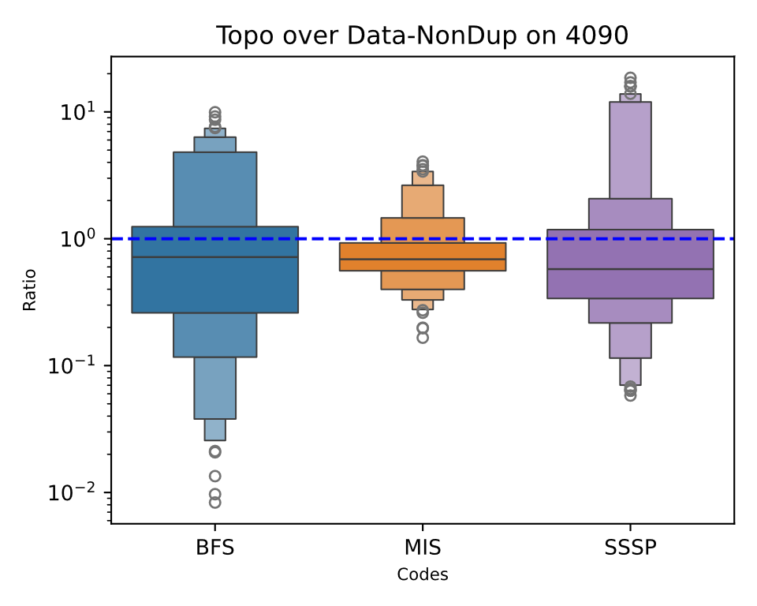
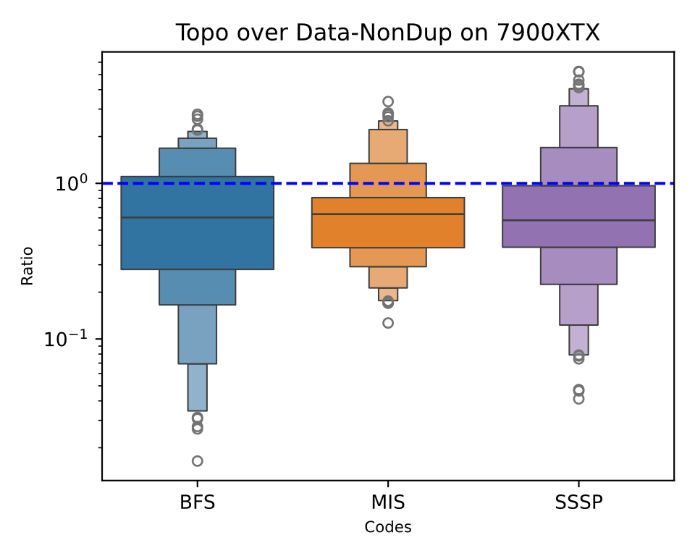
Style Trends – Topo/Data w/o Dups
Similar trends between NVIDIA and AMD

Slide 22
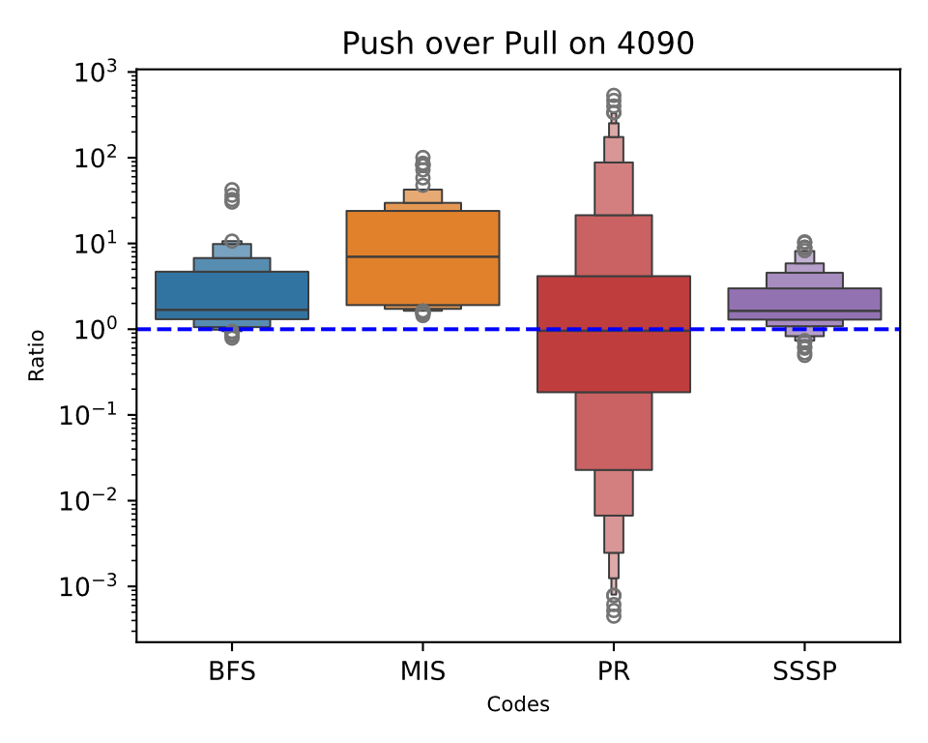
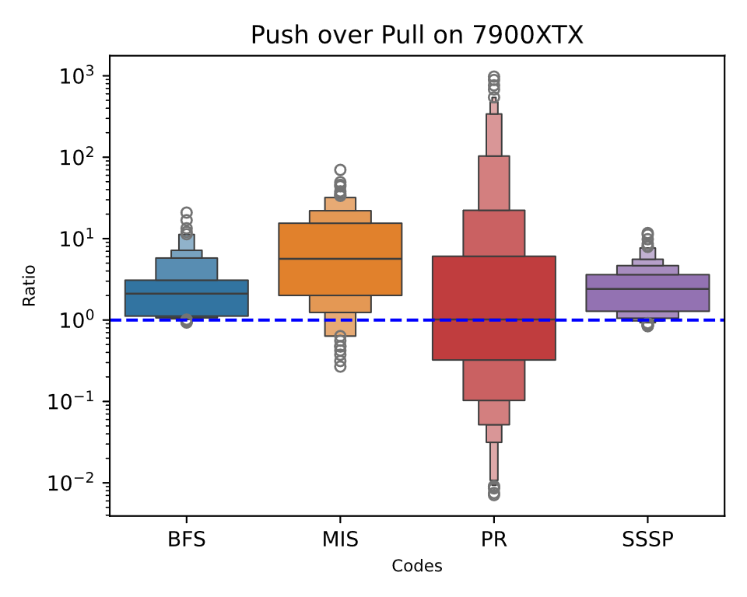
Style Trends – Push/Pull
Very similar trends between NVIDIA and AMD

Slide 23
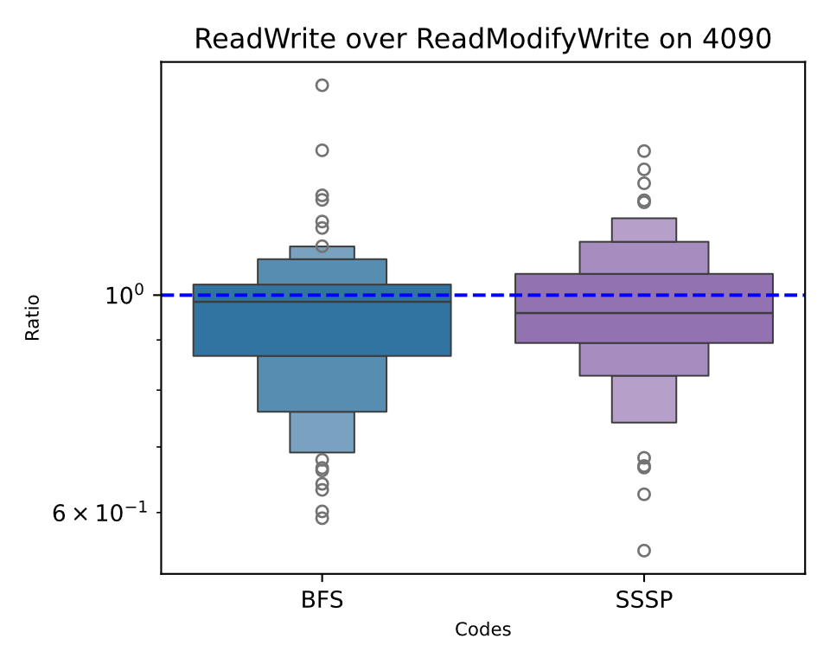
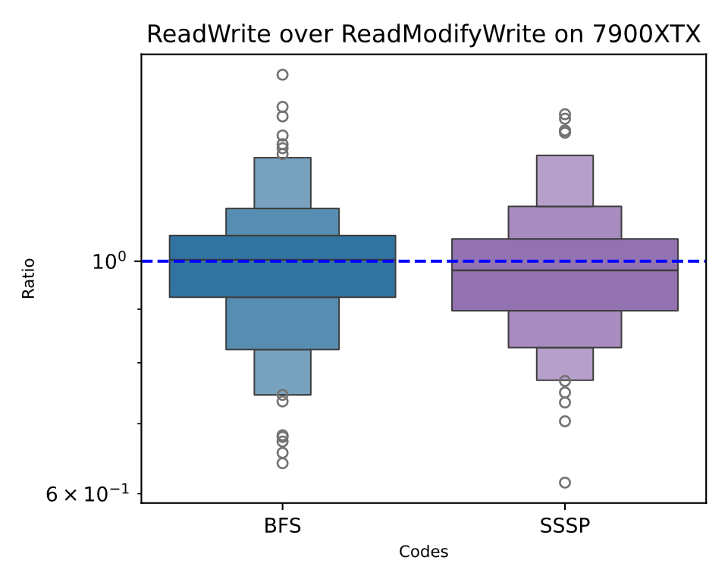
Style Trends – ReadWrite/RMW
Similar trends between NVIDIA and AMD

Slide 24
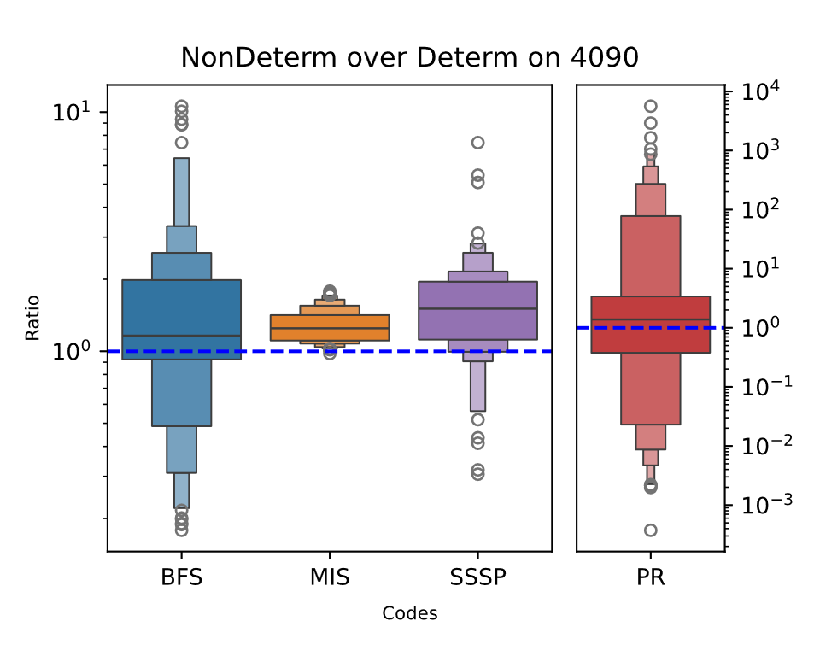
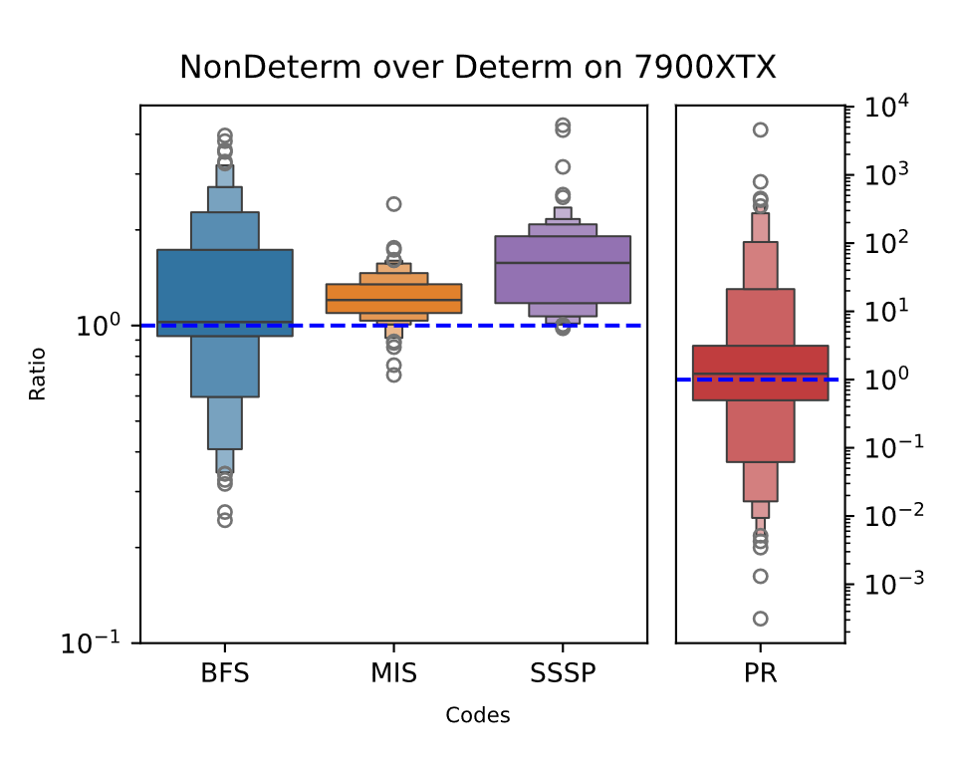
Style Trends – NonDeterm/Determ
Very similar trends between NVIDIA and AMD

Slide 25
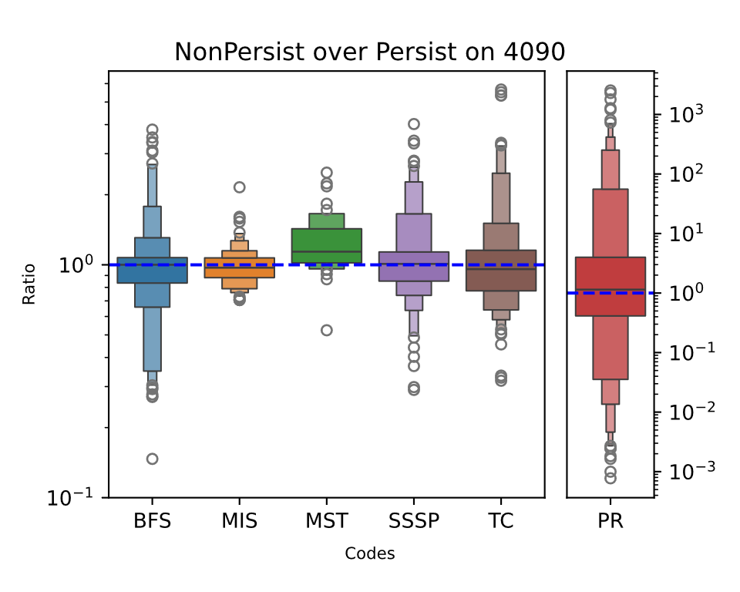
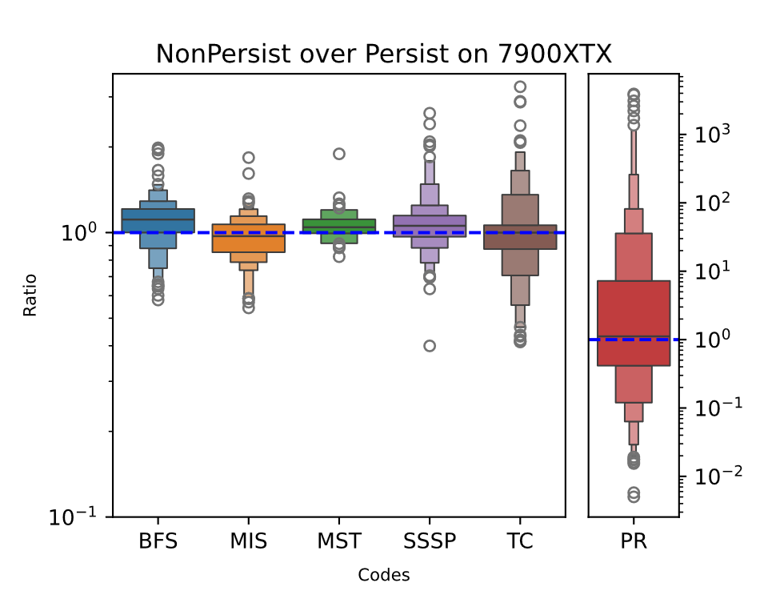
Style Trends – NonPersist/Persist
Similar trends between NVIDIA and AMD

Slide 26
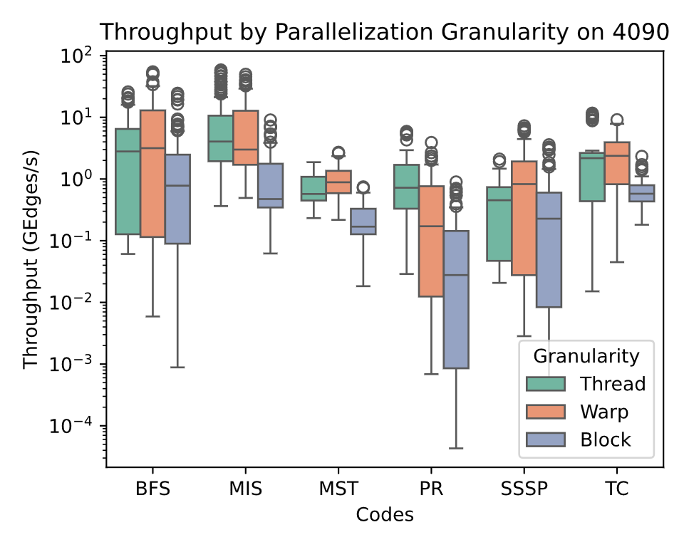
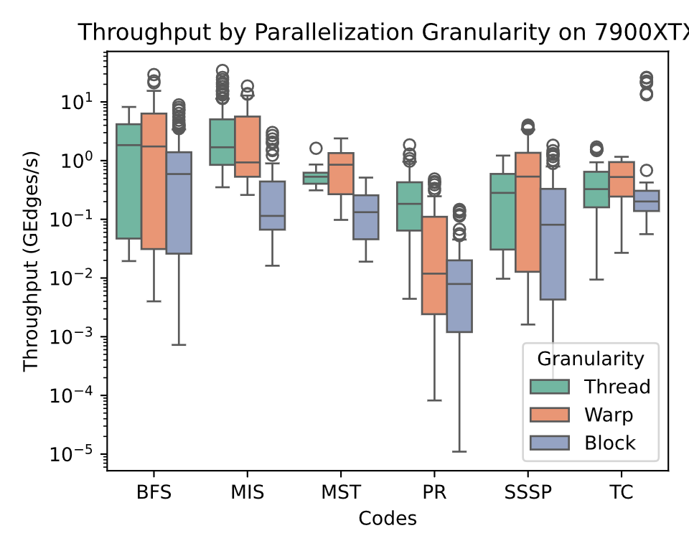
Style Trends – Granularity
Similar trends between NVIDIA and AMD

Slide 27
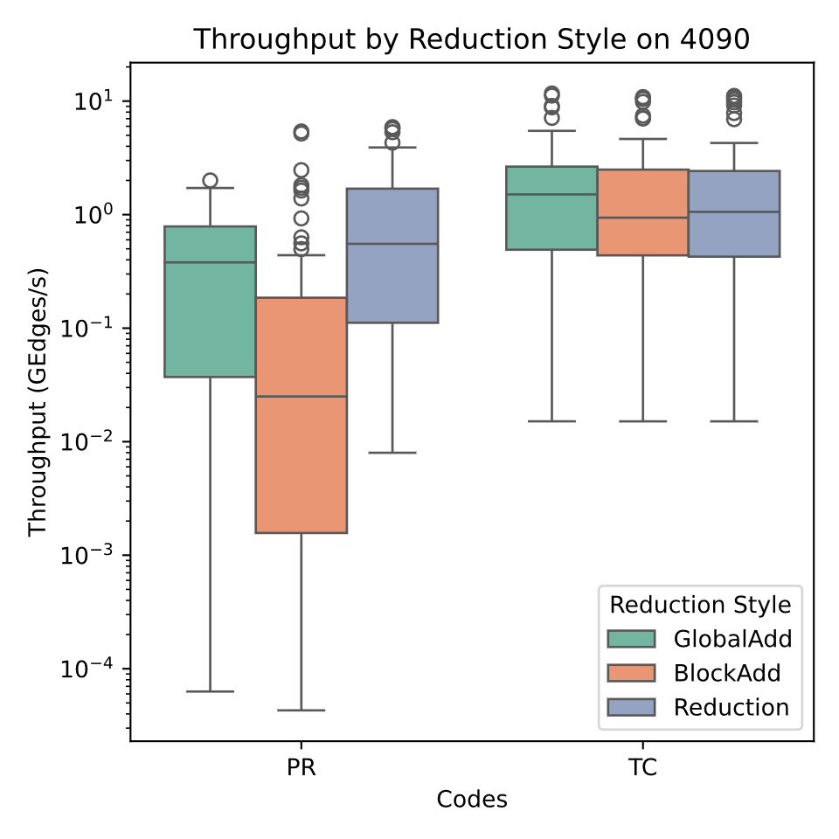
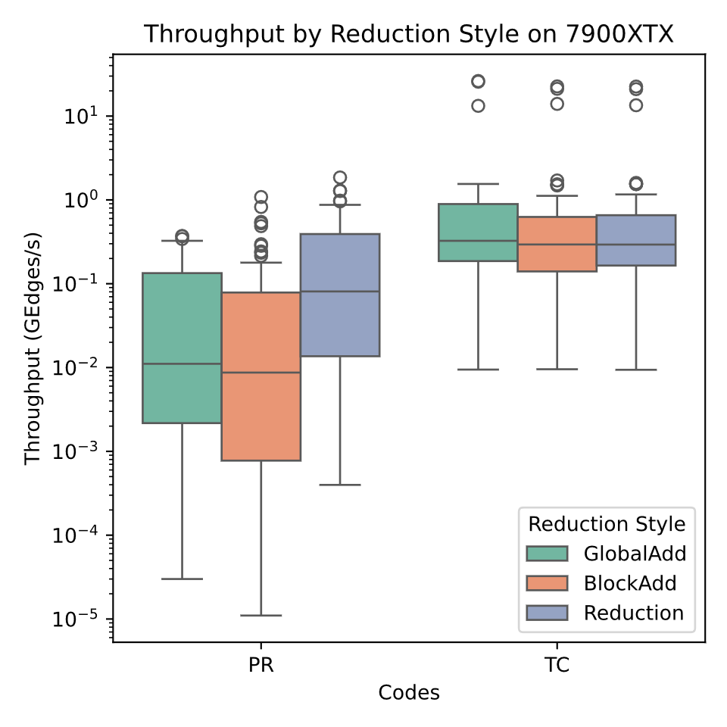
Style Trends – Reduction Style
PR GlobalAdd: lower speed on AMD due to NVIDIA warp-aggregating overlapping atomic accesses

Slide 28
Summary
Ported 330 CUDA codes from 6 problems to HIP
  Adds AMD GPU support to Indigo3 benchmark suite
Confirmed HIP ports not slower than CUDA
Demonstrated that code style performance has similar trends between AMD and NVIDIA GPUs
  Despite proprietary architectural differences
Acknowledgements: NSF Award #1955367 and NVIDIA
Contact: arv107@txstate.edu
Code + Paper: github.com/burtscher/Indigo3Suite

