Slide 1


F-Diam: Fast Exact Diameter Computation of Sparse Graphs
Cameron Bradley*, Anju Mongandampulath Akathoott and Martin Burtscher

Slide 2
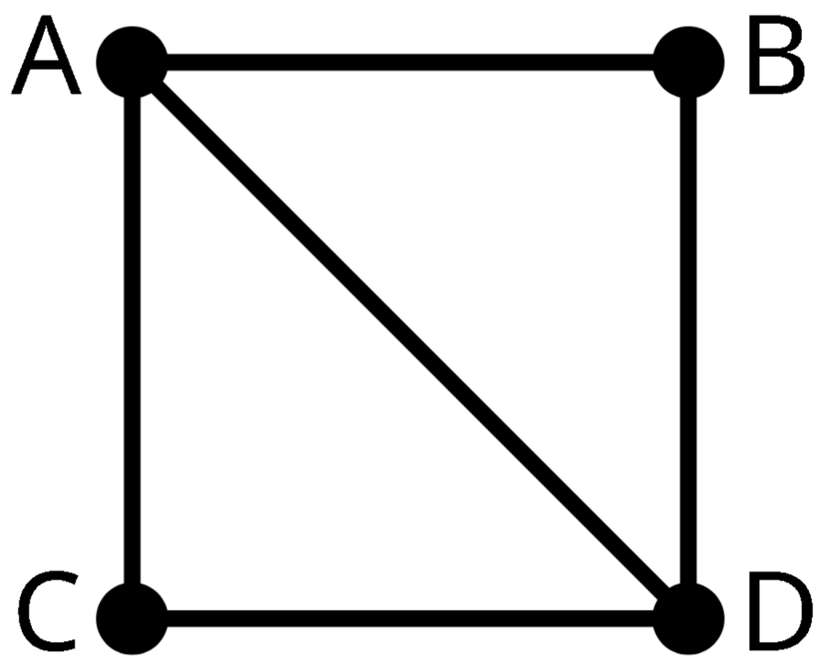
Diameter
Distance between two vertices
  d(x,y)
  Length of shortest path
Eccentricity of a vertex
  ecc(x)
  Length of longest shortest path from x
Diameter
  diam(G) = max_{x∈V}(d(v,x))
  Length of longest shortest path in graph
diameter = 2
ecc(A) = 1
ecc(B) = 2

Slide 3
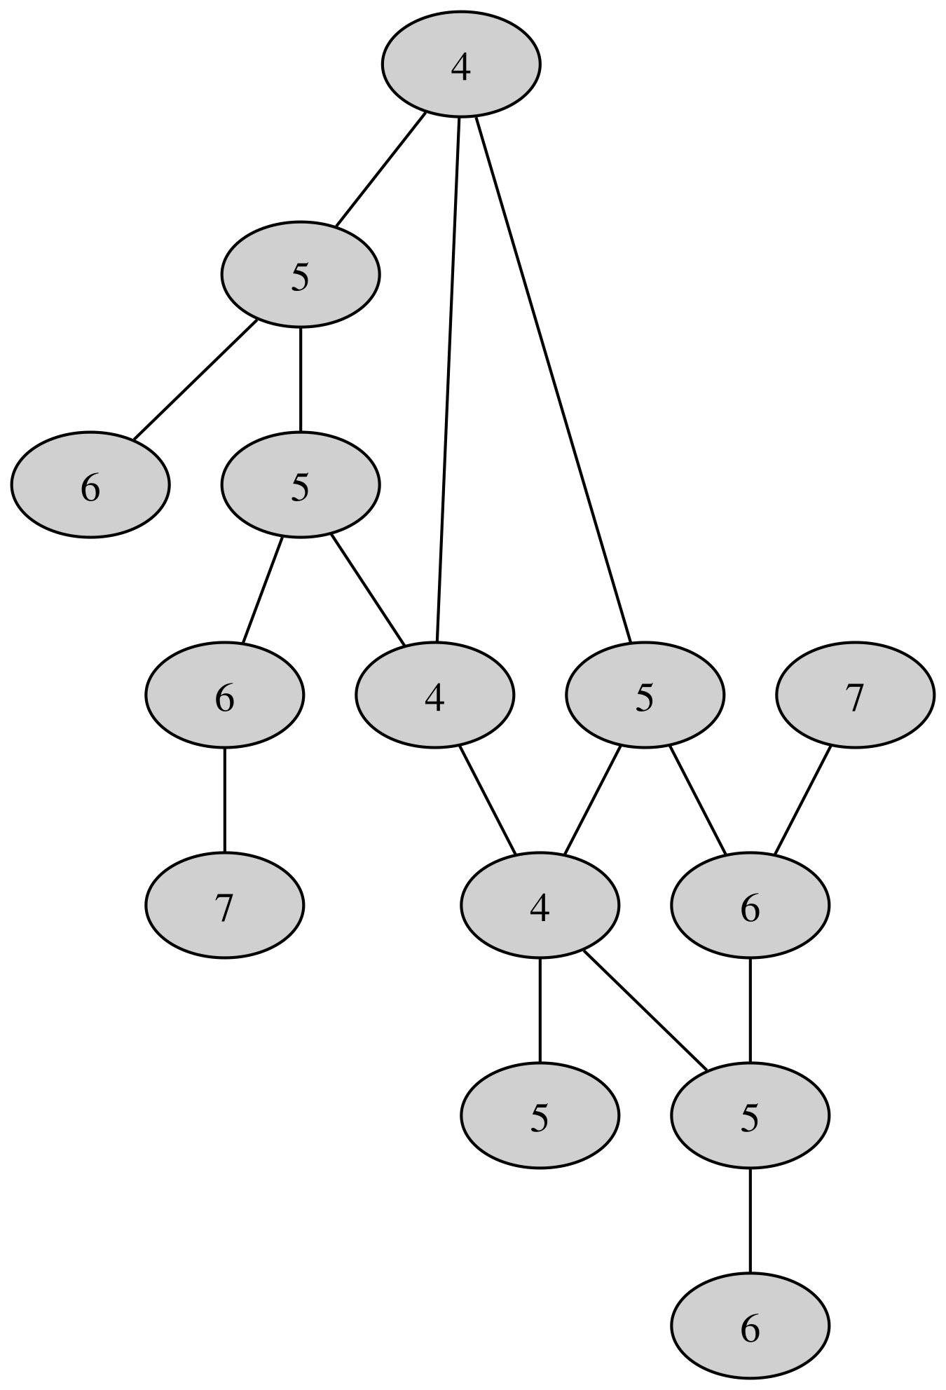
Diameter (cont.)
Importance
  Message delay
  Length of critical path
  Biological process efficiency
Basic algorithm
  Breadth-First Searches (BFS)
    Finds longest shortest path from any vertex
  Impractical on large inputs
    Time complexity is O(V * E)

Slide 4
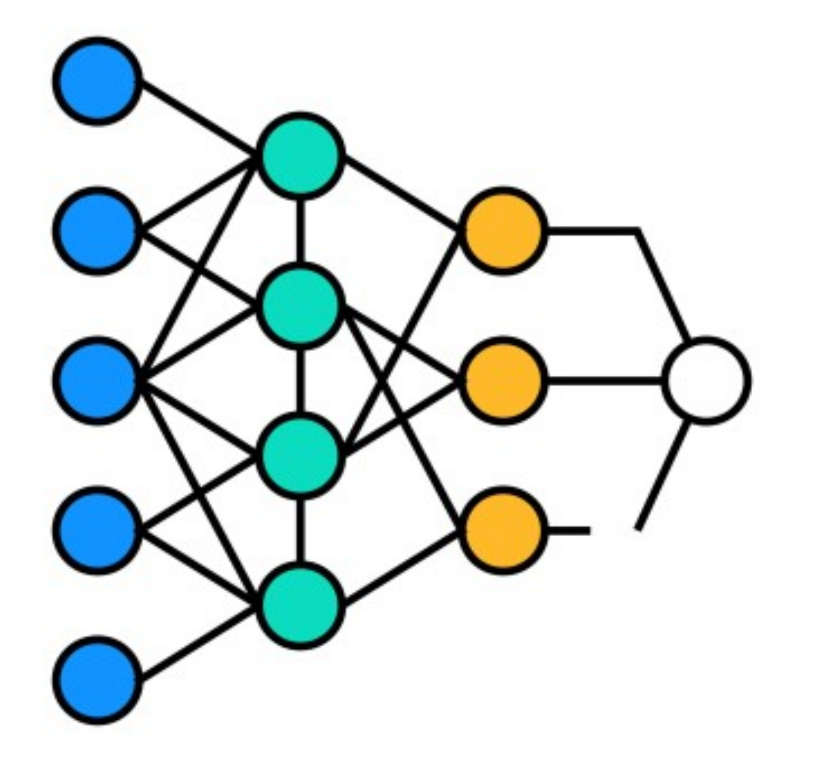
Breadth-First Search
Vertices of each level stored in worklist
  First level contains only starting vertex
  Set distance to zero
Iterate following steps
  Increment distance
  For every vertex in current worklist
    Put unvisited neighbors on next worklist
  Swap worklists

Slide 5
Theorems on Eccentricity
Eccentricity of adjacent vertices cannot differ by more than 1
Connected graph with ≥ 2 vertices has 2 or more vertices with maximum eccentricity
Smallest eccentricity is at least half of diameter

Slide 6
F-Diam Implementation

Slide 7
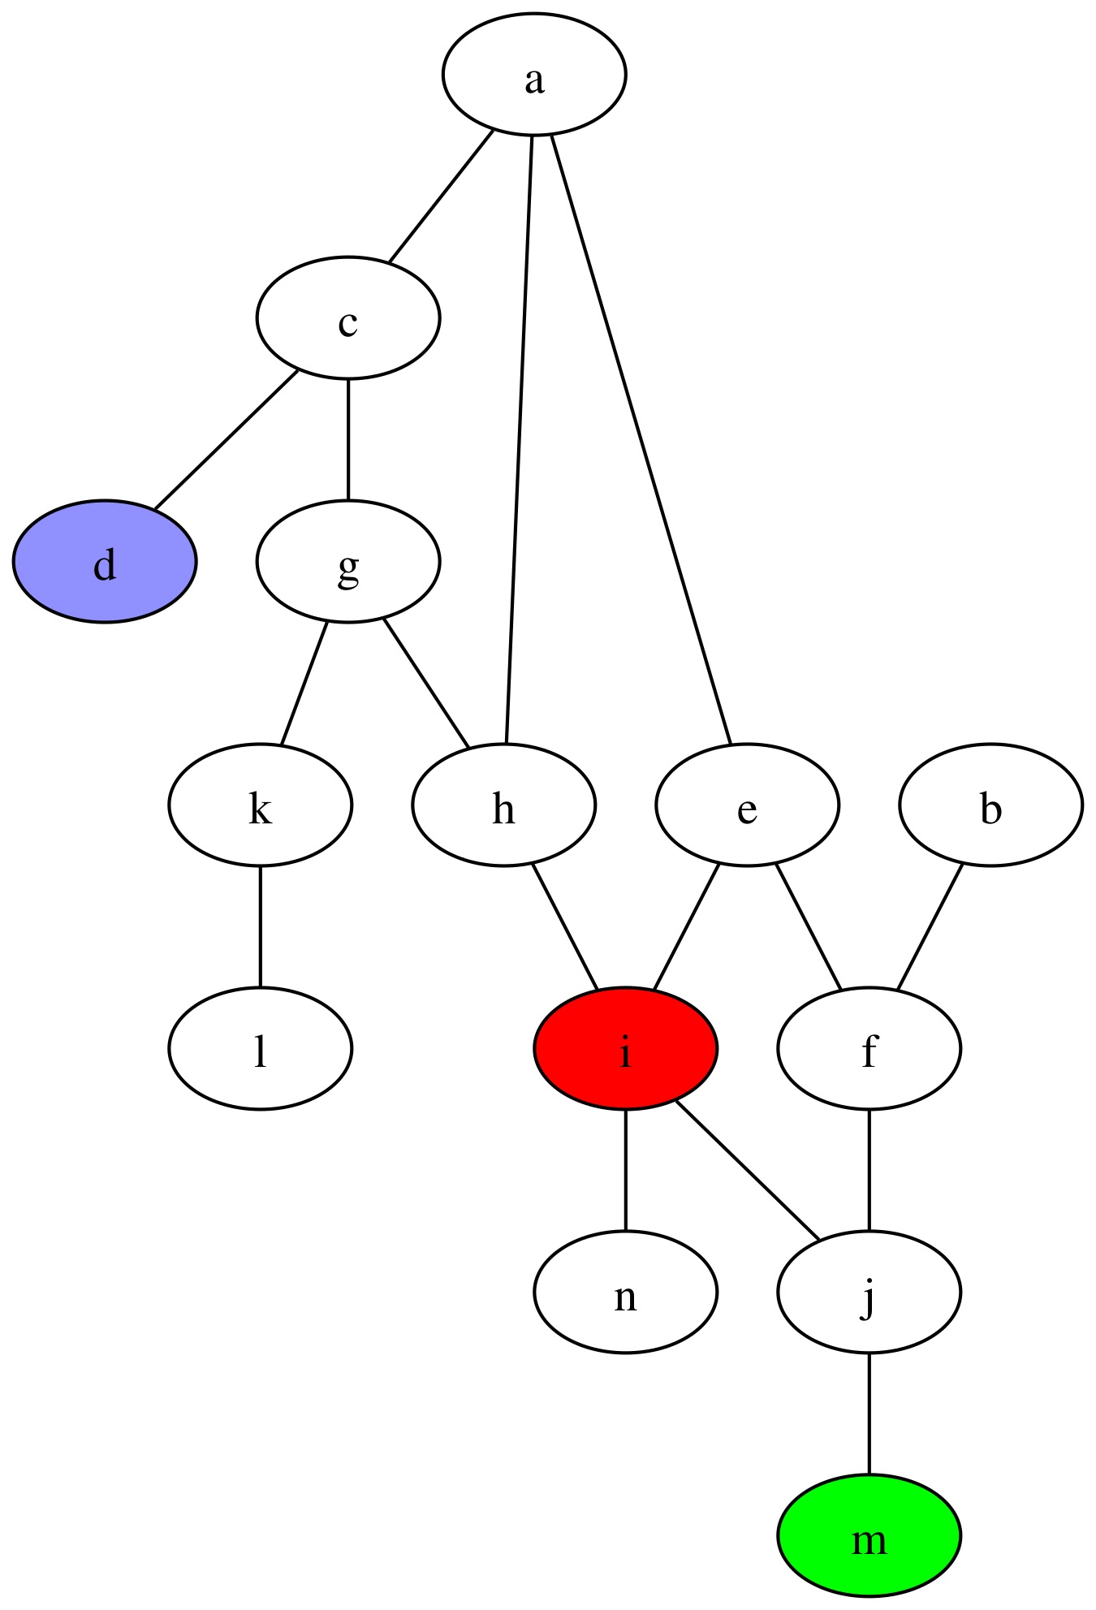
Initial Diameter Bound (2-Sweep)
Compute lower bound for diameter
  Compute ecc(i)
  d = vertex from final BFS worklist
  Compute ecc(d) → bound
Choice of vertex i
  Highest degree vertex
  Centrally located in the graph
Choice of vertex d
  Maximally distant from i
  ecc(d) = 6 (in example)

Slide 8
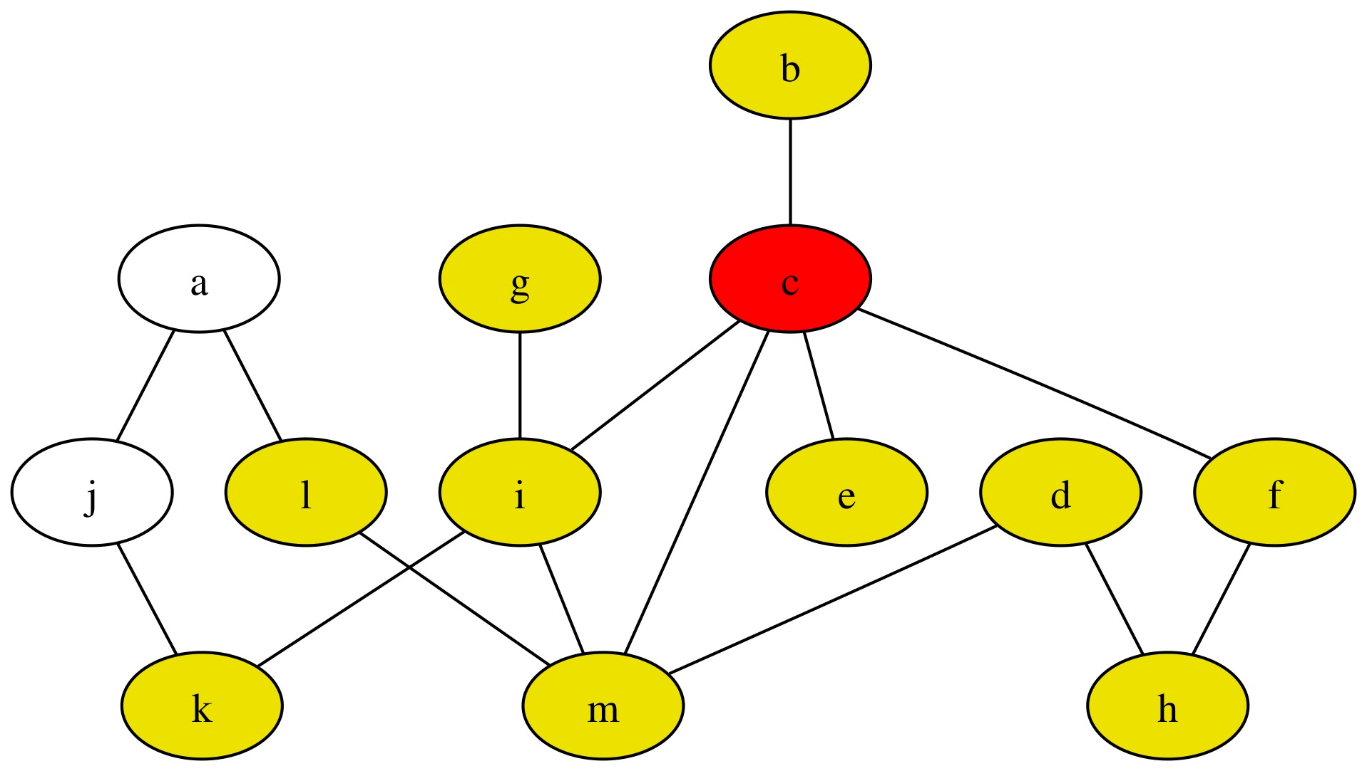
Winnowing (Key New Step)
Use Theorems 2 and 3 to remove vertices from consideration
  Pick a vertex c
  Mark vertices around c as
  removed
    All vertices within distance
    of bound / 2 (yellow)
Guarantees there still exists at least 1 vertex with maximum eccentricity not removed

Slide 9
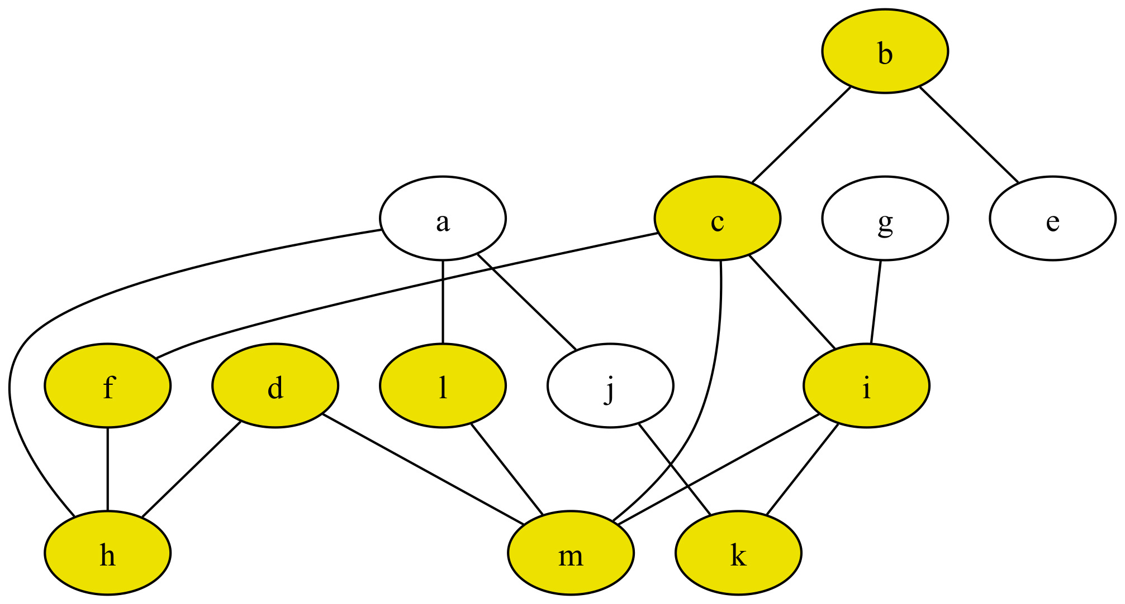
Chain Processing (New Step)
A chain starts with a degree-1 vertex x
Any shortest path contains adjacent neighbor
Vertices along chain have ecc(x) – s if s steps from x
Can remove further from last chain vertex
  Based on Theorem 1

Slide 10
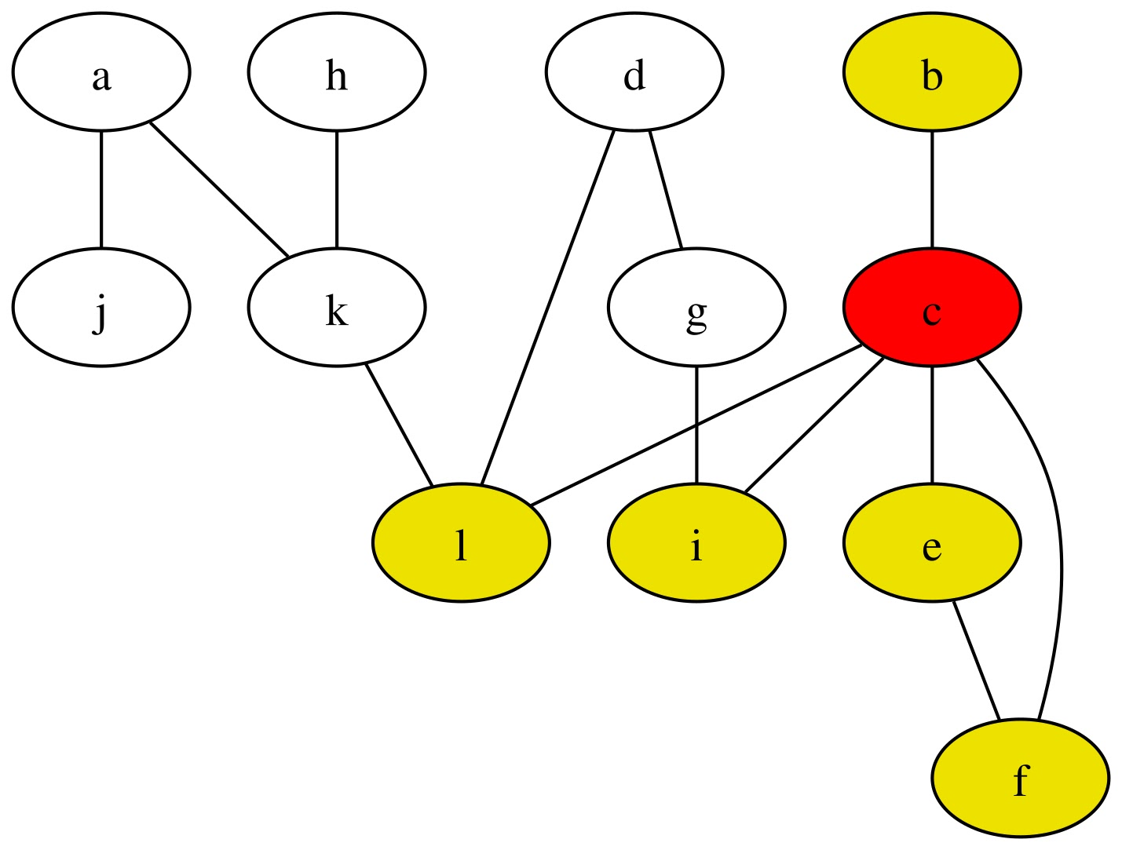
Eliminate (Partially New Step)
Compute eccentricity of non-removed vertex x
If ecc(c) < bound = 5
  Remove vertices within s steps from c (Theorem 1),
  where s = bound – ecc(c) > 0
If ecc(c) > bound = 5
  Update bound
  Extend regions of removed vertices
    Previously winnowed or eliminated

Slide 11
Hybrid Direction-Optimized BFS
Every level of BFS traversal done in parallel
Choose direction based on current worklist size
  If (worklist_size > 0.1 * graph_size) use bottom up
Top-down
  Iterates through worklist of current level
Bottom-up
  Iterates through graph to find next-level vertices
Benefits
  Fewer atomic operations
  Fewer edges examined

Slide 12

Evaluation Methodology
System
  Shared-memory NUMA system
  AMD Ryzen Threadripper 3970X with 32 cores
  G++ version 13.3.0
  OpenMP 5.2
Performance metric: throughput
  Number of graph vertices divided by runtime
  Median of 9 runs
  Missing values denote timeouts (> 2.5 hours)

Slide 13
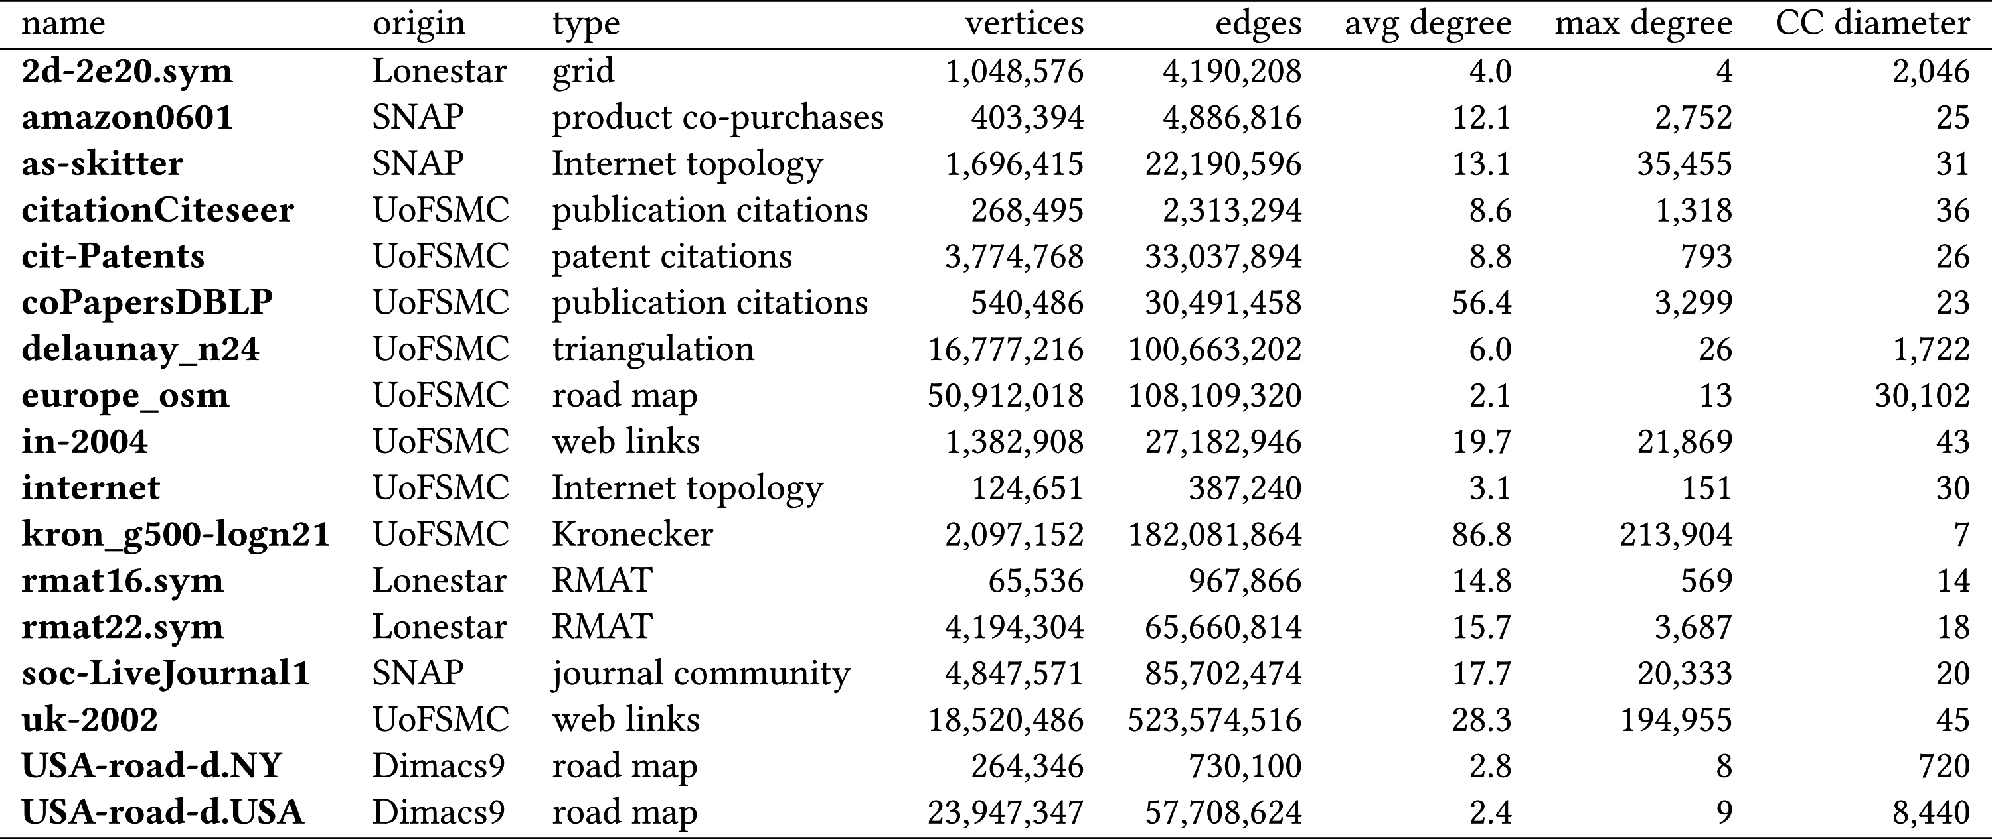
Input Graphs

Slide 14
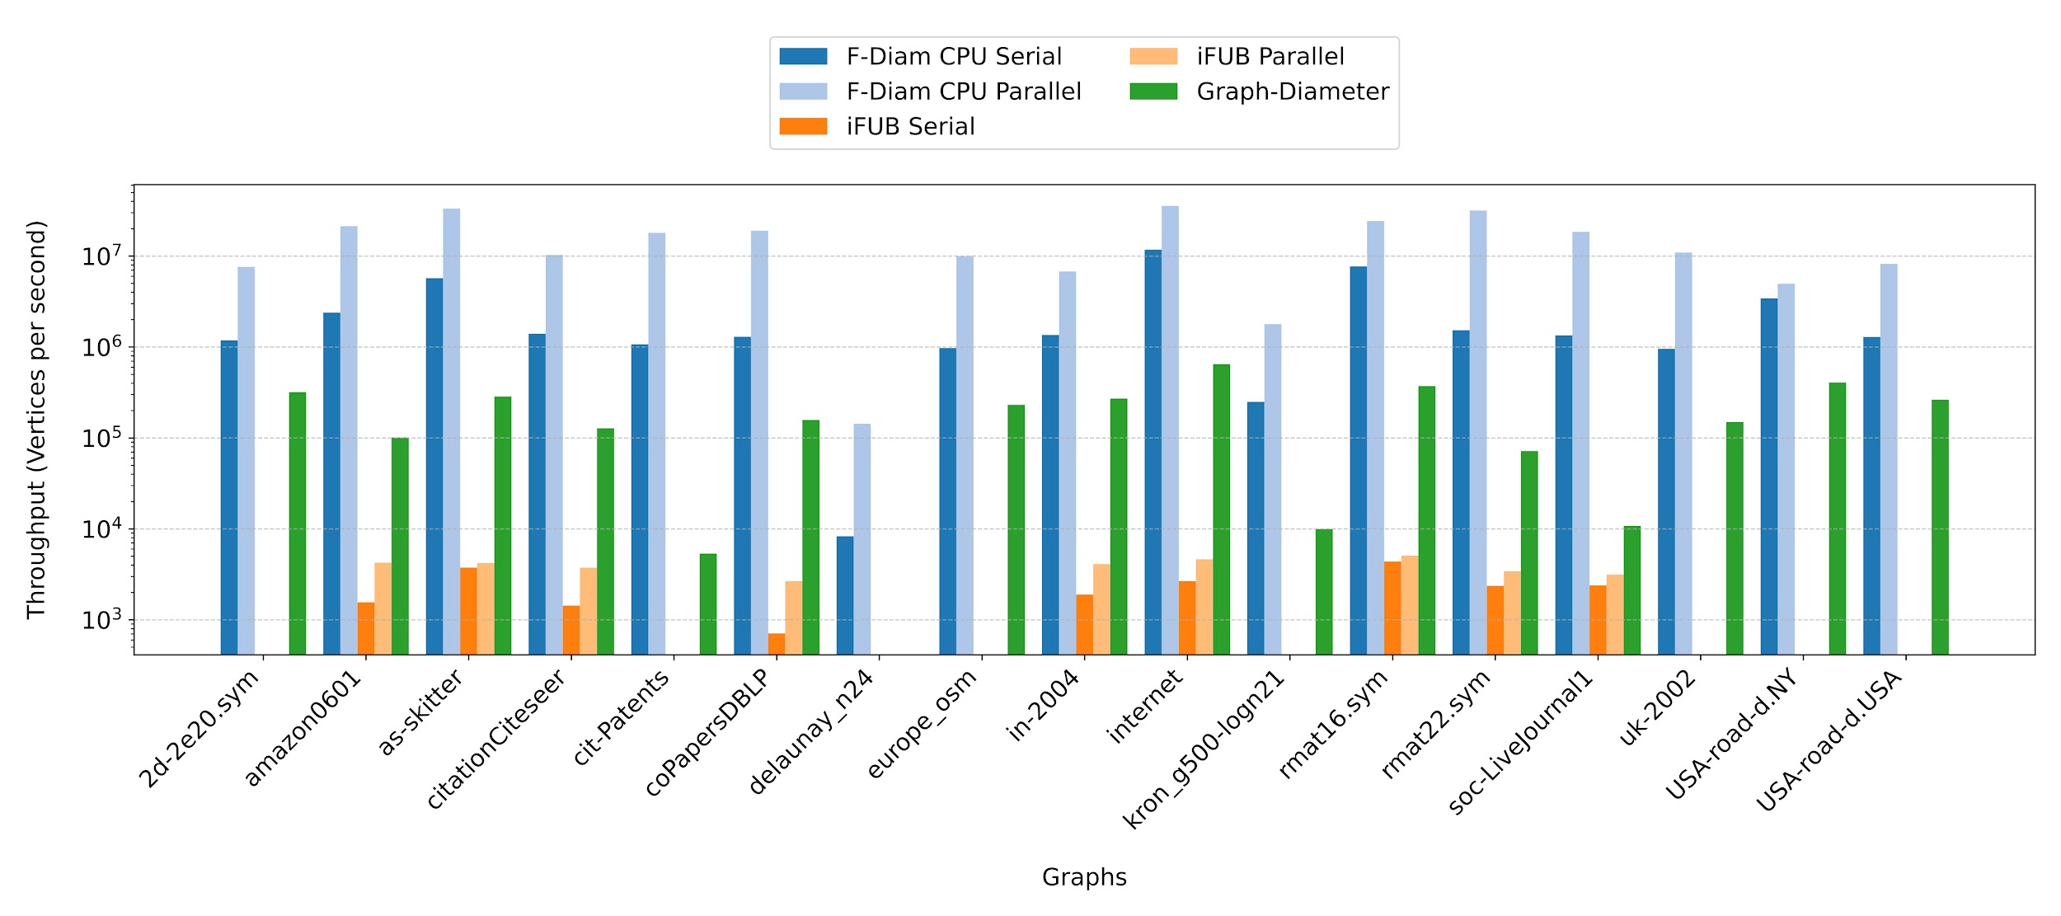
Results (Throughput)
F-Diam is 5158.7x faster than iFUB Parallel
F-Diam is 106.7x faster than Graph-Diameter

Slide 15
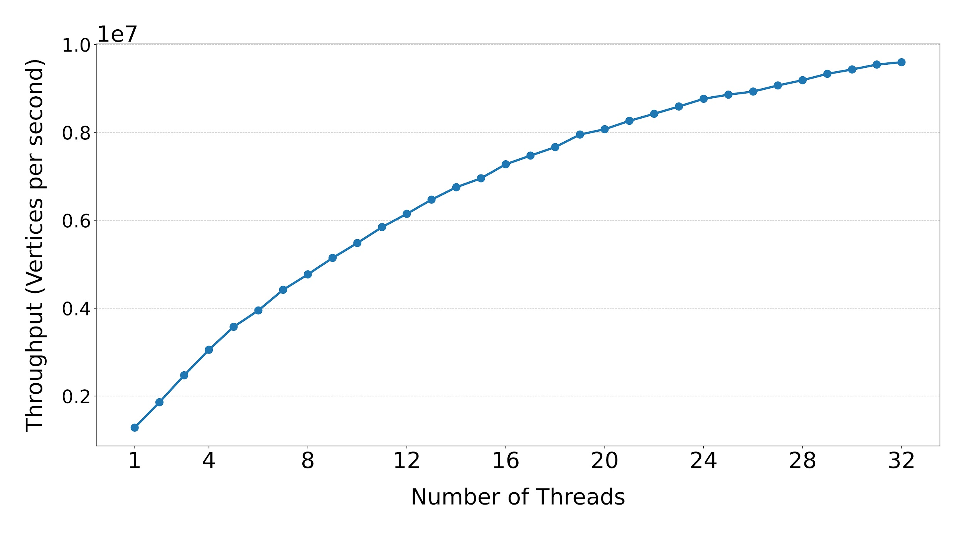
Scalability
Speedups are impacted by topology of graph
Low diameter & high avg. deg. improve parallelism

Slide 16
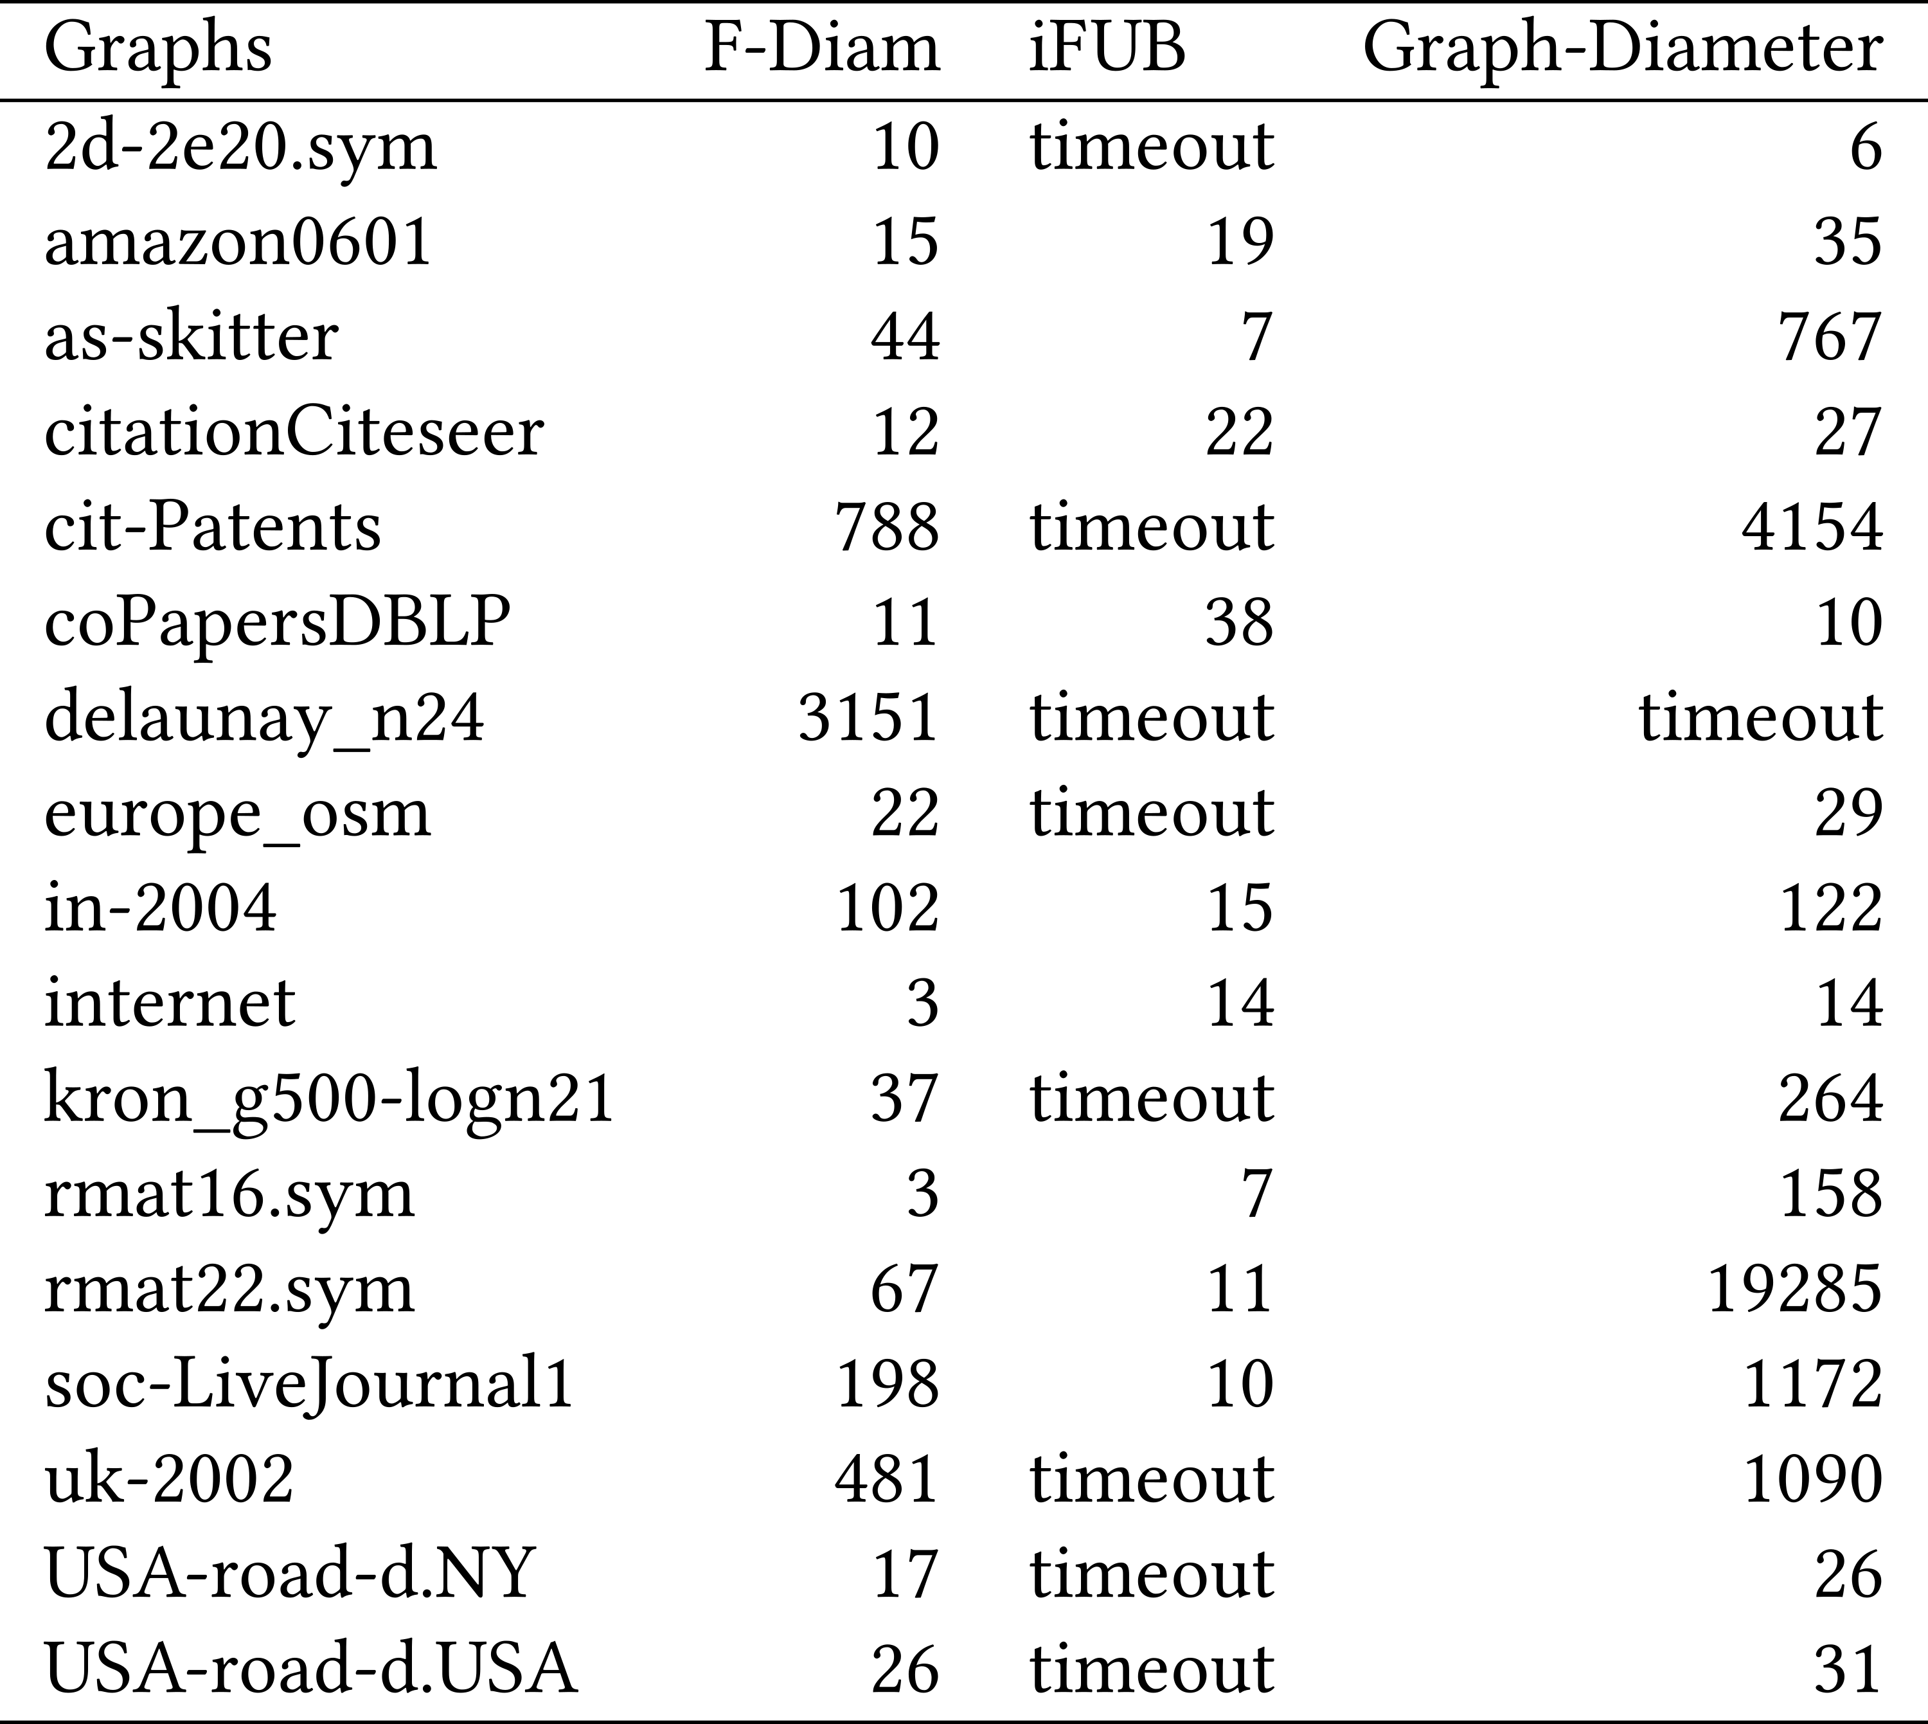
Number of BFS Traversals
Counting full traversals only
F-Diam has fewest BFS traversals on 11 of 17 graphs
BFS traversals are
not most significant performance indicator

Slide 17
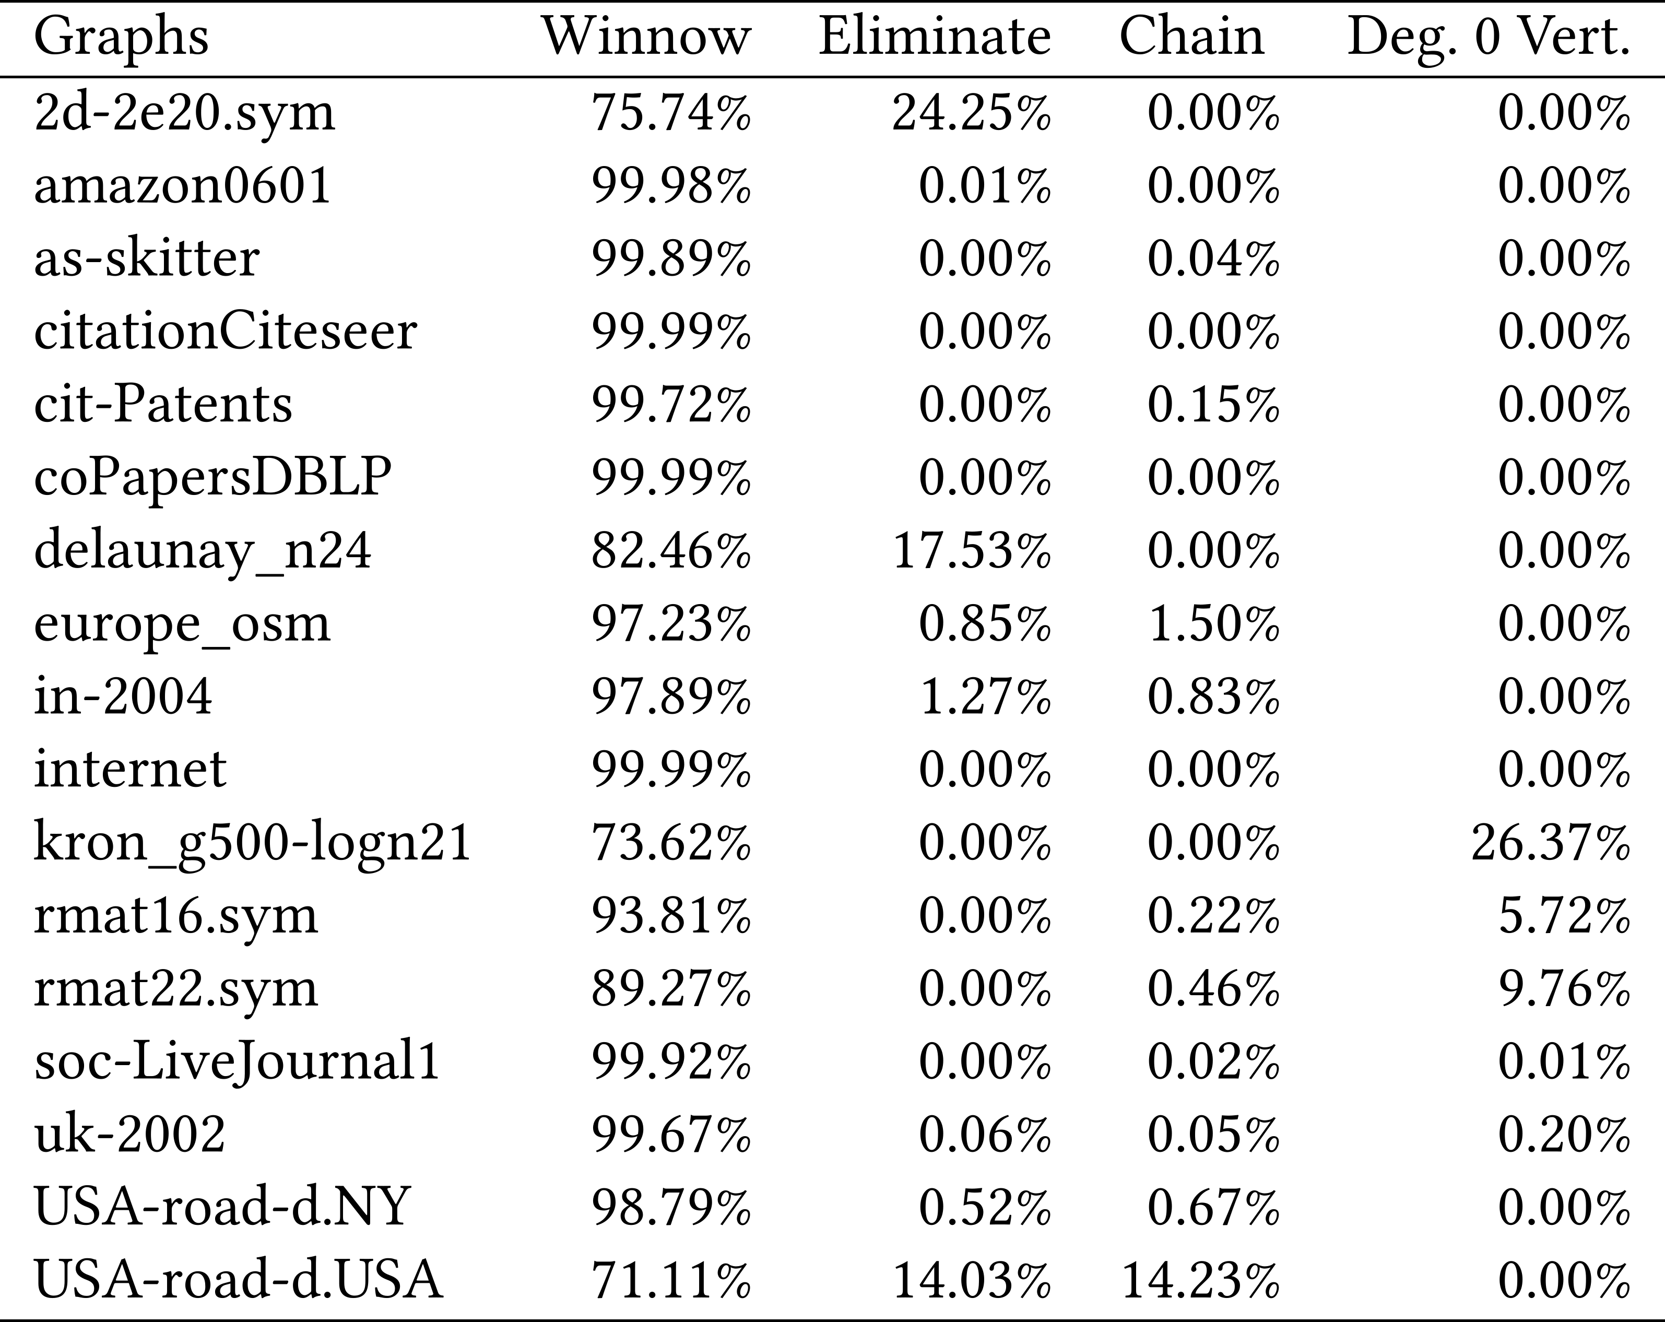
Percentage of Vertices Removed
Eliminate and Chain Processing
  Only effective on some inputs
Winnow
  Removes over 70% of
  vertices on tested inputs
  Removes over 99% of
  vertices on over half of
  tested inputs

Slide 18
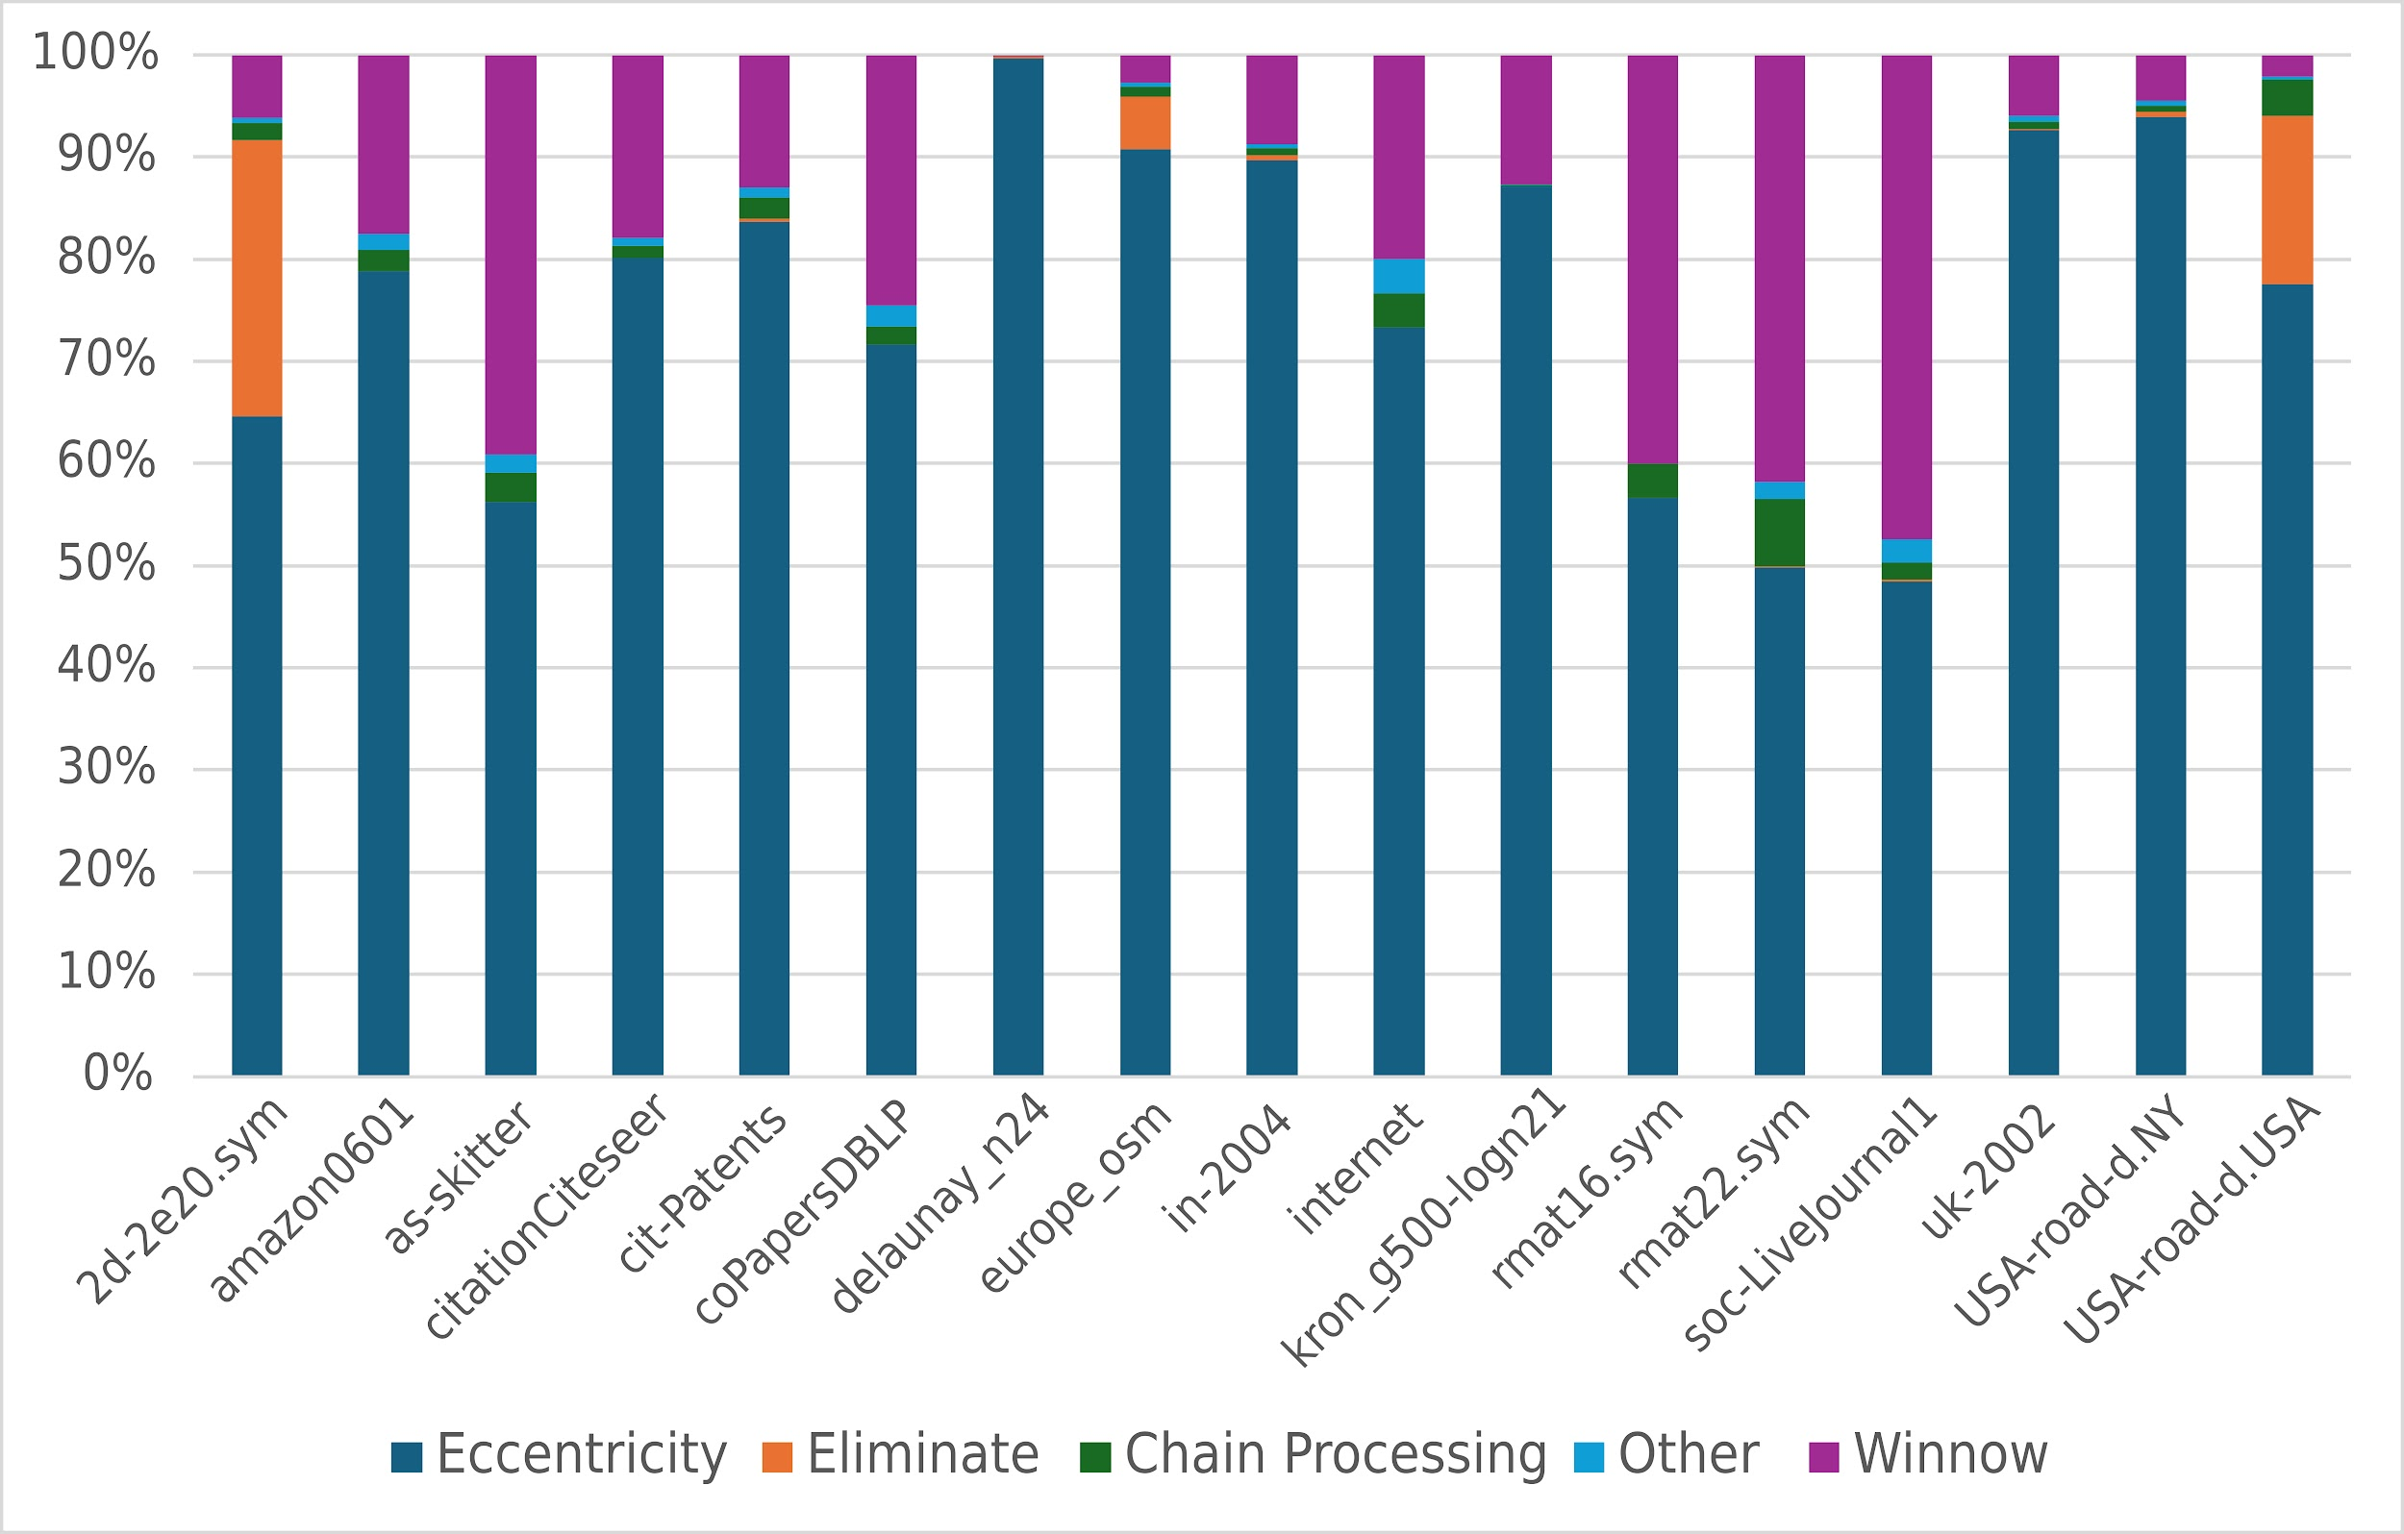
Runtime Breakdown
Eccentricity computations are most expensive

Slide 19
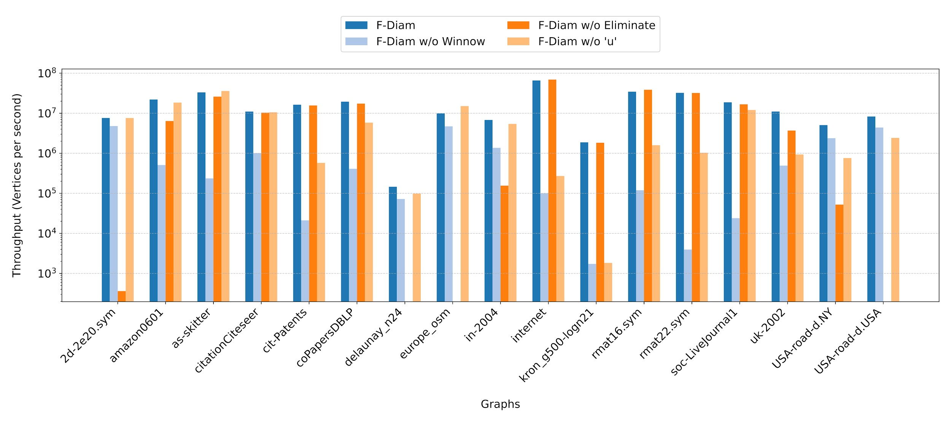
Effectiveness of Stages in F-Diam
Disabling Winnow makes F-Diam 50x slower!

Slide 20
Conclusion
F-Diam outperforms leading exact diameter-finding codes by over an order of magnitude
New winnow step is most effective
Acknowledgements
  NSF
Code available at github.com/burtscher/F-Diam
Contact: clb420@txstate.edu

