Slide 1


Fast and Effective Lossy Compression on GPUs and CPUs with Guaranteed Error Bounds
Alex Fallin¹, Noushin Azami¹, Sheng Di², Franck Cappello², Martin Burtscher¹
¹Texas State University
San Marcos, Texas, USA
²Argonne National Laboratory
Lemont, Illinois, USA

Slide 2
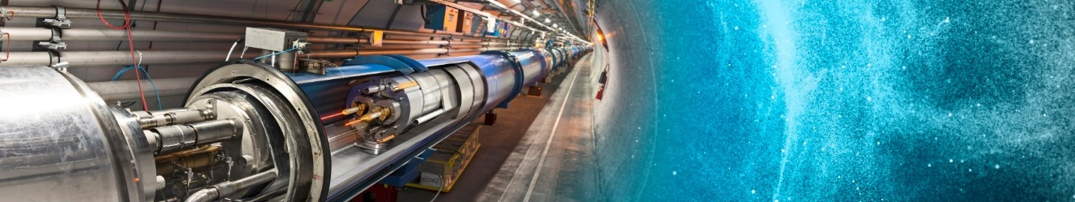
Introduction
Scientific data in HPC environments is becoming too large and being produced too fast
Lossless compression typically cannot yield high compression ratios on this type of data
http://cds.cern.ch/record/1996997

Slide 3
Introduction
Lossy compression needs to be error-bounded
  Three main error-bound types: ABS, REL, and NOA
  Many compressors do not guarantee error bounds
Support for heterogenous systems is important
  Data compressed on one system (GPU or CPU)
  Decompressed on another system (GPU or CPU)
  CPU/GPU compatibility rarely supported in SOTA

Slide 4
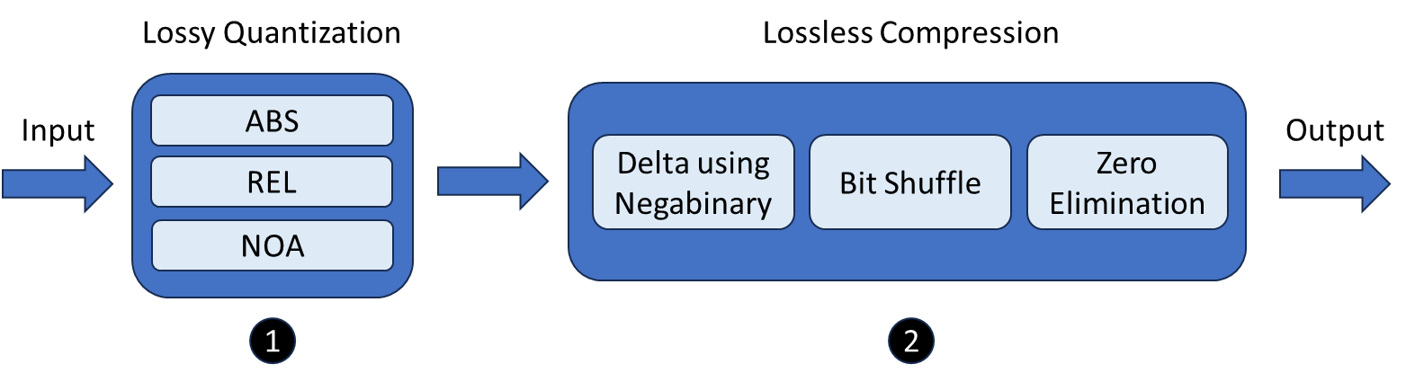
PFPL – Overview
Quantization followed by 3 data transformations
Data split after quantization into 16 kB chunks
Used LC framework to examine many algorithms

Slide 5
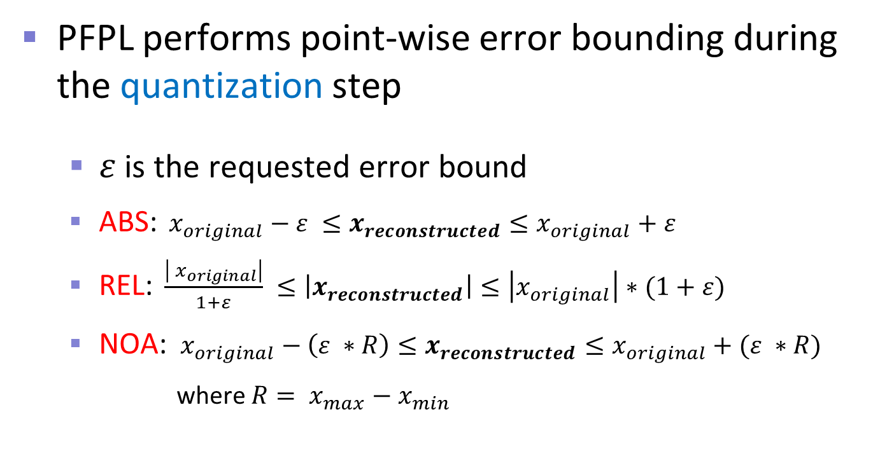
PFPL – Error Bounding
PFPL performs point-wise error bounding during the quantization step
  $ε$ is the requested error bound
  ABS:${ x}_{original} − ε ≤x_{reconstructed}≤x_{original}+ε$
  REL:$\frac{\left|{ x}_{original}\right|}{1+ε} ≤\left|x_{reconstructed}\right|≤\left|x_{original}\right|∗(1+ε)$
  NOA: ${ x}_{original} − \left(ε ∗R\right)≤x_{reconstructed}≤x_{original}+(ε ∗R)$
    where $R= x_{max}−x_{min}$

Slide 6
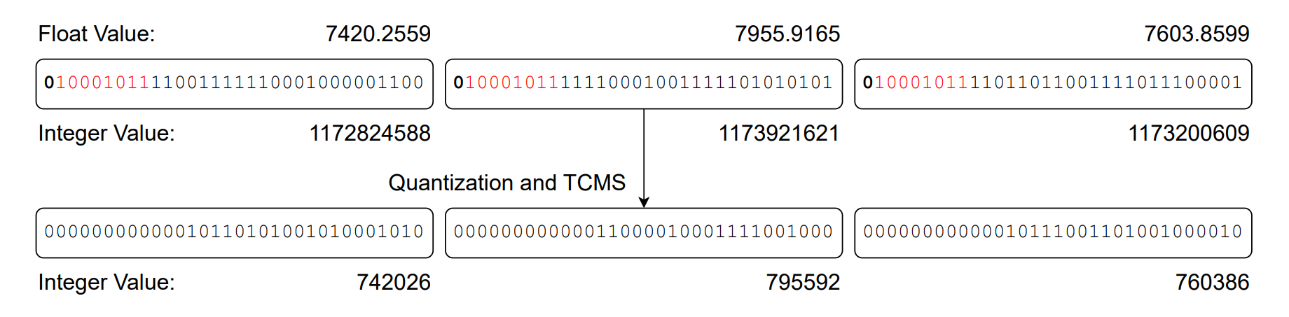
PFPL - Quantization
Helps make floating-point data more compressible by removing randomness
Where the error-bound is guaranteed

Slide 7
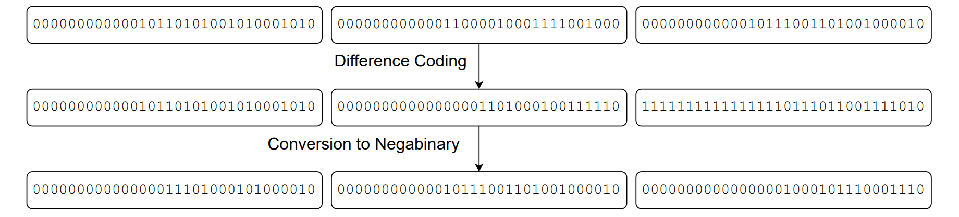
PFPL - Lossless Stage 1
Delta encoding, compute difference sequence
Output in negabinary to boost compressibility
  Base “-2” means that small values (both positive and negative) will have many leading zeros

Slide 8
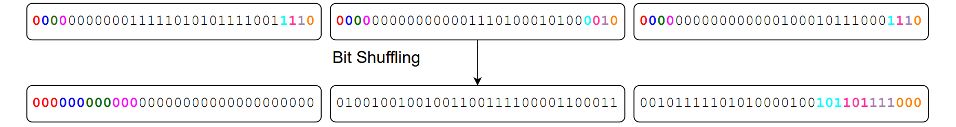
PFPL - Lossless Stage 2
Bit shuffling (bit transposition)
Groups bits from different words by position
Often creates longs strings of ‘0’ bits

Slide 9
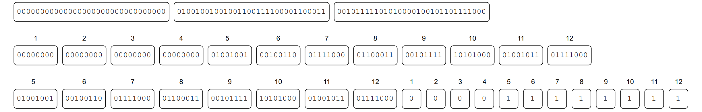
PFPL - Lossless Stage 3
Repeated zero elimination
This is the only transformation that compresses
Eliminates bytes that are all zeros
  Removed from data but recorded in bitmap

Slide 10
PFPL - Parallelization
OpenMP on the CPU, CUDA on the GPU
Quantizers are embarrassingly parallel
  Except NOA requires a min-max reduction
Each lossless stage is given data in 16 kB chunks
  Stage 1 only requires a prefix sum for decoding
  Stage 2 employs warp shuffles on the GPU
  Stage 3 requires prefix sums for encoding and decoding

Slide 11
Related Work – CPU Only
ZFP
  Converts floats to integers, performs a decorrelating transform, data mutation, and bit shuffling
  Lossless compression applied after the above steps
SPERR
  Uses wavelet transformations and SPECK
  Detects outliers and stores a correction factor
  Lossless compression step is ZSTD

Slide 12
Related Work – CPU Only
SZ2
  Uses Lorenzo prediction and linear regression followed by quantization
  Uses Huffman followed by GZIP after lossy stage
SZ3
  Often produces better compression ratios than SZ2 with similar throughputs
  Modular, lossless stage can be customized (e.g., ZSTD)

Slide 13
Related Work – GPU Only
FZ-GPU
  Uses Lorenzo prediction followed by GPU-friendly multi-byte Huffman coding
cuSZp
  Splits data into blocks, then quantizes and predicts values in non-zero blocks
  Compresses non-zero blocks using fixed-length encoding

Slide 14
Related Work – CPU and GPU
MGARD-X
  Only other compressor to support compatible CPU/GPU compression/decompression
  Uses multigrid hierarchical data refactoring to decompose and recompose data
  Selective loading based on the hierarchy after decomposition to determine accuracy
  Designed for the L₂ norm, but tested with L_{inf} norm
    Supplies point-wise error bounding

Slide 15
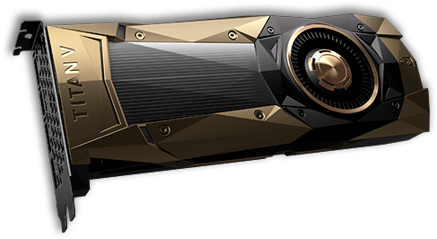
Experimental Methodology
System
  GPU: NVIDIA RTX 4090, 16384 PEs, 128 SMs, 24 GB memory, nvcc 12.0.14
  CPU: AMD Ryzen Threadripper 2950X (16 cores, 3.5GHz), gcc 12.2.1
We measure compression ratio and compression/decompression throughput
  Median of 9 runs

Slide 16
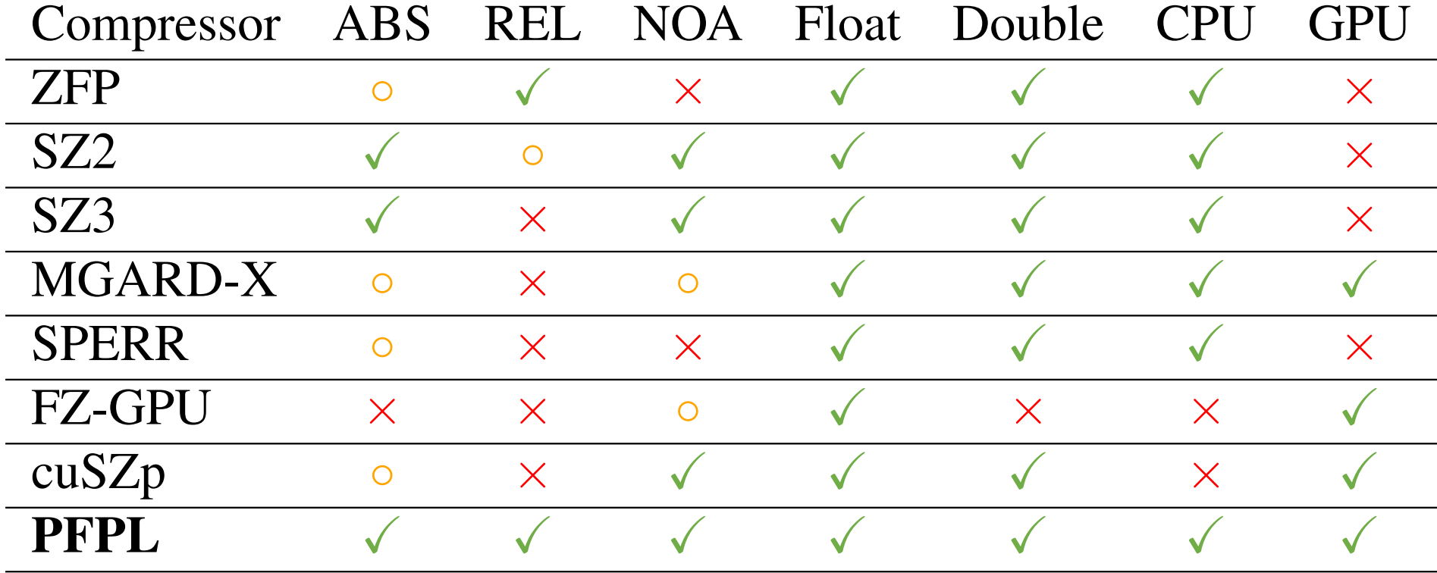
Evaluation Methodology
Compared to 7 compressors

Slide 17
Results

Slide 18
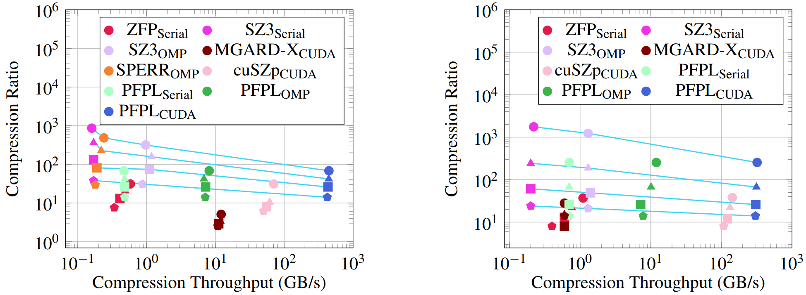
ABS – Compression
Single Precision
Highest GPU CR
Double Precision
Order of magnitude faster
Fastest CPU and GPU code

Slide 19
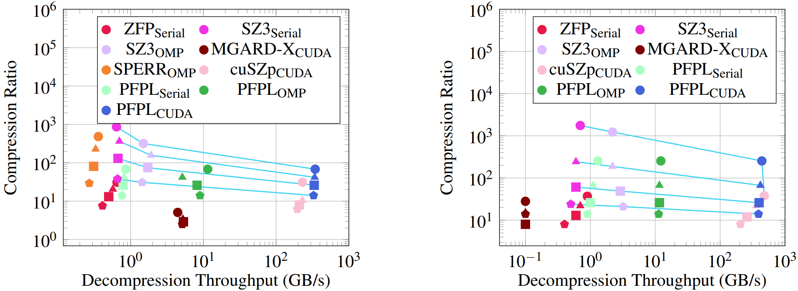
ABS – Decompression
Single Precision
Highest GPU CR
Double Precision
Fastest CPU and mostly fastest GPU code

Slide 20
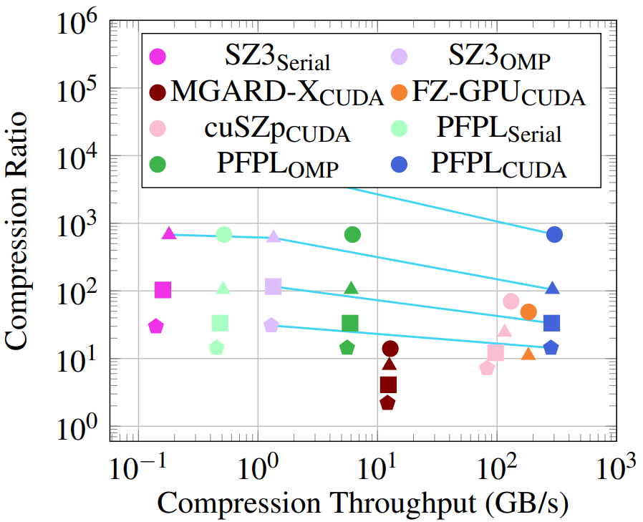
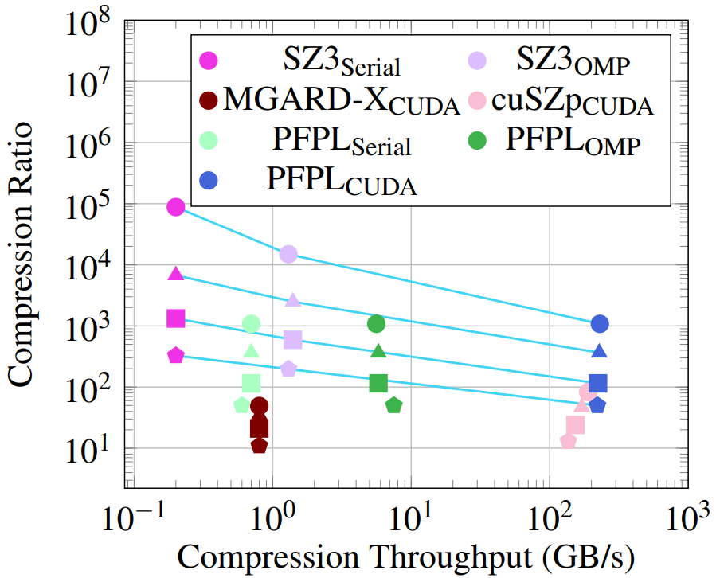
NOA – Compression
Single Precision
Highest GPU CR
Double Precision
Fastest CPU and GPU code

Slide 21
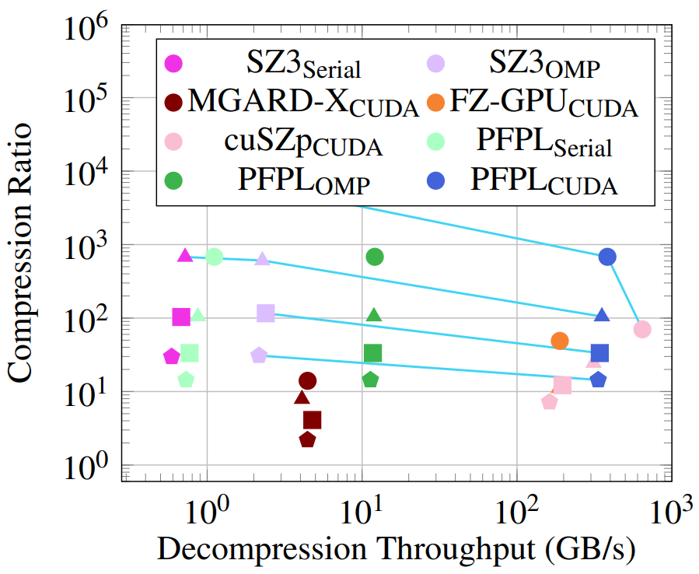
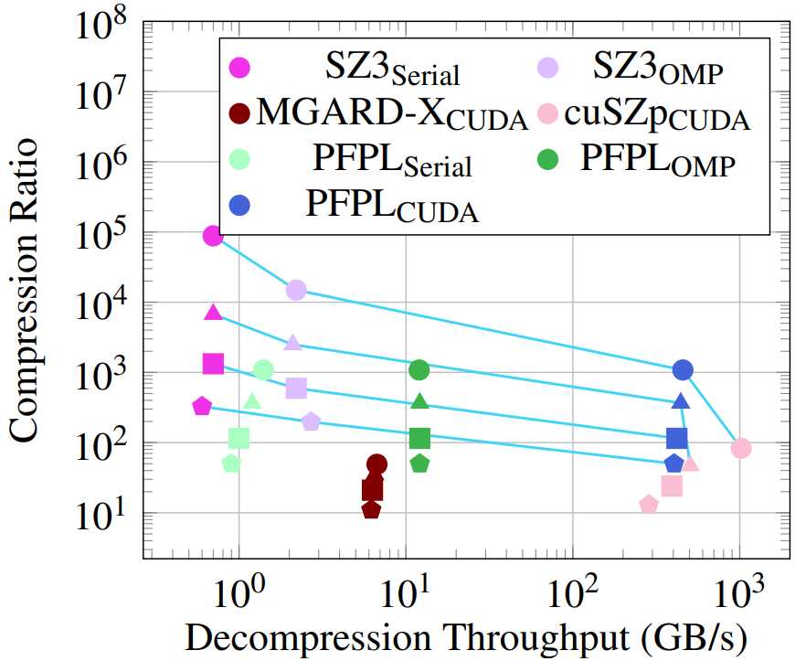
NOA – Decompression
Single Precision
Highest GPU CR
Double Precision
Fastest CPU and mostly fastest GPU code

Slide 22
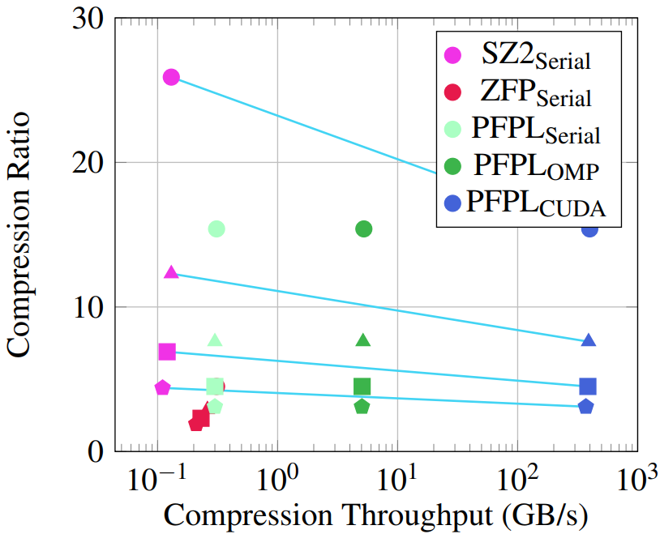
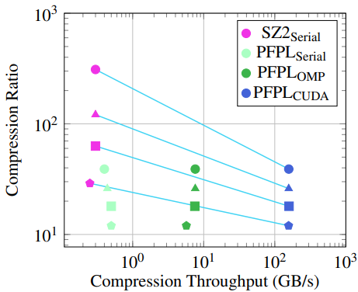
REL – Compression
Single Precision
Only REL GPU code
Double Precision
Fastest GPU and mostly fastest CPU code

Slide 23
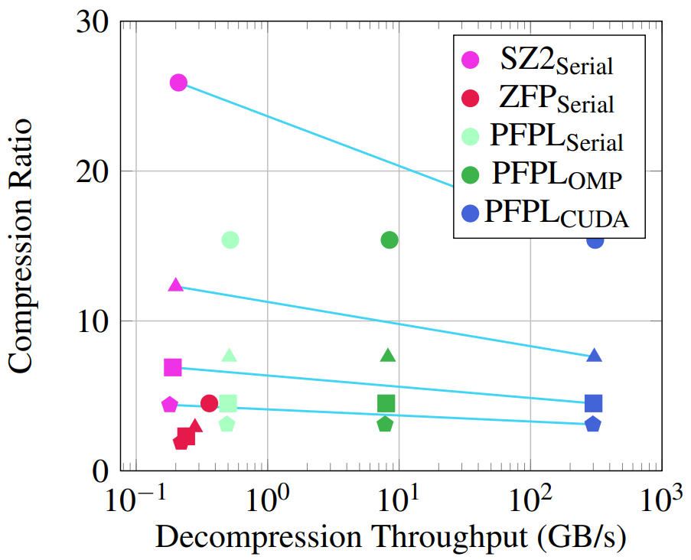
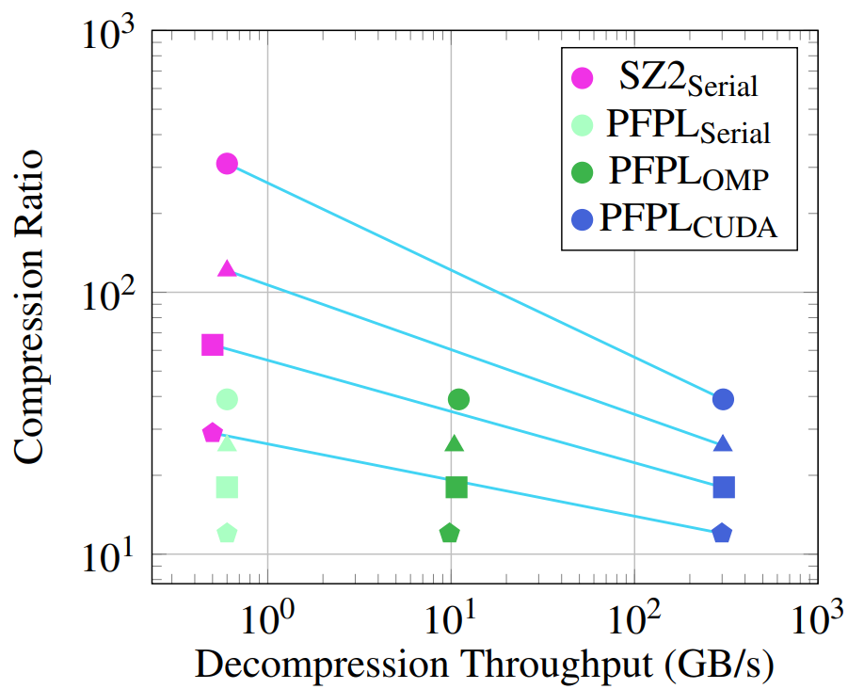
REL – Decompression
Single Precision
Only REL GPU code
Double Precision
Fastest CPU and GPU code

Slide 24
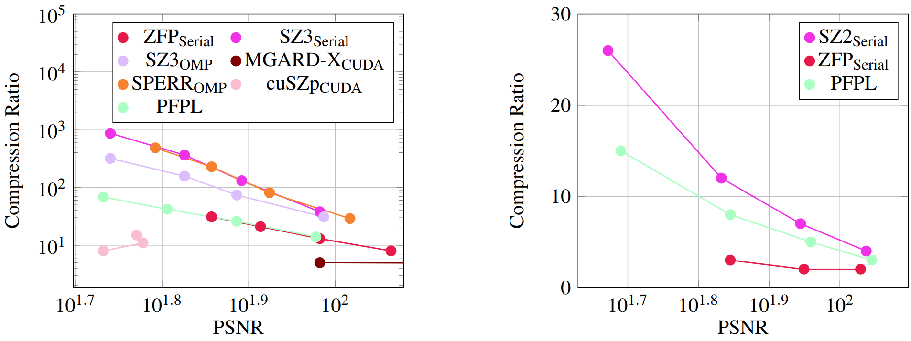
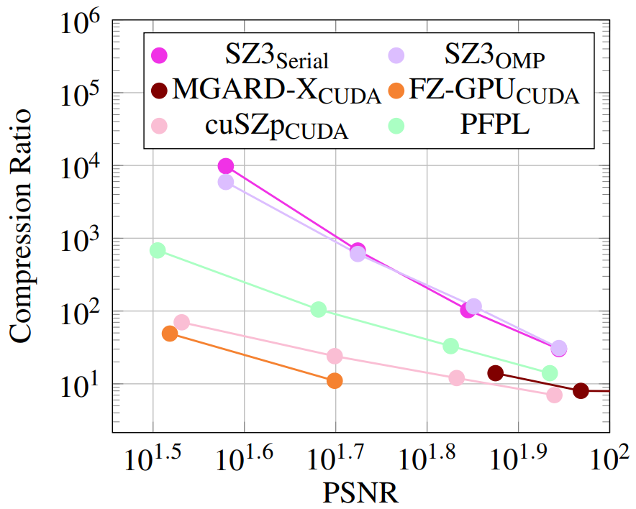
Peak Signal to Noise Ratio (PSNR)
REL
ABS
Comparable PSNR at same error bound
Always in the middle
NOA

Slide 25

Summary
Presented PFPL
  Fast and effective CPU/GPU-compatible compressor
  Targets scientific floating-point data
  PFPL guarantees ABS, REL, and NOA error bounds
Highest CR on the GPU & highest CPU throughput
Acknowledgements
  DOE, NVIDIA
Code available on GitHub
  https://github.com/burtscher/PFPL
Contact: waf13@txstate.edu

