Slide 1


SLEEK: Compressing Memory Copies for Floating-Point Data on GPUs
Anju Mongandampulath Akathoott, Andrew Rodriguez* and Martin Burtscher
Department of Computer Science

Slide 2
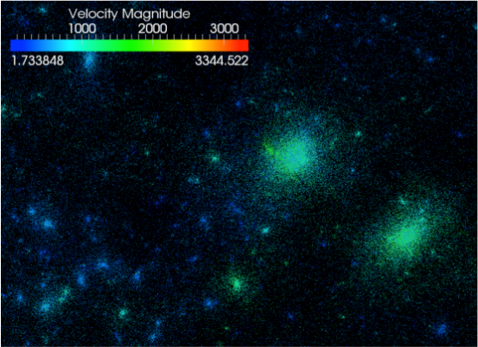
Scientific Applications & Instruments
Emit huge amounts of floating-point data
  HACC generates petabytes of data in one simulation
  LHC produces a petabyte of data per second
GPUs are used to process data quickly
  Limited GPU memory is a bottleneck
  One solution may be main-memory compression
HACC Visualization (ornl.gov)

Slide 3
GPU Main-Memory Compression
Keep data compressed and decompress on the fly
  Existing approaches do not allow writes, require special hardware, or are too slow
Effective GPU main-memory compressors should
  Be fast enough to match GPU memory access speeds
  Yield high compression ratios to reduce footprint
  Support lossless & guaranteed error-bounded lossy compression
  Be CPU/GPU compatible for moving compressed data

Slide 4
This Work
Introduces SLEEK, a GPU main-memory compressor
  Meets all aforementioned criteria
Evaluates SLEEK and 5 other lossy GPU compressors on 10 SDRBench datasets
  7 single-precision and 3 double-precision datasets
Demonstrates SLEEK delivers much higher throughput than the state of the art
  While delivering comparable compression ratios

Slide 5
SLEEK Algorithm
and Implementation
5

Slide 6

SLEEK
Lossless and lossy compression
  Guarantees point-wise absolute error bound for all values including infinities, NaNs and subnormals
CPU and GPU compatibility
  Bit-for-bit identical
  Parallelized with OpenMP for CPU and CUDA for GPU
Supports single- and double-precision inputs
API and AD at github.com/burtscher/SLEEK

Slide 7
Possible Use Cases
General data compression
  Compress on GPU before writing to disk
High-speed data compression
  Send compressed data from one device to another
    Reduces communication time by transferring less data over interconnect (e.g., NVLink)
  Expand GPU memory capacity
    E.g., two 5 GB datasets in 8 GB of memory
    Work on one uncompressed dataset at a time without moving any data to host or dealing with UVM page faults

Slide 8
Lossy - Conventional Quantization
Conventional approach
  Divide each value by twice the error bound
  Round result and cast to integer to get bin number
This approach has 3 issues
  Overflow: large values binned to infinity (violation)
  Rounding error: values are rounded to the nearest representable float (may violate error bound)
  Bin gaps: some large bin numbers are never used

Slide 9
SLEEK’s Quantization
SLEEK uses 2 techniques to solve these issues
  Round error bound to next smaller power of 2
    Multiplying and dividing by power of 2 is precise
    Emulated by adding/subtracting an integer from exponent
  Only quantize absolute values below a threshold
    Encodes values outside this range losslessly
    Yields denser encoding than lossy quantization!
All arithmetic done exclusively with integer ops
  Makes code portable to any kind of device

Slide 10
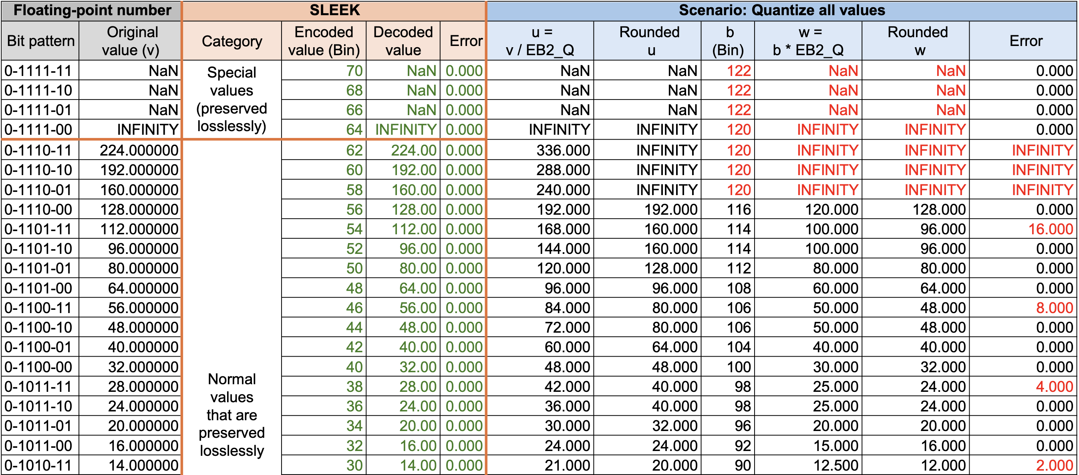
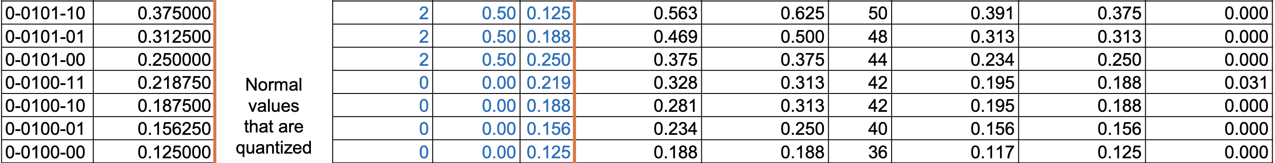
Quantization Examples – 7-bit Floats

Slide 11
Parallelization
Each input value can be processed in parallel
Divide the input into 16 kB chunks
  CPU: each thread processes a chunk at a time
  GPU: each thread block processes a chunk at a time
Use dynamic schedule to alleviate load imbalance
  Amount of work to process a chunk is data dependent
Further divide chunks into 512-byte subchunks

Slide 12
Parallelization (cont.)
Process of compressing a chunk
  Compress each chunk in local buffers
  Output compressed size as soon as its available
  Wait for carry info from previous thread (or block)
  Once received, copy local buffers to the output
Additional GPU optimizations
  One subchunk per warp
  Minimize and coalesce global memory accesses
  Almost all intermediate data in fast shared memory

Slide 13
Experimental
Methodology
13

Slide 14
Datasets
10 SDRBench datasets from different domains

Slide 15
System Information
3 GPUs
  RTX 4090
  A100
  RTX 3080

Slide 16
Experiment: D2D Memcpy
Compare lossless and lossy compressors to device-to-device (D2D) global memory copy
  Use the median of 9 runtimes
  Report throughput (uncompressed file size / runtime)
  Only show lossy single-precision results, other results (in paper) exhibit similar trends
Report geometric-mean throughput

Slide 17
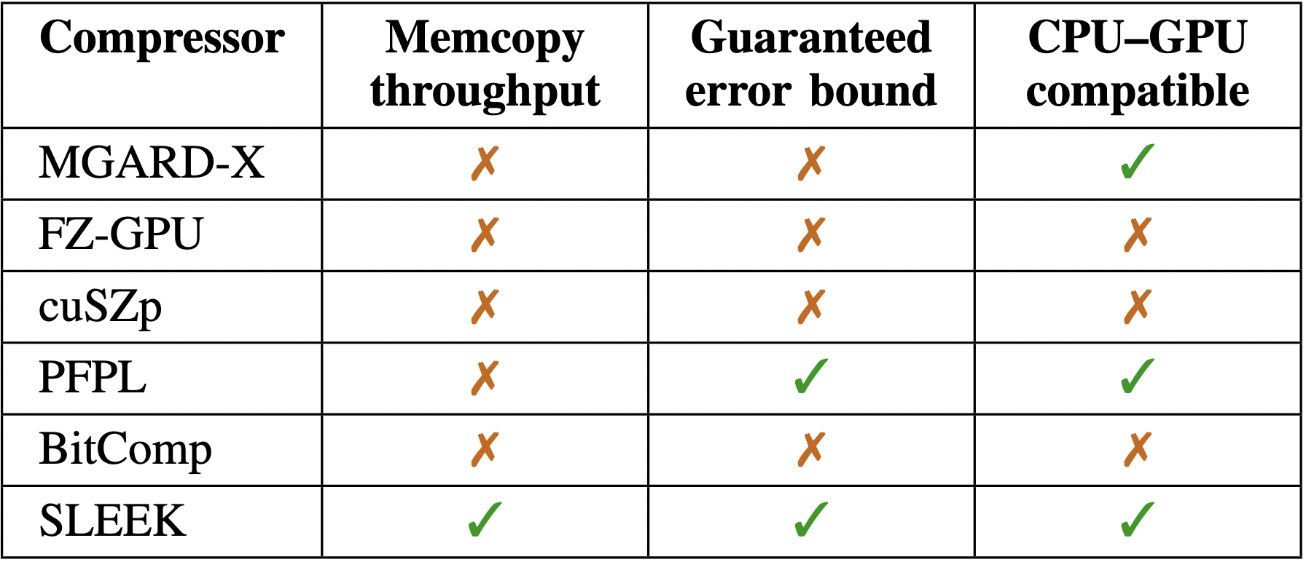
Experiment: Third-Party Codes
Compare lossy compressor to third-party codes
  Use throughput and compression ratio (CR) as metrics
  Only show single-precision lossy results on 4090, other results and GPUs (in paper) show similar trends
Report geometric-mean throughput and CR

Slide 18
Results
18

Slide 19
Lossy Compr. vs. D2D Memcpy
y-axis shows throughput
1.3 to 1.7 times faster than memcpy on 4090
0.99 to 1.2 times faster on the 3080
Slower than memcpy on the A100

Slide 20
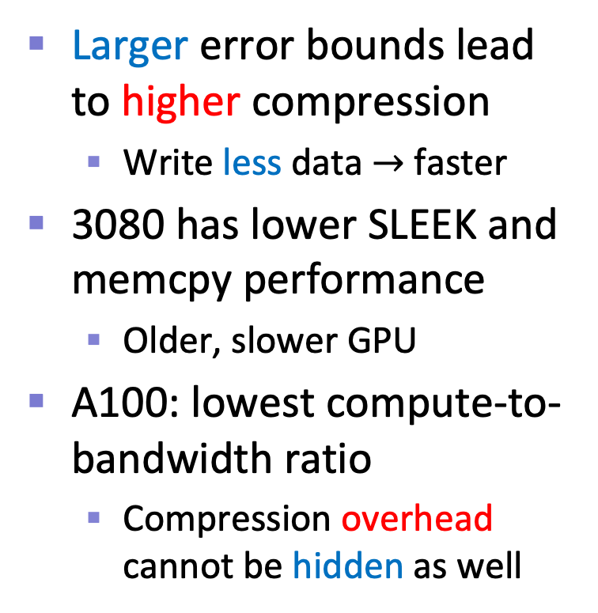
Lossy Compr. vs. D2D Memcpy (cont.)
Larger error bounds lead to higher compression
  Write less data $→$ faster
3080 has lower SLEEK and memcpy performance
  Older, slower GPU
A100: lowest compute-to-bandwidth ratio
  Compression overhead cannot be hidden as well

Slide 21
Lossy Decomp. vs. D2D Memcpy
y-axis shows throughput
1.2 to 1.6 times faster than memcpy on 4090
1.3 to 1.7 times faster on the 3080
0.99 to 1.4 times faster on the A100

Slide 22
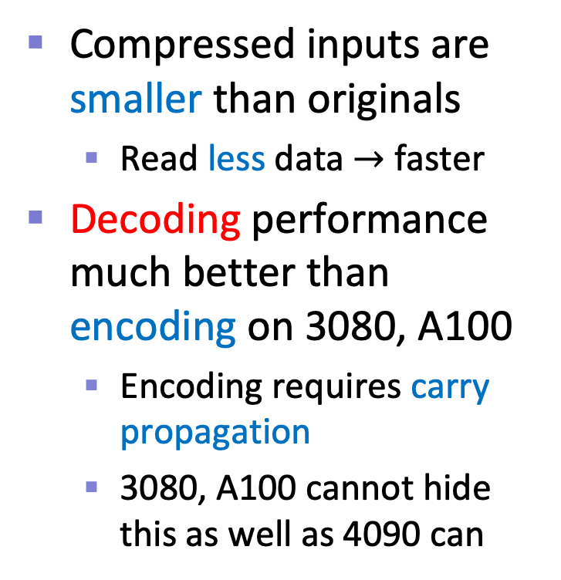
Lossy Decomp. vs. D2D Memcpy (cont.)
Compressed inputs are smaller than originals
  Read less data $→$ faster
Decoding performance much better than encoding on 3080, A100
  Encoding requires carry propagation
  3080, A100 cannot hide this as well as 4090 can

Slide 23
Takeaways
On the 4090, lossy SLEEK is 1.3x to 1.7x faster than D2D memcpy speed when compressing
  Similar trends on the 3080
  Compression overhead cannot be hidden behind memory accesses on the A100
Decompression is much faster than compression on the 3080 and A100
  Carry propagation not needed during decompression
  Propagation not hidden as well compared to the 4090

Slide 24
Third-Party Compression Comparison
Evaluate 4 error bounds
  1e-1 to 1e-4
Coarsest EB: 818 GB/s
  2.7x to 64x faster
Tightest EB: 689 GB/s
  2.4x to 57x faster
CRs on par or higher than others except PFPL
  CR of 5 to 50

Slide 25
Third-Party Decompr. Comparison
Evaluate 4 error bounds
  1e-1 to 1e-4
Coarsest EB: 743 GB/s
  1.9x to 167x faster
Tightest EB: 635 GB/s
  1.7x to 143x faster
CRs remain the same

Slide 26
Summary
SLEEK faster than D2D memcpy on the RTX 4090 and RTX 3080 GPUs when encoding and decoding
  On A100, only faster when decoding
SLEEK substantially faster than state of the art
  Compression ratios on-par or higher (except PFPL)
  Supports guaranteed error bounds
  CPU/GPU compatibility and integer ops only
  Employs novel floating-point quantizer

Slide 27
Thank you!
Acknowledgments
  Department of Energy, reviewers
Contact information
  andrew.rodriguez@txstate.edu
API and AD at github.com/burtscher/SLEEK

