Slide 1


PRACTICING SUSTAINABILITY IN ORGANIZATIONS
NAGASUSHMA DEVARAPALLI(SUSHMA)
silvia figueira

Slide 2

AGENDA
Background
Motivation
Problem
Process
Impact
Visual
Conclusion

Slide 3

background

Slide 4
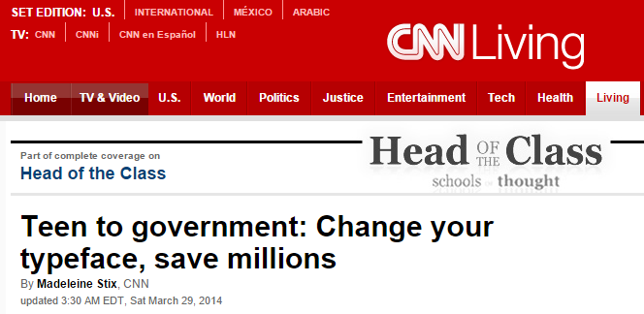
motivation

Slide 5

problem
What happens when we hit the Print Button?
Input :
Paper
Power
Ink/Toner
Output:
Printed Paper

Slide 6
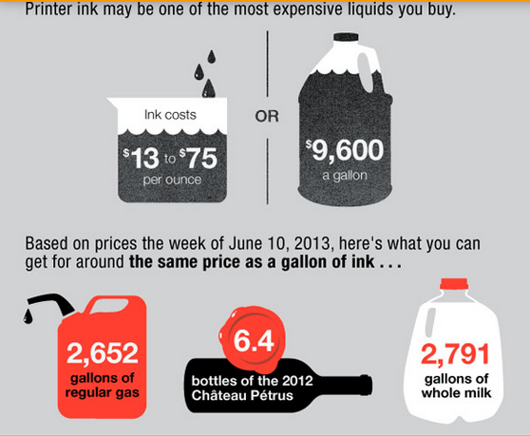
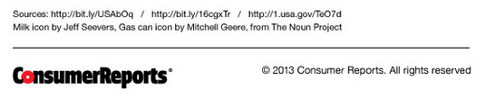
problem

Slide 7
problem
Manufacturing
Consumption
Disposal
1 laser cartridge – 1 gallon of fossil fuel
1 ink cartridge – 2 ½ ounces of oil
Indoor pollution
40% plastic
40% metal
20% rubber+ paper+ foam

Slide 8




problem

Slide 9
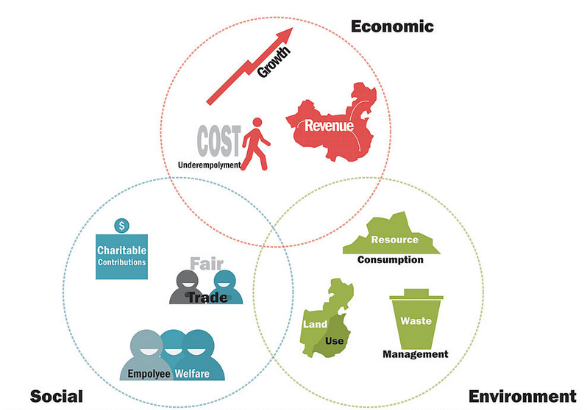
Why organizations?
Printing is a frequent activity
Regardless of the size and type
Helps in achieving monetary and non monetary benefits
Triple Bottom line

Slide 10
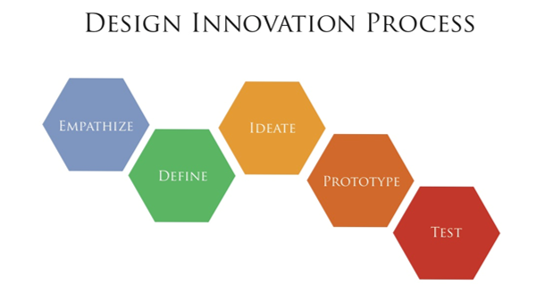
process

Slide 11

empathize
Expensive Ink
Harmful Effects on environment

Slide 12
define
Problem Statement :
“Reduce the ink consumption at Santa Clara University by at least 10% in 2014 to reduce the detrimental effects on the environment and contribute to sustainability”

Slide 13

ideate
Apply the study to Frugal Innovation Lab brochure
Estimate the savings
Extend the study to University wide printing policy

Slide 14
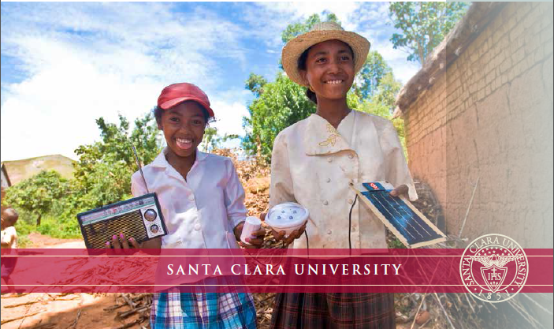
prototype
Sample – Frugal Innovation Lab brochure – 6 pages
Software – Adobe Acrobat Pro XI
APV Soft AP Fill Ink Coverage V 5.8
GPL Ghostscript 9.10
3. Test fonts – Garamond
Times New Roman
Century Gothic

Slide 15
test
Types of Printers:
Ink Jet – Monochrome and Color
Laser – Monochrome and Color
Types of Cartridges:
Ink Cartridges
Laser Cartridges
Color Models
RGB( Red Green Blue)
CMYK(Cyan Magenta Yellow Black)
Ink Coverage: Expressed as %, it is the amount of ink added in the printing process

Slide 16
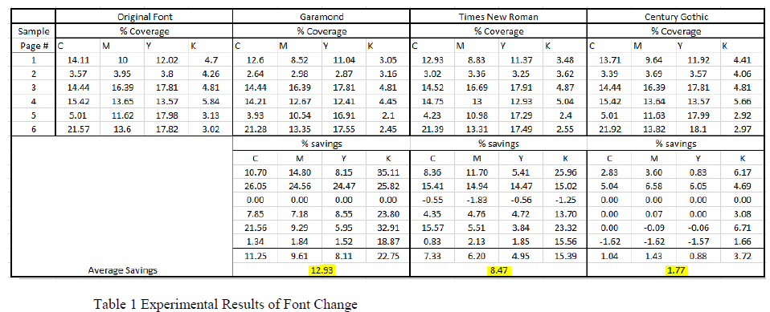
test

Slide 17
test

Slide 18
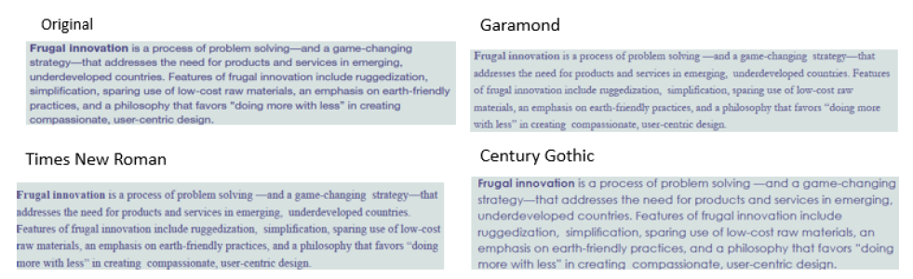
test

Slide 19
impact
Change to Garamond font has brought in 12% savings to the ink consumption
The savings do not include indirect savings with printing and recycling
The brochure used as prototype had more pictures than text and hence savings were marginal
Savings would be high in text intensive documents

Slide 20

future
Results shared with University
Plan is to apply to Undergraduate and Graduate bulletins at Santa Clara University
Make a larger impact through Organizations

Slide 21
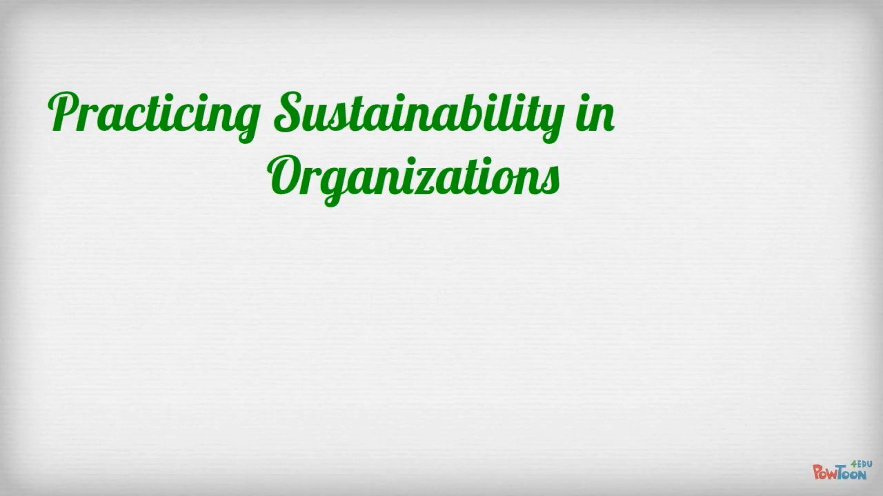
visual

Slide 22

conclusion

Slide 23


